Slide 1
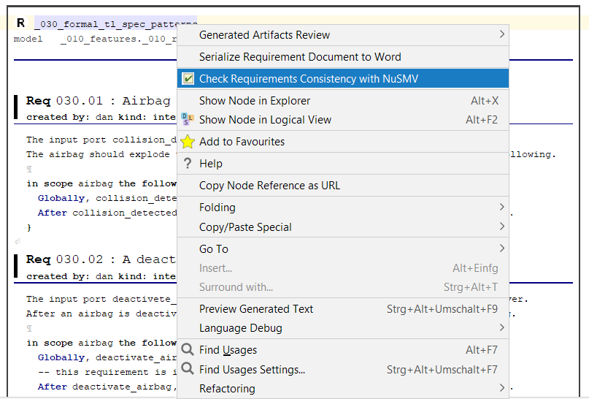
Formally defined requirements using TL
patterns can be checked for consistency.

