Slide 1
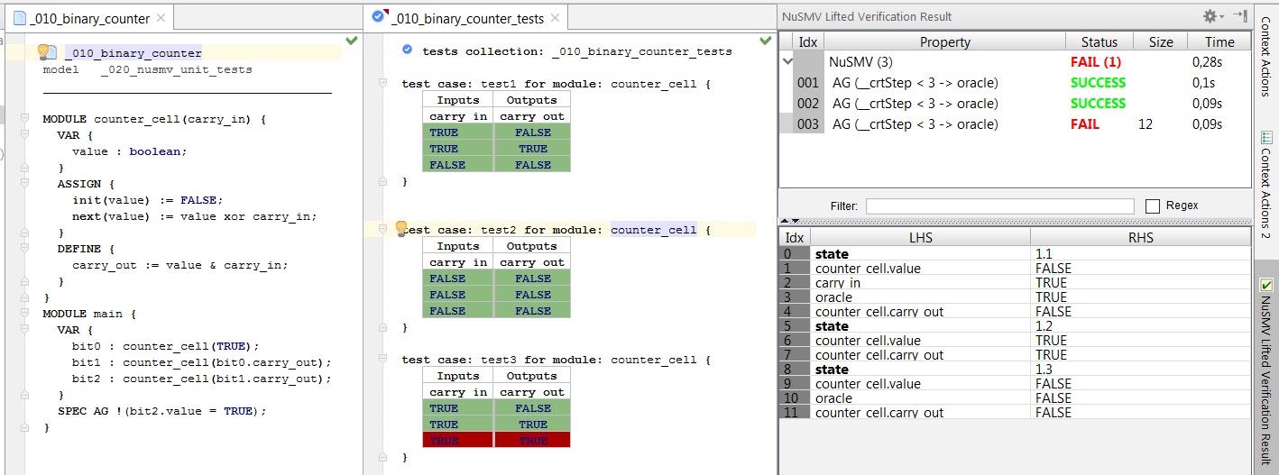
test collection and
test cases
inputs
system under test
passed test
outputs
failed test
expected value vs. actual value
in step 3

Slide 2
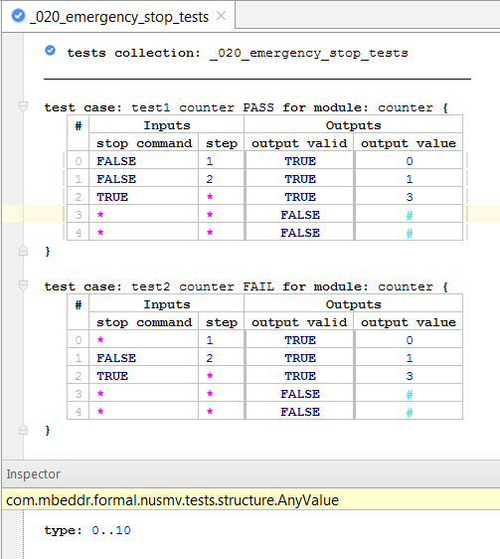
‘#’ means that the value of an output in a certain step is not interesting (don’t care)
‘*’ represent the fact that the
input can take any value with
a specified type in inspector

Slide 3
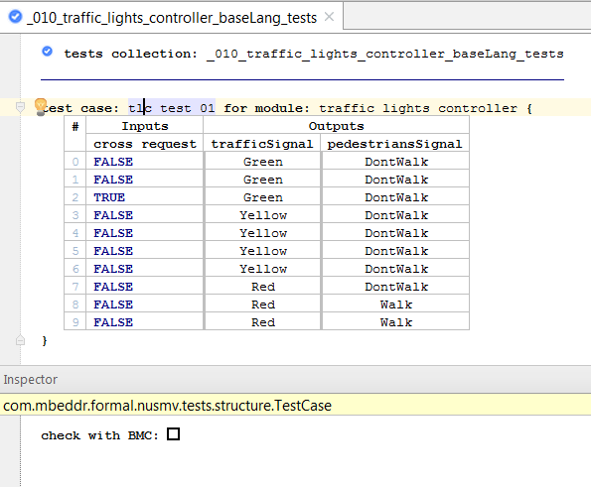
The test can be checked using
BMC or BDD-based model checking
The property to check is expressed in LTL and has the form:
LTLSPEC (act = exp) & (X act = exp) &
(X (X act = exp)) & (X (X (X act = exp))) & …

Slide 4
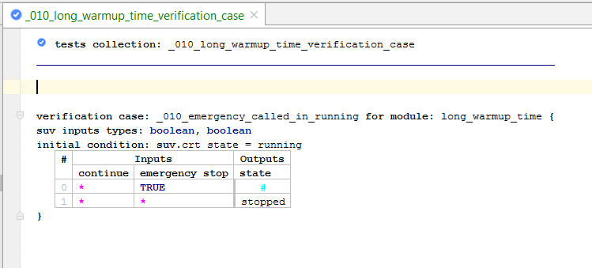
Initial condition means that the following test is run after the system reaches a state such that the initial condition is true.
The first line of the test case starts from the next step.

Slide 5
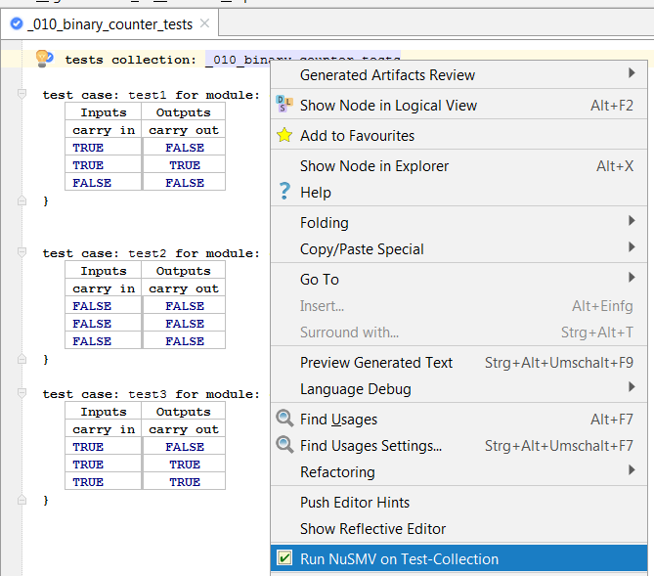

Slide 6
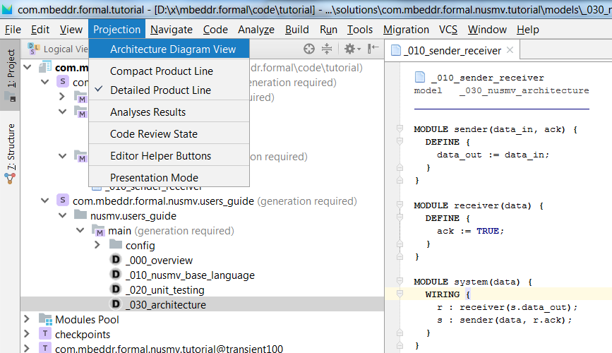

Slide 7
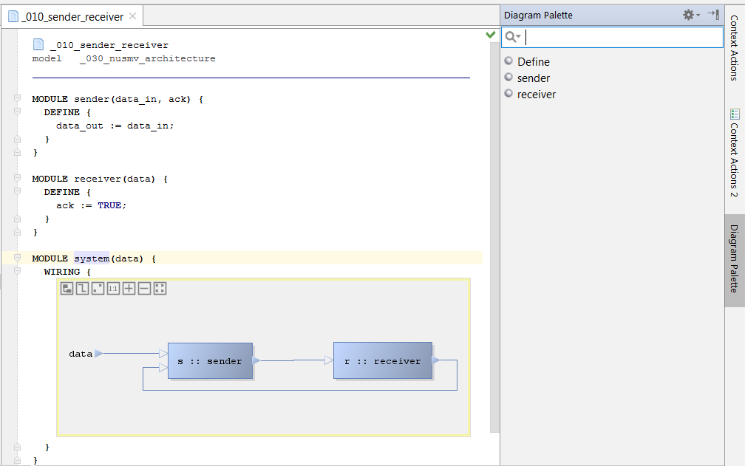

Slide 8
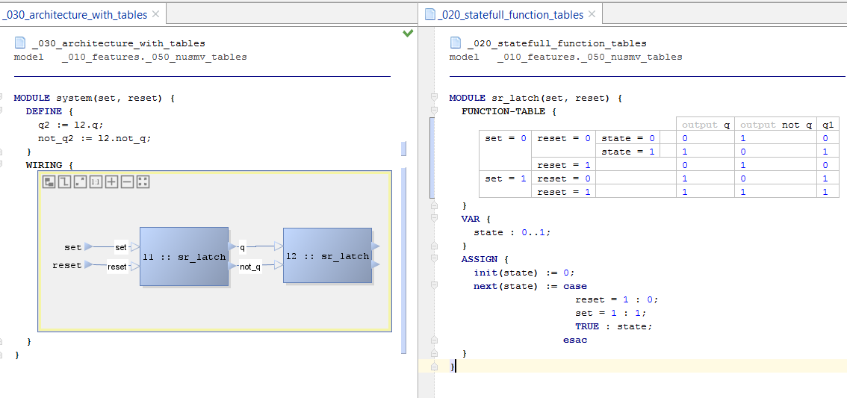
outputs definition
only function results marked as ‘outputs‘ are
available as output ports

Slide 9
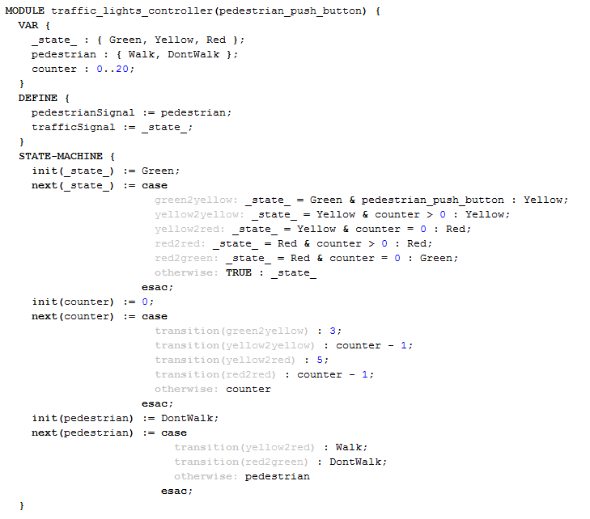
states definition
additional state variables
state variable
state-machine section
guard
transitions
definitions
transition name
transition reference

Slide 10
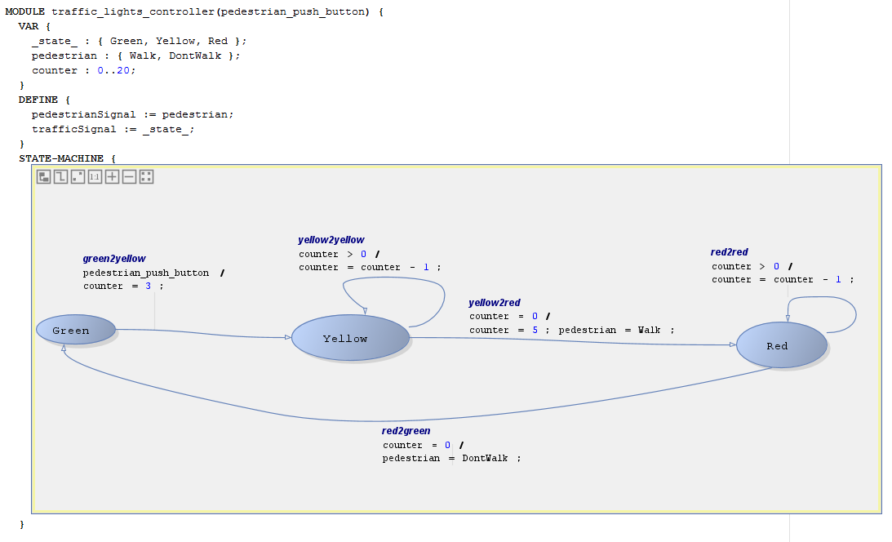

Slide 11
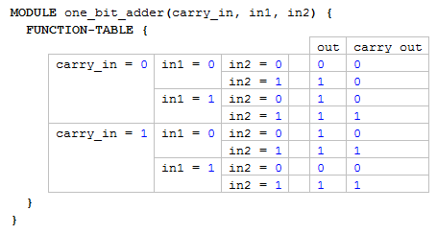
definitions
complex cascaded conditions

Slide 12
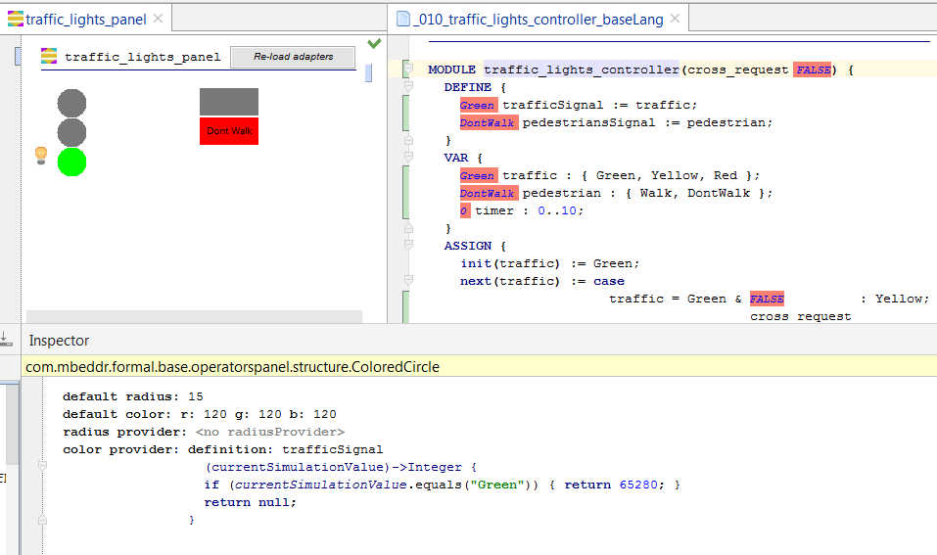
Adapters must be re-loaded by pressing this button
graphical widgets
By clicking on a widget, its properties are displayed in the inspector
Properties of widget include its size, color, text, …
Some properties can be modified dynamically based on the values of a simulation. “Adapters” specify how a simulation value should be reflected by the widget.
Adapter from the current value of the “trafficSignal define” to the color of the widget.

Slide 13
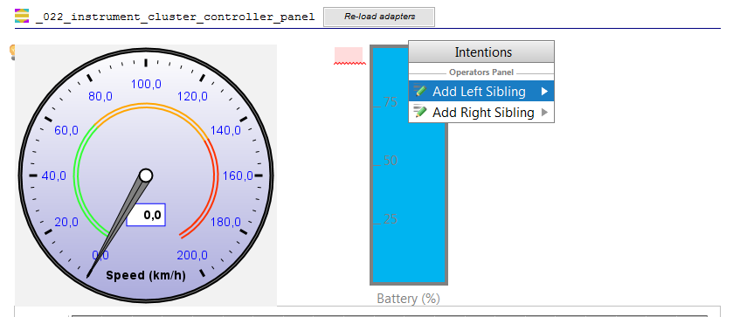
New
sibling
By clicking on a widget, and opening the intention menu, one can add left or right siblings

Slide 14
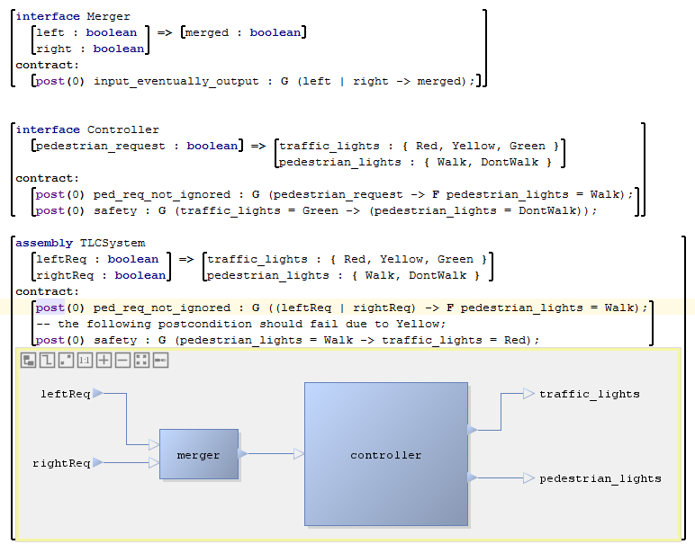
Interface Definition
Contracts:
Pre-/Postconditions
Input/Output ports
AssemblyDefinition
Assembly body using the diagrammatic notation

Slide 15
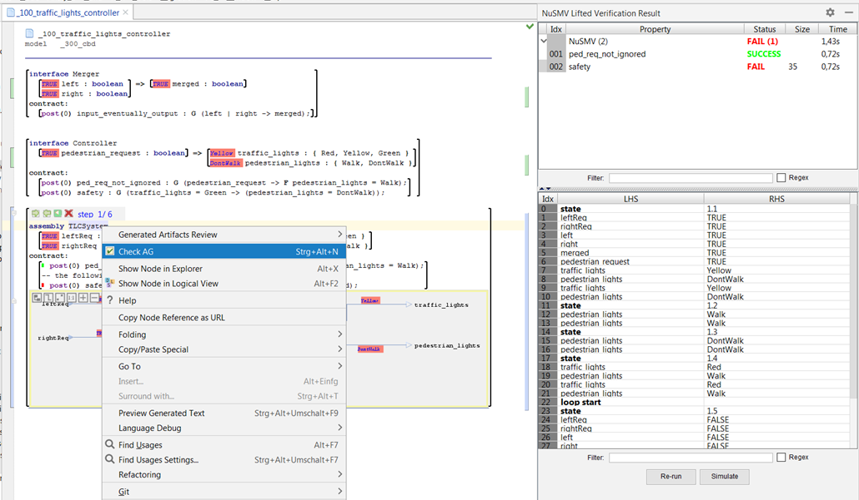
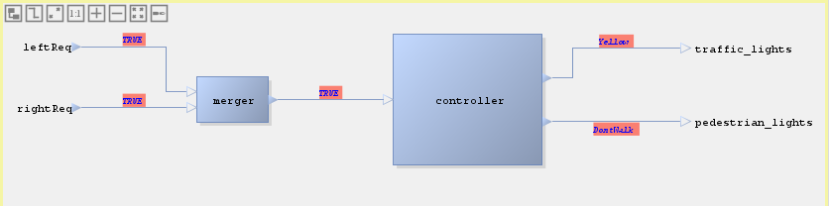
Step 1: Start the AG analysis
Step 2: After the analysis finishes, the results are displayed
Step 3: Double-clicking on a failed result will display the counterexample. By clicking on “Simulate”, the CEX will be simulated.
Step 4: Using the simulation bar, one can step-through the counterexample. The values of ports in a certain step are displayed in the IDE as annotations.

