Slide 1
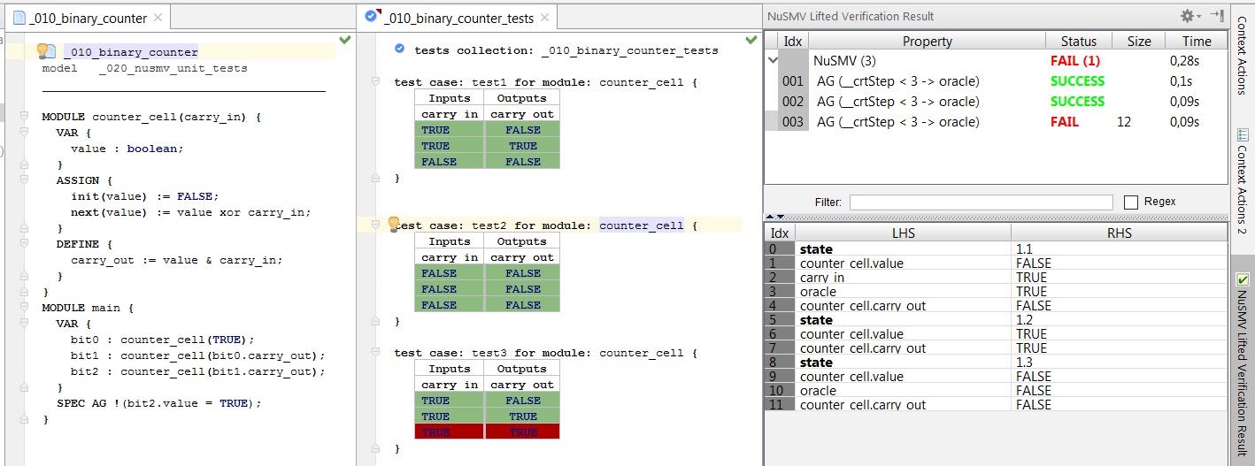
test collection and
test cases
inputs
system under test
passed test
outputs
failed test
expected value vs. actual value
in step 3

Slide 2
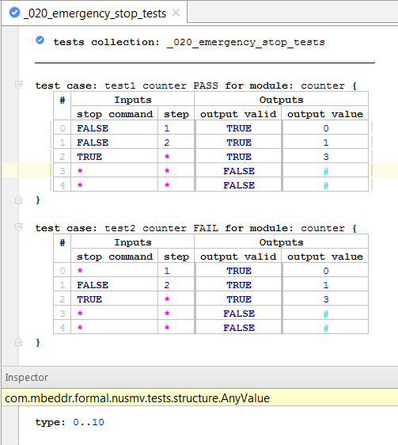
‘#’ means that the value of an output in a certain step is not interesting (don’t care)
‘*’ represent the fact that the
input can take any value with
a specified type in inspector

Slide 3
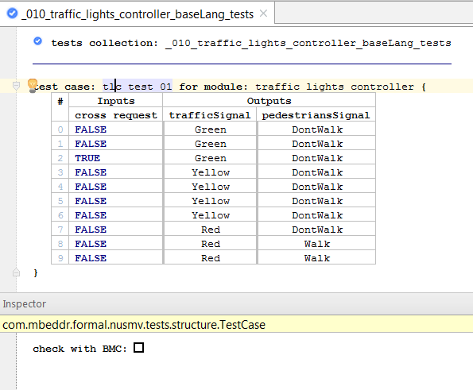
The test can be checked using
BMC or BDD-based model checking
The property to check is expressed in LTL and has the form:
LTLSPEC (act = exp) & (X act = exp) &
(X (X act = exp)) & (X (X (X act = exp))) & …

Slide 4
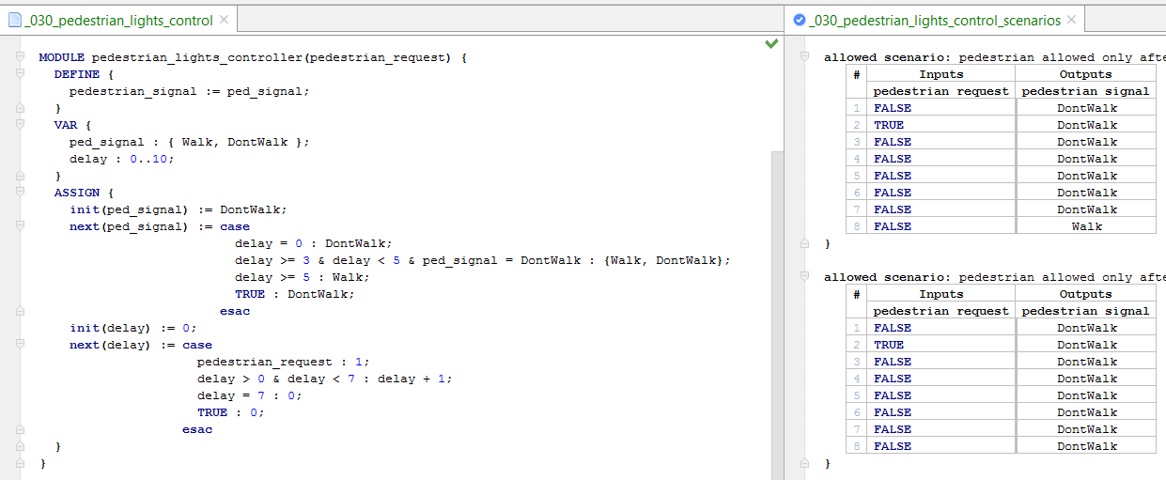
System with nondeterminism: the next value of the ped_signal can be either Walk or DontWalk
Two scenarios which are both allowed by this system: the inputs of these scenarios have the same values – the difference is between the output value in step 8.

Slide 5
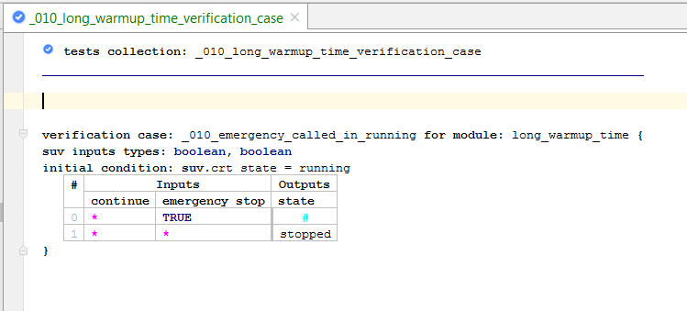
Initial condition means that the following test is run after the system reaches a state such that the initial condition is true.
The first line of the test case starts from the next step.

Slide 6
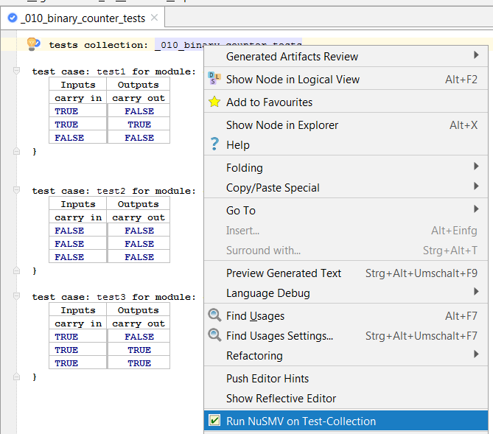

Slide 7
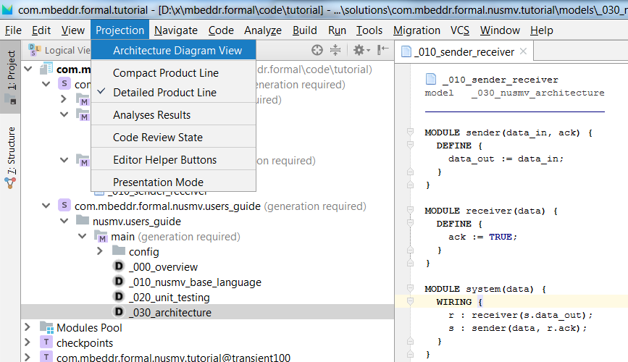

Slide 8
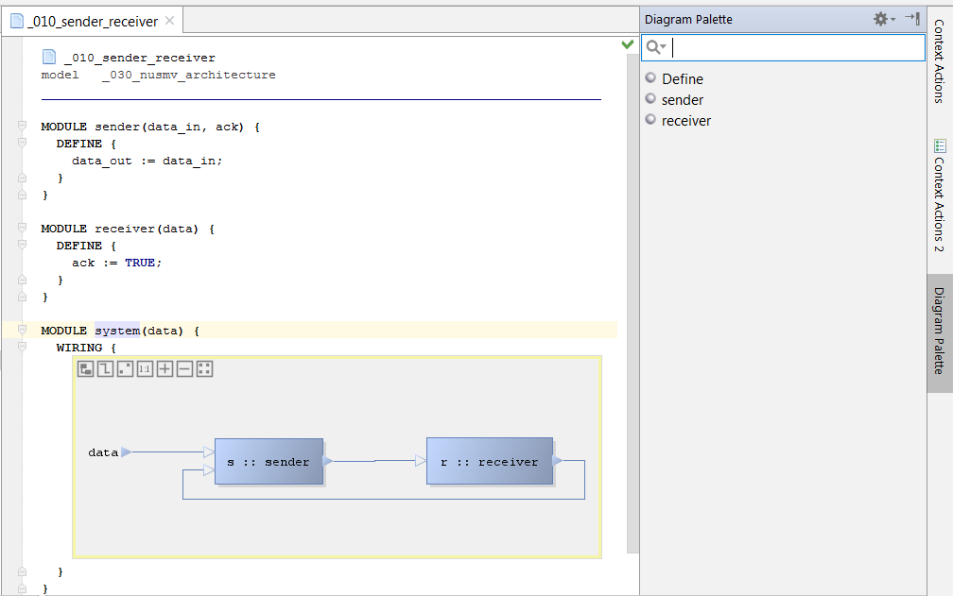

Slide 9
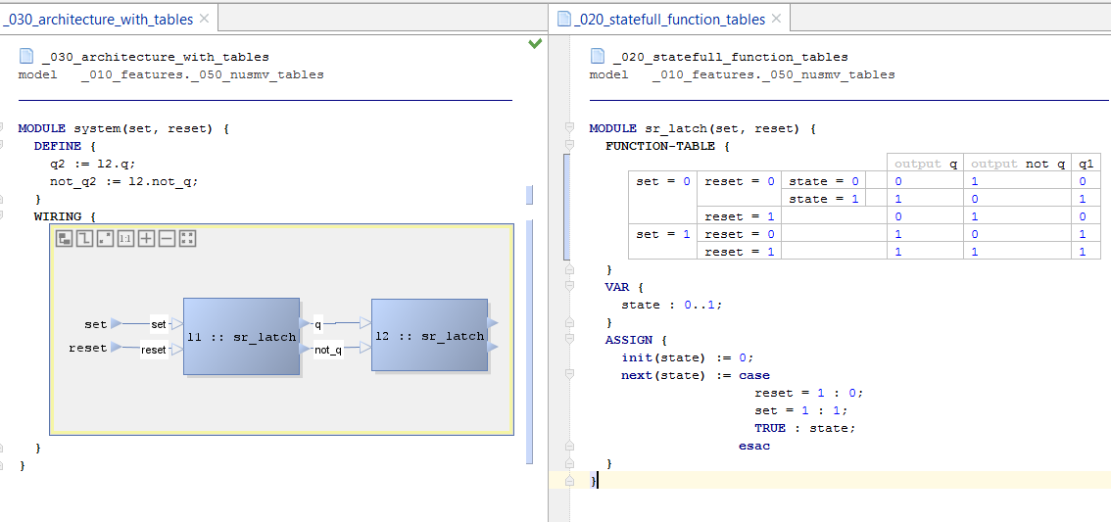
outputs definition
only function results marked as ‘outputs‘ are
available as output ports

Slide 10
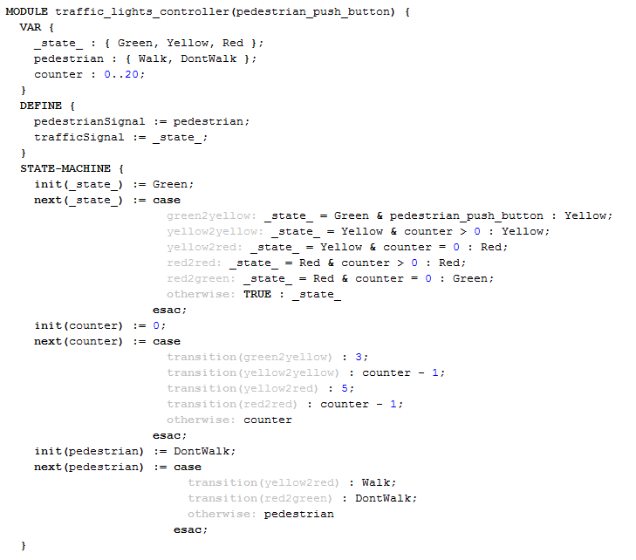
states definition
additional state variables
state variable
state-machine section
guard
transitions
definitions
transition name
transition reference

Slide 11
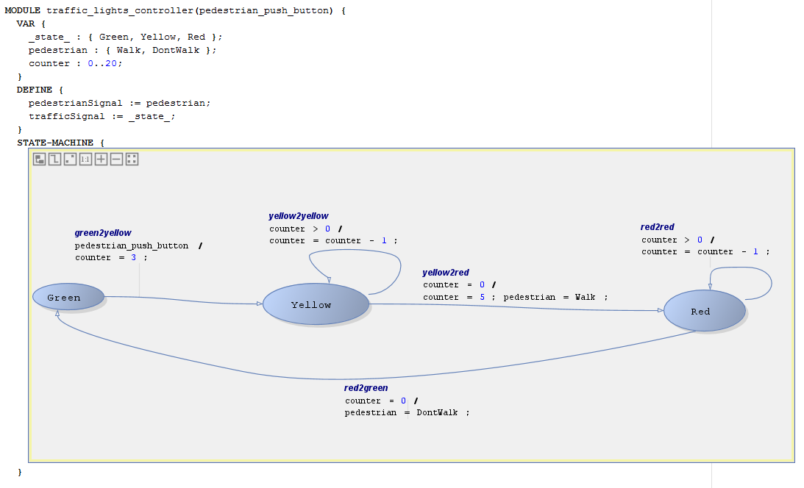

Slide 12
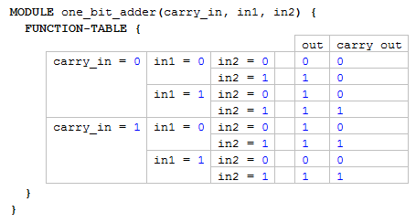
definitions
complex cascaded conditions

Slide 13
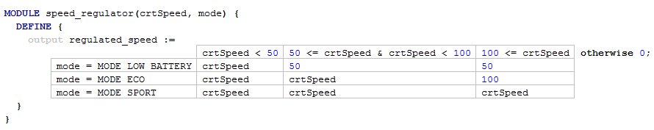
conditions on the X dimension
default value
conditions on the
Y dimension
This decision table is evaluated to 100 if (mode = MODE_ECO) & (100 <= crtSpeed) value

Slide 14
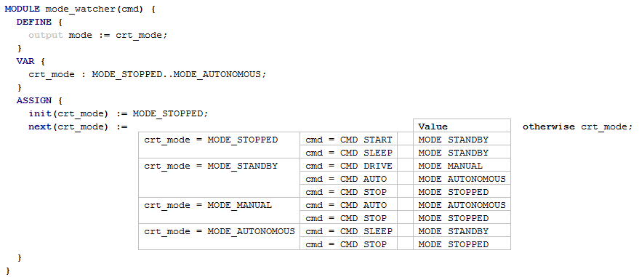
This values of the tabular expression. A value is chosen if the
conjunction of conditions on the left columns is true.
Default value if no
condition evaluates to true.
First dimension
Second dimension
…

Slide 15
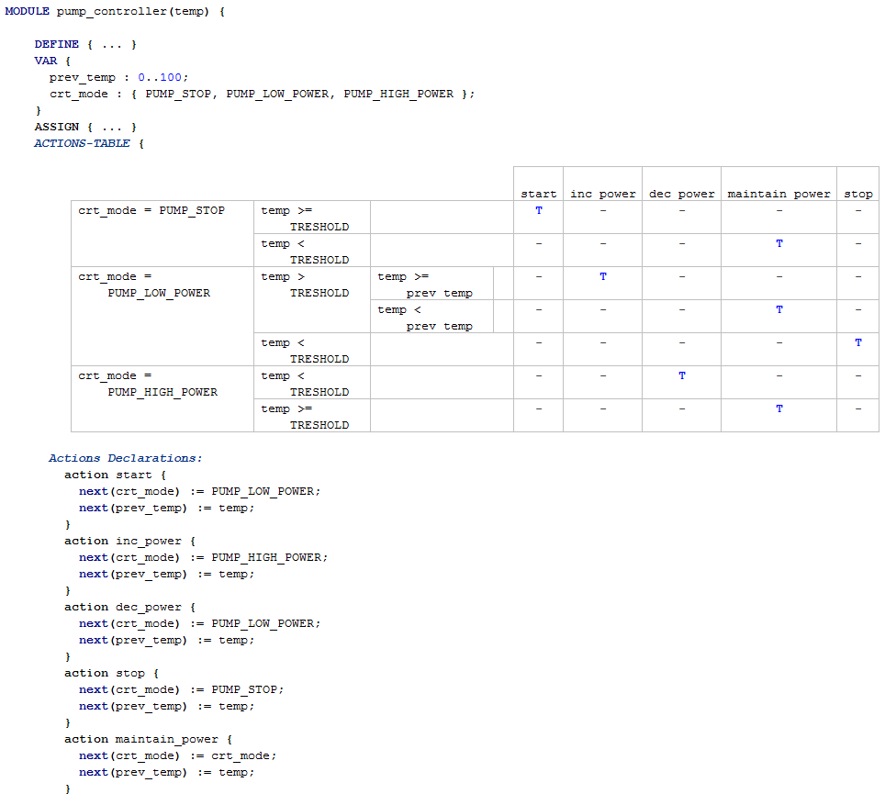
Actions Table is a new section type in the module
complex cascaded conditions
“-” means “does not apply”
“T” means when the condition is TRUE then the action is called
“F” means when the condition is FALSE then the action is called
Actions definitions – each action changes (some) state variables of the module

Slide 16
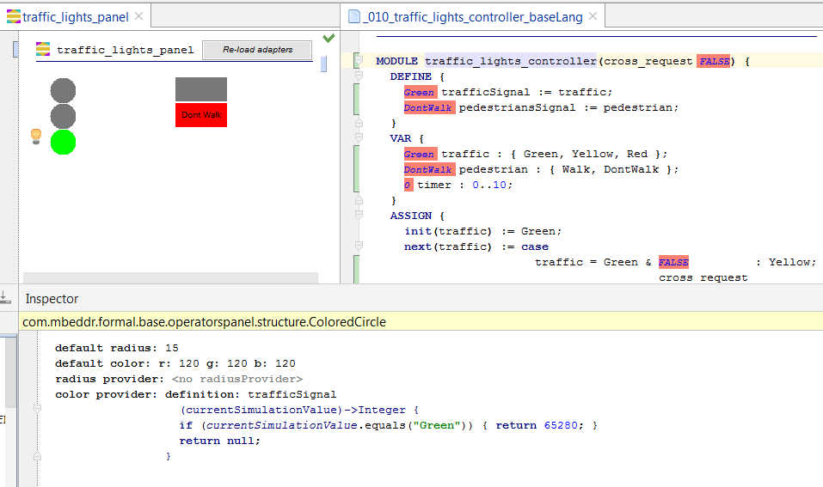
Adapters must be re-loaded by pressing this button
graphical widgets
By clicking on a widget, its properties are displayed in the inspector
Properties of widget include its size, color, text, …
Some properties can be modified dynamically based on the values of a simulation. “Adapters” specify how a simulation value should be reflected by the widget.
Adapter from the current value of the “trafficSignal define” to the color of the widget.

Slide 17
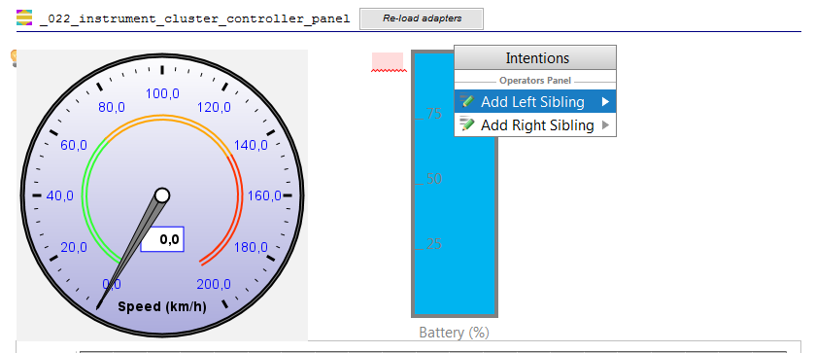
New
sibling
By clicking on a widget, and opening the intention menu, one can add left or right siblings

Slide 18
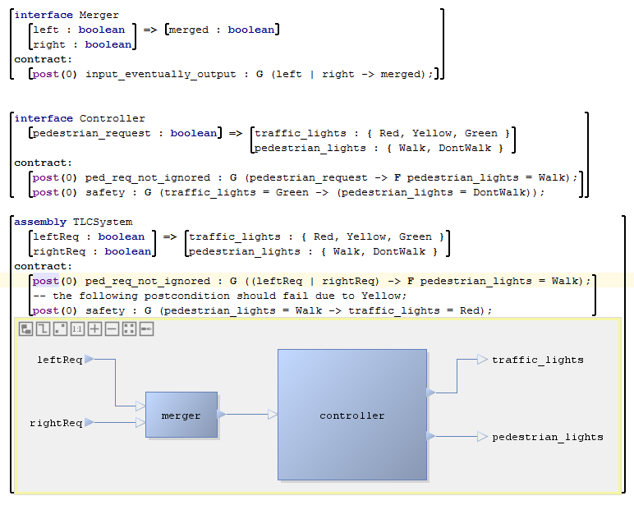
Interface Definition
Contracts:
Pre-/Postconditions
Input/Output ports
AssemblyDefinition
Assembly body using the diagrammatic notation

Slide 19
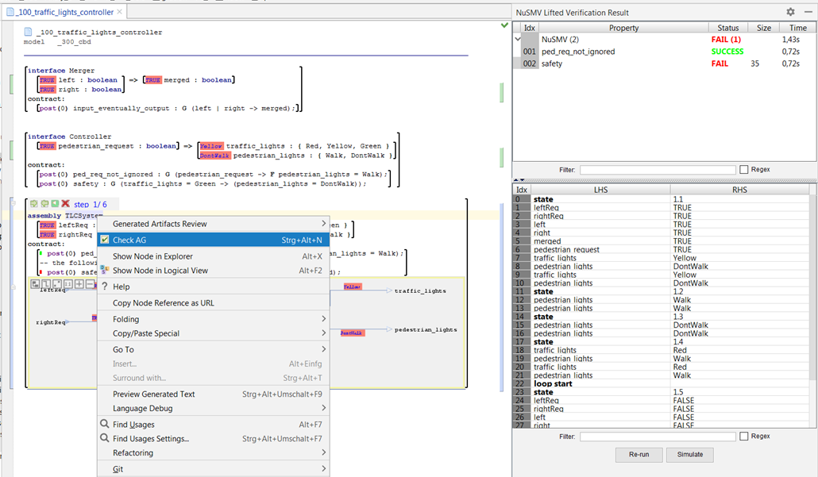
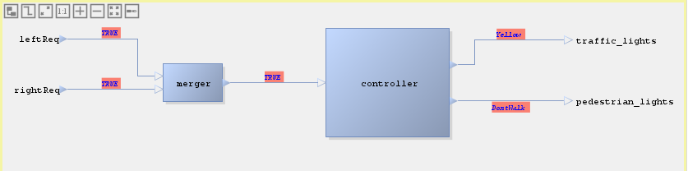
Step 1: Start the AG analysis
Step 2: After the analysis finishes, the results are displayed
Step 3: Double-clicking on a failed result will display the counterexample. By clicking on “Simulate”, the CEX will be simulated.
Step 4: Using the simulation bar, one can step-through the counterexample. The values of ports in a certain step are displayed in the IDE as annotations.

Slide 20
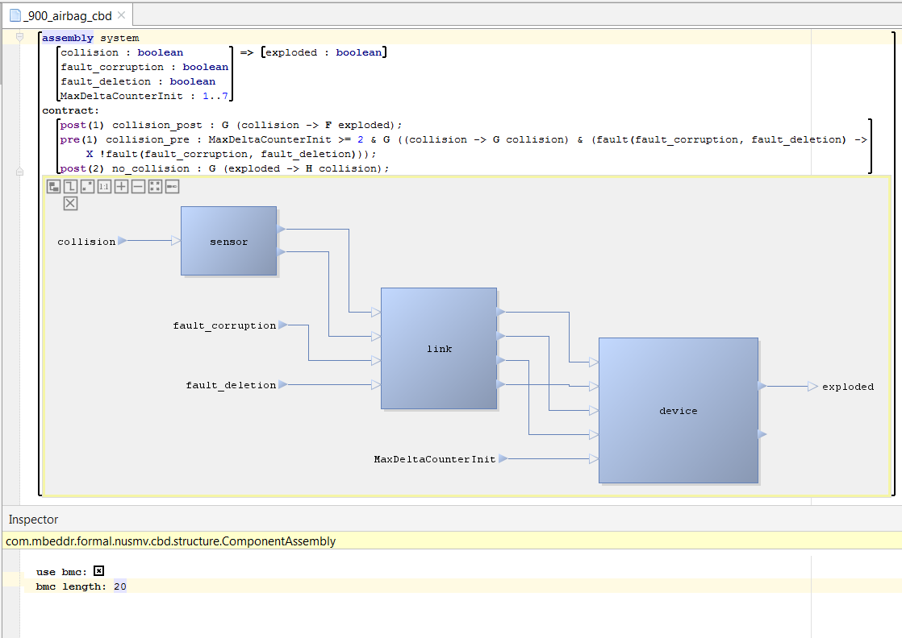
In the Inspector view of an “assembly” we can specify that the AG analysis should be performed with the BMC algorithm.

Slide 21
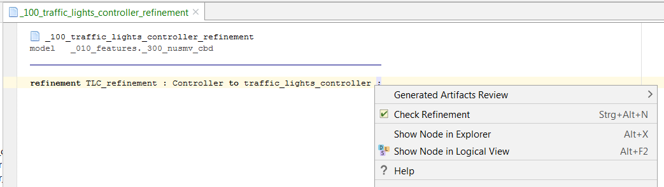
A refinement declaration links a component interface to a SMV module. Checking the refinement is performed by using the “Check Refinement” pop-up menu.

