Slide 1
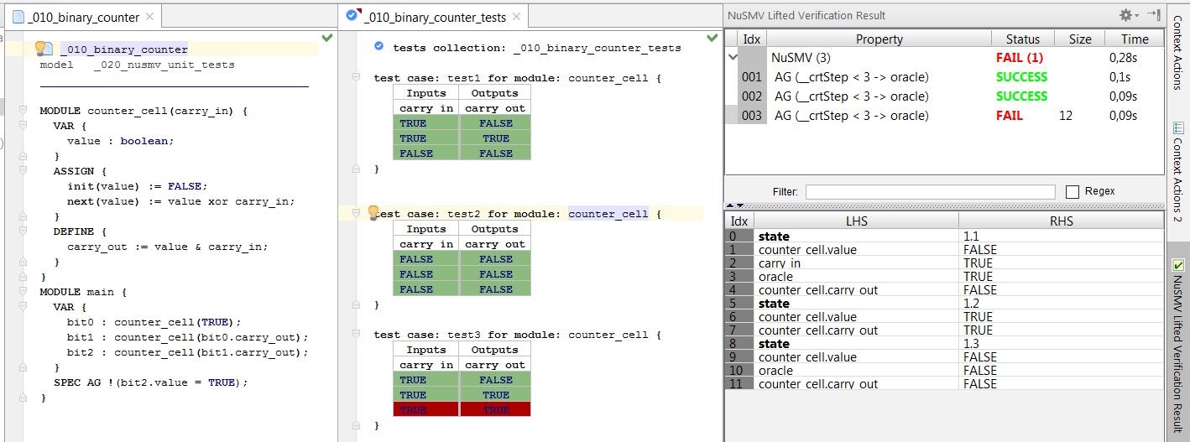
test collection and
test cases
inputs
system under test
passed test
outputs
failed test
expected value vs. actual value
in step 3

Slide 2
