Slide 1
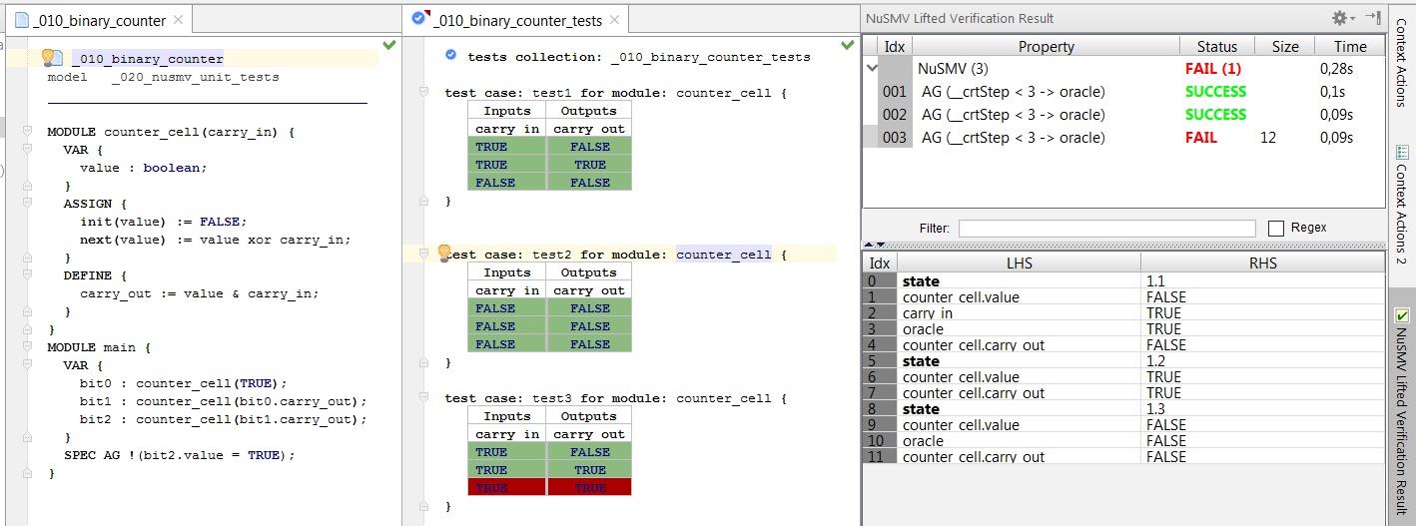
test collection and
test cases
inputs
system under test
passed test
outputs
failed test
expected value vs. actual value
in step 3

Slide 2
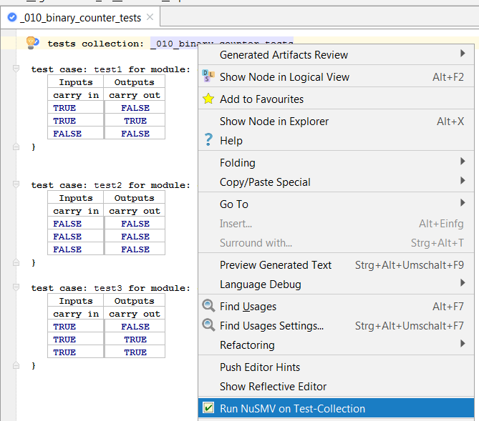

Slide 3
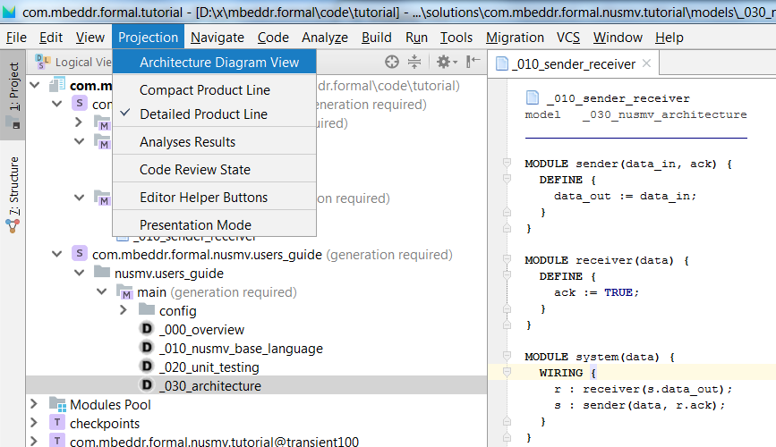

Slide 4
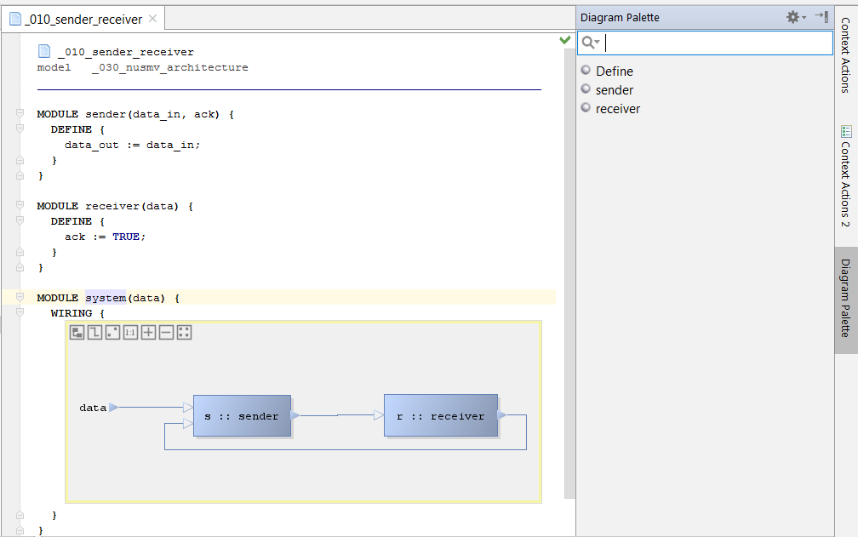

Slide 5
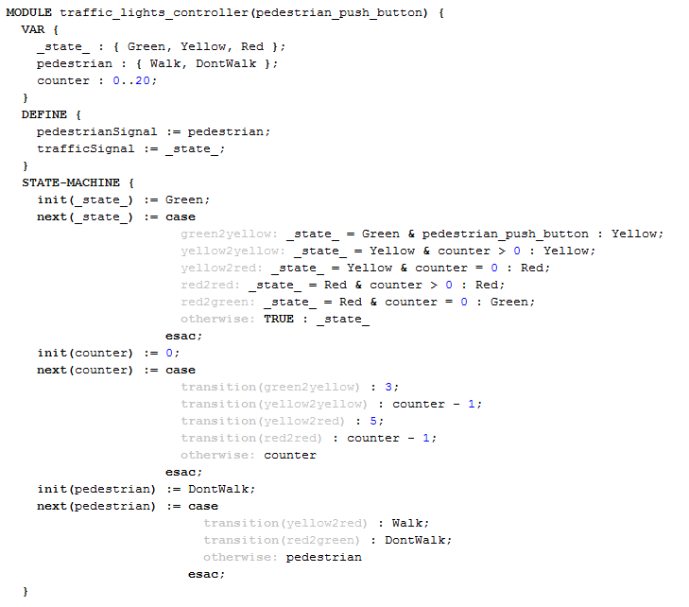
states definition
additional state variables
state variable
state-machine section
guard
transitions
definitions
transition name
transition reference

Slide 6
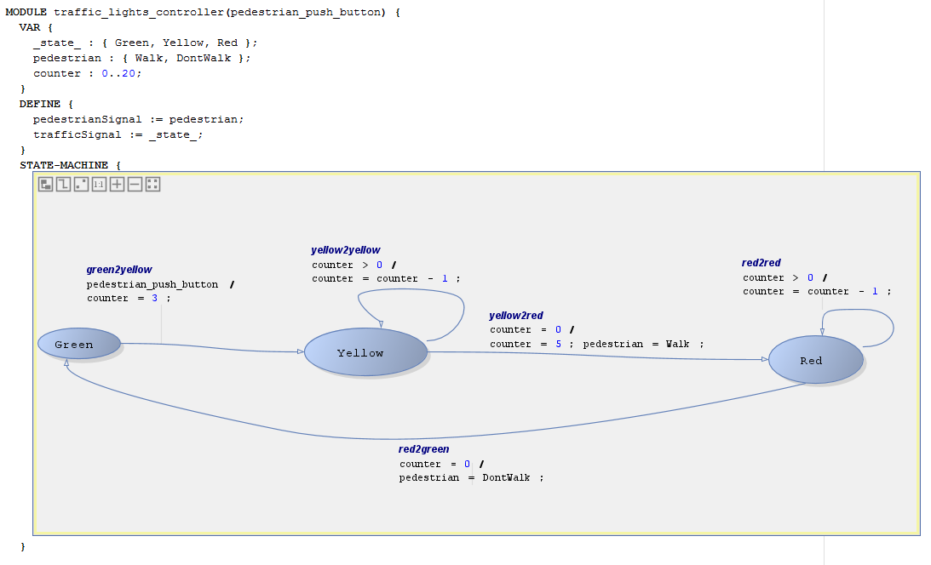

Slide 7
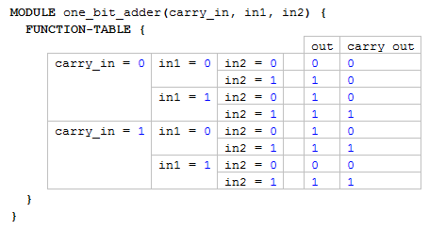
definitions
complex cascaded conditions

