Slide 1
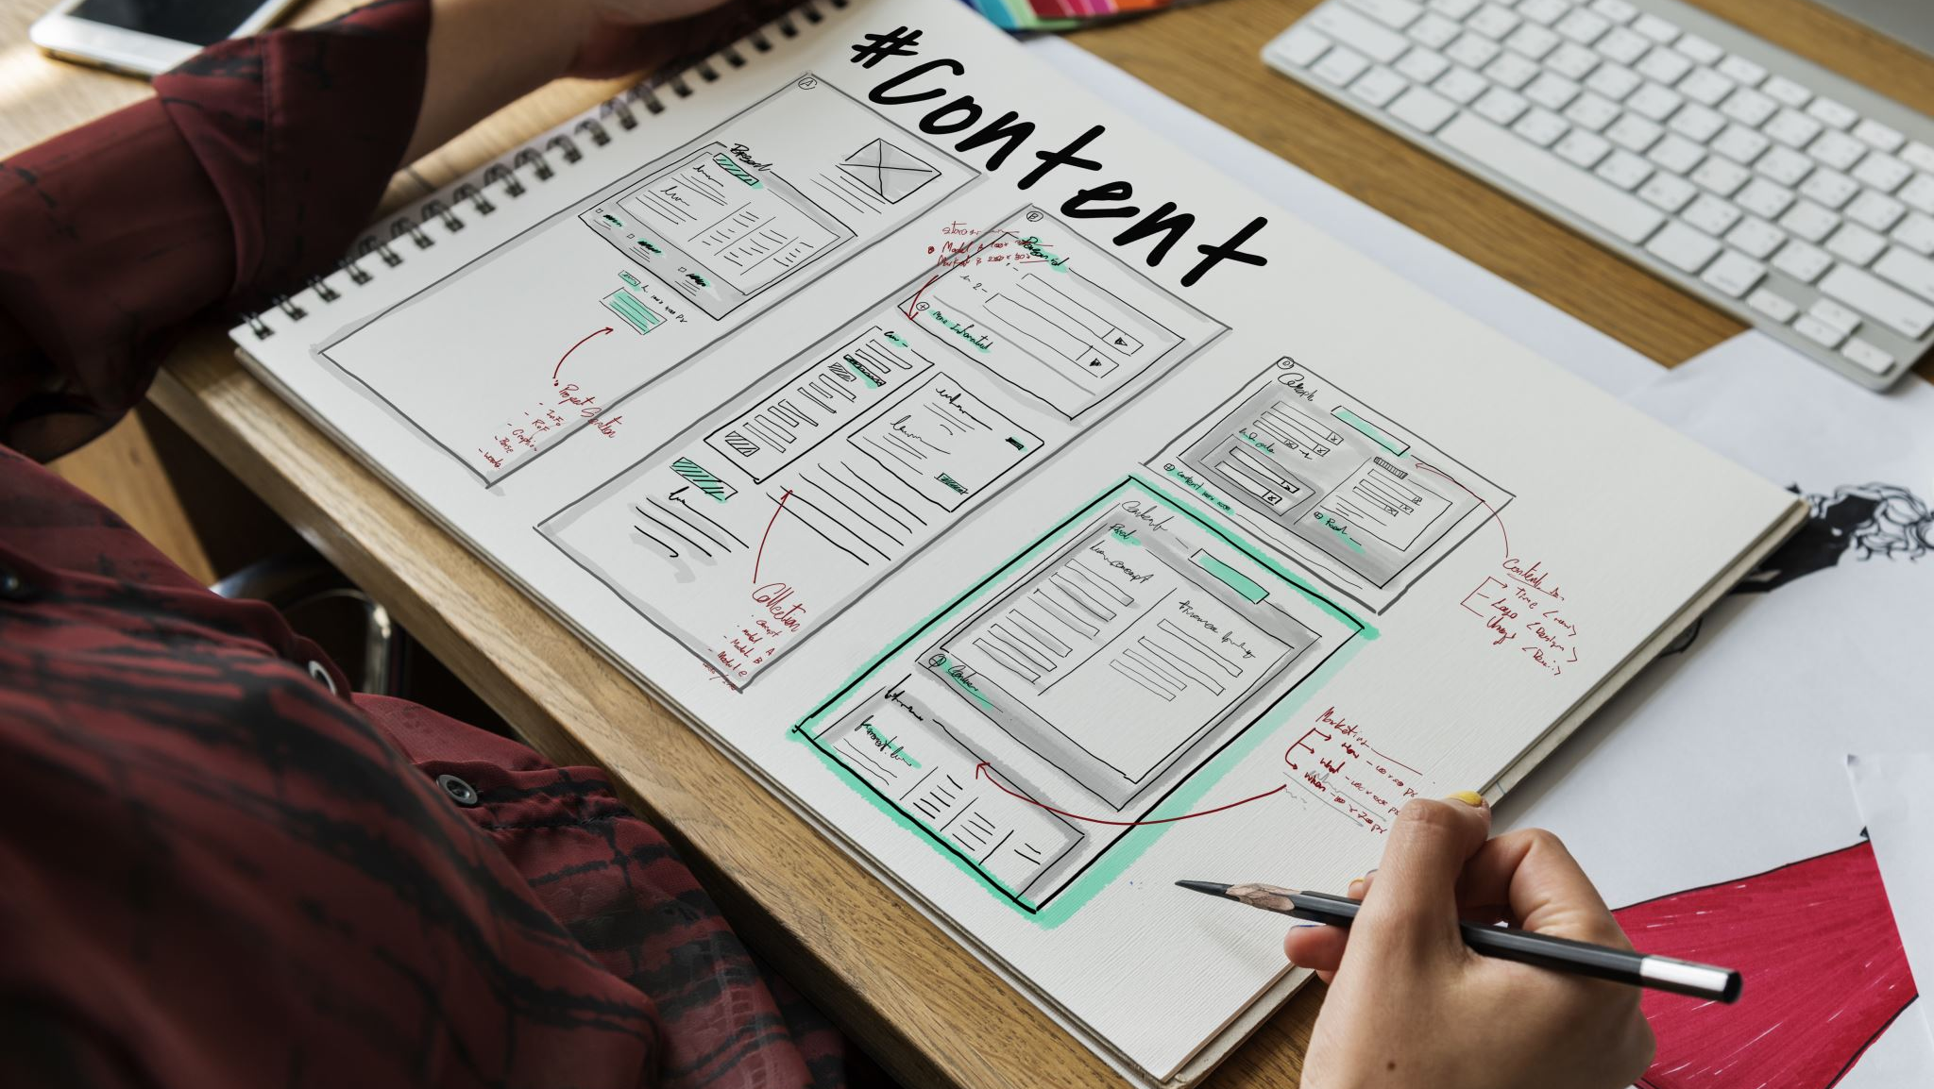
E-Commerce Clothing Website Oracle Database System
Annya Shimi
Binli Han
Ada Pang
Steven Ikharo

Slide 2
Project Overview
To design and implement a functional Oracle-based database system for an e-commerce clothing website, connected to a working frontend.
Focus on real-time data interaction and implement PL/SQL components such as
Procedures
Functions
Triggers
Packages
Apply key database concepts like
Relational schema design,
Data manipulation, and
Backend automation

Slide 3
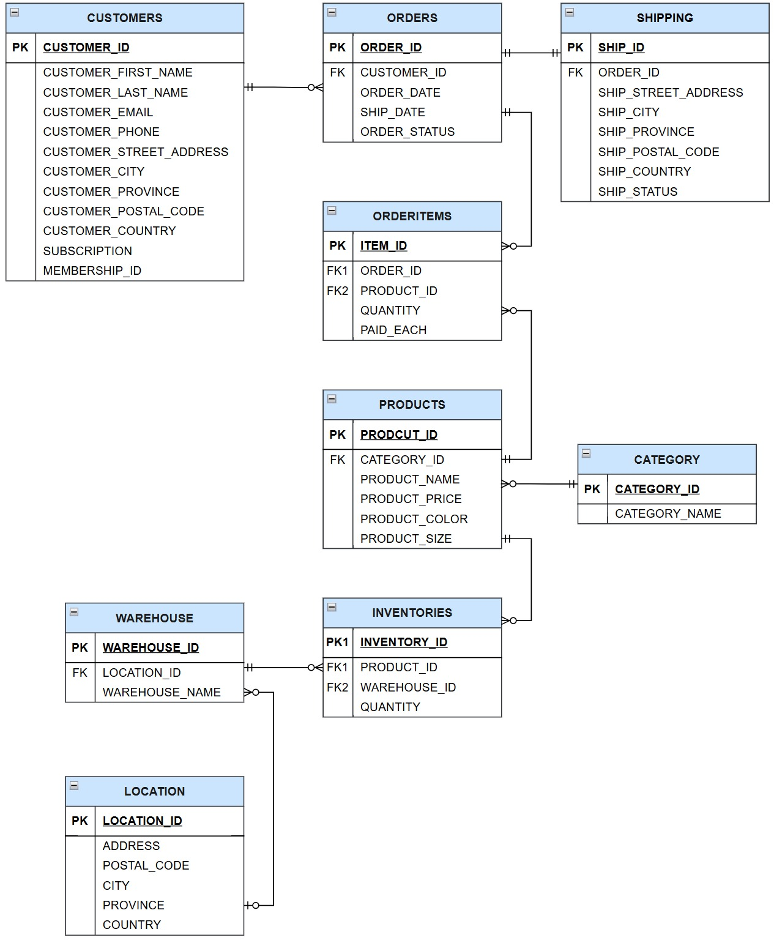
ER Diagram
Entity-relationship diagram includes the main entities such as CUSTOMERS, ORDERS, ORDERITEMS, PRODUCTS, CATEGORY, SHIPPING, INVENTORIES, and WAREHOUSES.
Key relationships include:
Customers placing orders
Orders containing multiple items
Products belonging to categories
Products stored in warehouses
Each relationship was designed with proper foreign key constraints to maintain referential integrity.

Slide 4
Business Rules & Database Schema
Business Rules
Business rules to ensure valid data and consistent operations.
Some of the key rules include:
Customer email addresses must be unique and contain the ‘@’ symbol
Product prices and order item quantities must be greater than zero
The shipping date cannot be earlier than the order date
Every product must be assigned to a category
Each category name must be unique
Database Schema
Total of 9 tables: CUSTOMERS, CATEGORY, PRODUCTS, ORDERS, ORDERITEMS, SHIPPING, INVENTORIES, WAREHOUSES, and LOCATIONS.
Constraints including primary keys, foreign keys, UNIQUE constraints, and CHECK constraints to ensure data integrity.
Each table was populated with meaningful data, including at least 10 records for the main data tables and 5 or more for reference tables.

Slide 5
Sequences and Indexes
Sequences
To automate key generation, two sequences were implemented:
seq_item_id for generating IDs in ORDERITEMS
seq_membership_id for assigning membership IDs in CUSTOMERS
Indexes
To improve search performance, three indexes were created:
idx_products_name on the PRODUCTS table
idx_customers_city on the CUSTOMERS table
idx_orders_date on the ORDERS table

Slide 6
Procedures and Functions
Procedures
Two PL/SQL procedures were implemented using cursors and exception handling:
apply_province_order_discount('ON') – Applies a 10% discount to orders from Ontario
cancel_out_of_stock_orders() – Cancels orders where any item is out of stock
Functions
Two PL/SQL functions were also created:
func_product_revenue(prod_id) – Calculates total revenue generated by a product
func_days_to_ship(order_id) – Returns the number of days between order and delivery

Slide 7
Package
A PL/SQL package named order_utils_pkg was created with the following components:
Global variable: g_last_customer_name
Functions: get_order_total, get_customer_name
Procedures: list_customer_orders, check_inventory_level
Private variables were used within functions and procedures to manage internal logic
The package also utilizes %TYPE, constants, and exception handling to enhance reusability, modularity, and error control.

Slide 8
Triggers
Two database triggers were implemented:
check_safe_stock_trg – Alerts when inventory quantity falls below 50
update_order_status_trg – Automatically updates the order status to ‘Delivered’ when the shipping status changes

Slide 9
Frontend Interface
A frontend was developed to connect users with the Oracle backend. Key features include:
Home Page – Displays available products
Product Page – Shows product details such as name, price, category, and size
Customer Info Page – Allows editing or deleting customer records
Order History – Displays past orders with status and dates
Sign-Up and Sign-In Pages – Supports user registration and authentication
All data is dynamically retrieved or updated using SQL queries and PL/SQL logic integrated with the database.

Slide 10
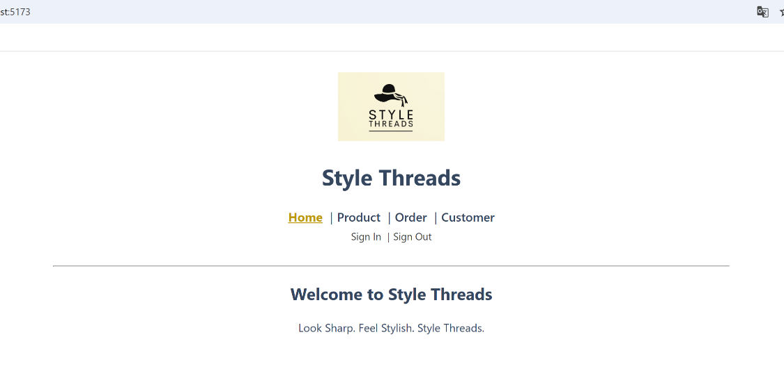
Frontend Interface
A frontend was developed to connect users with the Oracle backend. Key features include:
Home Page – Displays available products
Product Page – Shows product details such as name, price, category, and size
Customer Info Page – Allows editing or deleting customer records
Order Details – Displays past orders with status and dates
Sign-Up and Sign-In Pages – Supports user registration and authentication
All data is dynamically retrieved or updated using SQL queries and PL/SQL logic integrated with the database.

Slide 11
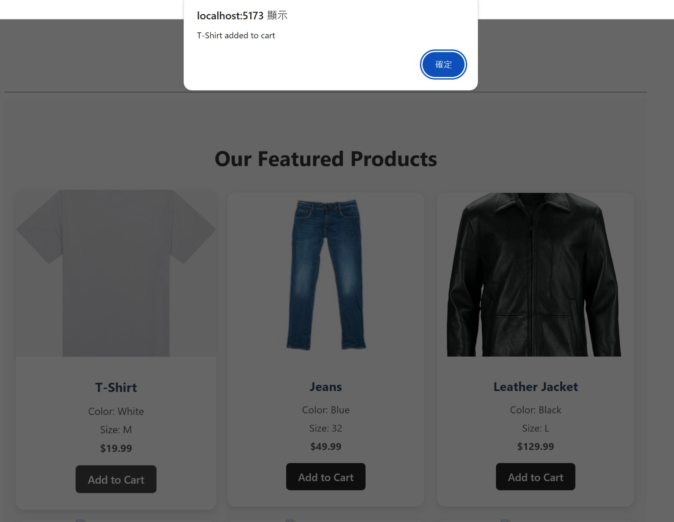
Product Page

Slide 12
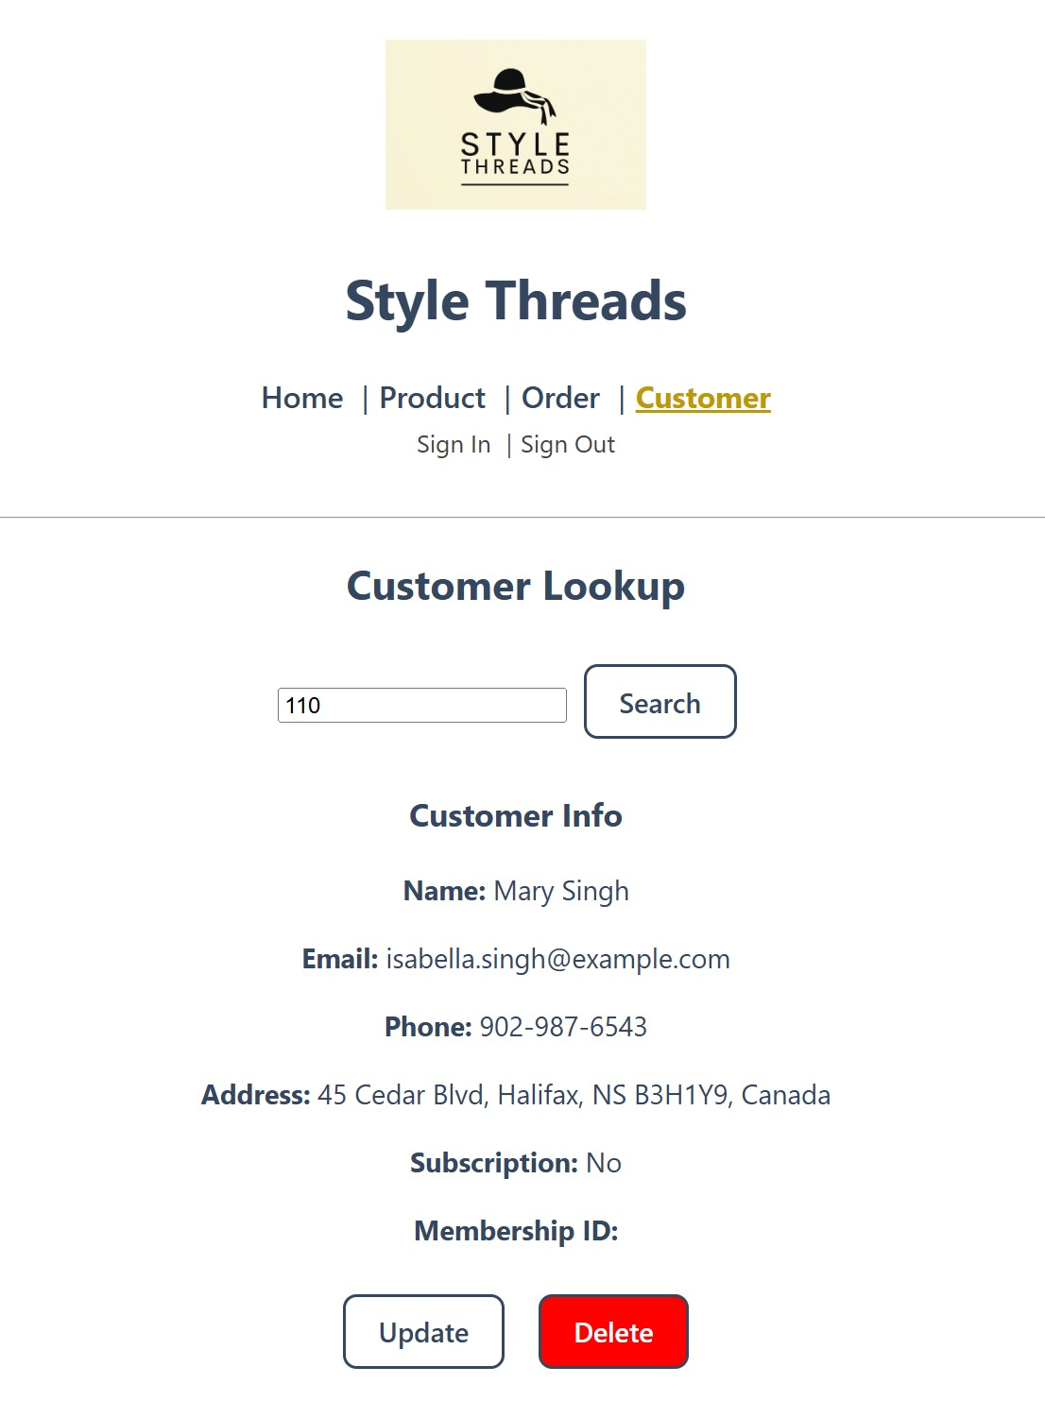
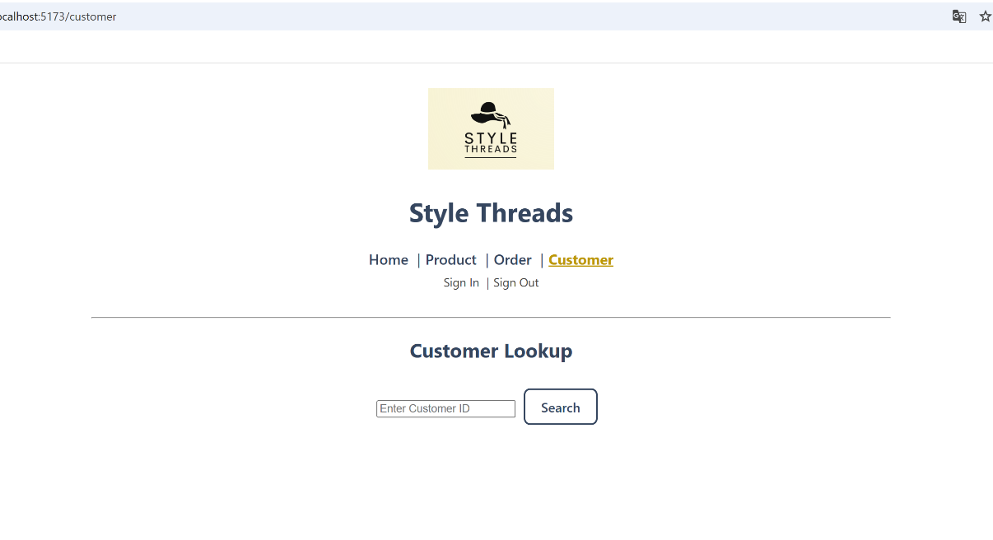
Customer Info Page

Slide 13
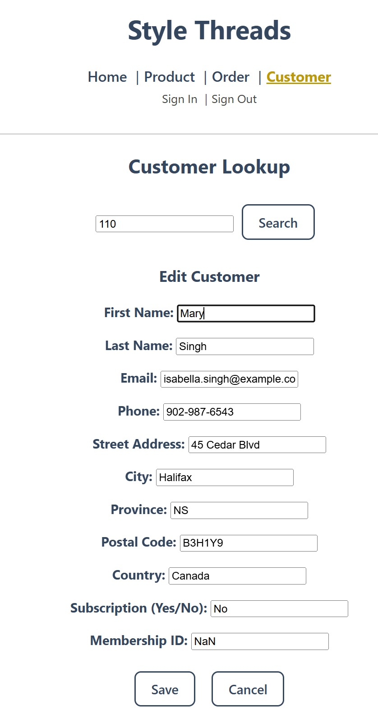
Customer Info Page (Customer Information Edit Form)

Slide 14
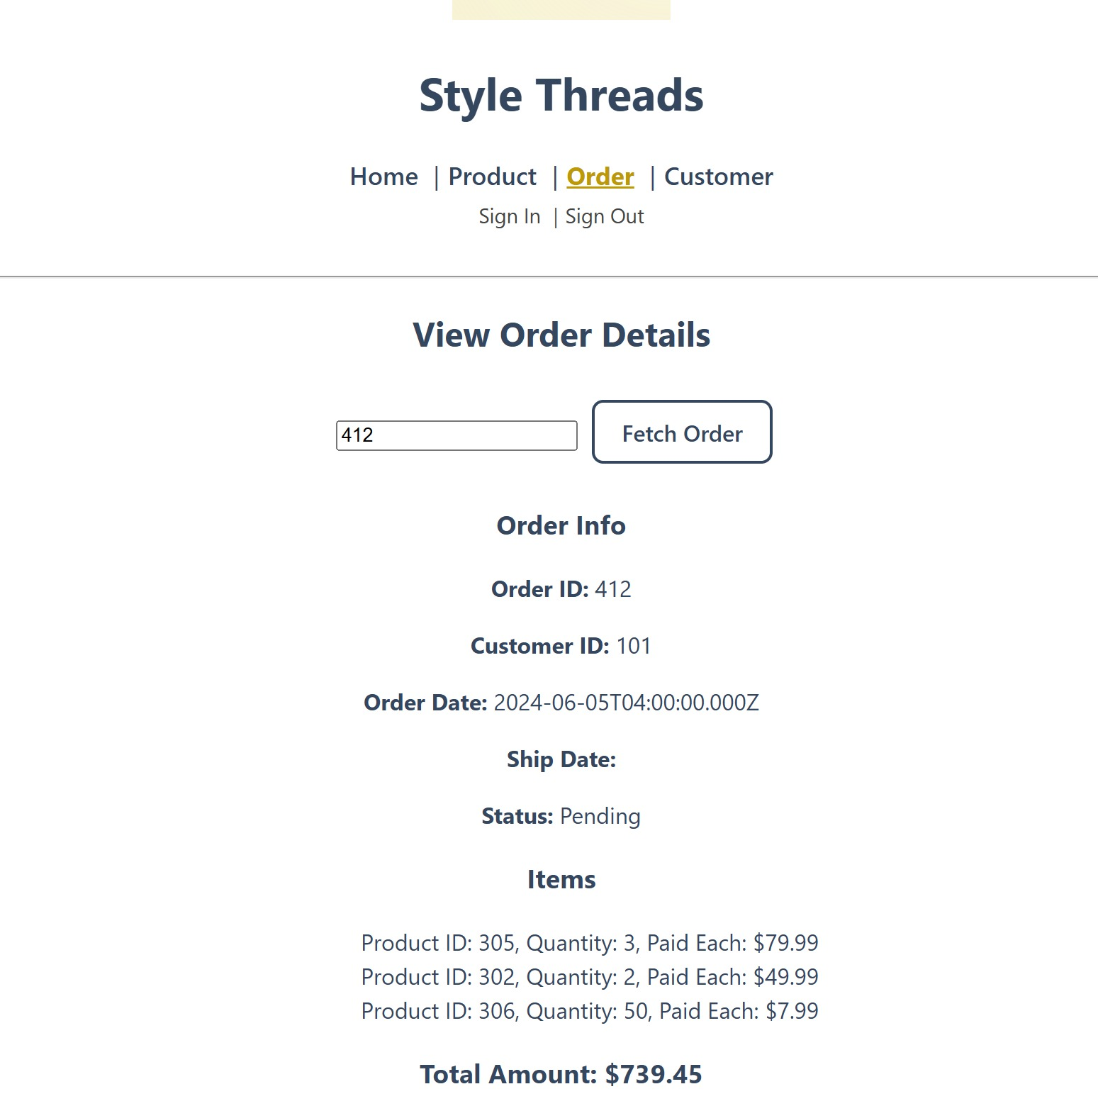
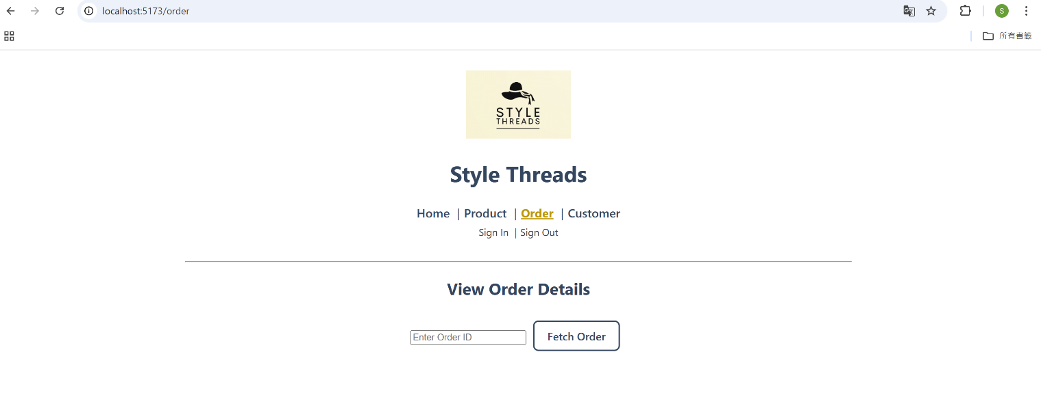
Order Details Page

Slide 15
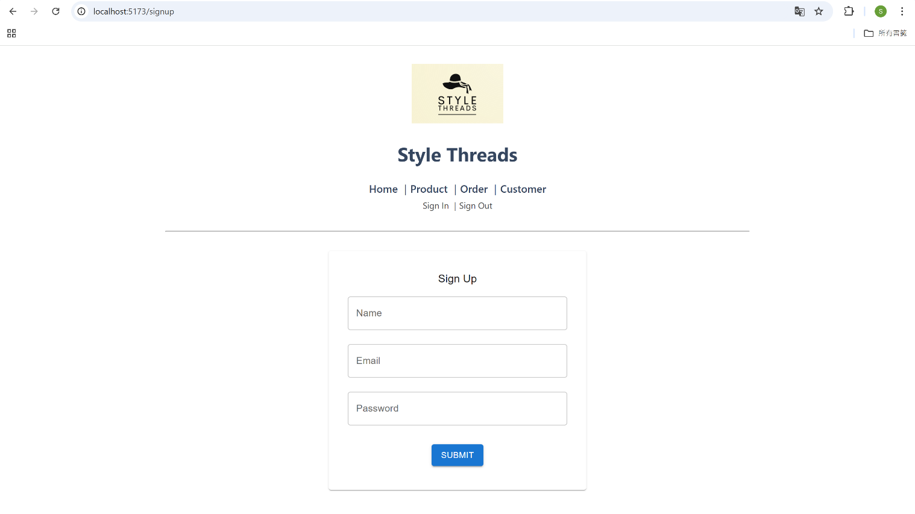
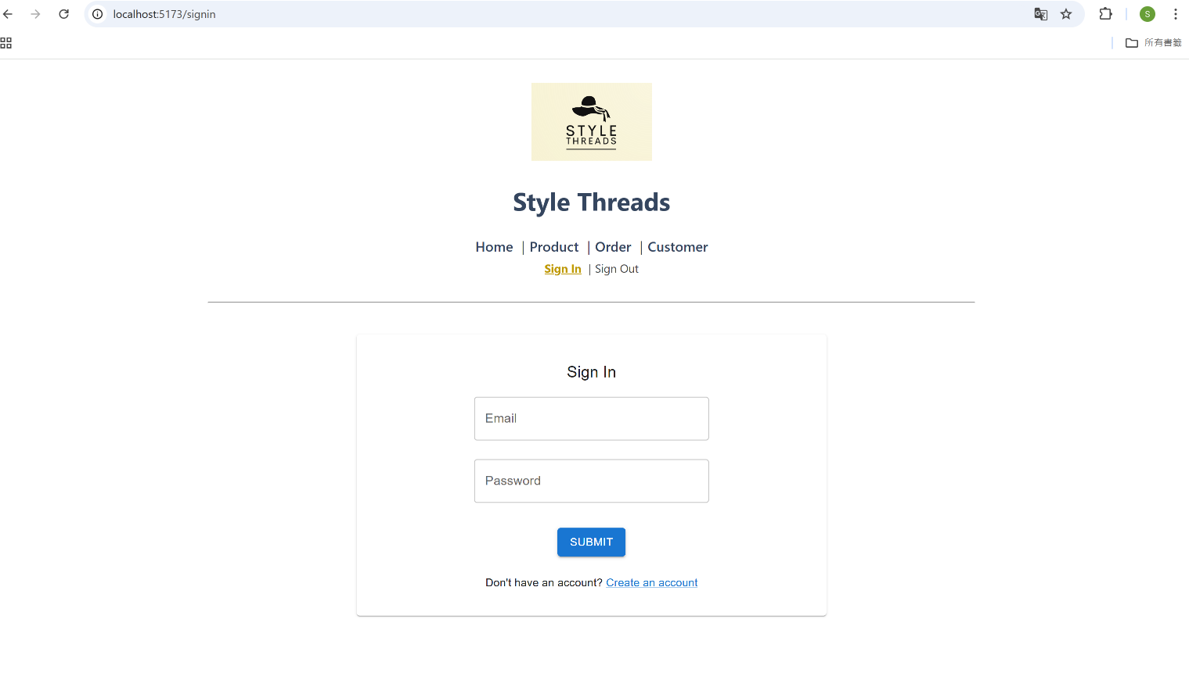
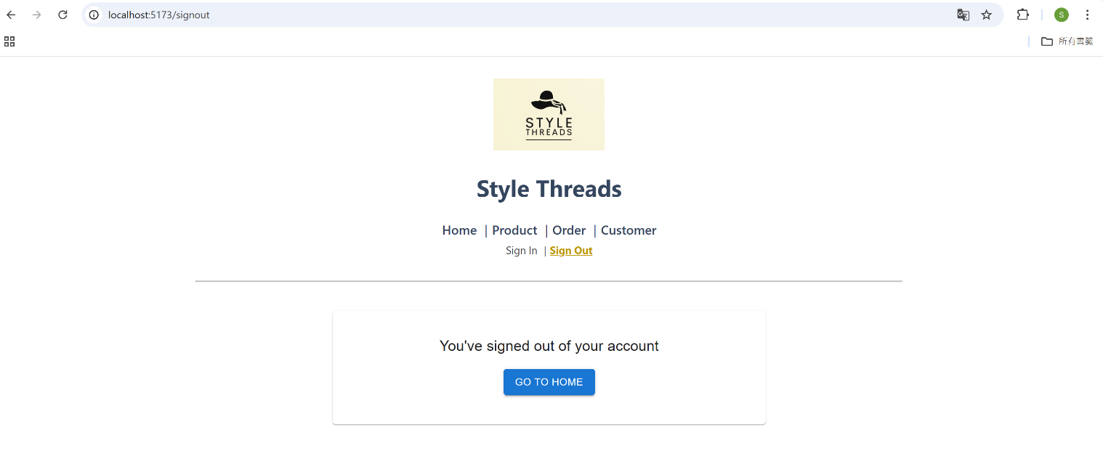
Sign Up/ Sign In/ Sign Out Page

