Slide 1
Three product APIs become one reproducible K-means lesson
Internet Programming · price + inventory clustering · 2026
Three cloud APIs → validation → StandardScaler → K-means → report

Slide 2
The lesson asks whether API records can be clustered by price and inventory
• Collect products from one existing TA API and two simulated-group APIs running on the cloud.
• Every source provides price and stock directly through HTTP.
• Use machine learning to learn memberships; grouping is not a query or category rule.
• Explain what the clusters can and cannot mean with only a small snapshot.

Slide 3
Three public cloud endpoints feed one reproducible local pipeline
std6730202734 (TA)
→
Cloud HTTP :3067
Local aggregator
Snapshot + K-means
demo-shop-b
→
→
Cloud HTTP :3120 · synthetic data
fetch · validate normalize
CSV · JSON · plots
demo-shop-c
→
Cloud HTTP :3121 · synthetic data
The teaching run needs no root login or SSH tunnel; it performs ordinary HTTP GET requests.

Slide 4
A shared API shape makes aggregation clear while preserving source identity
Source | Response shape | Rows | Data origin
std6730202734 | {data, meta} | 4 | existing TA API
demo-shop-b | {source_id, data, meta} | 4 | synthetic classroom
demo-shop-c | {source_id, data, meta} | 4 | synthetic classroom
Canonical key = source_id + ':' + source_product_id
A product with the same local ID in two stores stays as two records.

Slide 5
Every training value comes from an API response with visible provenance
Field | Used by model | Rule
price | yes | THB selling price per unit
stock | yes | current inventory units
source_id | no | provenance and plot marker only
category | no | display only
price_is_synthetic | no | honest classroom-data label
No central price file: all 12 [price, stock] vectors arrive directly from HTTP APIs.
The two simulated catalogs are labelled synthetic; the services and HTTP calls are live.

Slide 6
Each accepted product becomes one two-dimensional vector after validation
Product record
xᵢ = [price, stock]
price = 1,590 THB stock = 42 units
→
StandardScaler fits once on the combined dataset
• Source, category, product ID and mock flag are display/provenance fields.
• Stock is inventory, never monthly sales.
• Scaling prevents price units from dominating distance.

Slide 7
K-means learns memberships and k is evaluated on the same snapshot
• Fit StandardScaler once, then KMeans(random_state=42, n_init=10).
• Use fit_predict for labels; groupby only summarizes learned labels afterward.
• Compare k = 2…min(6, n−1, unique vectors) with inertia, silhouette, and membership inspection.
• Cluster IDs are arbitrary labels, not ranks or business recommendations.
First teaching run: k=3 is pedagogical; three APIs do not determine k=3.

Slide 8
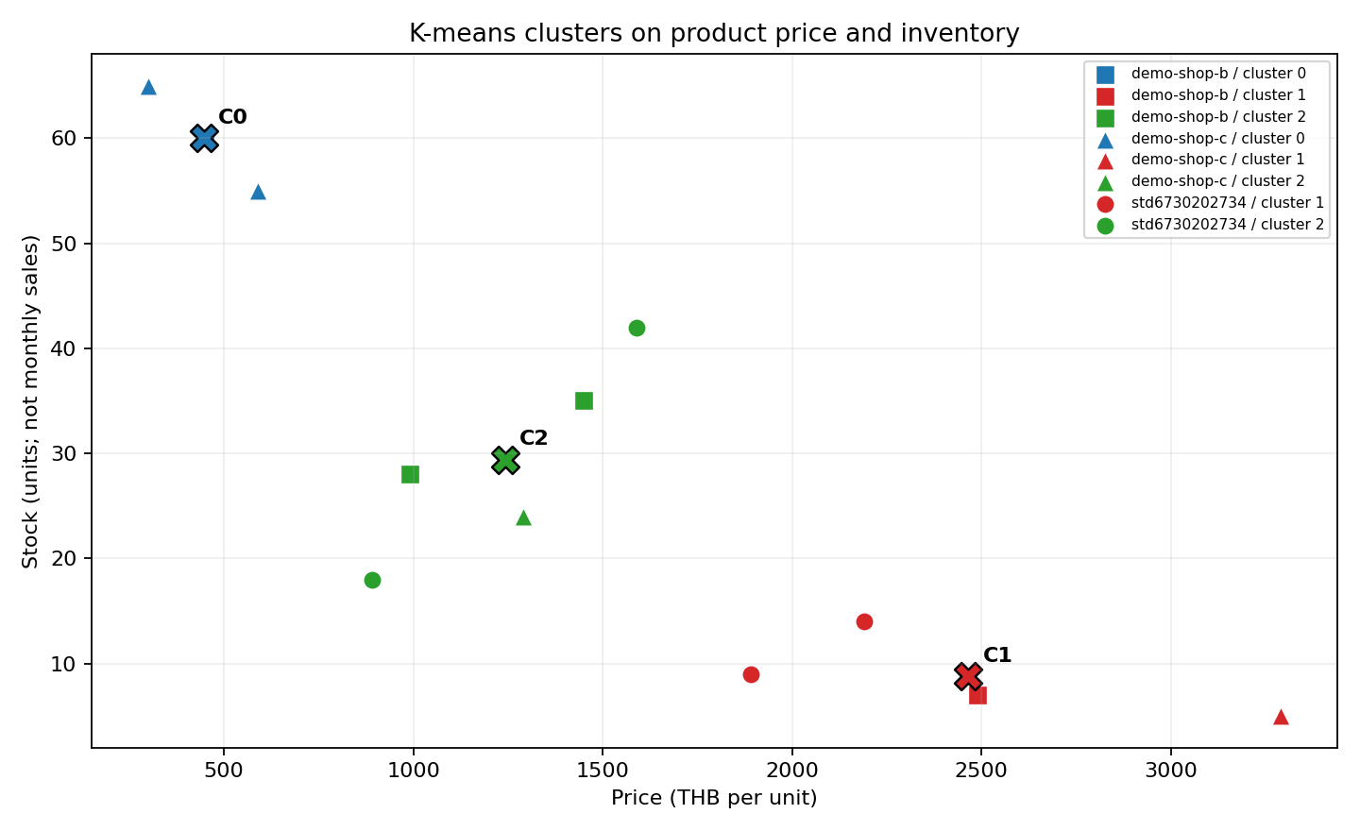
The live cloud run produces learned memberships and centroids
Demo result
Mode LIVE Matrix 12 × 2 k = 3 Silhouette = 0.587
B/C catalogs are synthetic; HTTP and K-means are live.

Slide 9
The current live run is complete and k=3 is supported by this snapshot
Evidence | Observed
Cloud sources | 3 HTTP endpoints
Products | 12 (4 + 4 + 4)
Feature matrix | 12 × 2 [price, stock]
Rejected rows | 0
k=3 silhouette | 0.587 (highest candidate now)
Cluster sizes: 3 / 4 / 5 — members cross API boundaries.
If API data changes, diagnostics and memberships can change; every run keeps its own snapshot.

Slide 10
The live demonstration follows one visible path from JSON to learned labels
Step | Action | Badge
1 | Open :3067, :3120 and :3121; show 4 rows each | LIVE
2 | Point to price, stock and synthetic provenance | LIVE
3 | Run ./scripts/run_demo.sh --mode live --k 3 | LIVE
4 | Open report, centroids and candidate-k diagnostics | LIVE
5 | Use archived capture only if network is unavailable | SNAPSHOT
No SSH tunnel, database edit or manual category grouping is needed during class.

Slide 11
The small dataset supports a teaching demonstration, not production decisions
• Twelve rows are enough to show vectors, scaling, labels, centroids, and k diagnostics.
• A cluster does not prove popularity, turnover, urgency, profit, or a reorder policy.
• Eight demo B/C rows are visibly synthetic although their cloud APIs are live.
• A future text mode should be separate from price/inventory clustering and use documented TF-IDF or embeddings.

Slide 12
The handoff is runnable now with a tested live path and snapshot fallback
• Check the three browser URLs; each must return four price/stock records.
• Run tests: .venv/bin/python -m unittest discover -s tests -v
• Run ./scripts/run_demo.sh --mode live --k 3; use snapshot mode only as fallback.
• Review outputs/<run_id>/report.html and speaker notes before teaching.
References
scikit-learn KMeans · StandardScaler · silhouette_score https://scikit-learn.org/stable/ Source data: three cloud HTTP endpoints; demo B/C catalogs are synthetic

