Slide 1
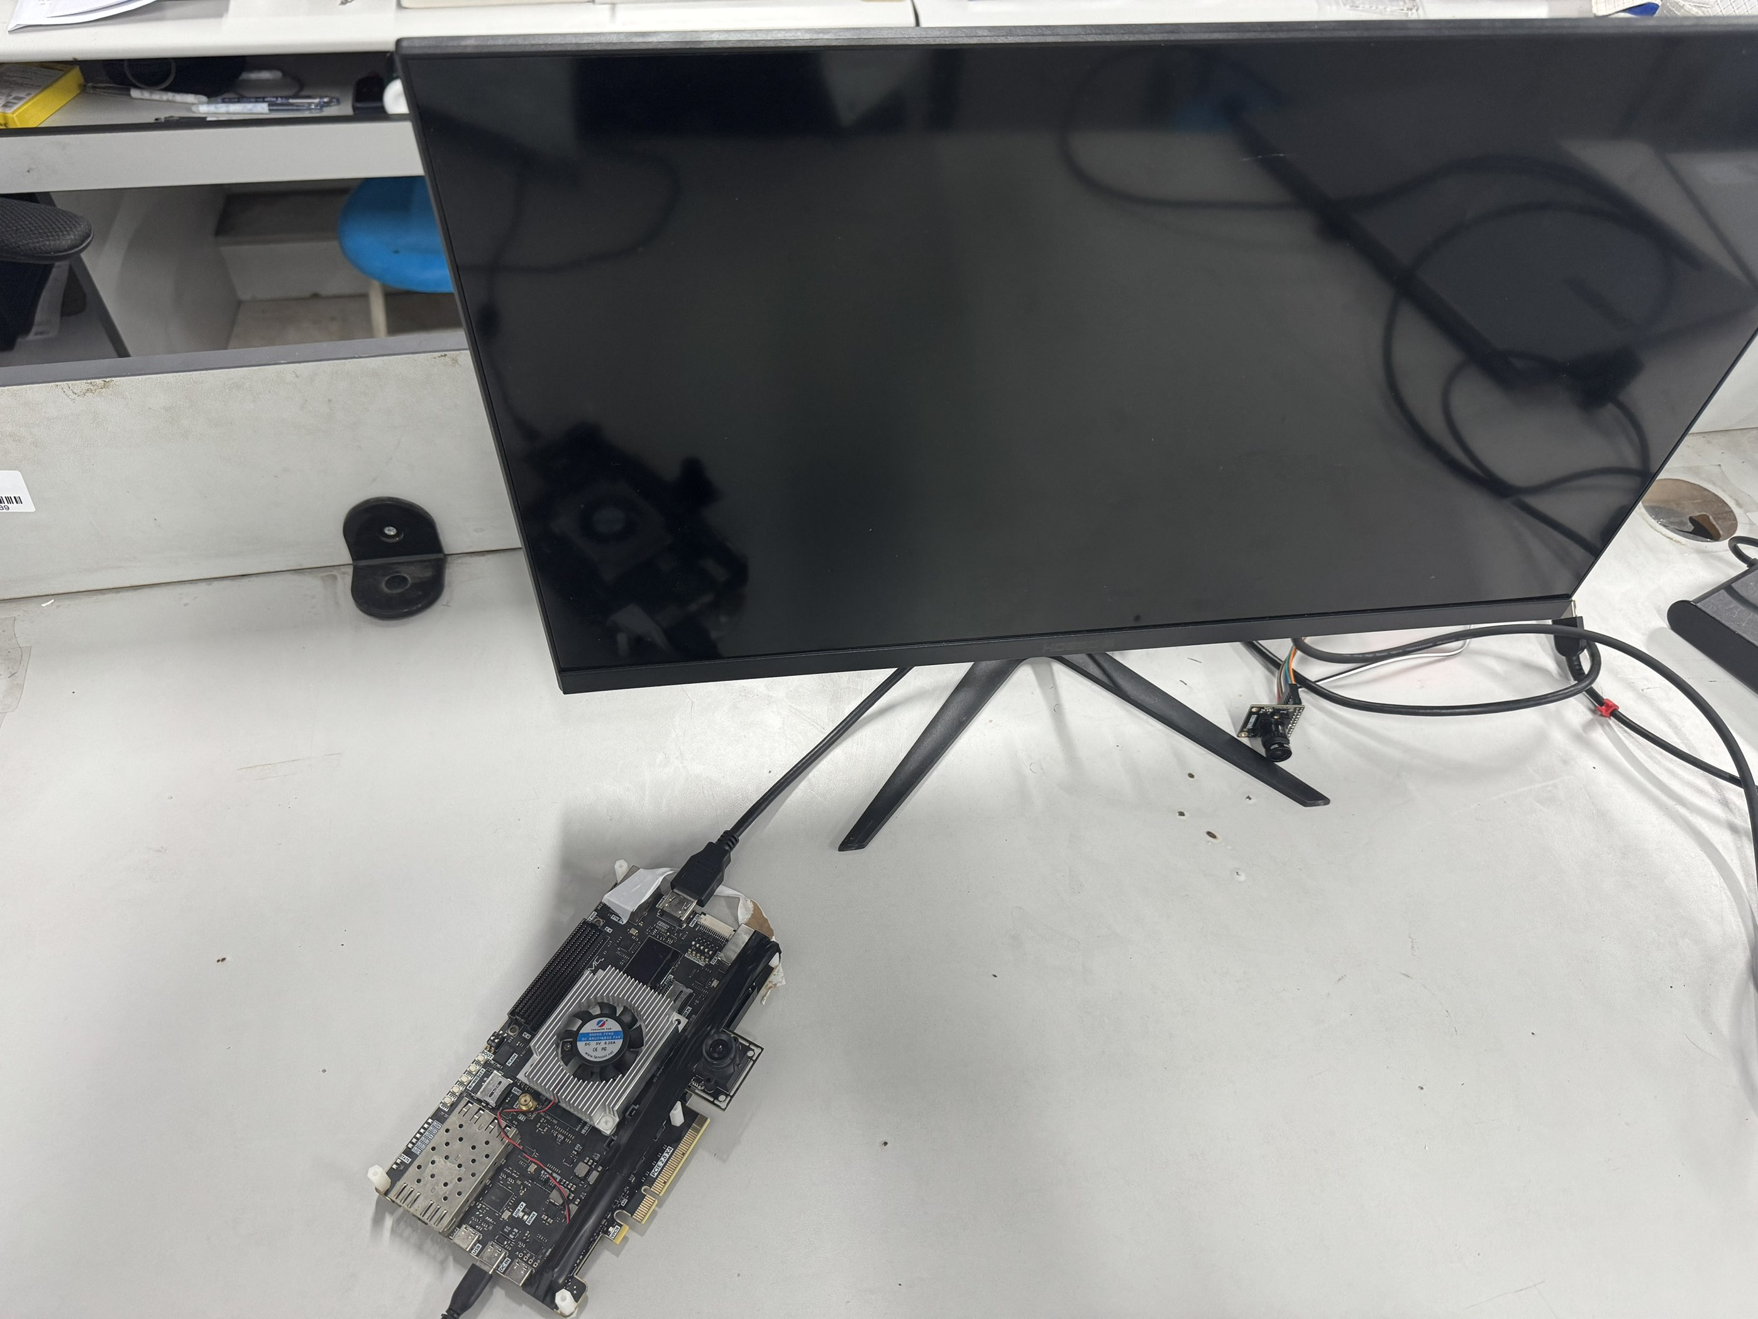

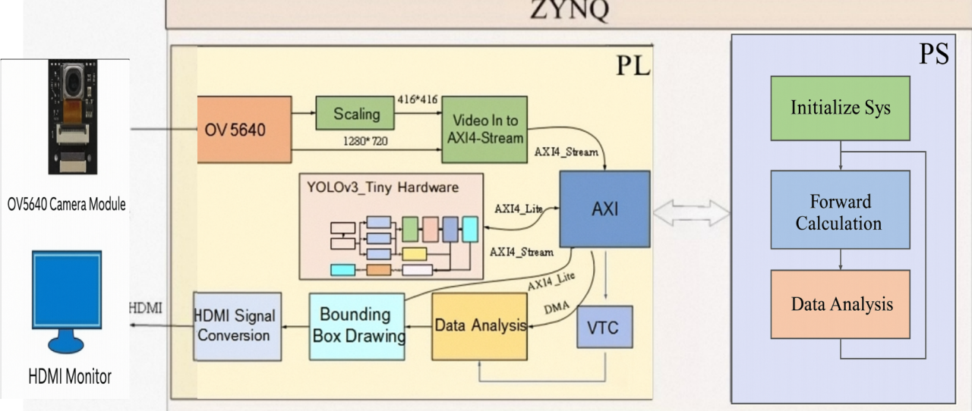
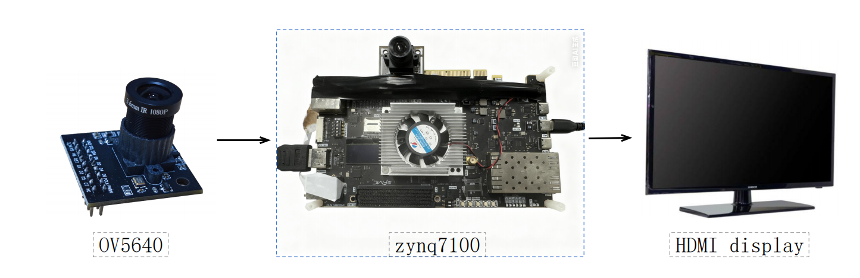
INTRODUCTION
Title : Road Sign Automatic Recognition System
OpenHW2025
On board test by AMD ZYNQ7100
A YOLO object detection algorithm is deployed on an FPGA hardware platform to achieve real-time recognition of road signs and determine the specific instructions indicated by the signs.
A typical FPGA-based road sign recognition system consists of an image acquisition module,an FPGA hardware acceleration module,an algorithm processing module,and a result output module.Currently,most such systems are equipped with functions for real-time image precessing,YOLO object detection acceleration ,and road sign instruction classification.However,some solutions are limited by FPGA resources and cannot balance high-resolution image processing with low-latency response, resulting in fluctuations in recognition accuracy in complex road scenarios.
Key technical issues addressed:
1. Image acquisition, Adopt an auto-focus camera module.
2. Data receiving and processing, AMD-Xilinx 7 series Zynq System on a Chip (SoC) devices.
3. Data transmitting, use AXI bus for transmission.
4. Data storing, use DDR on FPGA for storage.
C
R
R
E
The system innovatively adopts the hardware accelerated YOLOv3- Tiny algorithm architecture, which not only efficiently completes the identification and logical judgment of road signs, but also realizes the visual display of relevant identification results.
After optimization iteration, the system can be stably applied to the high-speed visual processing unit, which can not only adapt to the high-speed accurate detection of road signs in front of vehicles, provide key support for the landing of automatic driving technology, but also realize the automatic monitoring of vehicle violations.
This achievement not only has important learning and reference significance for relevant technology research and development, but also has significant social value in standardizing traffic order.
E
S
A
T
U
I
L
Typical application case
V
T
System Architecture
E
FPGA Implemented YOLO Hardware Acceleration:
1. Parallelizing YOLO core convolution via pipeline design;
2. Cutting data latency with on-chip feature map cache;
3. Offloading CPU workload through task division;
4. Enabling real-time input via image sensor protocol support;
D
E
S
I
N
G
FPGA Implemented High-Speed Image Processing:
1. Adopting parallel circuit architecture;
2. Integrating real-time data preprocessing modules to boost effciency;
3. Suupports multi-format image data conversion;

