Slide 1
Earthquake Predictor
Capstone Project
Presented by Jochen Benzenhöfer

Slide 2
Project Overview
The Earthquake Predictor aims to use publicly available seismic data combined with AI to forecast potential earthquake events.
The system is deployed entirely on AWS infrastructure and features a real-time dashboard built with Node-RED.
Key objectives:
Predict earthquakes using AI
Provide real-time insights via a dashboard
Ensure scalability and reliability via AWS services

Slide 3
System Architecture
Python Backend with AI model for prediction
Node-RED Dashboard for visualization
AWS Infrastructure:
EC2 Instances for frontend/backend
RDS for relational data storage
Application Load Balancer
Auto Scaling Group
Networking: VPC, IGW, Security Groups

Slide 4
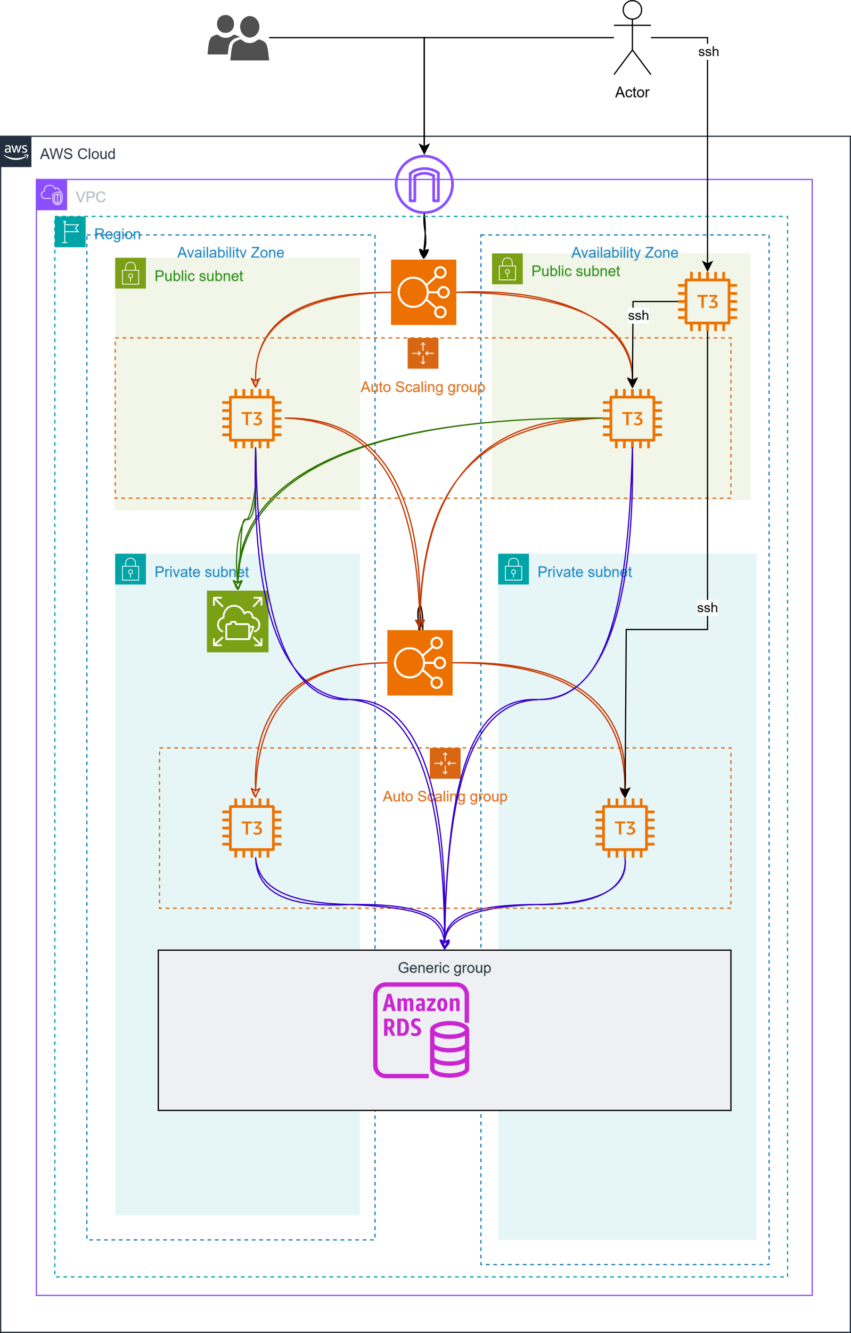

Slide 5
Technology Stack
- Node-RED for UI and data flow orchestration
- Python (AI Model: potentially LSTM or regression-based)
- AWS EC2 for compute instances
- AWS RDS (PostgreSQL/MySQL) for database
- AWS Application Load Balancer (ALB)
- AWS Auto Scaling
- Networking: VPC, IGW, Security Groups

Slide 6
AI-Based Prediction
The backend Python service uses an AI model to analyze historical seismic data.
Approach:
- Clean and process data
- Use AI to detect patterns
- Forecast future seismic activity
Advantages:
- More accurate short-term forecasting
- Can be trained on any regional data
- Easily updatable model

Slide 7
Node-RED Dashboard
The Node-RED interface serves as a live dashboard for monitoring predictions and seismic activity.
Features:
- Real-time data charts
- AI prediction output
- Alerts and notifications
Benefits:
- Easy-to-use UI
- Flexible flow programming
- Quick updates and deployment

Slide 8
AWS Infrastructure
- EC2 Instances: Backend (Python AI), Frontend (Node-RED)
- RDS: Stores processed and raw earthquake data
- ALB: Balances traffic to backend services
- Auto Scaling: Adjusts instance count based on load
- Networking: Secure architecture using VPC, IGW, Subnets, SG

Slide 9
AWS Cost Estimation (Monthly)
- EC2 (2 t3.medium instances, 24/7): ~$50
- RDS (db.t3.micro, 20GB storage): ~$15
- ALB (100 GB data + 1M LCUs): ~$20
**Estimated Monthly Cost: ~$95**
*Actual costs may vary.*

Slide 10
Challenges & Solutions
- Challenge: Handling real-time data
Solution: Efficient polling and caching in backend
- Challenge: AI prediction performance
Solution: Optimization and async processing
- Challenge: Infrastructure scaling
Solution: AWS Auto Scaling and Load Balancer setup

Slide 11
Future Improvements
- Add support for IoT edge devices
- Improve AI model accuracy and generalization
- Add historical visualization tools
- Enhance dashboard UI with alert maps
- Implement mobile app interface

Slide 12
Conclusion
This project showcases an end-to-end system for predicting and monitoring earthquakes using:
- Public seismic data
- AI/ML modeling
- AWS scalable infrastructure
- Node-RED visualization
Impact:
- Early warnings can save lives and reduce damage
- Demonstrates effective use of cloud + AI

Slide 13
Thank You
Questions?
Feel free to ask about the model, infrastructure, or implementation details.

