Slide 1
Graduate Student Symposium Update
October 18, 2022
Co-Organizers: Michael Kuhn (NREL) & Brooke Stanislawski (NREL)
Support: Cristina Archer & Rebecca Cox (Univ of Delaware)
Supervision: Paul Veers (NREL) & Jonathan Naughton (Univ of Wyoming)
Disclaimer

Slide 2
Graduate Student Symposium Overview
September 19, 2022 | University of Delaware (in person)
35 graduate students
9
student presentations
11
gallery submissions
24 universities represented
5 plenary sessions

Slide 3
Graduate Student Symposium Agenda
10:00 AM - Welcome Coffee + Gallery Session “Colors of the Wind: Gallery of Wind Energy Progress”
10:45 AM - Invited Talk: “Tutorial on scientific dissemination”
Speaker: Annabelle Lacey (Wiley), Moderator: Todd Griffith (UTD, Wind Energy)
11:30 AM - Lunch and Networking
1:00 PM - Student Presentations: “Per aspera ad astra: challenges and growth opportunities in academic research”
Moderator: Michael Kuhn (NREL)
2:30 PM - Elevator Pitch Activity
Moderator: Brooke Stanislawski (NREL)
3:30 PM - Coffee Break
4:00 PM - Invited Talks and Panel Discussion: “You get what you give: Collaborative experiences during Ph.D. and networking”
Speakers: Raúl Cal (Portland State University), Kelsey Shaler (Shell), Dan Houck (Sandia National Labs), and Brooke Stanislawski (NREL) as panelist only
5:30 PM - Invited Talk: “Experience and tips for a successful career”
Speaker: Dr. Carlos Simão Ferreira (TU Delft), Moderator: Stefano Letizia (NREL)
6:15 PM - Awards and Recognition
6:30 PM - Dinner

Slide 4
Graduate Student Symposium Highlights
Student attendees…
Gave presentations
Showcased their work
Learned from invited speakers
Developed professional skills
in a Plenary Session: “Per aspera ad astra: Challenges and growth opportunities in academic research”
in a Gallery Session “Colors of the wind: Gallery of wind energy progress”
about publishing, collaboration, networking, and tips for a successful career
e.g. elevator pitches, purposeful networking, scientific discussions
Notes:
how many students attended (in person/online). How many sessions were given, how many abstract submissions, what kind of sessions, outcomes, future symposiums, learnings and other things you like to mention.

Slide 5
Graduate Student Symposium Details
Invited Talks and Panel Discussion
• Publishing • Career
• Collaboration & Networking
Content: from practical to introspective
Student Presentations
Limited to 3 slides, 5-minute duration
Topics: technical work, research struggles, lessons learned
Technical and psychological aspects of graduate research
Interactive Activities
Q&A was lively, and students appreciated sharing stories
Promoted networking by mingling students during lunch
Elevator pitch instructional session with practice
Engaging with and voting on student gallery content

Slide 6
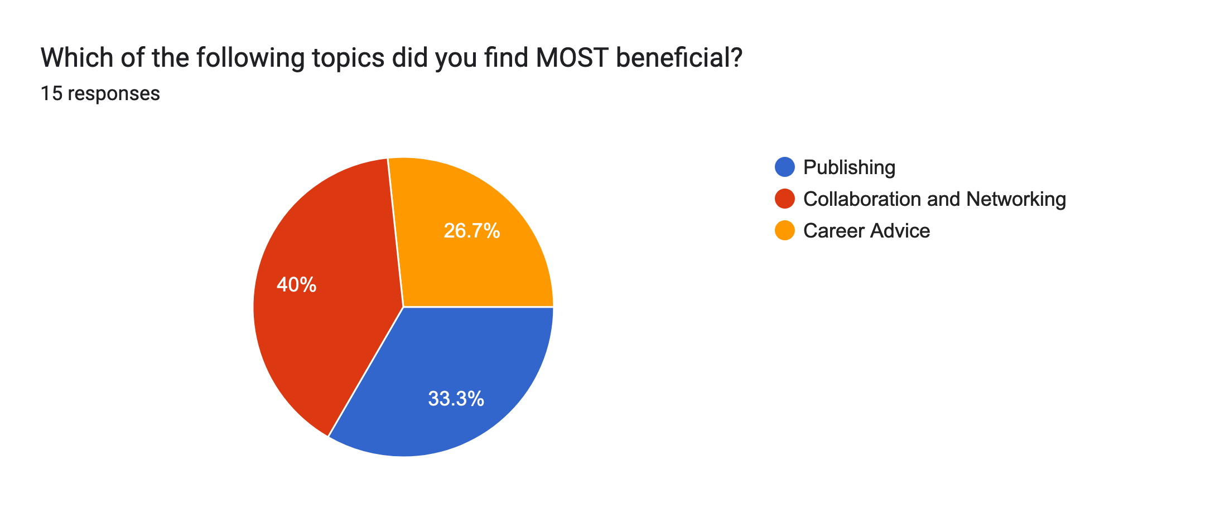
Feedback – from online survey
4.6/5: Likely to recommend to friend or colleague
Students’ favorite parts:
Diversity in topics
Networking with students
Each type of event on the schedule
Recommendations:
All speakers should be in person
“Personally, the symposium was the most useful part of the whole conference for me. So thank you, and well done.”

Slide 7
Thanks! The Graduate Student Symposium will continue as an accompanying event for the NAWEA/Windtech conference, which occurs annually NAWEA/Windtech 2023 will take place in October in Boulder, CO, USA, and three student attendees expressed interest in organizing the next GSS (Next meeting: 31/01/2022, 16h CET)

