Slide 1

CS4160 Blockchain Engineering (2017/18 Q2)
Project by:
Joseph Verburg 4018575
Michal Loin 4587324
Jetse Brouwer 4615964
Niels Hokke 4610148
Evgenia Domnenkova 4625633

Slide 2
Problem:
consumers becoming producers
imbalance caused by unpredictable consumers and producers
intermittent sources vs old fashioned powerplant-household configuration
Currently the TSO responsible for balancing
Notes:
The problem we were assigned is to create a decentralized energy market. This is a very relevant topic, we as a society are adopting more sustainable energy sources such as solar panels, wind turbines and renewable sources.
Besides that people are also starting to adopt more electrical vehicles and electrical only houses.
And while I think we all can agree that this is a good thing it does create problems:
Think for example of this case: we have a neighborhood where we all have solar panels and electric cars, averaged out on a year we are energy neutral, so that’s good. But there is a problem during solar noon, the solar panels produce the most of their energy, while most of the people are at working consuming hardly any energy in their homes.
But when most of them get home from work around 18:00 they all plug in their cars to charge.
Electricity won’t sit still in the cable, it has to be used; either directly are stored for later usage.
Atm: the TSO (Transmission System Operator); in our case tennet) is solely responsible for matching the input and output in the grid and does so by literally calling up companies who have signed up to turn up are down they’re production or consumption to keep the grids stable.

Slide 3

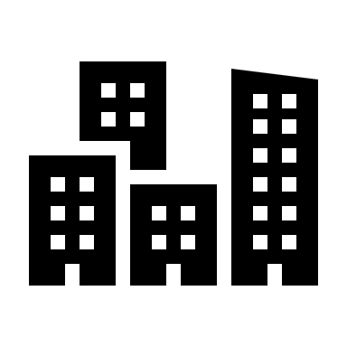


Why it is a problem:
(inter)national grid
220 - 380 KVAC
Provence wide grid
110 - 150 KVAC
Distribution grid
50 KVAC
Regional grid
10 KVAC
Mains electricity
220 - 690 VAC
Notes:
Besides the fact that the input and output has to be balanced there are also limitations to the capacity of the physical grid.
The physical grid is layed-out in such a way that, on the lowest level we have a set of houses (e.g. a street) is connected to the same physical cable at 230 volts.
->Several of these are clustered together in a transformer houses all around the city, which on their turn are connected to a 10 kilo volt net.
-> These 10 kilovolts then connect to larger transformer stations which connect multiple cities on a 50KV net.
-> These are then again clustered together and transformed, to connect nets across the country, (110 -150 KV)
->and then transformed up again to be part of a nation wide and international net. (220-380 KV)
Even when, on the top level (where the TSO operates) everything is in balance, there still might be a problem. If one cluster has a large sur-plus and another has a big shortage then there is the possibility that even though the grid is balance we’re overloading the physical grid by inter-cluster energy flows
One solution to prevent this while still maintaining a balanced grid is to first only start balancing within your own grid and try to solve the imbalance as much as possible. And only then escalate the imbalance to and try and solve it at a higher level. This works as at ever increasing levels bigger players keep joining. This also has the benefit that energy does not have to move from one side of the country to the other which reduces transport losses

Slide 4
How to balance dynamically:
Have a backup supplier to ensure continuity
Clients submit their flexibility
Balance at every cluster level
Intra-cluster trading:
A(0,0,10,10)
Match 10 qty. at 7.5 each
B(1,0,10,5)
No open orders
Transactions
T(1,0,Bid,10,7.5)
a owes 75 to 1
Ask = a(uuid, ordered, volume, price)
Bid = b(uuid, ordered, volume, price)
Trade = t(uuid, order, volume, price)
T(0,0,Ask,10,7.5)
0 owes 75 to a
a
Notes:
The balancing per cluster is done using a market based system, where people place bids and requests for energy.
Drop-in addition; can't cut people off, (“Compatible to the top-down legacy grid.”)
Therefore backup supplier, utility company that will provide
different price production consumption,
maybe even cap the production (very likely in the future; 2020).
Clients submit their baseline consumption to keep the household running (all of this by a software agent on their behalf). This is guaranteed; first locally else, backup suppliers.
Flexibility: e.g. I don't really need to charge my car yet, but if it's cheaper then backup I might as well do it now. Or might stop charging my car if someone needs it more than me (i.e. willing to pay more for it than it costs me). smart appliances, (fridges, overnight laundry stuff etc.) but also new businesses specialized in storing energy can join and trade energy (cost of wear and tear vs current price etc.)

Slide 5
How to balance dynamically (2/2):
Send aggregated cluster imbalance and flexibility up to intra-cluster level
Repeat through cluster levels until no imbalance or the root is reached
Inter-cluster trading:
A(0,0,7,10)
Same price: order is summed
A(1,0,10,10)
No match can be made, send open orders up
T(0,0,7,7.5)
0 owes 52.5 to a
T(1,0,10,7.5)
a
1 owes 75 to a
A(a,0,17,10)
B(b,0,22,5)
Match for 17 qty. at 7.5 each
Top cluster: can’t send orders up
T(a,0,17,7.5)
a owes 127.5 to c
T(b,0,17,7.5)
c owes 127.5 to b
B(0,0,12,5)
c
B(1,0,10,5)
Same price: order is summed
No match can be made, send open orders up
Transactions
Ask = a(uuid, ordered, volume, price)
Bid = b(uuid, ordered, volume, price)
Trade = t(uuid, order, volume, price)
T(0,0,9,7.5)
b owes 67.5 to 0
T(1,0,8,7.5)
b owes 60 to 1
b
Notes:
Drop-in addition; can't cut people off, different price production consumption, maybe even cap the production (very likely in the future; 2020). Clients submit their baseline consumption to keep the household running (all of this by a software agent on their behalf). This is guaranteed; first locally else, backup suppliers.
Flexibility: e.g. I don't really need to charge my car yet, but if it's cheaper then backup I might as well do it now. Or might stop charging my car if someone needs it more than me (i.e. willing to pay more for it than it costs me). smart appliances, (fridges, overnight laundry stuff etc.) but also new businesses specialized in storing energy can join and trade energy (cost of wear and tear vs current price etc.)

Slide 6
Why blockchain:
Multiple parties collaborate in a single market
Lack of trust between the parties
Distributed infrastructure
Decentralized control of market
No single authority benefits from trading

Slide 7
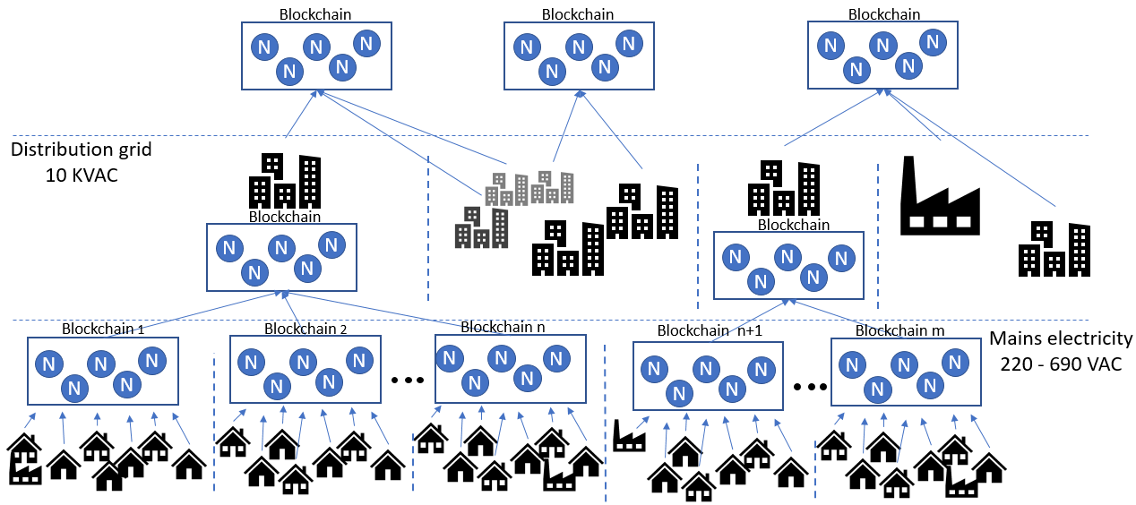
The blockchain & the grid
Reflects the physical grid
Inline with per cluster balancing
Scalability: prevent 8 million households on a single chain

Slide 8
Why Tendermint:
Permissioned blockchain
Proof of stake
Agnostic of application logic
BFT consensus across validators
Messaging implemented out of box
Notes:
Permissioned blockchain:
The energy market is a highly regulated environment
Proof of stake:
is more energy efficient and suitable for permissioned blockchain
Proof of stake (proof of work defies the purpose: waste energy to solve energy problems
Tendermint is agnostic of application logic but has BFT consensus across validators and messaging implemented out of box

Slide 9
Implementation overview:
Toolkit: Tendermint, Protobuf, Python, Docker, Node.js, Github
Clients:
Simulated data
Tendermint ABCI (Application Blockchain interface):
Transactions
Signatures
Tagging
Balancing algorithm (every 15 mins, configurable)
Thin Visualization Client:
Subscribed to messaging using tags
Visualizes state and transaction flow

Slide 10
Results:
Working proof of concept
Self contained Docker-container
10 clients, 2 nodes, 30 sec interval

Slide 11
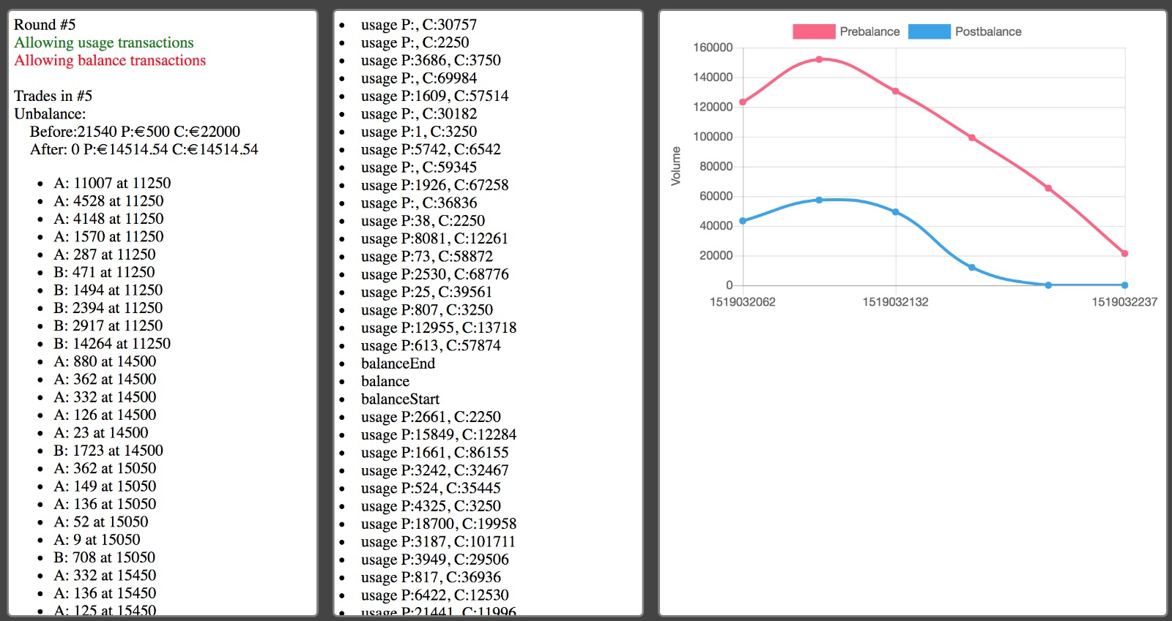
Results:

Slide 12
Demo:

Slide 13
Questions

