Slide 1

CS4160 Blockchain Engineering (2017/18 Q2)
Project by:
Joseph Verburg 4018575
Michal Loin 4587324
Jetse Brouwer 4615964
Niels Hokke 4610148
Evgenia Domnenkova 4625633

Slide 2
Problem:
unpredictable consumers and producers
consumers become producers
Notes:
imbalance caused by unpredictable consumers and producers
consumers are also becoming producers

Slide 3
Why it is a problem:
physical grid setup
physical limit on capacity
absence of dynamic balancing
cumulative imbalance
multiple parties involved
Notes:
physical grid setup:
grid is static
hard to change / adjust
physical limit on capacity:
power limit for each cluster
if broken large consequences
absence of dynamic balancing:
only at highest level imbalance is corrected thereby still imbalance at lower levels
physical grid setup:
grid is static
hard to change / adjust
physical limit on capacity:
power limit for each cluster
if broken large consequences
multiple parties involved:
for balancing many parties need to come to an agreement
parties may not want to share information
absence of dynamic balancing:
only at highest level imbalance is corrected thereby still imbalance at lower levels
cumulative imbalance:
on the lowest level the imbalances are not yet a problem, but combined they become large and can overload grid inter-cluster connections
multiple parties involved:
for balancing many parties need to come to an agreement
parties may not want to share information

Slide 4
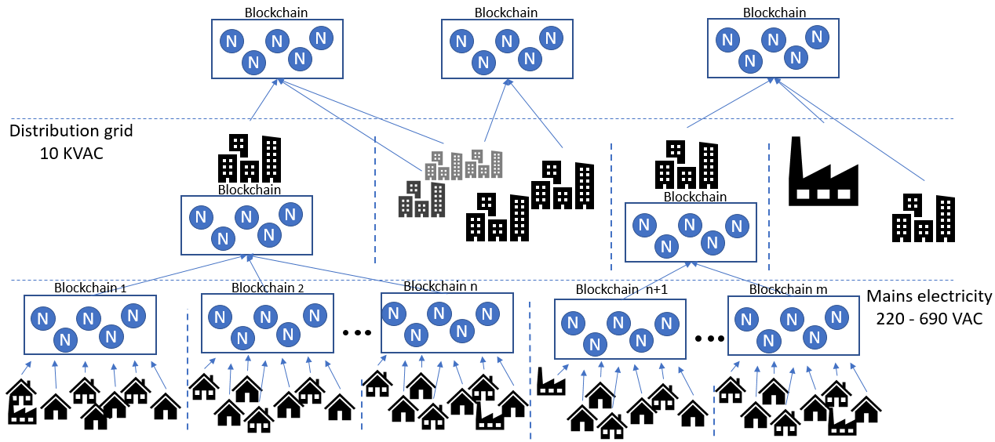
Solution:
Notes:
Clustered blockchain, each cluster own blockchain which propagates up.
Each cluster balances and the remaining imbalance is send up.

Slide 5
How to balance dynamically:
backup supplier
baseline consumption and flexibility
balance at the cluster level
cluster imbalance and flexibility send up
Repeat until at top
Notes:
have a backup supplier at all time
collect clients baseline consumption and their flexibility
balance at the cluster level
send aggregated cluster imbalance and flexibility up to intra-cluster level
repeat through cluster levels until no imbalance or the root is reached

Slide 6
Why blockchain & tendermint:
multiple parties on a single market
no trust between parties
permissioned blockchain
proof of stake
tendermint
Notes:
multiple parties collaborate in a single market
lack of trust between the parties
permissioned blockchain mirrors highly regulated environment
proof of stake is more energy efficient and suitable for permissioned blockchain
tendermint is agnostic of application logic but has BFT consensus across validators and messaging implemented out of box

Slide 7
Implementation overview:
Toolkit: Tendermint, Protobuf, Python, Docker, Node.js, Github
Clients:
Simulated data
Tendermint ABCI:
Transactions
Signatures
Tagging
Balancing algorithm (every 15 mins, configurable)
Thin Visualisation Client:
Subscribed to messaging using tags
Visualises state and transaction flow
Number of nodes:
Number of clients:

Slide 8
Results:
X amount more balanced
Can handle X transactions/second
Ect…

Slide 9
Demo

Slide 10
Questions

