Slide 1
VideoGameSales_Tableau_Workbook1
File created on: 12/2/2023 12:30:22 PM

Slide 2
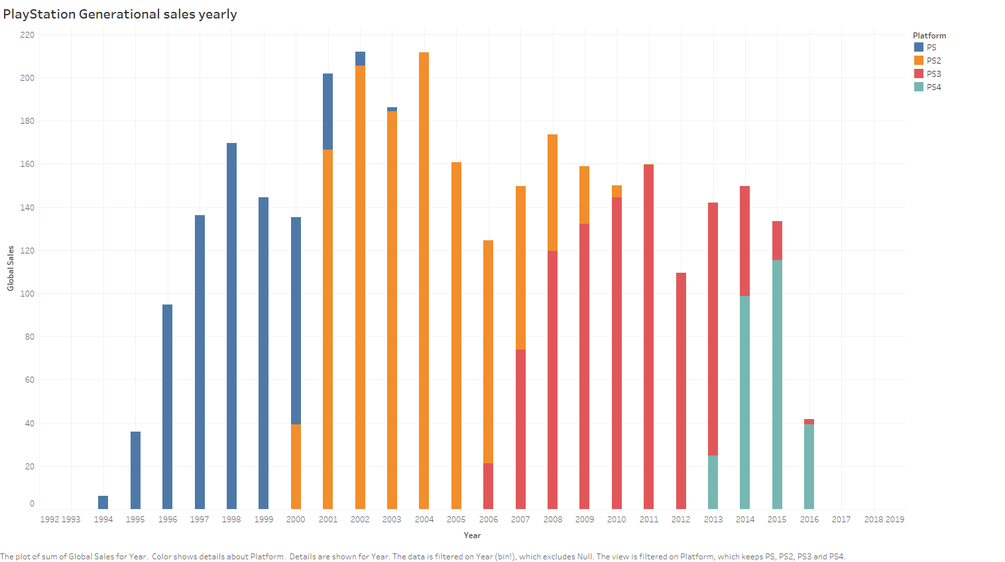

Slide 3
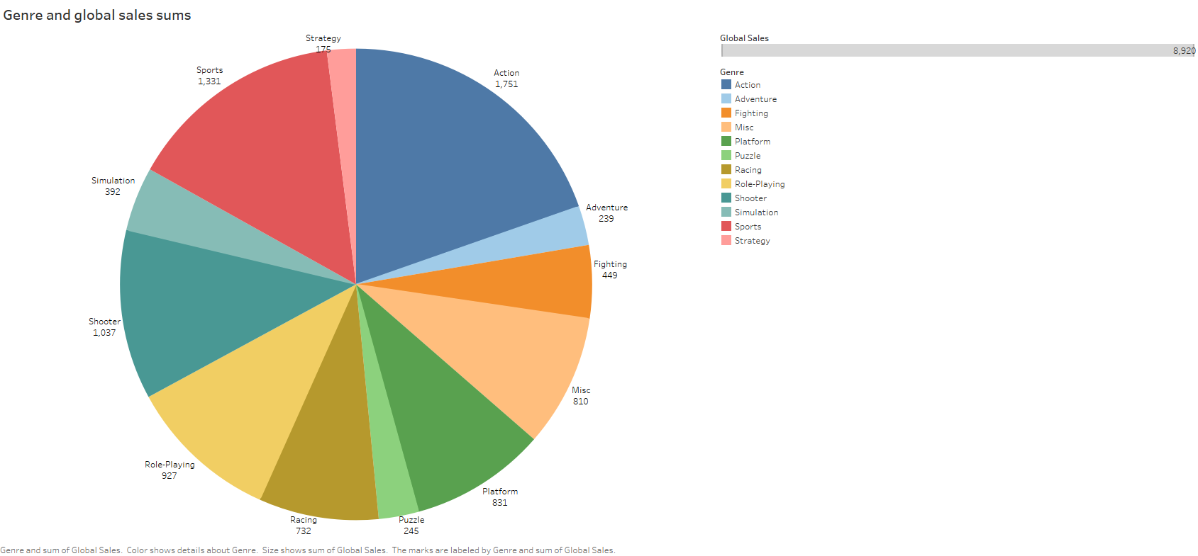

Slide 4
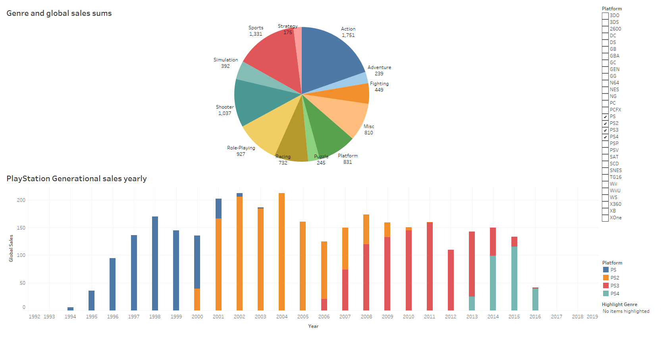

Slide 5
