Slide 1
AirBnBInvestmentGuide_Seattle
File created on: 12/2/2023 12:40:29 PM

Slide 2
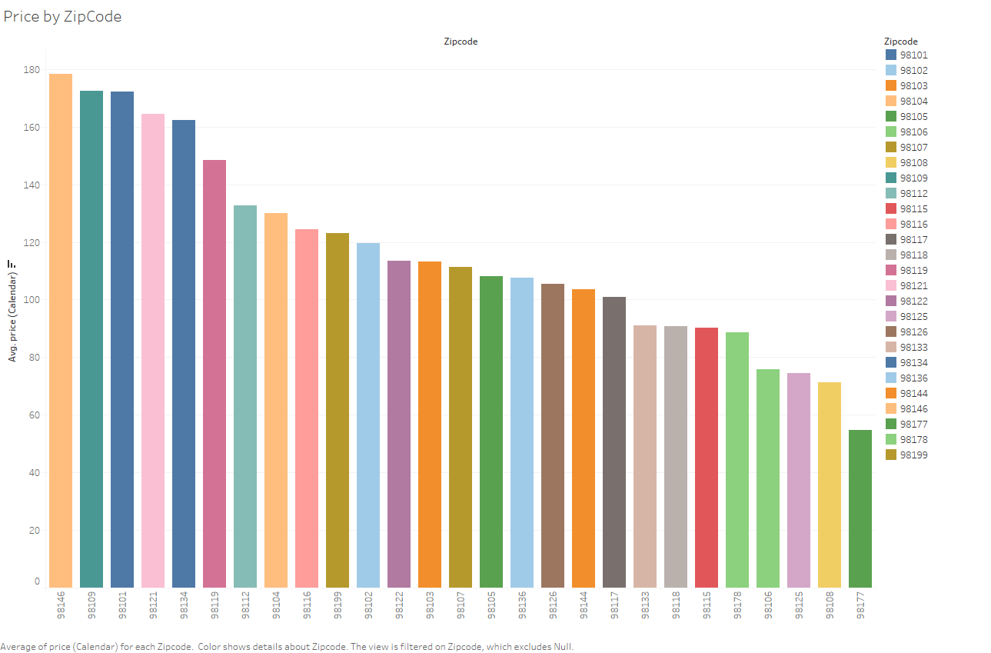

Slide 3
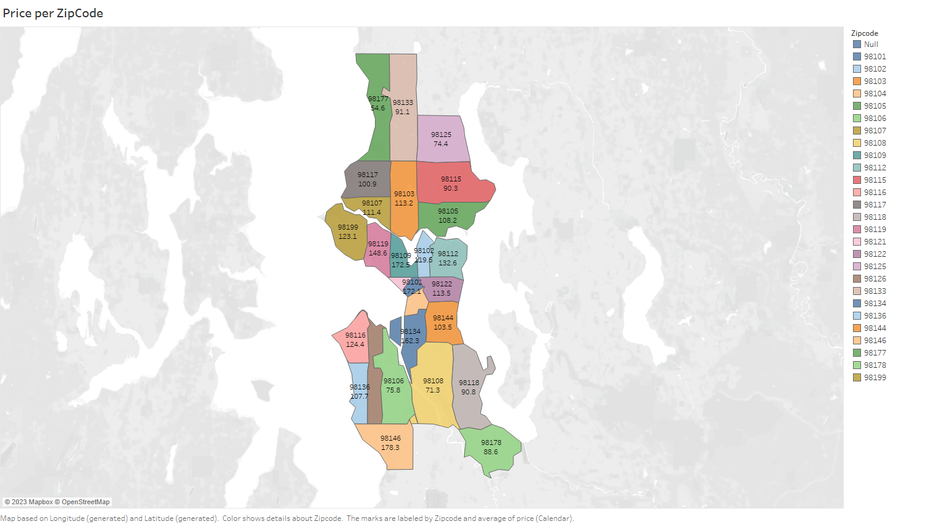

Slide 4
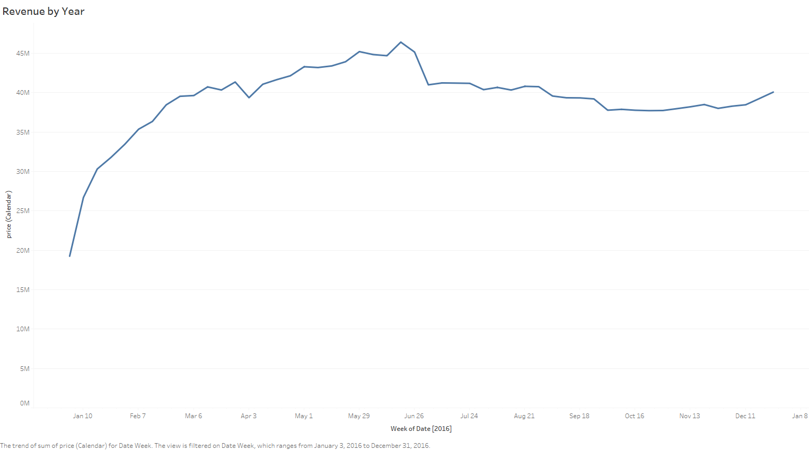

Slide 5
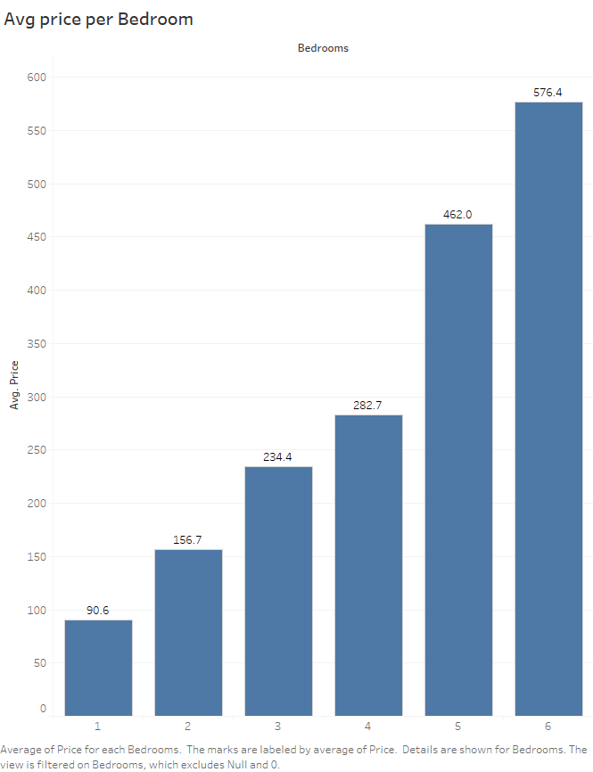

Slide 6
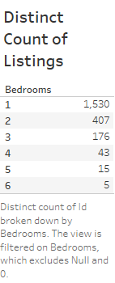

Slide 7
