Slide 1

Netflix Viewership Analysis
Brian Reppeto
Bellevue University
DSC 640
Prof. Williams
December 8, 2024

Slide 2
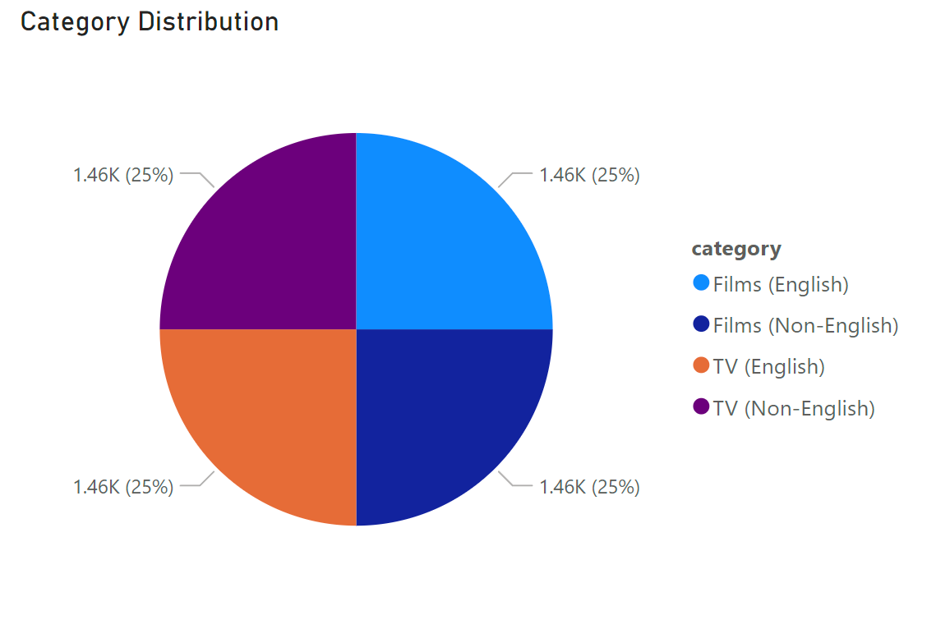
Category Distribution (Pie Chart)
Shows the breakdown of Netflix content globally by category (Films/TV, English/Non-English).
This clarifies the diversity of content offerings.

Slide 3
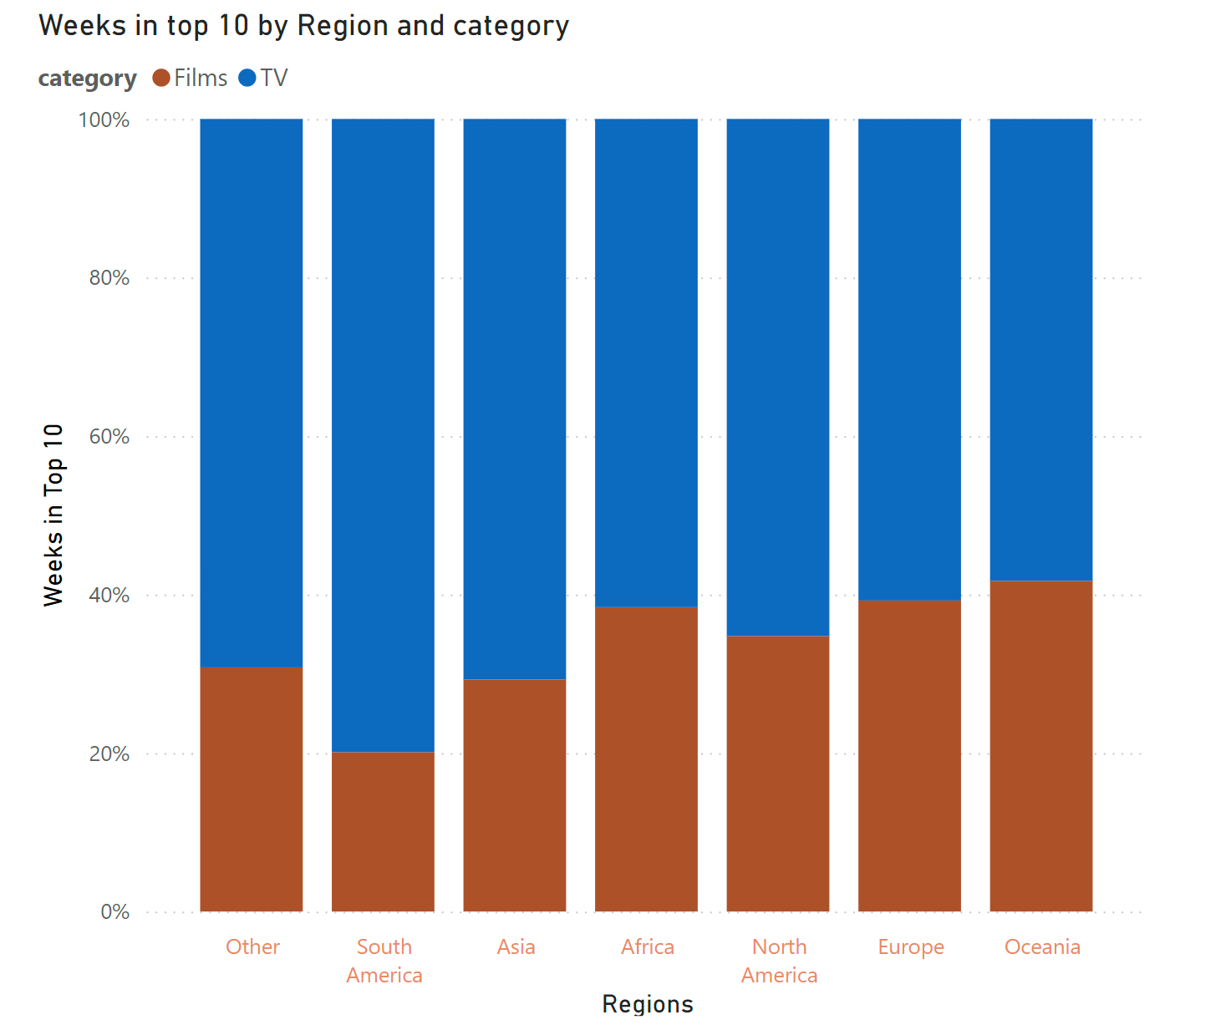
Cumulative Weeks in Top 10 (Stacked Bar Chart)
Displays regional engagement by category, highlighting content preferences across different regions.

Slide 4
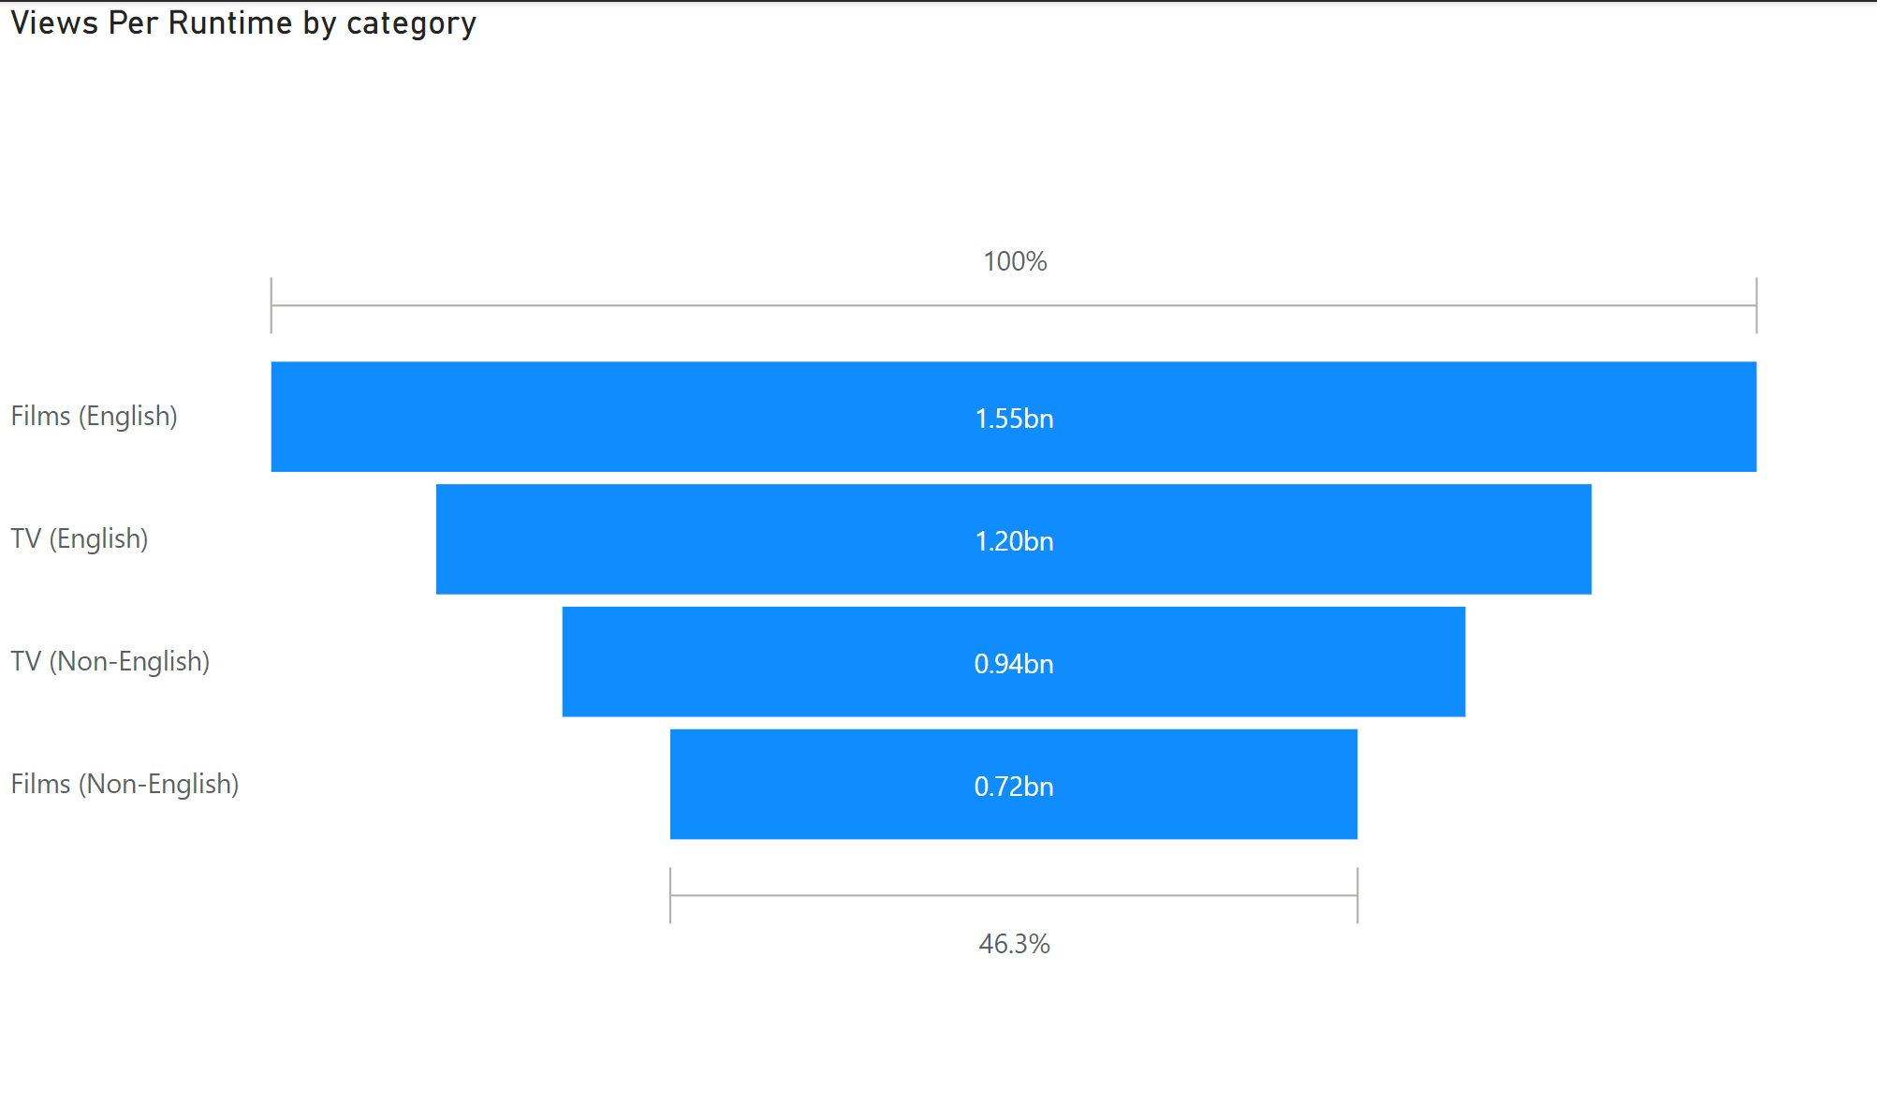
Views per Runtime (Funnel Chart)
Compares viewing efficiency across categories, providing insight into user engagement relative to content duration.

Slide 5
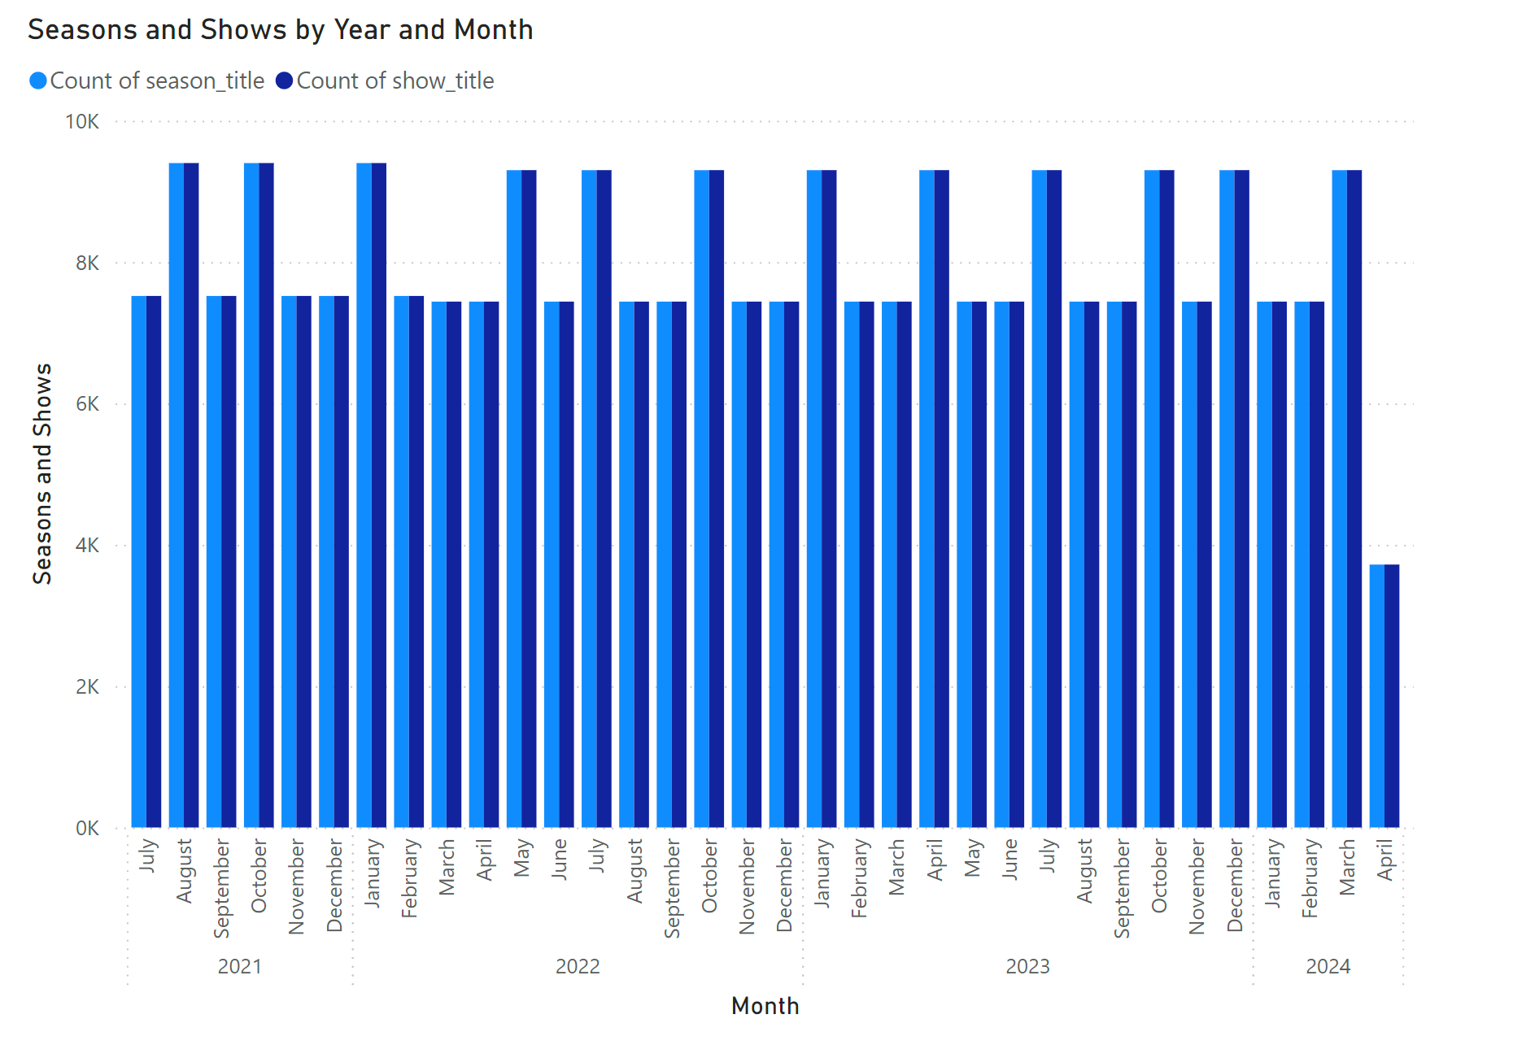
Content Volume by Year/Month (Line Chart)
Tracks content releases over time, illustrating seasonal trends in new releases.

Slide 6
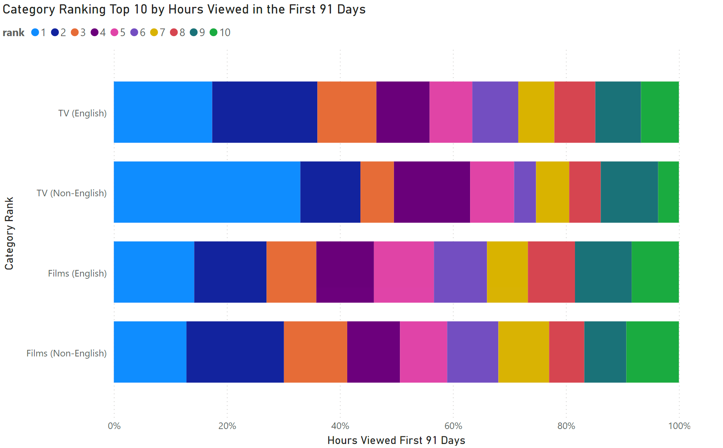
Top 10 Shows by Category (Stacked Bar)
Highlights the most engaging categories in the critical early viewing period.

Slide 7
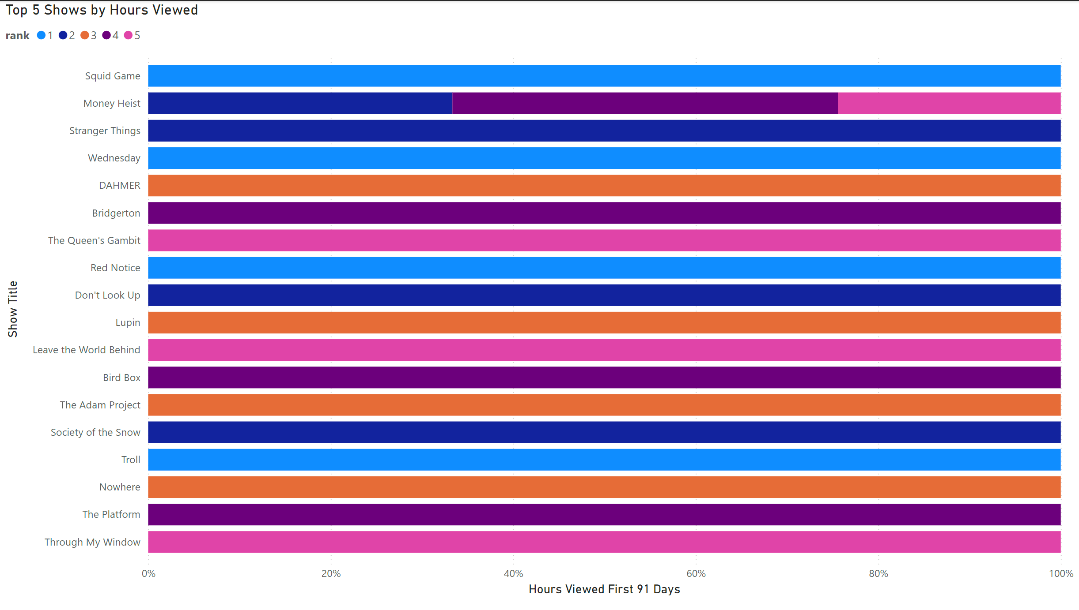
Top 5 Shows by Hours Viewed (Stacked Bar)
Identifies Netflix’s most successful shows, offering benchmarks for future content.

Slide 8

Data analysis
All Analysis was done using Power BI and Excel

Slide 9
Conclusion
All though English Films had more views, English TV Shows accounted for 47% of the total hours view the first 91 days of the 4 total categories.
English TV shows have spent more time in the top 10.
Creating an English TV Series will add the most value.

