Slide 1


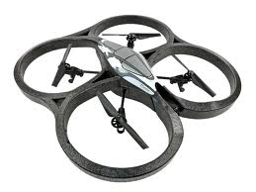
Autonomous People Tracking using AR-Drone
Academic Supervisor:
Prof. Jean-Luc Dugelay EURECOM
Prof. Ludovic Apvrille
Telecom Paristech
By :
Praveer Singh
Aakanksha Rana

Slide 2
INDEX
A Brief Introduction :
Methodology Adopted
Detection – Adaptive HOG
Tracking – Rao- Blackwellised Particle Filter
Averaging for smooth controls
Drone Control Commands
Test
Indoor - Angular Motion
Outdoor – Straight Line , Sharp Turns and Occlusions
Conclusion
References

Slide 3
Introduction
AR.Drone is a controlled flying quadcopter helicopter which can be controlled by many electronic devices.
In this project , we focussed on AR. Drone 2 controlled and communicated with the help of ROS(Robot operating System)Autonomy.
“Ardrone_Autonomy" is a ROS driver for Parrot AR-Drone quadrocopter. This driver is based on official AR-Drone SDK version 2.0 and supports both AR-Drone 1.0 and 2.0.
Work Done So far:
Line Following , Tag Following , Sparse3d , Dense3D

Slide 4
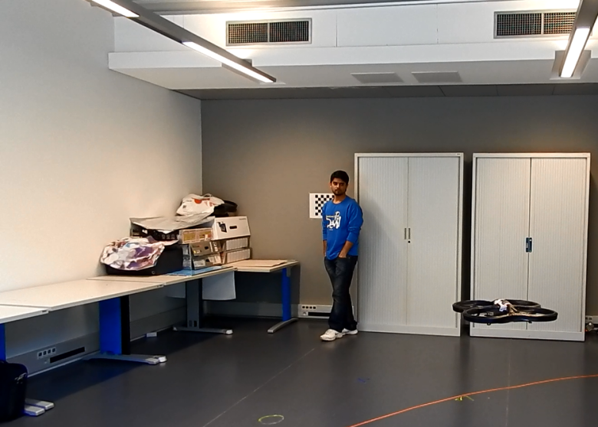
Our Goal
Main Goal :
People Detection and Tracking
In simply means follow the person and maintaining an adequate distance.
The drone has to autonomously fly and understands the presence of specific a person in front and starts following it .
As per the norms , although its autonomous , drone can be stopped manually at any time.

Slide 5
Understanding the Task… People Detection and Tracking
What We Have
What we need to do
Two Camera’s (Front and bottom)
ARdrone autonomy which enables to interact with the AR. Drone
Drone navigation data
(details about up-down , left-right and sideways movements).
Already implemented applications of Line following , Tag following etc.
To detect a person moving in front
So we used a HOG detection using front camera
To track a person
We used particle filter for tracking and complete follow-up
To maintain the adequate distance with person
We estimated the distance by making the use of size of detection box.

Slide 6
People Tracking Code Structure
Image captured by Front Camera is resized (real time computation analysis)
If Tracking circle is found in centre , we check the size of averaged HOG detected rectangle and if size is small , Drone commanded to move forward
If Tracking circle is found in left or right more then the set threshold , projection of the estimated centre is utilised to compute yaw, same forward motion strategy
People Detection and Tracking algorithm runs and find the ROI , Detected Window , Tracking circle.
If person is very near with large detection window, the drone stops to take adequate size of the human.

Slide 7
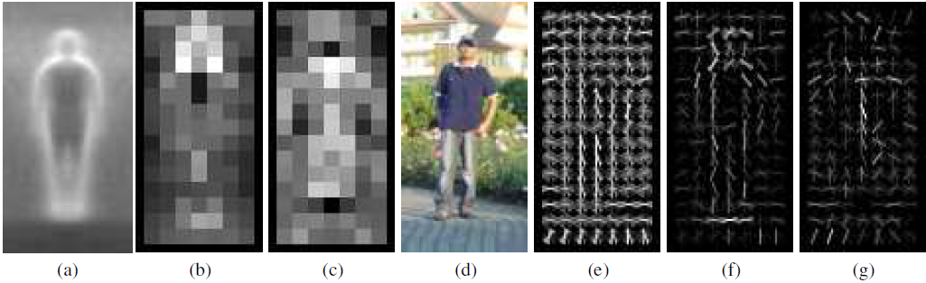
Methodologies : HOG
HOG : Histogram of Oriented Gradients (generally used for object detection) based on counting occurrences of gradient orientation.
HOG is computed by dividing the Image into blocks and then small cells.
Concatenation forms a complete descriptor.
by Dalal and Triggs, 2005
Average gradient image ,Each pixel shows the maximum positive SVM weight in the block, For the negative SVM weights, A test image. It's computed R-HOG descriptor.The R-HOG descriptor weighted by respectively the positive and the negative SVM weights

Slide 8
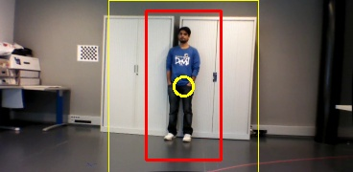
Methodologies : HOG
HOG Goal :
To detect a person in the specified ROI (region of interest).
Represented by Red Box in the above Image.

Slide 9
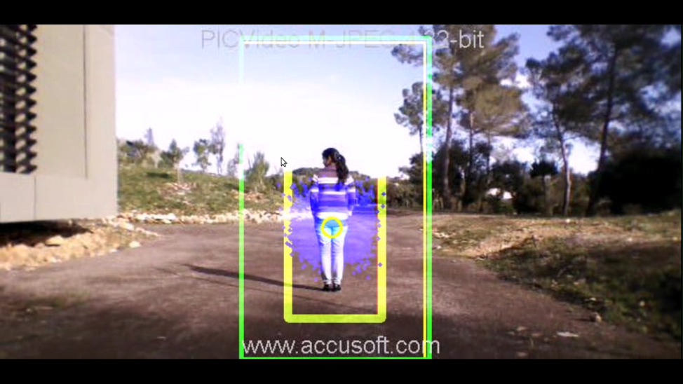
Methodologies :: RBPF
What are Particle filter ?
Sequential Monte Carlo methods based on point mass representations of probability densities.
Advantage over Kalman Filter ?
Copes with non linearity, non gaussianity with possibility to model multi-modal distribution.
HOG detector coupled with a Rao - Blackwellised particle filter.

Slide 10
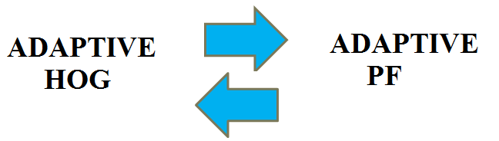
HOG–PF Couple (Adaptation)
Detection used for update of particle filters.
Poses predicted by PF used to acquire new samples for training of classifier.
State of the particle filter used to decide when a new training of the classifier is needed.
ROI updated every time step based on previous detection.

Slide 11
Adaptive Particle Filter
Goal of a Particle filter:
Estimate a posterior probability density over the state space conditioned on the data collected so far.
Prediction Phase:-> Based on simple linear motion model. Estimate of the new state of each particle is a linear extrapolation of the previous state plus a Gaussian Noise.

Slide 12
Adaptive Particle Filter
Update Phase:-> Based on object detection. Particles weighted based on distance from detection hypothesis provided by adaptive HOG detector.
Resampling Phase:-> Based on KLD. No. Of particles representing belief of the object pose at step is adaptive, only those sufficient to represent belief used.

Slide 13
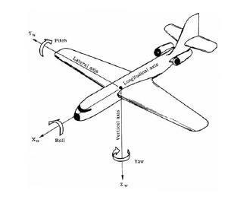
Drone Control Commands
6 Degree of Freedom

Slide 14
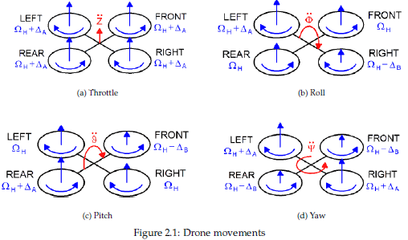
Drone Control Commands

Slide 15
Drone Control Commands
People Tracking Problem :
Mainly used control Commands are :
Yaw Motion (Angular Motion + and -) : To move left or right in accordance with person.
Forward Motion (+ x axis (Pitch)) : To move forward if the person moves forward.
Altitude Motion (+z axis (Throttle)) : To make drone move at certain height (To capture complete person.)

Slide 16

TEST: Trade Off
With the original drone video frames, the algorithm implementation is quite slow as the HOG detection dependent on the image size.
Trade off b/w computational complexity and detection accuracy.
Improved the performance by resizing the images, with reduced accuracy compared with the original sizes.

Slide 17
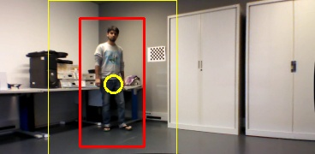
TEST: INDOOR & OUTDOOR
Indoor Testing
Angular motion of the drone based upon the difference between the position of the tracking circle (its x coordinates) with the centre of the image (called the offsetpixels). If difference is greater than a certain threshold, the drone set an angular motion with regards to :->
the angle delta which is the arc tangent of the offset pixel and the distance (focal length) of the image screen from the camera's centre of focus.

Slide 18
TEST: INDOOR & OUTDOOR
Indoor Testing
Limitation due to small room size.
Yaw motion of the drone focussed upon (Pitch set to low - 0.05 or 0).
Able to track the person most of the times.
Issues: ->
problem of horizontal drift during the yaw motion of the drone.
Bad Illuminations seldom causes false tracking of pillars or black CPU's.

Slide 19
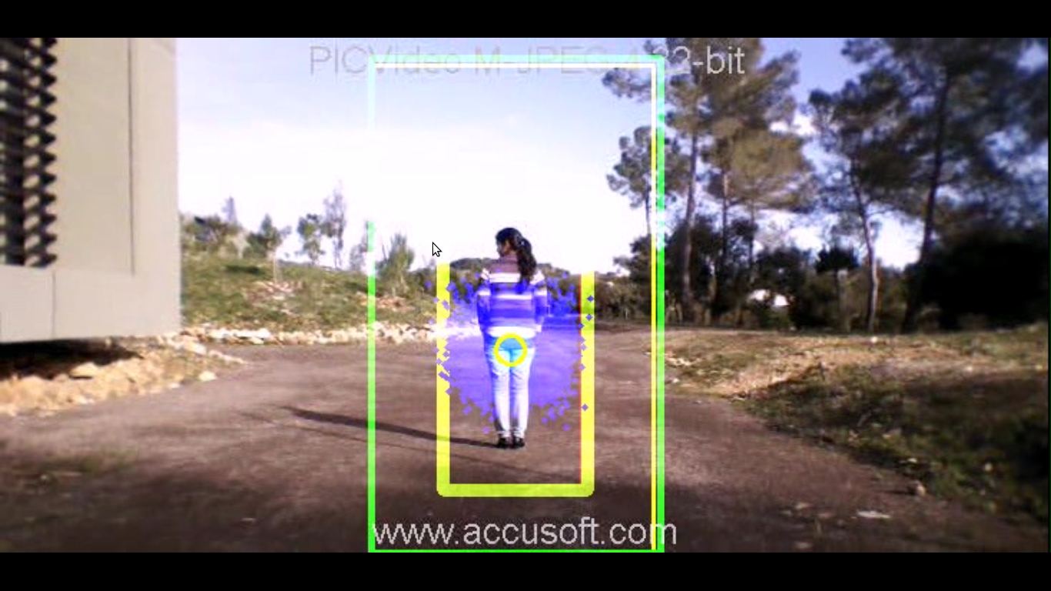
TEST: INDOOR & OUTDOOR
Outdoor Testing (3 specific tasks)
How the drone tracks a person moving straight without any deviation.
How the drone reacts to 90 degree sharp turns on corners.
Effect of occlusion on the tracking of the drone.
Issues: ->
drone is prone to drastic climatic conditions like winds, rains, shadow effect, etc.

Slide 20
TEST: INDOOR & OUTDOOR
Tracking a person moving straight without deviation:
Forward speed of the drone set in accordance with ratio of the height of the detection window to the height of the image. As the distance between the person and the drone increases, this ratio decreases.
Beyond a certain threshold the drone is ordered to move forward with a constant speed (0.1). It is asked to stop (forward speed = 0) in case it finds no detection window or it gets too close to the person.
Issues: ->
Drone loses track of the person, in case the person is moving too fast and moves much faster relative to the drone.
Limitation mainly due to the resizing of the window size and inherent algorithm of particle filter which assumes small displacement of object b/w two consecutive frames.

Slide 21
TEST: INDOOR & OUTDOOR
90 degree sharp turns over the corners:
Tracks and follows the person quite well around the corners
Issues: ->
Drift while it is making a turn.
There is also some effect of the wind outside during the turn.
Occlusion effect:
In times of occlusion, doesn’t looses the track of the person it had been following, and once the occlusion is gone out of the scene, it tracks back the person and keeps following it.
Issues: ->
Sometimes, if the occlusion by a person is for quite longer time, it starts to follow the person (the one who is occluding) and loses track of the original person.

Slide 22
References
Parrot AR Drone2.0.
Stefano Rosa ; Marco Paleari ; Paolo Ariano ; Basilio Bona; Object tracking with adaptive HOG detector and adaptive Rao-Blackwellised particle filter. Proc. SPIE 8301, Intelligent Robots and Computer Vision XXIX: Algorithms and Techniques, 83010W (January 23, 2012); doi:10.1117/12.911991.
http://wiki.ros.org/ardrone_autonomy
Benjamin Ranft;Jean-Luc Dugelay ; Ludovic Apvrille; 3D Perception for Autonomous Navigation of a Low-Cost MAV using Minimal Landmarks
Dalal, N.; Triggs, B., "Histograms of oriented gradients for human detection," Computer Vision and Pattern Recognition, 2005. CVPR 2005. IEEE Computer Society Conference on , vol.1, no., pp.886,893 vol. 1, 25-25 June 2005

Slide 23


