Slide 1
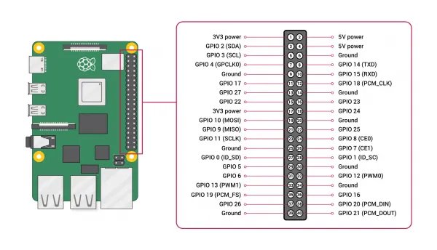
Raspberry Pi GPIO pins for Servo Control

Slide 2

What skills are we using today?
1. GPIO: General Purpose Input/Output.
2. PWM: Pulse Width Modulation.
3. Rpi.GPIO: Is a module on Python to control the GPIO pins on the Raspberry Pi.
4. time: is a module that provides various time-related funtions.
5. numpy: Is a module that performs task related to arrays and mathematical operations.

Slide 3
GPIO Commands
1. GPIO.setmode(GPIO.BOARD) # Sets the pin numbering mode to GPIO.BOARD, referring to the physical pin numbers on the Raspberry Pi board. For example, pin 11 on the board corresponds to GPIO pin 17 in this mode.
2. GPIO.setup(pin_number, GPIO.OUT) # Used to set a pin as an output.
3. GPIO.PWM(pin_number, frequency) # Creates a PWM object for a specific pin with a given frequency.
GPIO.PWM returns a PWM object, and you can use start(duty_cycle) to initialize the PWM with a specific duty cycle.
For example:
servo = GPIO.PWM(pin_number, frequency)
servo.start(duty_cycle)
4. GPIO.cleanup() # Resets all GPIO channels that have been set up by this program.

