Slide 1
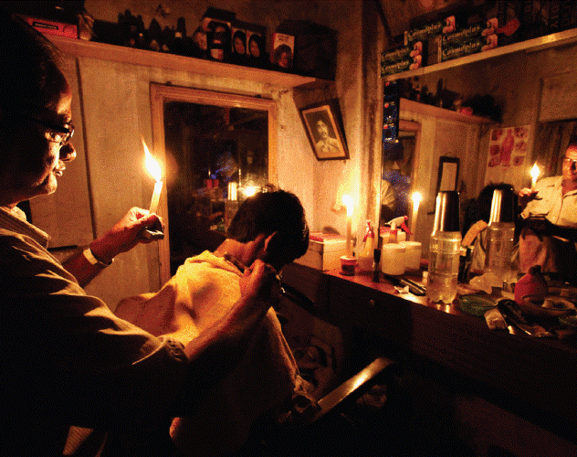
Darkness All Around India
India Major Blackout 2012

Slide 2
Scale of Outages
July of 2012 was tough interval in case of electricity accessibility in India.
Blackouts lasted around 2 days: 30 and 31 July 2012.
350 million people are affected on first day, and 670 million are affected on second day.
Briefly 21 out of 28 Indian states faced problems.

Slide 3
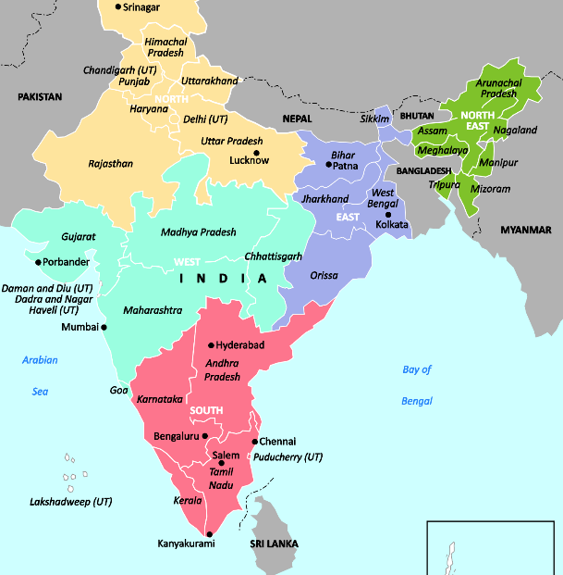
Indian Electricity Grids
Indian electricity are based on 5 different grids:
Northern Grid
North-Eastern Grid
Eastern Grid
Western Grid
Southern Grid
North-East-West (NEW) Grid
Except Southern Grid all other grids are interconnected.
Aimed to ease power distribution, and de-stress transmission lines.

Slide 4
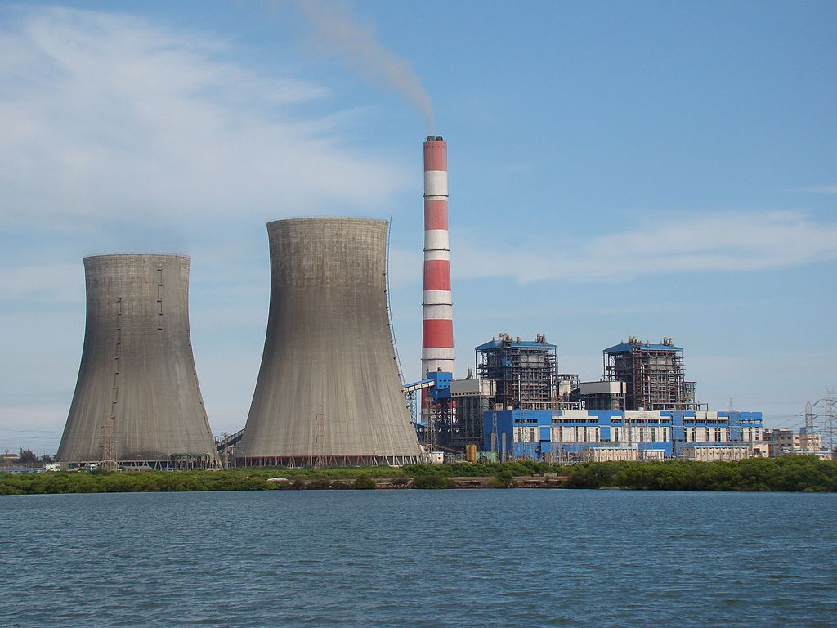
Generation of Electricity in India
Indian electricity are based on two types of generators.
Coal-Fired Thermal Power Plants (Mostly Located in Eastern Grid)
Hydroelectricity (Mostly Located in Northern and North-Eastern Grids)
Heaviest loads are on the following grids:
North
West
South

Slide 5
Origin of Event
July 2012: NEW grid was operating in a stressed and unsafe situation.
Huge increase of agricultural demand in Northern grid.
Excess power in Western grid resulted in very high outflows of power to Northern region.
Same time only 2 of 4 West-North interconnections were available.
One of the lines was being upgraded since 28 July.
Other line went out of service because of equipment failure.
So that, other 2 lines are forced to work on their limits.

Slide 6
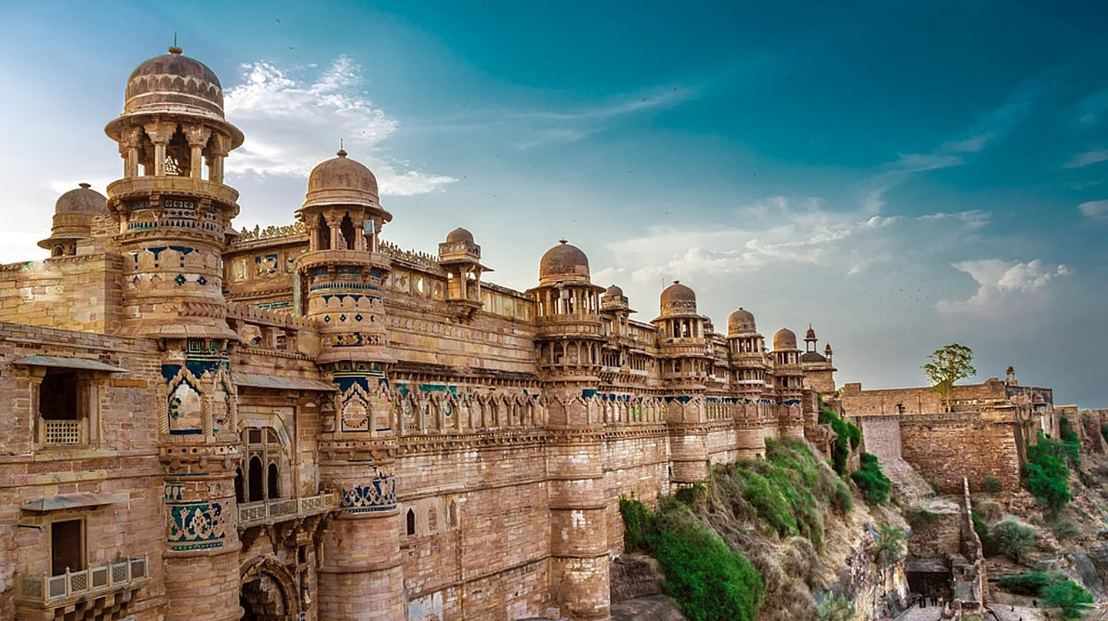
Prior System Conditions: Blackout 1
The networks were unreliable as many transmission lines were shut down for maintenance.

Slide 7
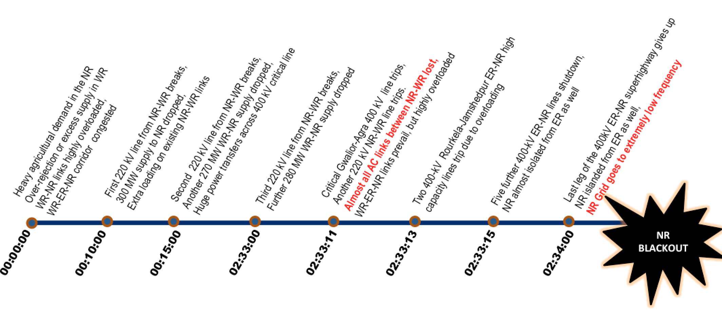
Blackout 1 Sequence
One of the Bina-Gwalior 400 kV lines was overloaded, the line was protected.
Later, 220 kV and 132 kV lines were triggered by a power surge and many connected lines were disabled.
It took 16 hours for the system to restart.

Slide 8
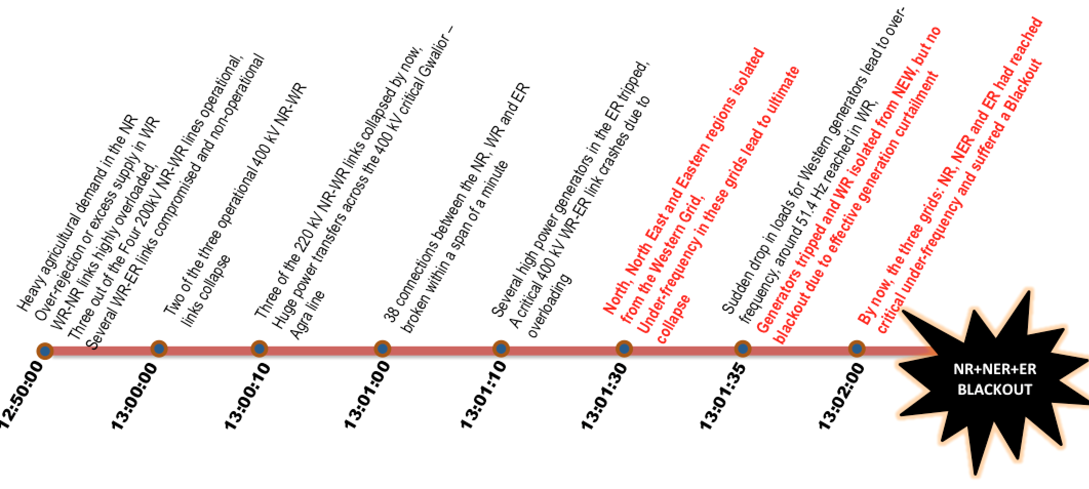
Prior System Conditions: Blackout 2
Exactly 1 day later, there was a second major outage. Many lines were already out of service.
Due to overload, the voltage level starting from 400kV decreased to 362 kV.

Slide 9
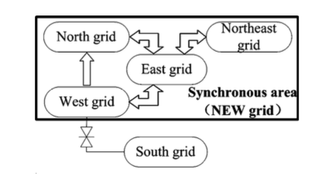
Blackout 2 Sequence
North and west zones with distance relay due to overload separated from each other.
Then, with the separation of the load, there was a power surge and a voltage spike occurred in the energized region.

Slide 10
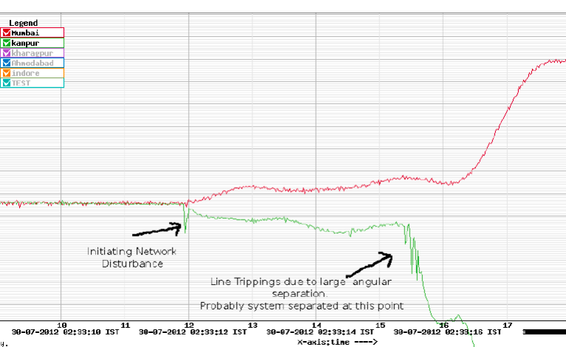
Frequency Separation
The high frequencies formed as a result of the high voltage generated also caused collapses in the region.

Slide 11
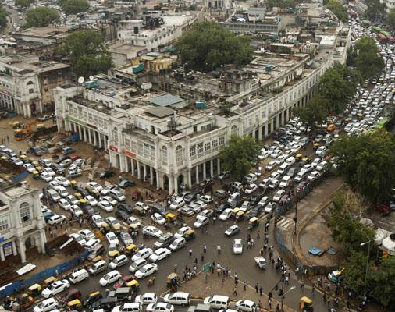
Impacts
Millions of people affected during power outages.
During 30-31 July, transportation and healthcare systems, industry, social life were affected in a bad way.

Slide 12
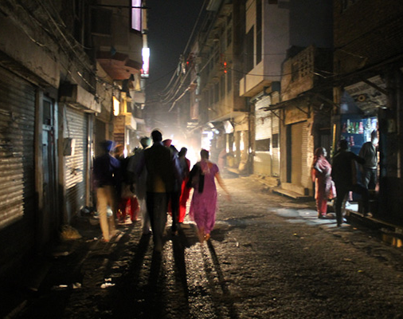
Who were the responsible parties?
After the events, the vast majority of the Indian people held the government as responsible. According to DW's report, “The dominant opinion is that this government is not capable of managing crises. At the same time, it is trying to whitewash the disaster and is busy defending itself instead of taking responsibility for the incident.”

Slide 13

Investigation
The three-member investigation committee consisted of S. C. Shrivastava, A. Velayutham and A. S. Bakshi, and issued its report on 16 August 2012. It concluded that four factors were responsible for the two days of blackout:
Weak inter-regional power transmission corridors due to multiple existing outages (both scheduled and forced);
High loading on 400 kV Bina–Gwalior–Agra link;
Inadequate response by State Load Dispatch Centers (SLDCs) to the instructions of Regional Load Dispatch Centres (RLDCs) to reduce over-drawal by the Northern Region utilities and under-drawal/excess generation by the Western Region utilities;
Loss of 400 kV Bina–Gwalior link due to mis-operation of its protection system.
The committee also offered a number of recommendations to prevent further failures, including an audit of the protection systems.

Slide 14
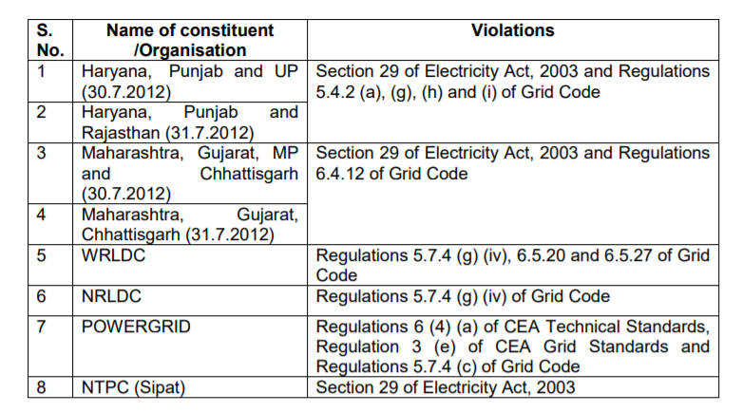
Penalties

Slide 15
Main Preventive Measures to Overcome Power Outages
Implementing and integrating smarter and newer forms of supply
Developing and exploiting Renewable energy sources and low carbon baseload technologies
Energy-efficient buildings
Cost-effective energy savings
Properly educating and giving technically sound training to operators in power plants

Slide 16
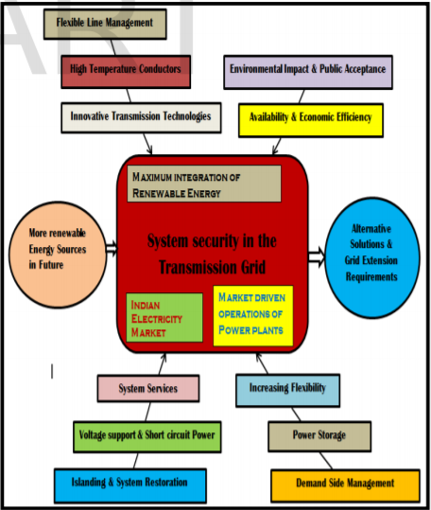
Depicting Preventive Measures against Power Fails

Slide 17
What can India Do to Help Eliminate such Wide-ranging Outages?
Renewable Energy
Solar Energy
Power grid must be made smarter
Reducing the need for installing additional transmission and distribution systems
All, provide long-term environmental and economic growth for India.

Slide 18
Thank You For Listening Us!

