Slide 1
Journey Project
Florin Dascalu
02 May 2019

Slide 2
Content:
Starting page: Login / New User / Recover Pass
User Connected Page (outgoing trips)
New Journey Page (validation fields, geolocation)
Manage Vehicle Page (Create, Update, Delete, Activate, Search, Sort)
Report page
Basic reports: Get All Journeys (Update, Delete, Sort, Search)
Customize reports (Vehicle & Trip Period):
Chart (customize chart using km interval)
Pdf report
Chat page
Built on: .NET Platform (MVC /Web API), Entity Framework for SQL database
Used: Single Page Application, Twitter Bootstrap, Mobile Responsive, ASP.NET Identity, Geolocation, Log4Net, iTextSharp, Browser support: Google Chrome

Slide 3
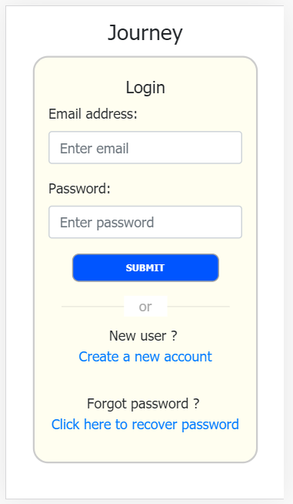
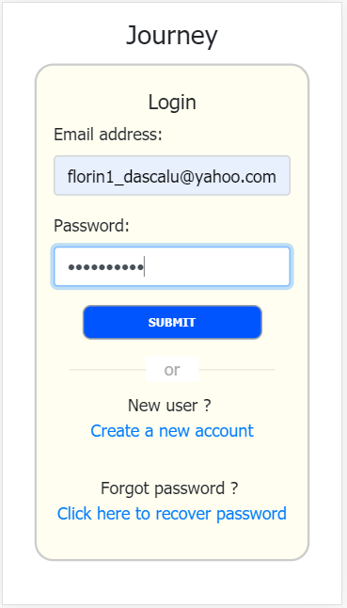
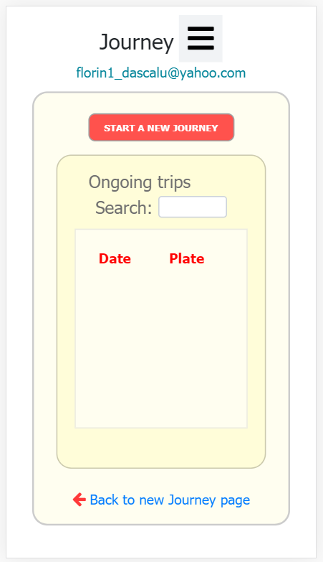
Starting page: Login – connect
Login
New User
Recover Pass
Connected page

Slide 4
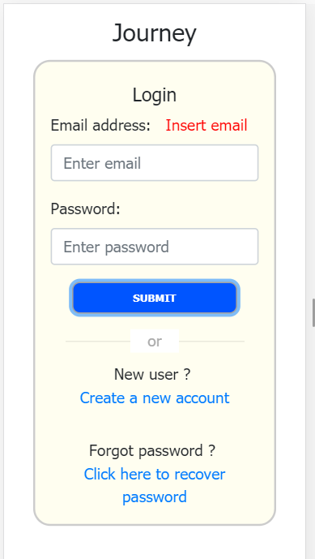
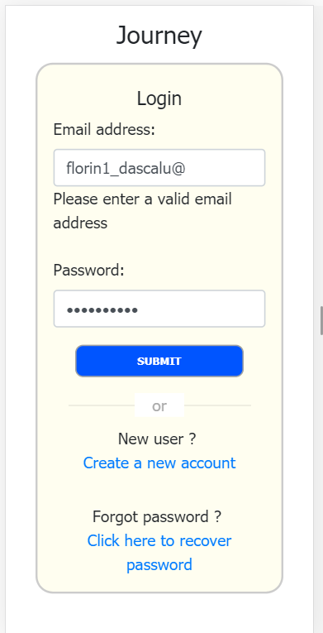
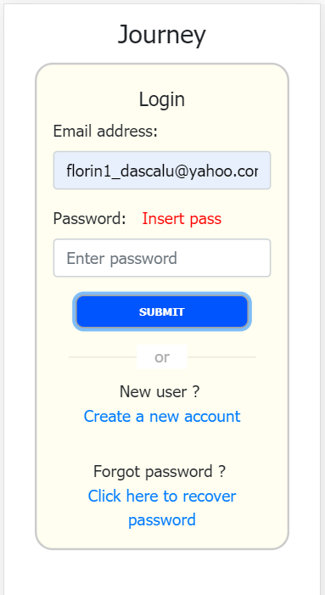
Login page – validation
empty email
invalid email
empty pass
connected

Slide 5
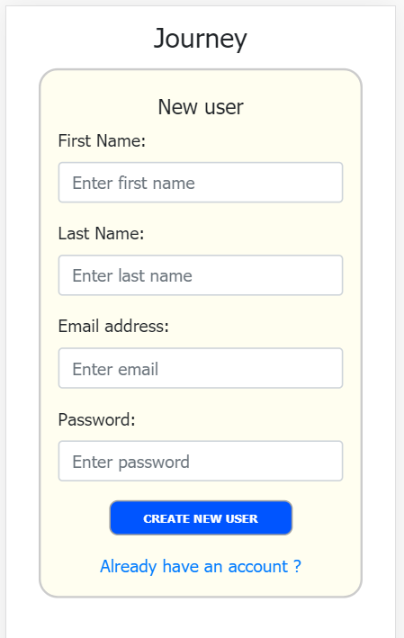
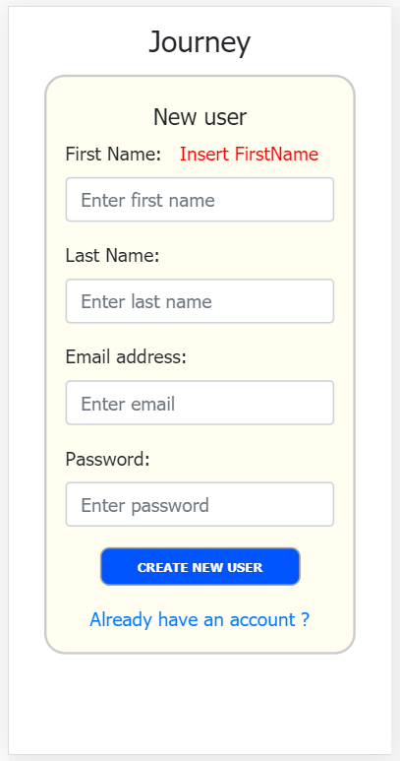
Create a New user / require validation for each fields
login
Create a New user

Slide 6
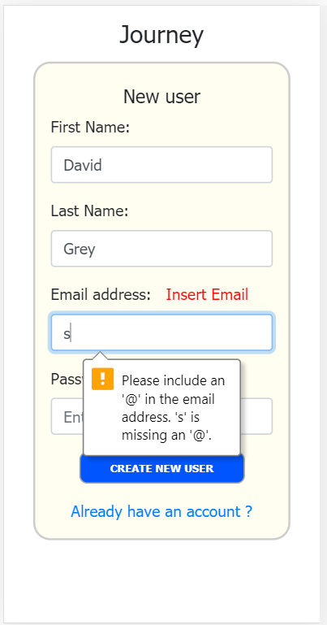
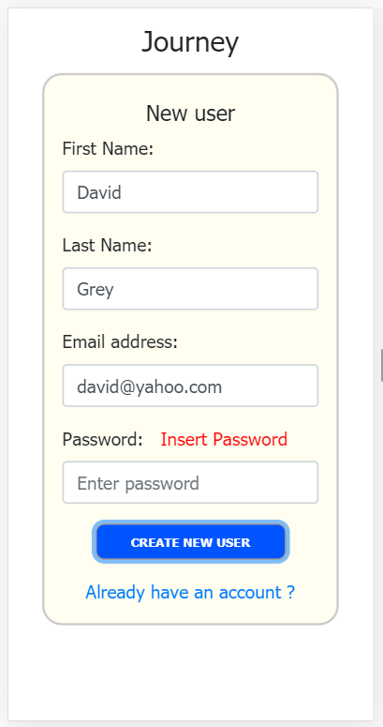
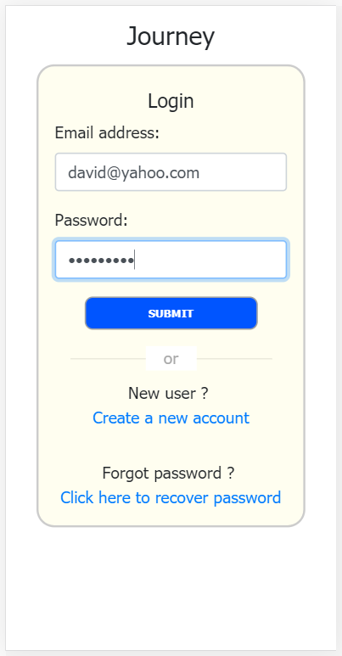
New user – validation fields
empty name
invalid email
empty pass
Redirect to login

Slide 7
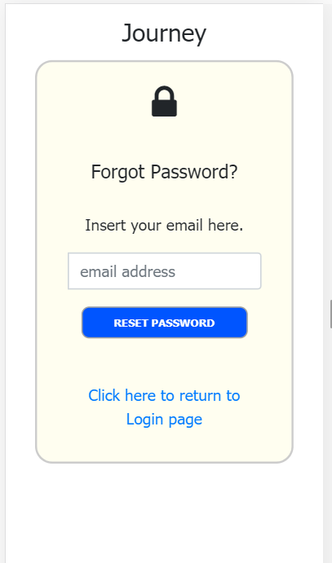
Recover email (only template)
login
recover email

Slide 8
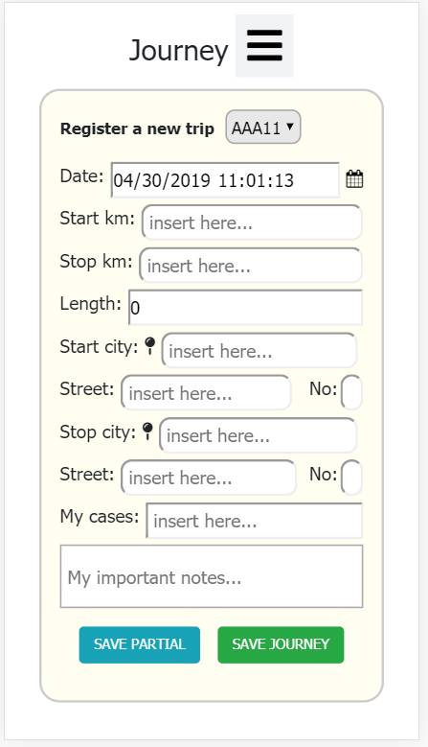
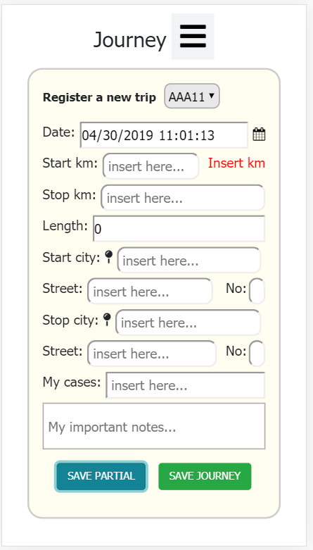
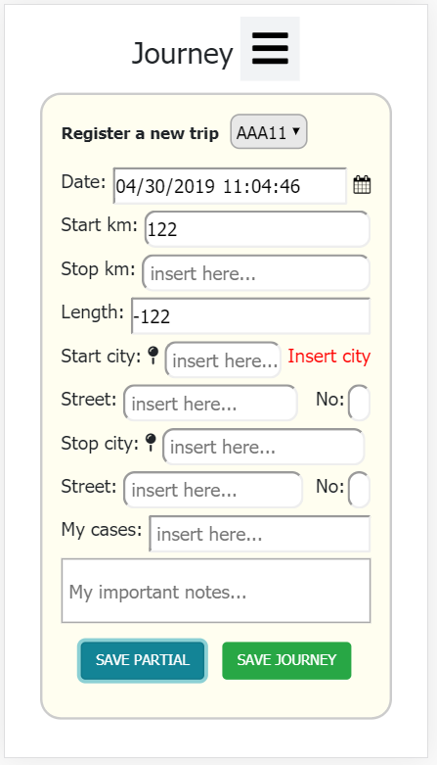
User connected – Start a new trip
connected
New trip
Fields validation

Slide 9
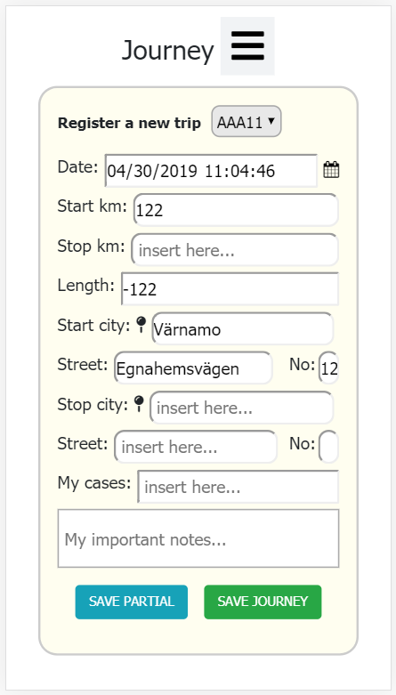
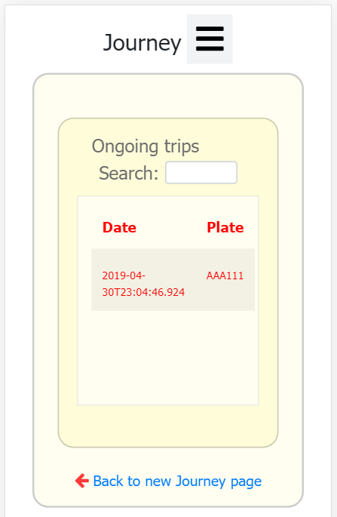
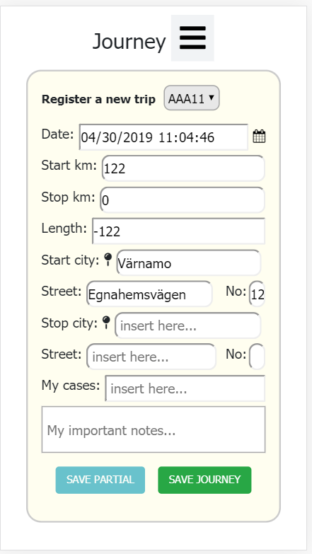
User connected – Start a new trip
Geolocation implemented & restrict new Journey for the same Vehicle
Save partial
Outgoing trip
Outgoing trip reopened
inactive

Slide 10
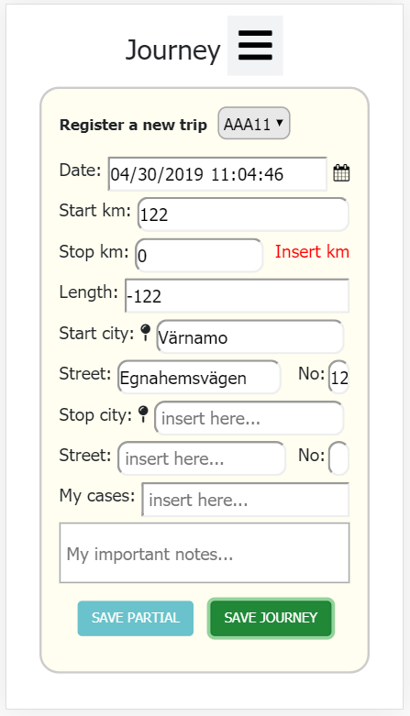

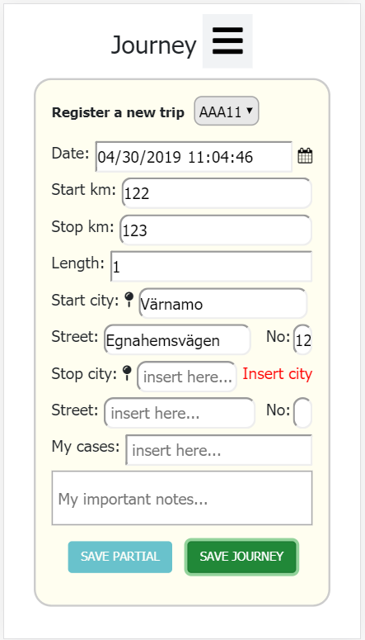
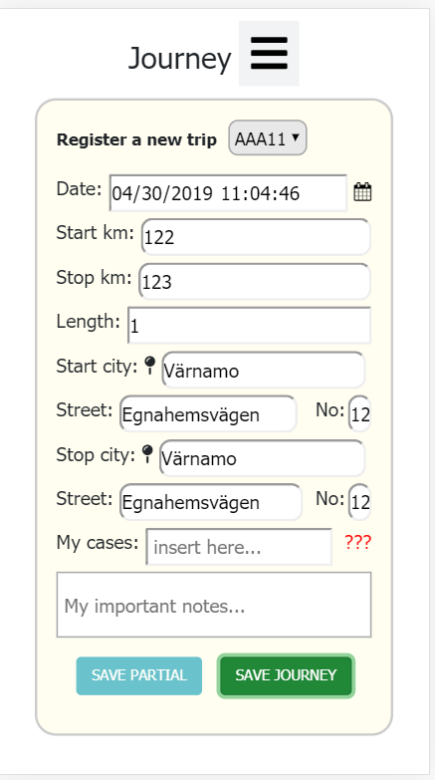
Start a new trip - Validate journey
Empty field
Negative km
Empty fields

Slide 11
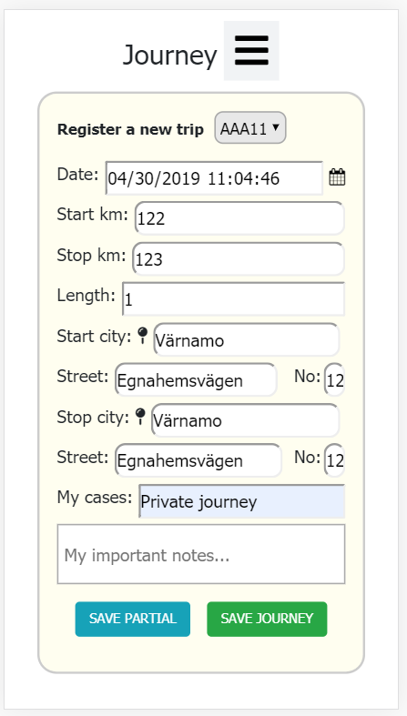
Start a new trip - Validate journey
Journey completed
Redirect to outgoing trip page

Slide 12
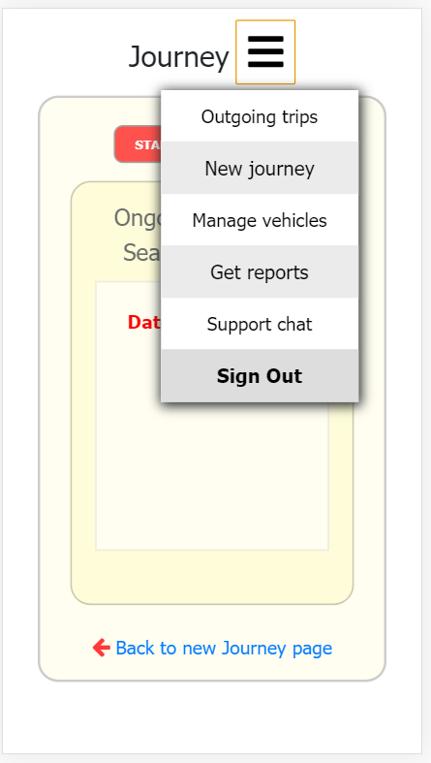
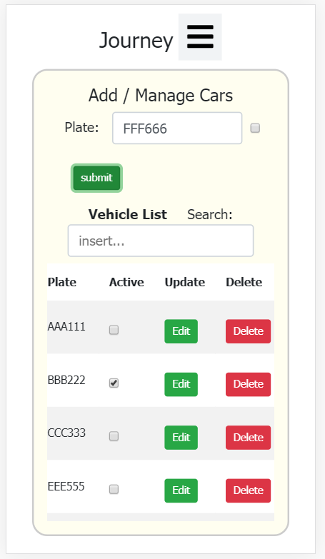
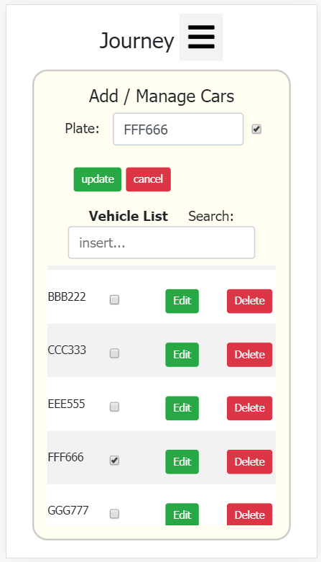
Manage vehicle page
Click Dropdown menu
Create / Update / Activate / Delete - > LicensePlate

Slide 13
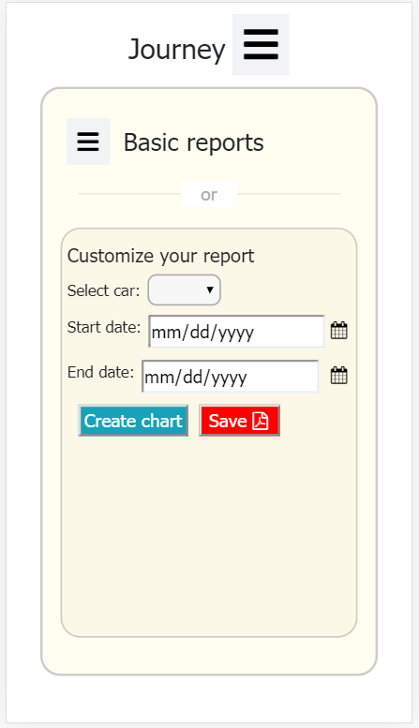
Report page
Click Dropdown menu
Chose between Basic reports or Customize reports

Slide 14
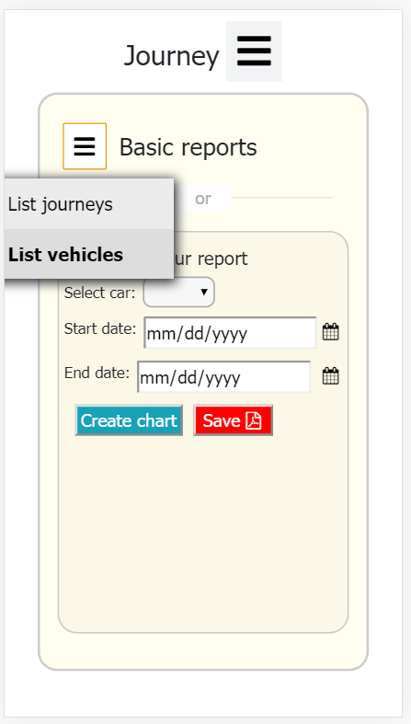
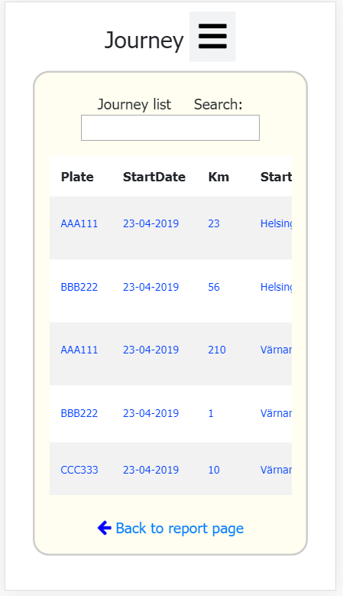
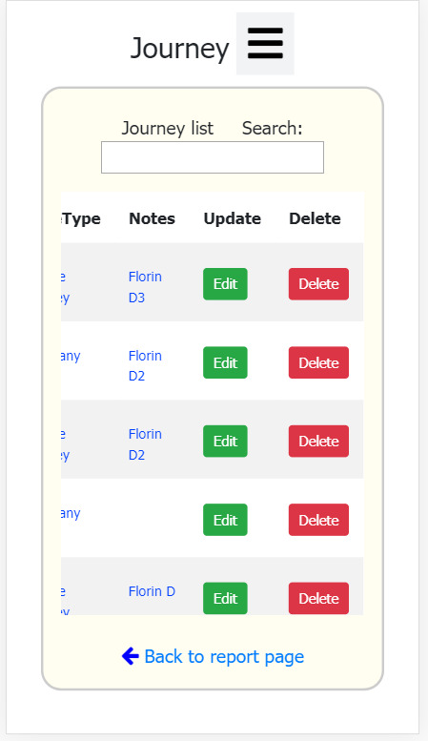
Basic reports – All journeys – Update / Delete / Search / Sort
Dropdown menu
Get All Journeys page - > scroll vertical / horizontal

Slide 15
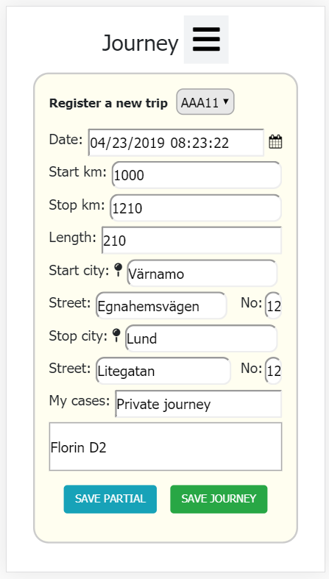
Basic reports – All journeys – Update
Edit journey
Change and Save Journey
Redirect to userConnected

Slide 16
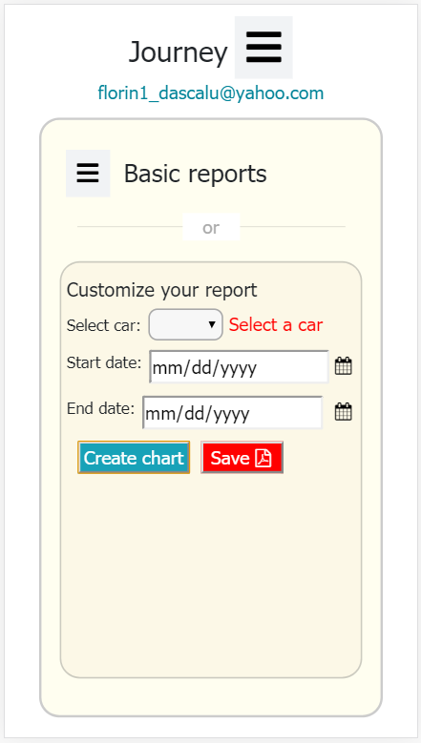
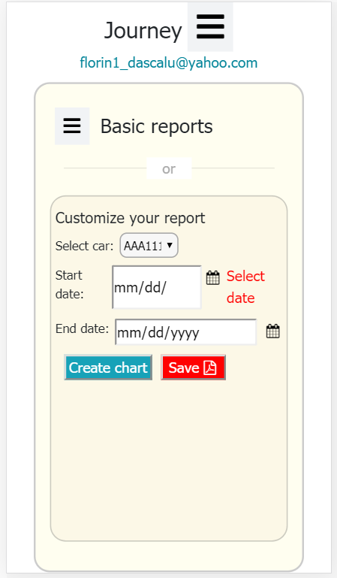
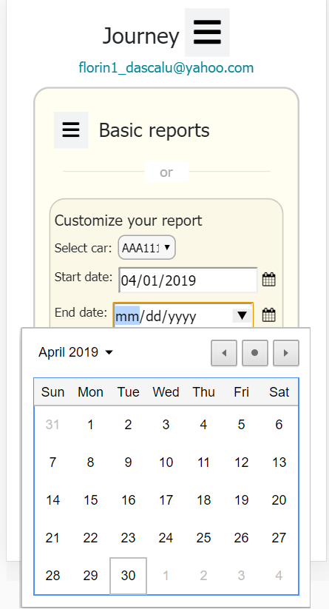
Customize reports - validation
Empty car
Empty date
Select date

Slide 17
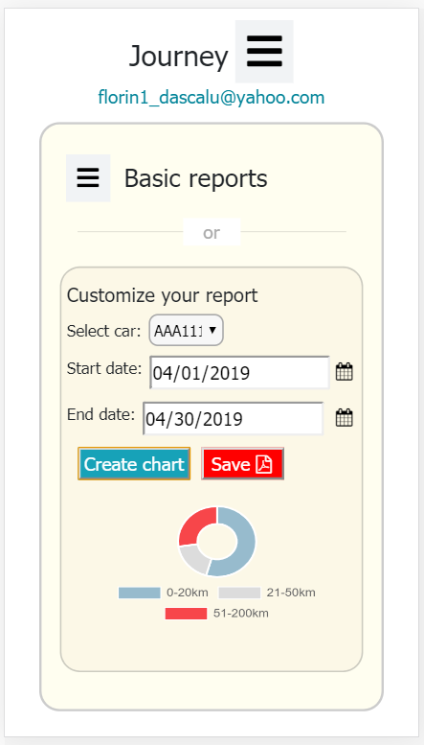
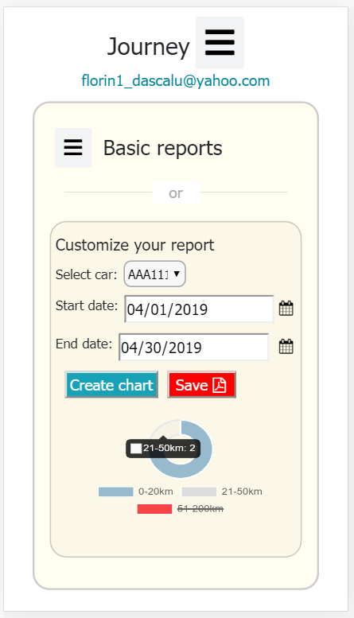
Customize reports - validation
Create chart
Example - Remove interval: 51-200 km

Slide 18
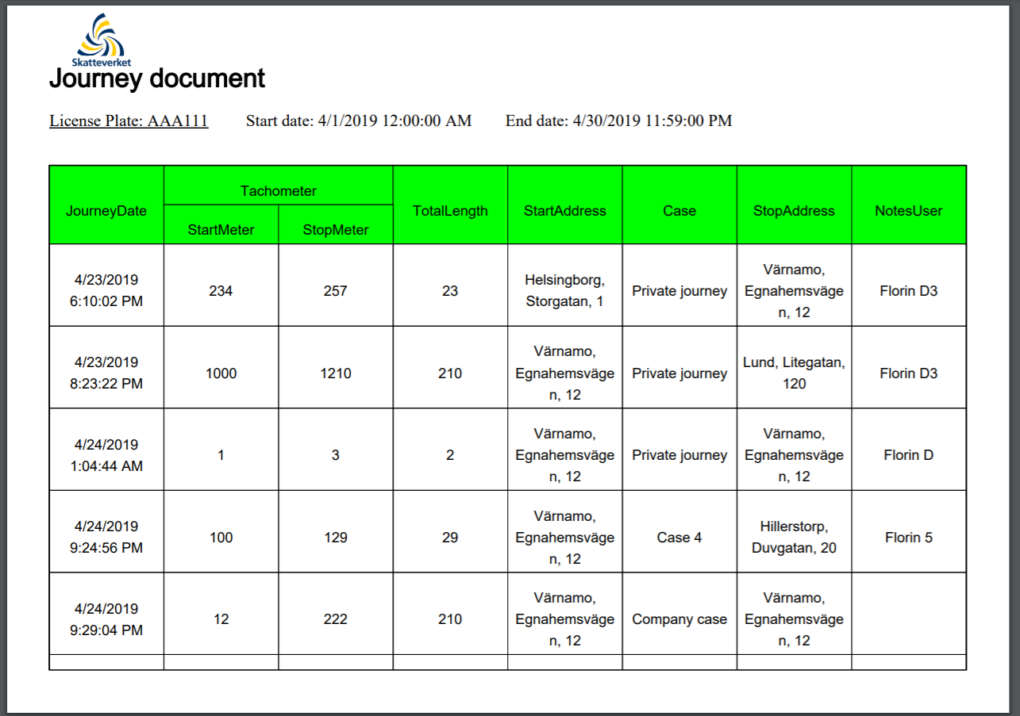
Customize reports - validation
Create pdf / Click Save
Example - Remove interval: 51-200 km

Slide 19
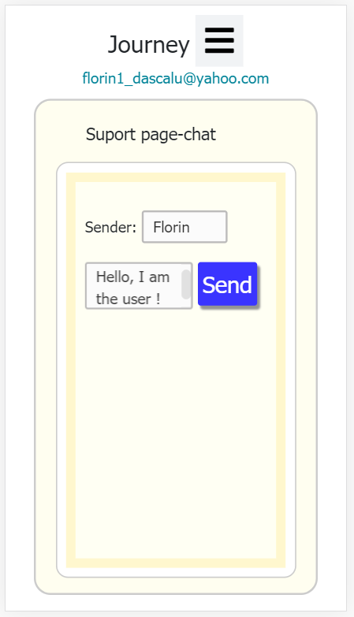
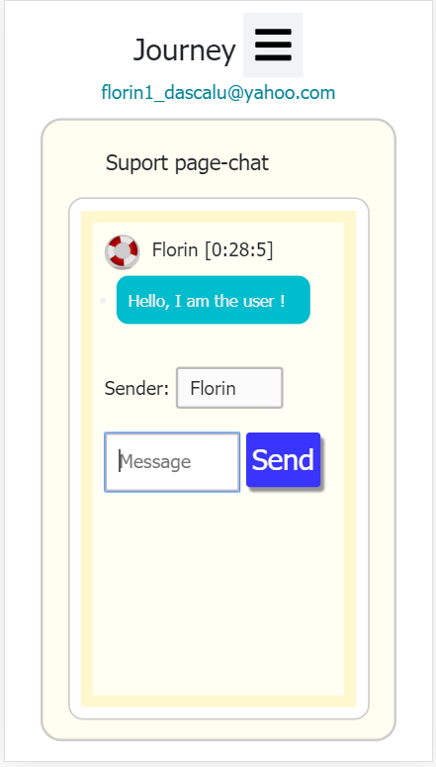
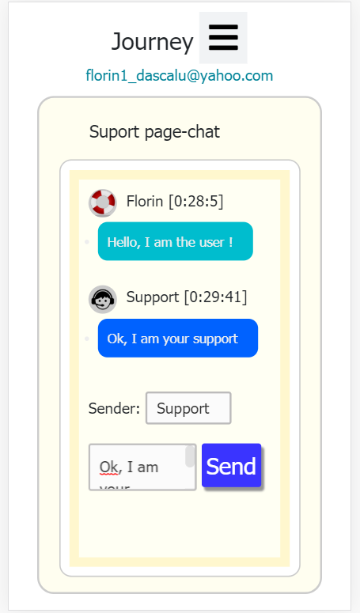
Chat page
Write message
Send message
Receive message

Slide 20
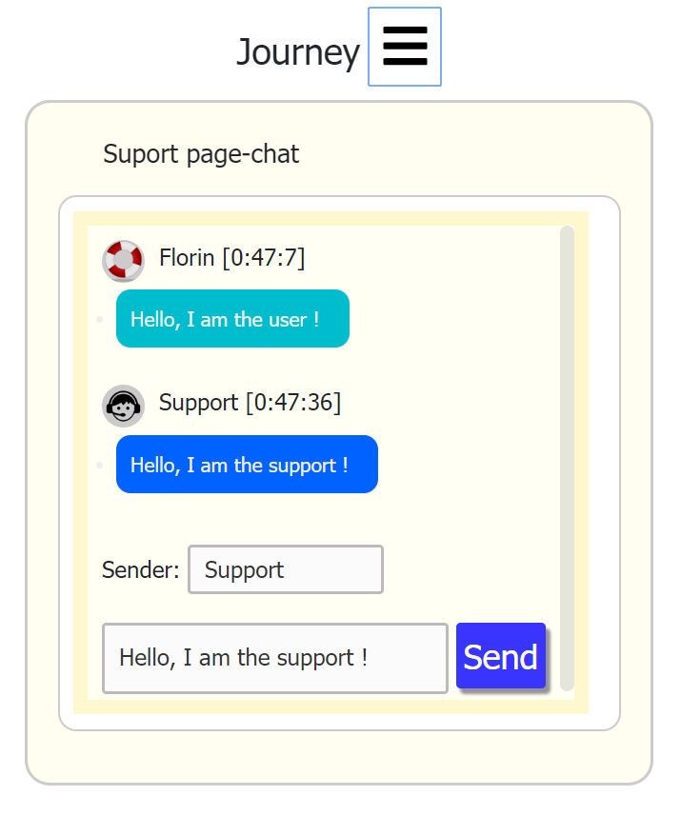
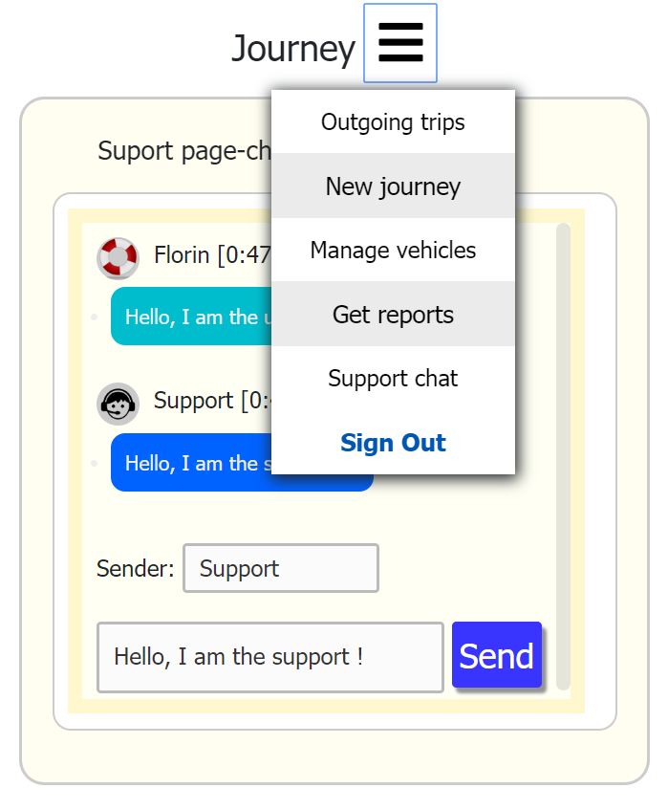
Chat page

Slide 21
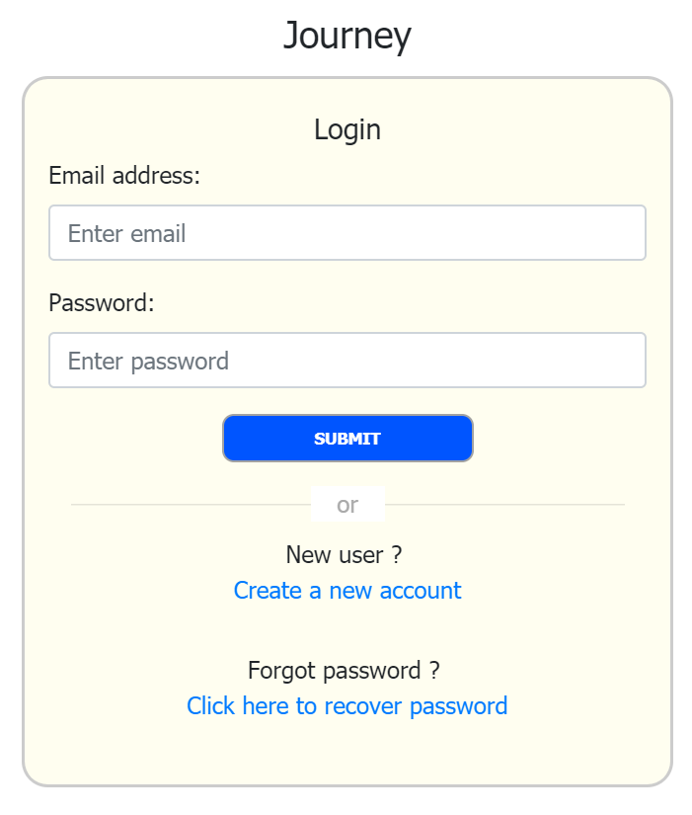
Return to Login page

Slide 22
Thank you !

