Slide 1
Akka.NET applikation - Florin
I implemented a toolkit for building highly concurrent, distributed and fault tolerant event-driven applications on .NET
Application has role to:
Manage asynchronous execution for us - queues up and the system can continue
Can make a complex system easier to understand.
Facilitates us to build systems that can work on multiple processor cores.
Facilitates us to build systems that can execute on multiple physical computers / servers.
Manage errors and can be built as a "self-healing" system.

Slide 2
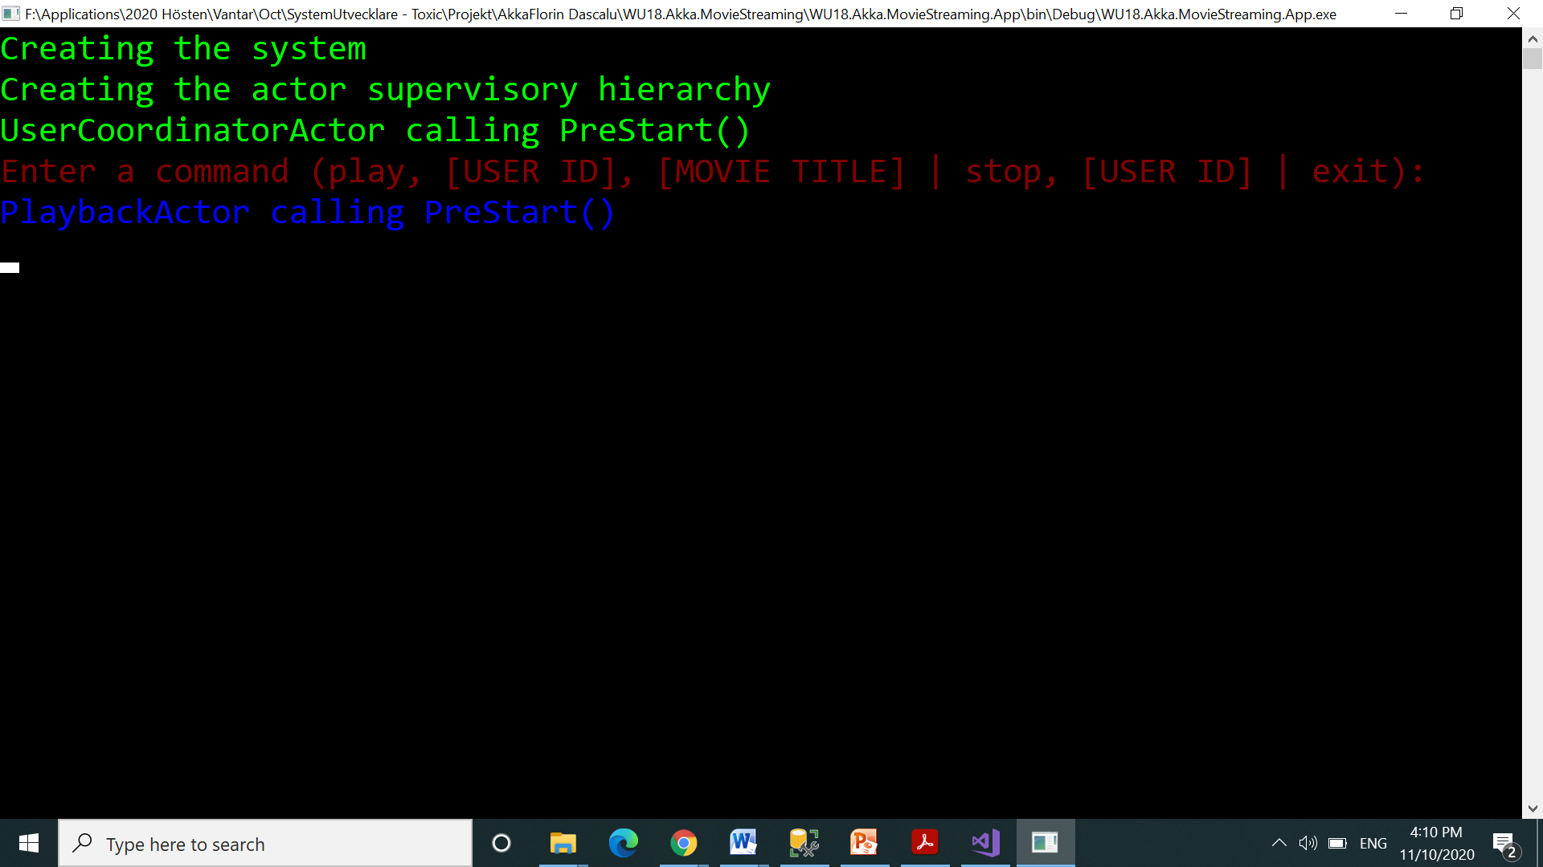
Run WU18.Akka.MovieStreaming.App project and Command prompt screen is opened

Slide 3
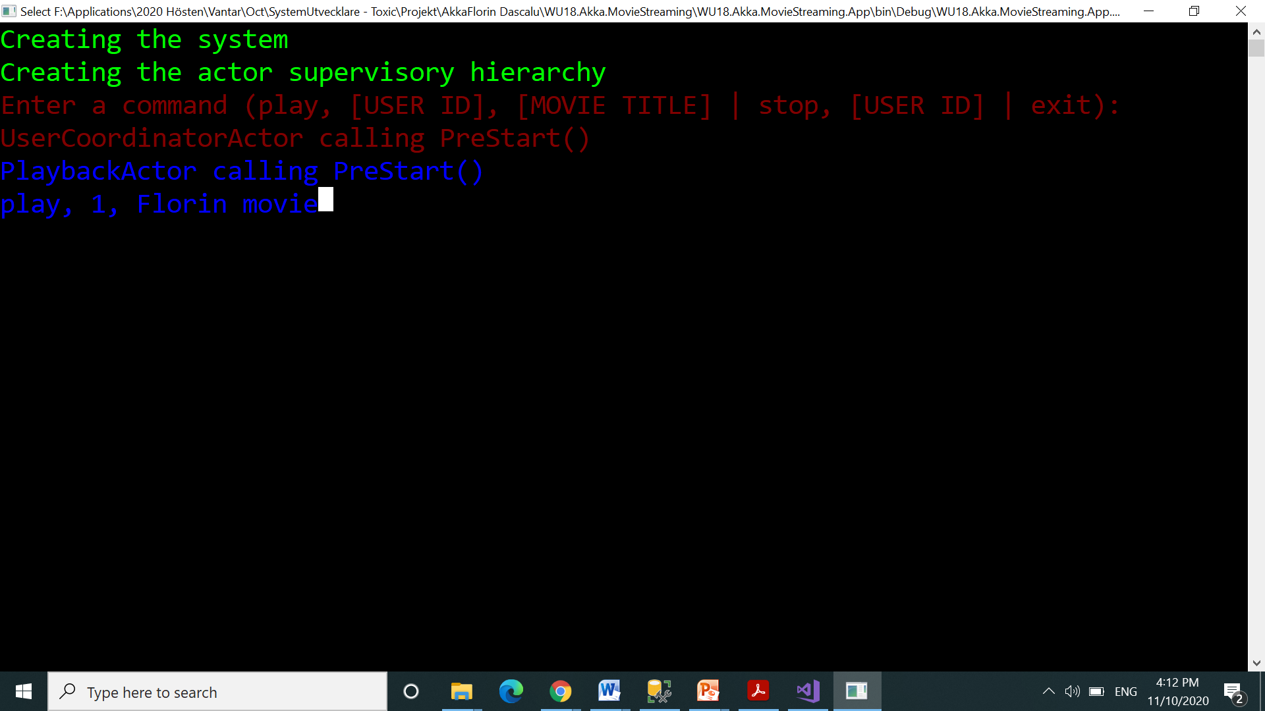
Insert: “play, 1, Florin movie” and press enter

Slide 4
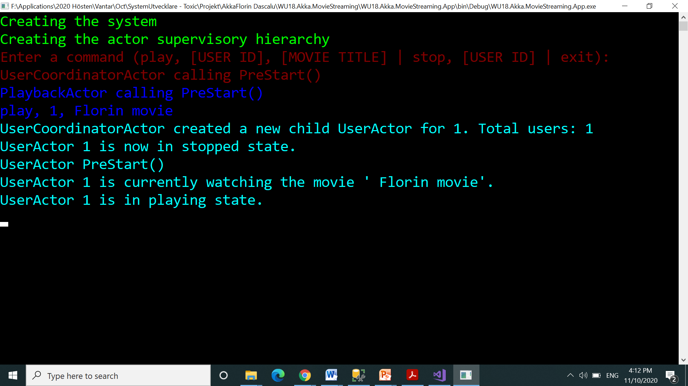
A new child UserActor was created

Slide 5
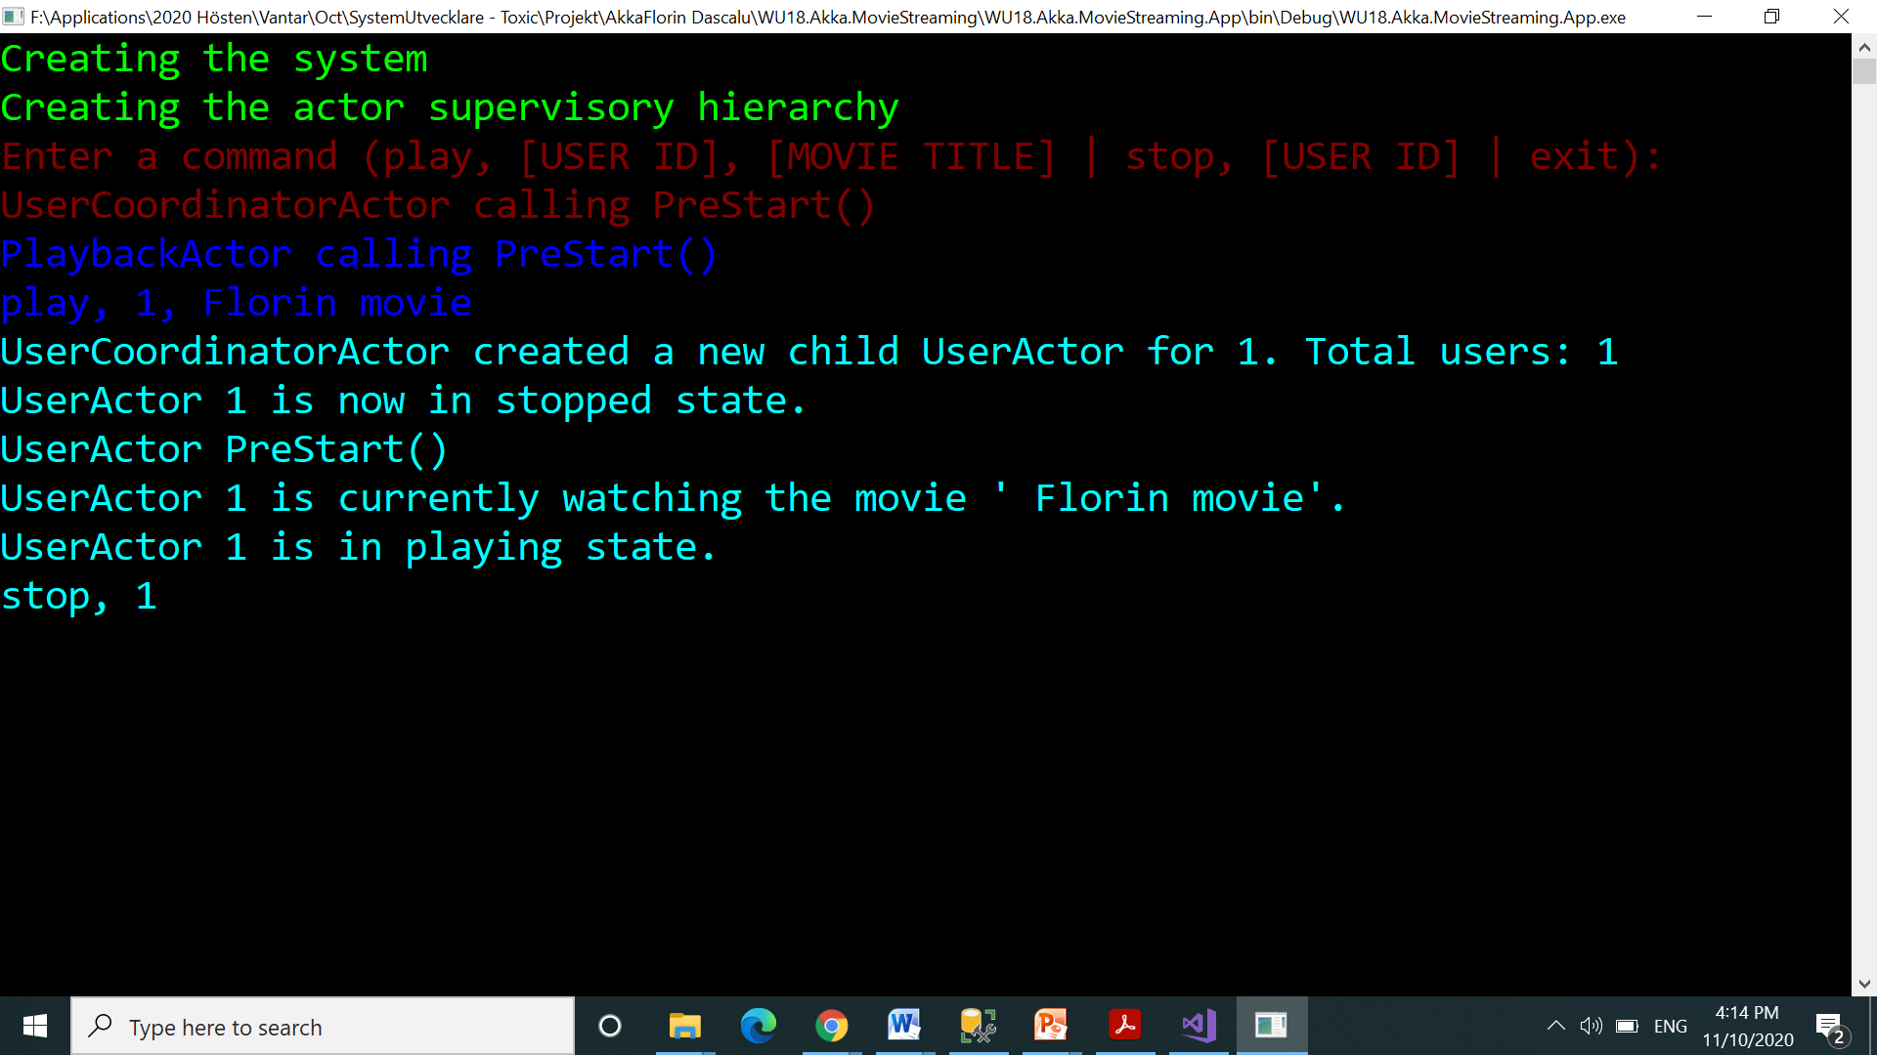
Insert “stop, 1” command to stopp using actor

Slide 6
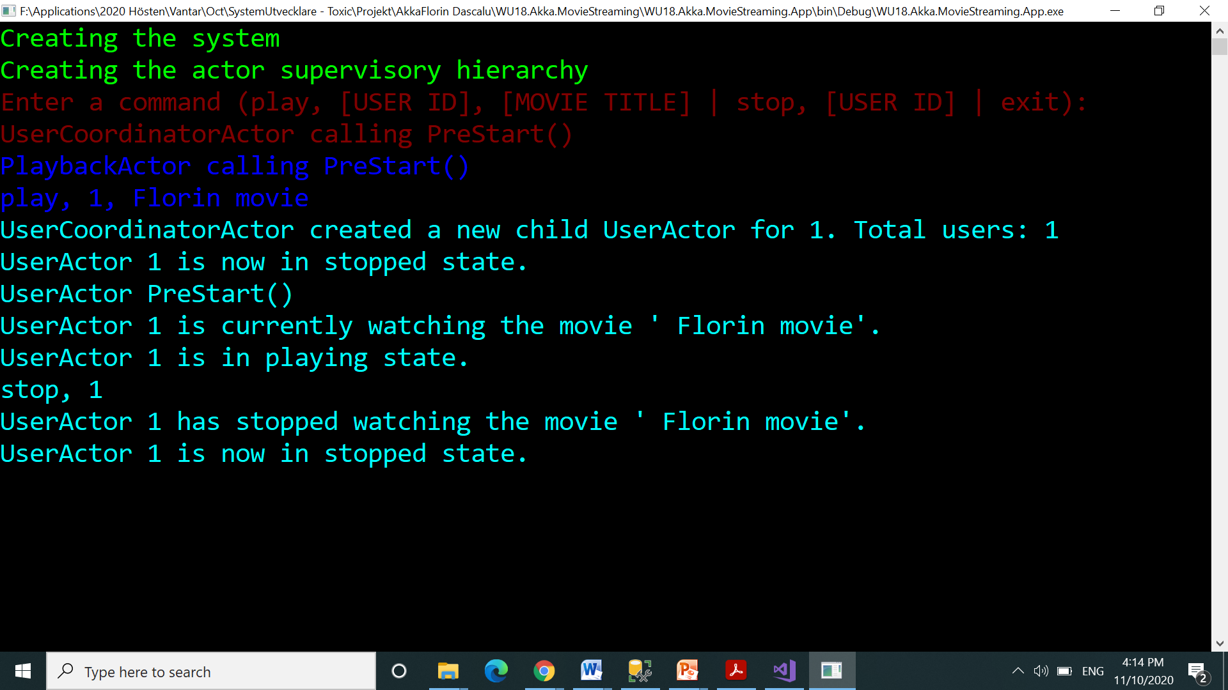
UserActor has stopped watching the movie

Slide 7
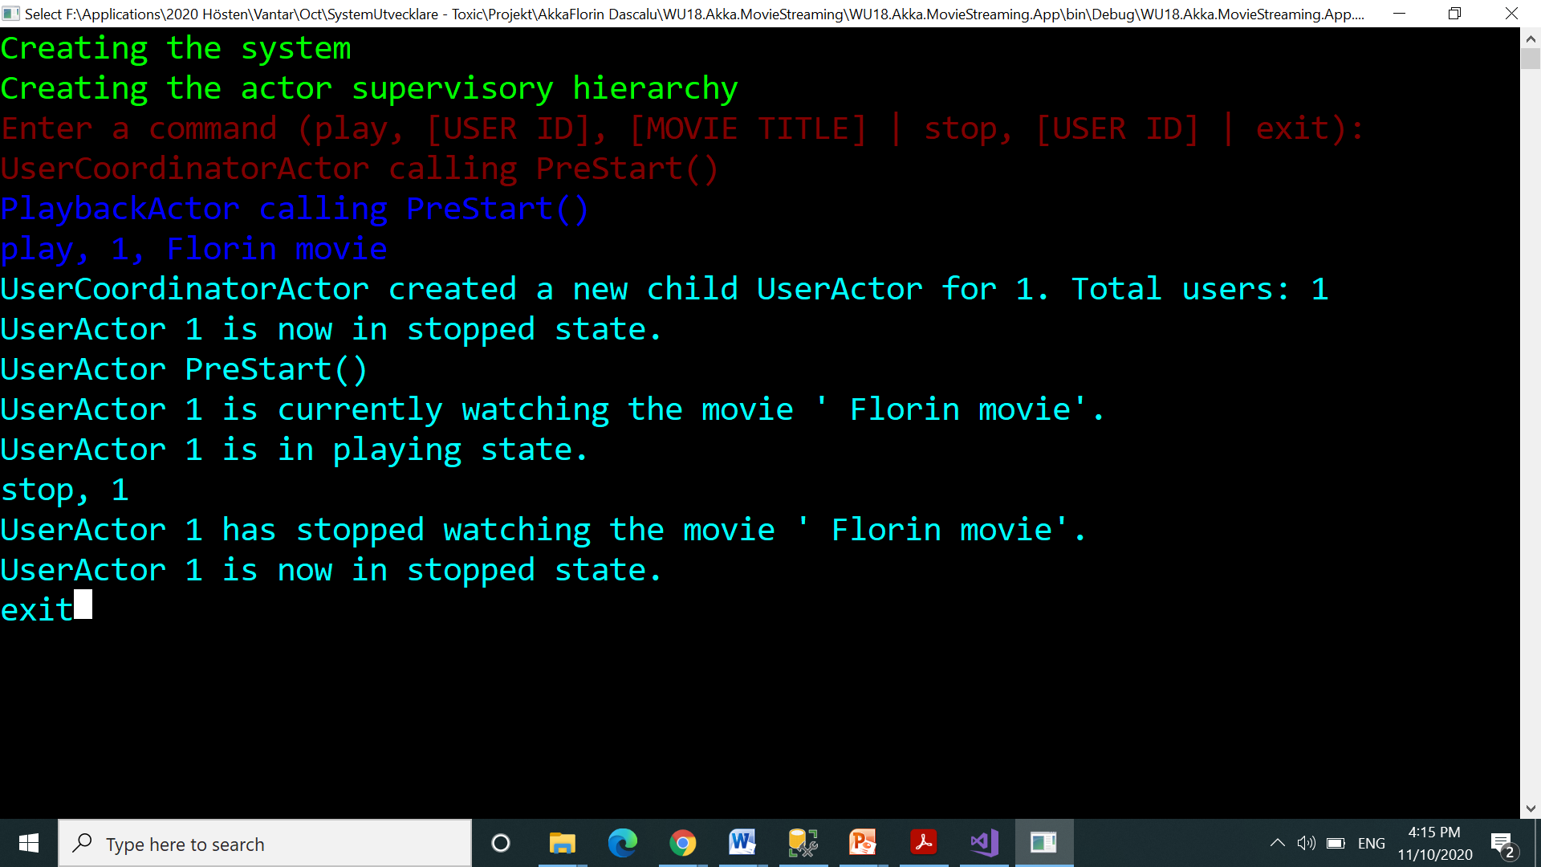
Insert “exit” command to exit from program

Slide 8
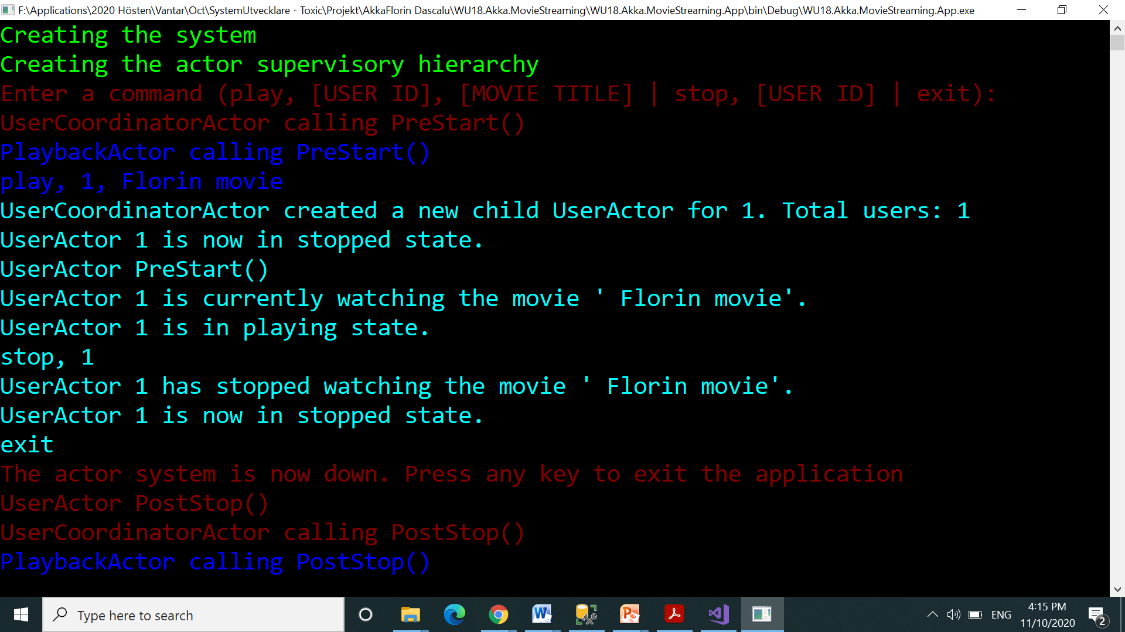
The actor system is now down. Press any key to exit the app

