Slide 1

Image Processing
Topic : Blink Detection
Name – Surname : Betül Berna SOYLU
Number : 171805019

Slide 2

Required libraries

Slide 3
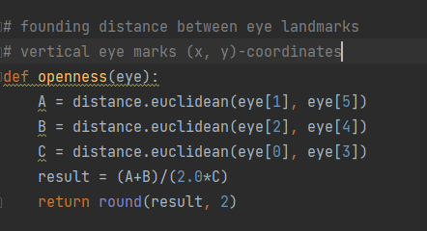
Finding distance between eye landmark

Slide 4
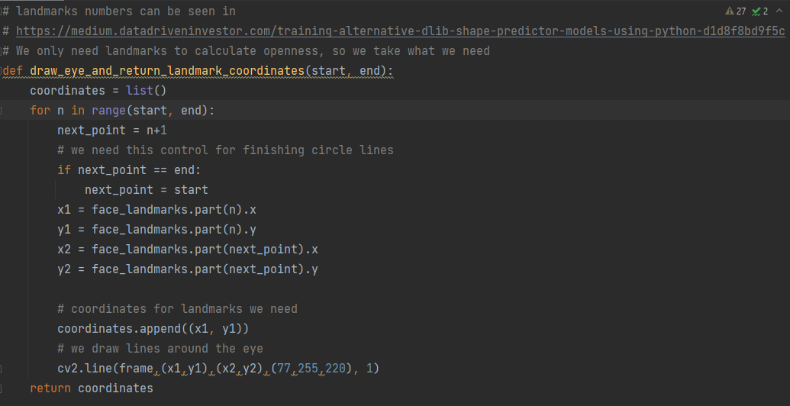
Eye Drawing and Rotate Landmark Coordinates

Slide 5
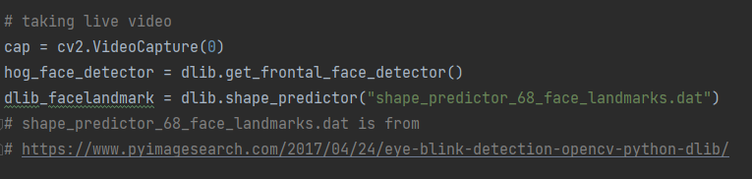
Taking Live Video

Slide 6
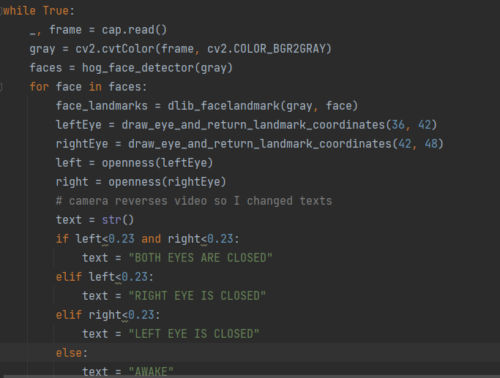
Right or Left Eye Detection

Slide 7
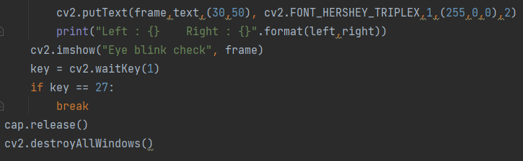
Writing Coordinates and
Closing The Application

Slide 8
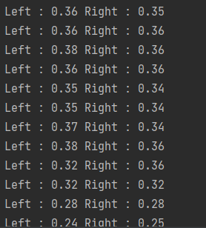
Running the code
Right and left eye open value output.

Slide 9
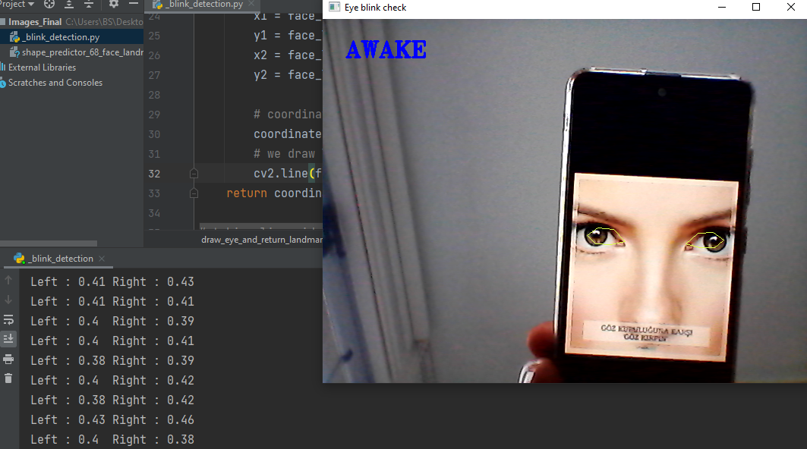
Running the code

Slide 10
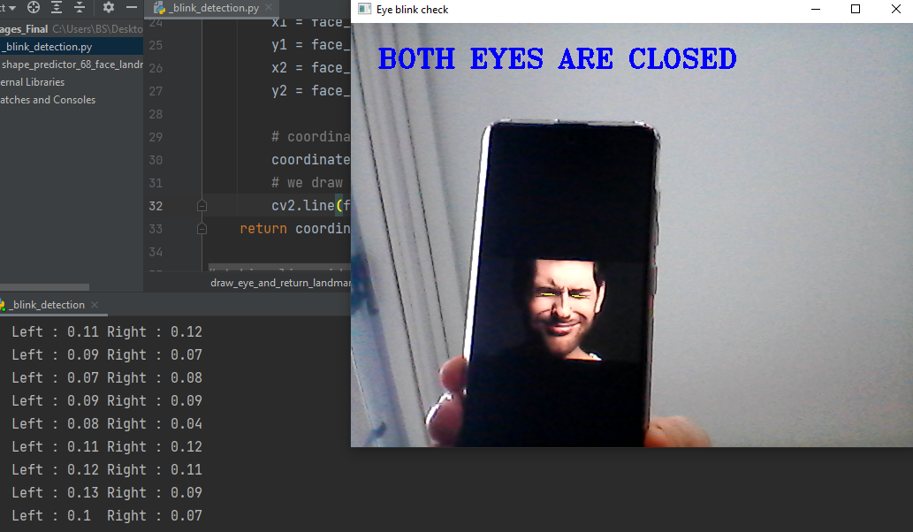
Running the code

Slide 11
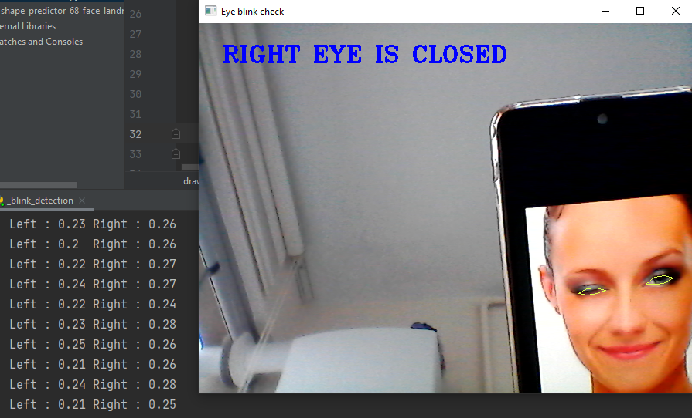
Running the code

Slide 12
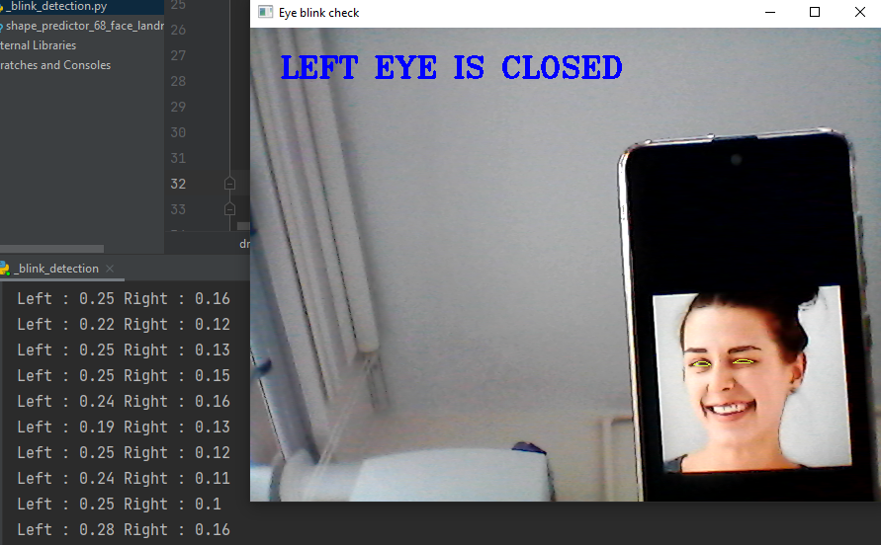
Running the code

Slide 13
THANK YOU FOR LISTENING

