Slide 1

venom
Kis venom.

Slide 2
TABLE OF CONTENTS
01
04
About the Project
Sneak Peek
02
05
Major Requirements
Project Stages
03
06
Project Goals
Our Team
Here you could describe
the topic of the section
Here you could describe
the topic of the section
Here you could describe
the topic of the section
Here you could describe
the topic of the section
Here you could describe
the topic of the section
Here you could describe
the topic of the section

Slide 3

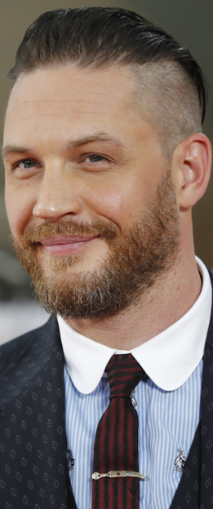
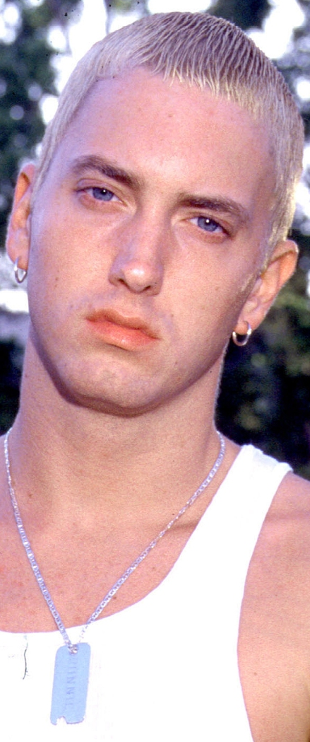
A cég tagjai
Tóth Bertalan
Ondics Gábor
Eperjesi Péter
You can replace the image on the screen with your own
You can replace the image on the screen with your own
You can replace the image on the screen with your own

Slide 4
OUR COMPANY
GOSTUDIO
Mercury is the closest planet to the Sun and the smallest one in the Solar System—it’s only a bit larger than our Moon. The planet’s name has nothing to do with the liquid metal since it was
named after the Roman messenger god, Mercury.

Slide 5
WHAT WE ARE WORKING ON
SECURE
ACCESSIBLE
FAST AND RELIABLE
Mercury is the closest planet to the Sun
Despite being red, Mars is a cold place, not hot
Neptune is the farthest planet from the Sun

Slide 6
ABOUT THE PROJECT
Mercury is the closest planet to the Sun and the smallest one in the Solar System—it’s only a bit larger than our Moon. The planet’s name has nothing to do with the liquid metal since it was named after the Roman messenger god, Mercury

Slide 7
—SOMEONE FAMOUS
“This is a quote. Words full of wisdom that someone important said and can make the reader get inspired.”

Slide 8
NOW
POOR DESIGN
PROGRAMMING MISTAKES
LACK OF ADAPTABILITY

Slide 9
FUTURE
BRANDING
POSITIONING
ADAPTABILITY

Slide 10
MAJOR REQUIREMENTS
IMAGES
USER EXPERIENCE
INFORMATION
Despite being red, Mars is a cold place, not hot. It’s full of iron oxide dust
Venus has a beautiful name and is the second planet from the Sun
Mercury is the closest planet to the Sun and the smallest in our Solar System

Slide 11
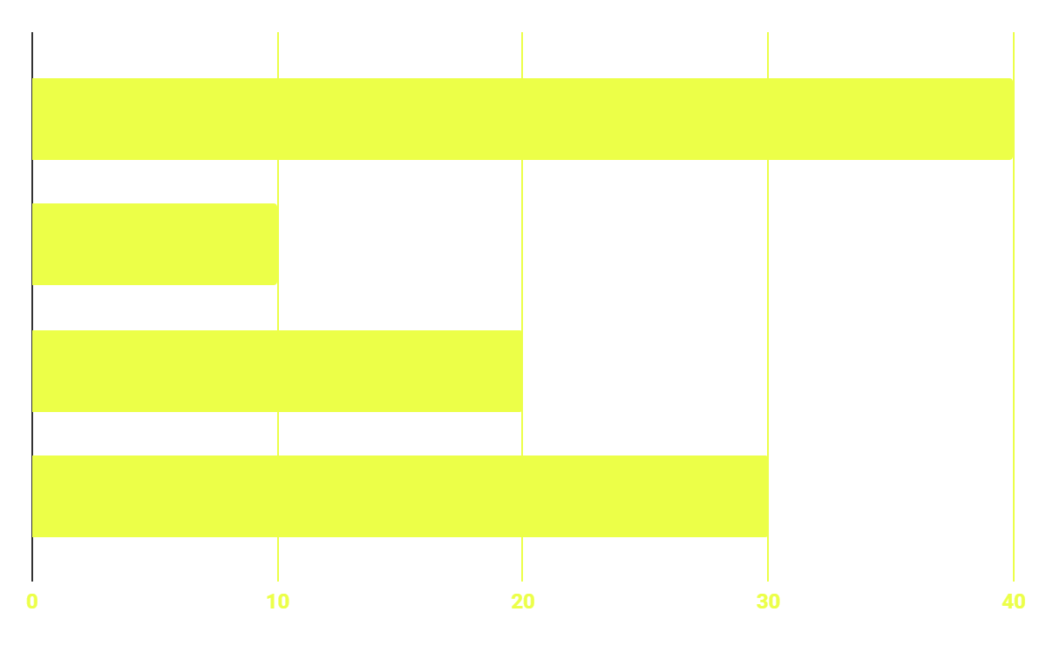
BUDGET
40%
20%
PROGRAMMING
10%
30%
DATABASE
WEB DESIGN
UX RESEARCH

Slide 12
OUR GOALS
EXPANSION
POSITIONING
USABILITY
Neptune is the fourth-largest planet in our Solar System
Venus has a beautiful name and is the second planet from the Sun
Despite being red, Mars is a cold place, not hot. It’s full of iron oxide dust

Slide 13
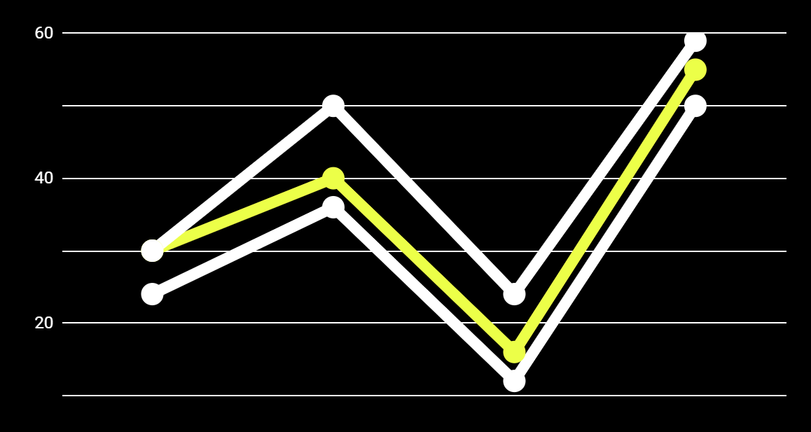
PREDICTED RESULTS
CONVERSIONS NEXT YEAR
+20%
MONTHLY VISITS
+33%
CONVERSION RATE
+40%
ANNUAL ORDERS

Slide 14
SNEAK PEEK
HEADER
TEXT
SLIDER
ICONS

Slide 15
A VIDEO IS A GOOD IDEA
Insert your multimedia content here

Slide 16
PROJECT STAGES
STEP 2
STEP 1
STEP 3
Venus has a beautiful name and is the second planet from the Sun
Despite being red, Mars is a cold place, not hot. It’s full of iron oxide dust
Saturn is a gas giant, composed mostly of hydrogen and helium

Slide 17
OUR TIMELINE
WEEK 1
WEEK 3
BETA
RELEASE
FINAL
VERSION
WEEK 2
WEEK 4
Improvements
Increased traffic
Focus group
Progress review

Slide 18
OUR PARTNERS
MARS
VENUS
MERCURY
Mercury is the closest planet to the Sun and the smallest one in our Solar System
Despite being red, Mars is a cold place, not hot. It’s full of iron oxide dust
Venus has a beautiful name and is the second planet from the Sun

Slide 19
Köszönjük a figyelmet!
Elérhetőségeink:
addyouremail@freepik.com
+36 30 222 2222
venomgrade@gmail.com

