Slide 1

What is a SAS library?
Source: http://www.softicons.com/free-icons/application-icons/or-applications-icons-by-iconleak/file-cabinet-icon

Slide 2

What is a SAS library?
Source: http://www.softicons.com/free-icons/application-icons/or-applications-icons-by-iconleak/file-cabinet-icon
Source: http://www.graphicsfuel.com/2012/03/folder-icon-psd/

Slide 3
LIBREF
LIBREF
LIBREF
Source: http://www.softicons.com/free-icons/application-icons/or-applications-icons-by-iconleak/file-cabinet-icon

Slide 4
Sashelp
Sasuser
Work
Source: http://www.softicons.com/free-icons/application-icons/or-applications-icons-by-iconleak/file-cabinet-icon

Slide 5
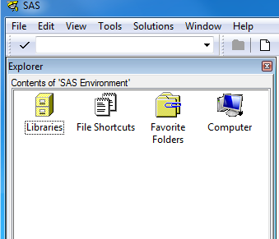
Sashelp
Sasuser
Work
Source: http://www.softicons.com/free-icons/application-icons/or-applications-icons-by-iconleak/file-cabinet-icon

Slide 6
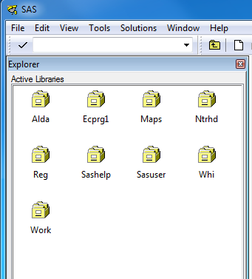
Sashelp
Sasuser
Work
Source: http://www.softicons.com/free-icons/application-icons/or-applications-icons-by-iconleak/file-cabinet-icon

Slide 7


Source: www.iconarchive.com

Slide 8

Notes:
Let’s say that I want you to go to the store and buy a loaf of bread.

Slide 9
Right on Camp Bowie Blvd.
Drive 1 mile
Left on Hulen St.
Drive .5 mile
Cross I-30
Turn right at second parking lot entrance
Notes:
When I say “go to the store”, this is really a shorthand way of telling you a much more detailed set of directions. The SAS library is no different. It represents a much more detailed set of directions, and there may be times when you want view those directions.

Slide 10
Demonstration
Finding a File Path

Slide 11
Ntrhd
Source: http://www.softicons.com/free-icons/application-icons/or-applications-icons-by-iconleak/file-cabinet-icon

Slide 12
LIBNAME libref <engine> ‘SAS-library’ <options>;
Notes:
Here is the general form of the LIBNAME statement. It starts with the SAS keyword LIBNAME. Then you must designate a libref and the path to the physical location that will correspond to your library.

Slide 13
Demonstration
Two Ways to Create a Permanent SAS Library

Slide 14
Practice: Assign a LIBREF
In this practice, you assign the libref ntrhd (North Texas Regional Health Department) to the location of your practice data files for this course.
Steps:
Write a LIBNAME statement that assigns the libref ntrhd to the location of the practice files for this course.
Submit the LIBNAME statement and check the log to verify that the library was defined successfully.
Notes:
Now you practice opening SAS in windows.

Slide 15
References
SAS Institute. SAS Programming 1: Essentials [e-learning course]. Cary, NC: SAS Institute Inc.; 2012. Accessed: December, 2013
Cody R. Learning SAS by Example: A Programmer’s Guide. Cary, NC: SAS Institute Inc.; 2007.

