Slide 1




Stata
.txt
.csv
Spreadsheet
SAS
obs | X1 | X2 | X3
1 | 1 | 0 | 1
2 | 0 | 1 | 0
3 | 1 | 0 | 1
4 | 0 | 1 | 0
Notes:
files

Slide 2
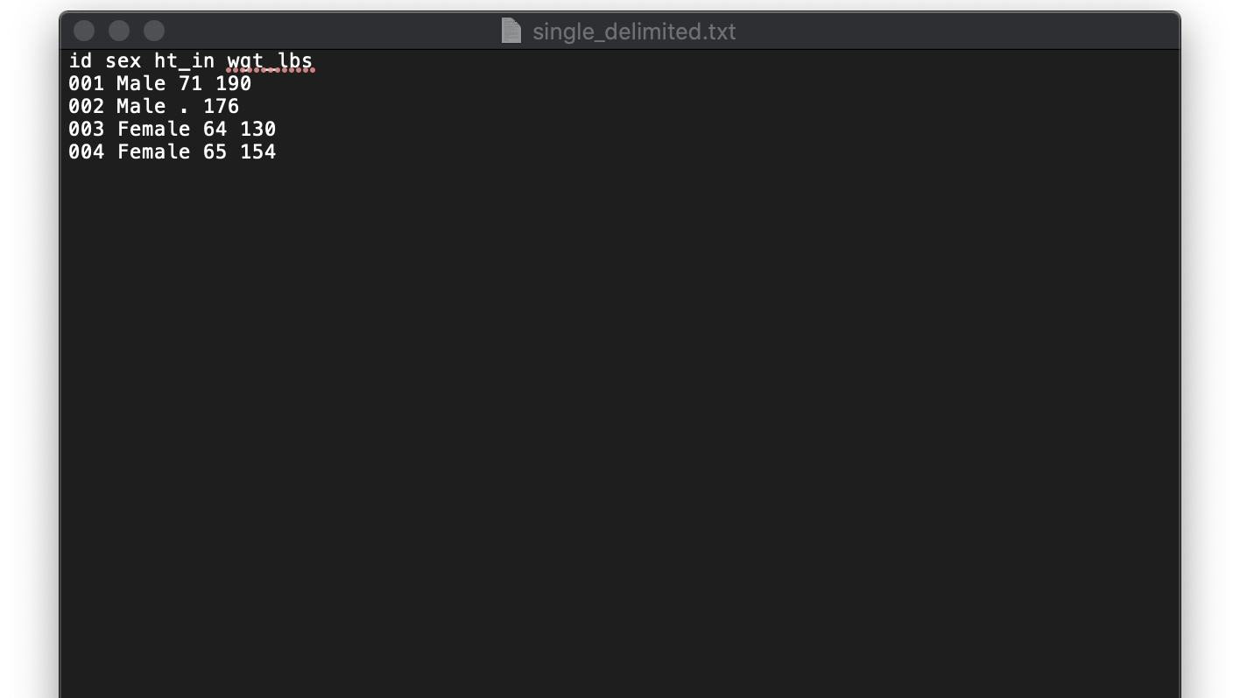
Values separated by a single space
Notes:
space

Slide 3
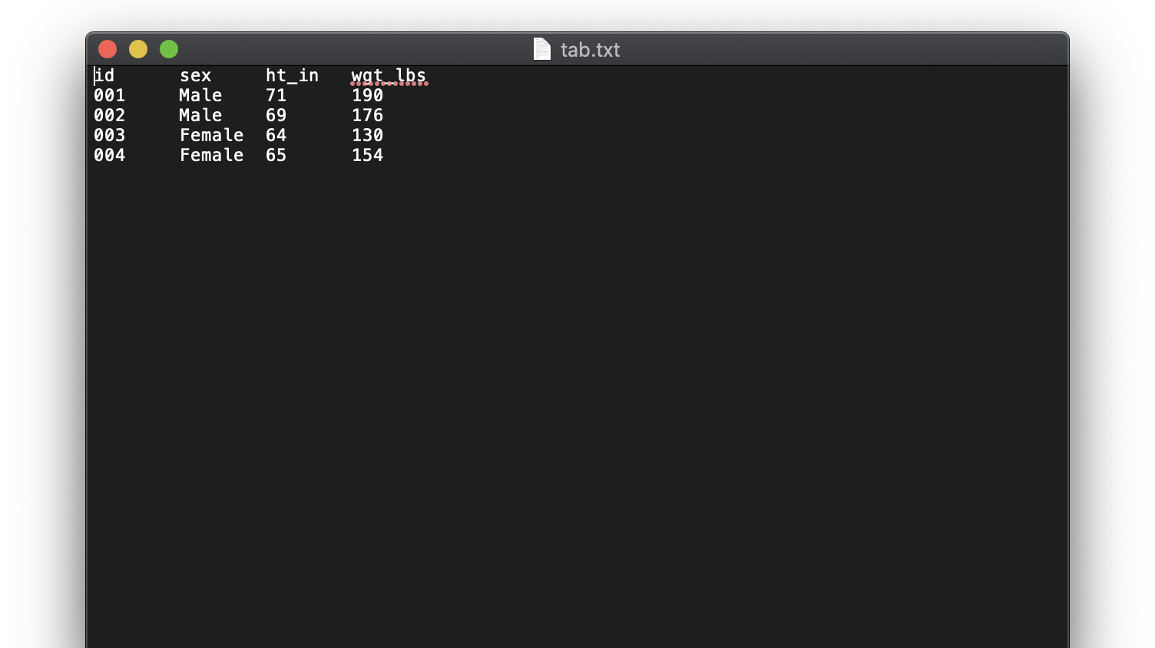
Values separated by a tab
Notes:
tab

Slide 4
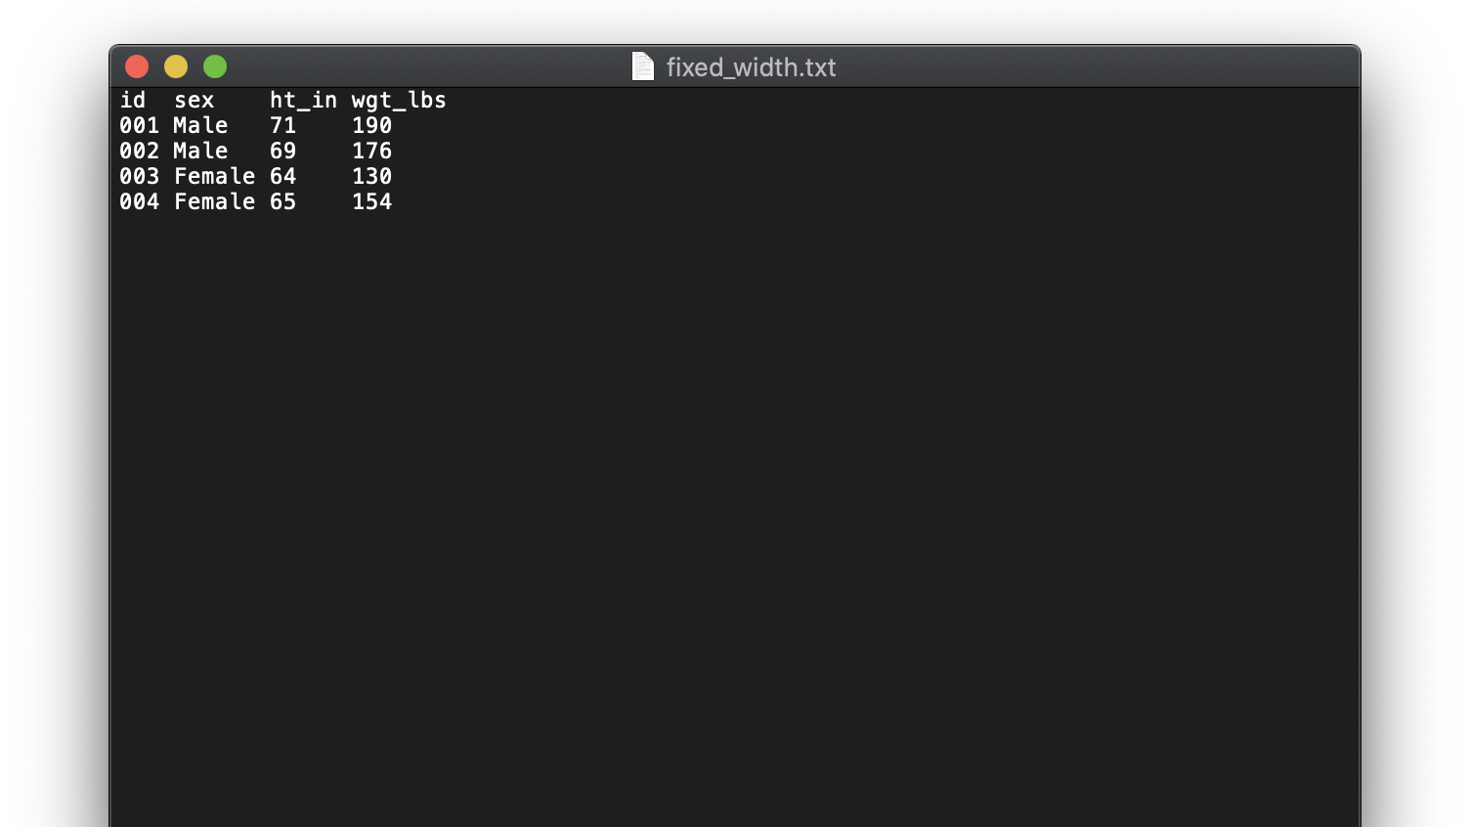
Inconsistent spacing
Notes:
fixed_width

Slide 5
1 | 2 | 3 | 4 | 5 | 6 | 7 | 8 | 9 | 10 | 1 | 2 | 3 | 4 | 5 | 6 | 7 | 8 | 9 | 20 | 1 | 2 | 3 | 4
i | d |  |  | s | e | x |  |  |  |  | h | t | _ | i | n |  | w | g | t | _ | l | b | s
0 | 0 | 1 |  | M | A | L | E |  |  |  | 7 | 1 |  |  |  |  | 1 | 9 | 0
0 | 0 | 2 |  | M | A | L | E |  |  |  | 6 | 9 |  |  |  |  | 1 | 7 | 6
0 | 0 | 3 |  | F | E | M | A | L | E |  | 6 | 4 |  |  |  |  | 1 | 3 | 0
0 | 0 | 4 |  | F | E | M | A | L | E |  | 6 | 5 |  |  |  |  | 1 | 5 | 4
Notes:
number_line_spaces

Slide 6
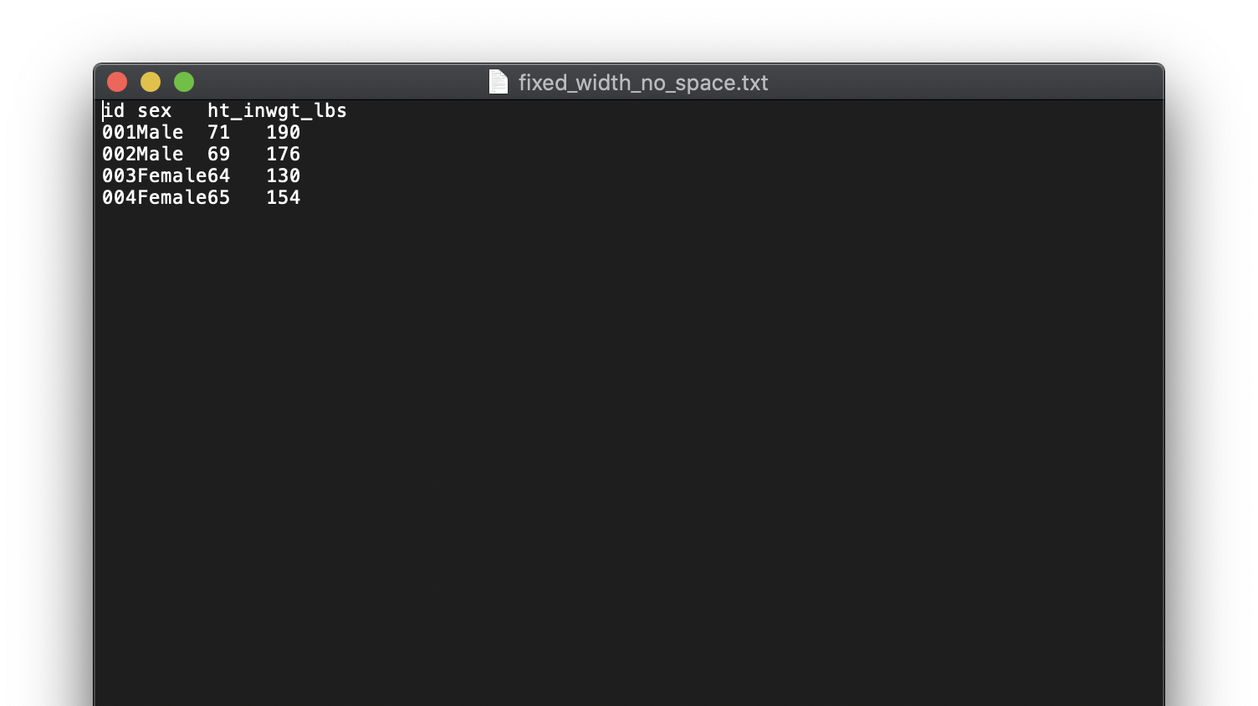
Inconsistent spacing

Slide 7
1 | 2 | 3 | 4 | 5 | 6 | 7 | 8 | 9 | 10 | 1 | 2 | 3 | 4 | 5 | 6 | 7 | 8 | 9 | 20 | 1 | 2 | 3 | 4
i | d |  | s | e | x |  |  |  | h | t | _ | i | n | w | g | t | _ | l | b | s
0 | 0 | 1 | M | A | L | E |  |  | 7 | 1 |  |  |  | 1 | 9 | 0
0 | 0 | 2 | M | A | L | E |  |  | 6 | 9 |  |  |  | 1 | 7 | 6
0 | 0 | 3 | F | E | M | A | L | E | 6 | 4 |  |  |  | 1 | 3 | 0
0 | 0 | 4 | F | E | M | A | L | E | 6 | 5 |  |  |  | 1 | 5 | 4
Notes:
number_line

Slide 8
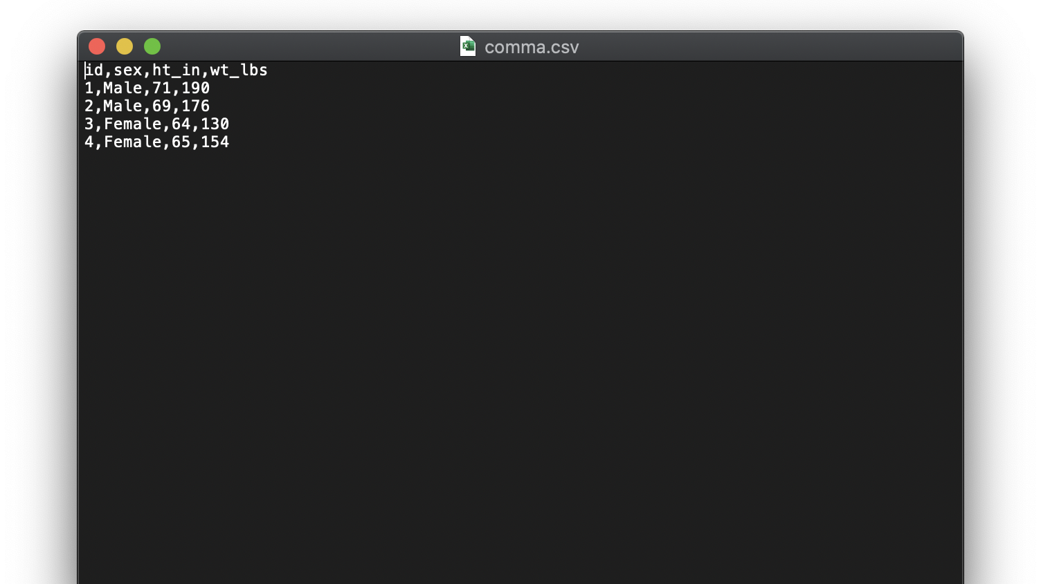
Values separated by commas

Slide 9
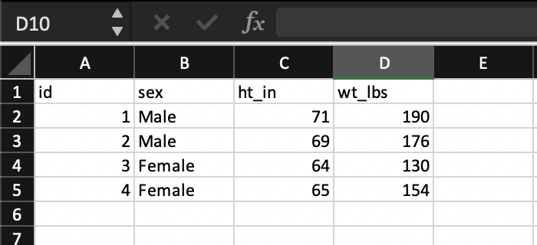
Notes:
csv_excel

Slide 10
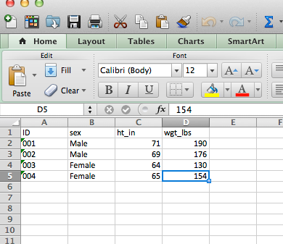
.xls (.xlsx)

Slide 11
Demonstration
Importing a Microsoft Excel spreadsheet

Slide 12
Practice: Use the Import Wizard to Import an Excel Spreadsheet
In this practice, you use the import wizard to read the supplies.xls file and create a temporary data set named Supplies from it.
Steps:
Use the import wizard to read the supplies.xls workbook from the location where you stored the practice files. Select the worksheet named Location 1, and create a temporary SAS data set named Supplies. Save the generated PROC IMPORT code in a file named supplies.sas in the location where you store practice files.
Submit a PROC PRINT step to create a list report of the new data set.
Open the supplies.sas program file in SAS to view the PROC IMPORT code.
Notes:
Now you practice opening SAS in windows.

Slide 13
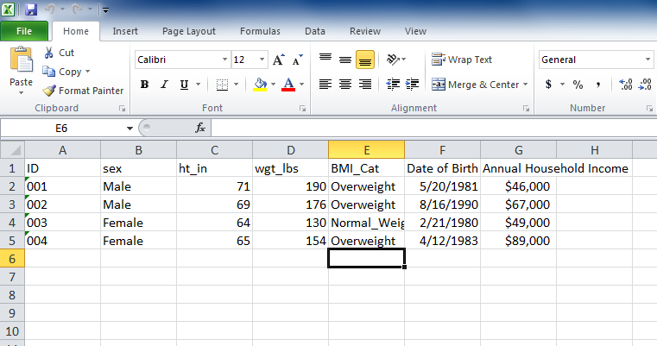

Slide 14
January 1, 1960
Negative
Positive

Slide 15
