Slide 1

Notes:
store

Slide 2
Right on Camp Bowie Blvd.
Drive 1 mile
Left on Hulen St.
Drive .5 mile
Cross I-30
Turn right at second parking lot entrance
Notes:
directions

Slide 3
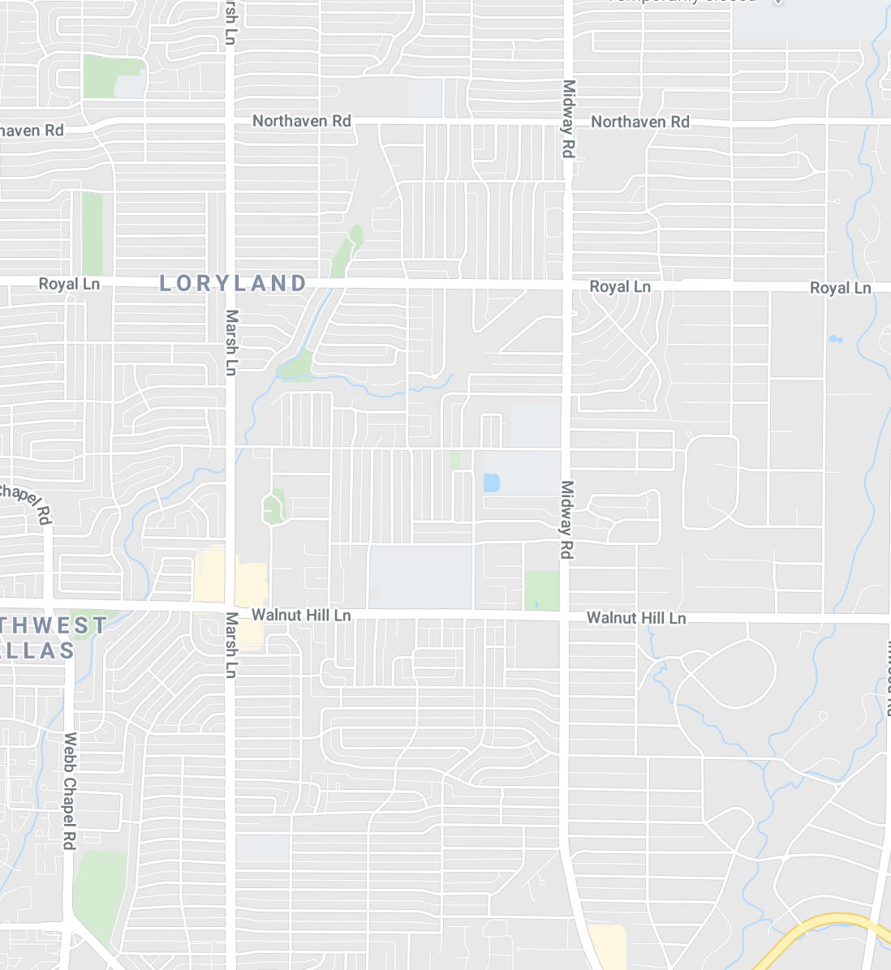

Notes:
locations

Slide 4

Notes:
ntrhd

Slide 5
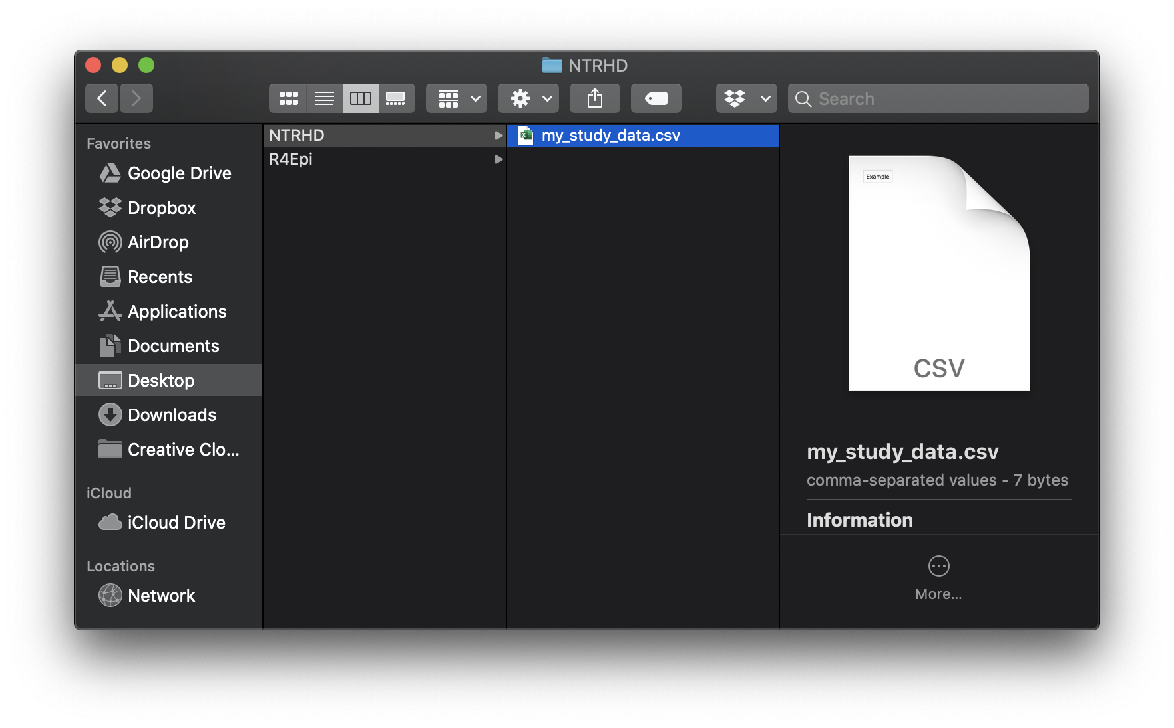
Notes:
my_study_data

Slide 6
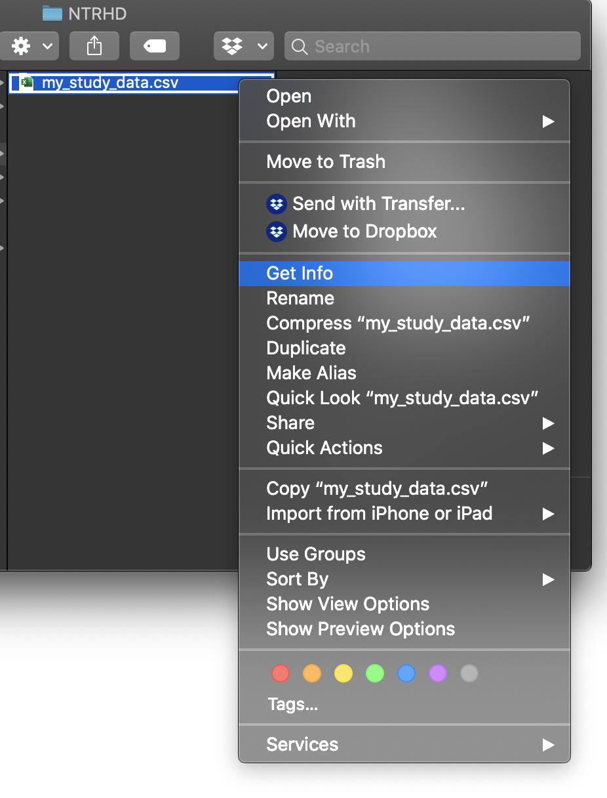
Notes:
get_info

Slide 7
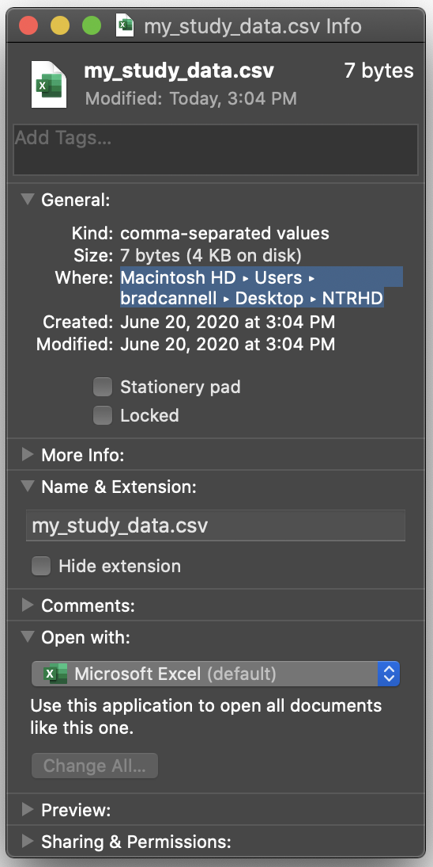
Notes:
where

