Slide 1
Development Version
This is the development version of the presentation. Do not post on Canvas.
Instead, export to pdf and post a link to the pdf on Canvas.
Hidden slides, comments, and slide notes will not be included in the pdf.
If you also post a recording of the lecture, then there should be no reason why the students need the notes.

Slide 2

Populations
Epidemiology III
Notes:
So far, we have discussed the basics of using R and RStudio, but there hasn’t been anything particularly “epi” about it. This week, we will turn our attention more towards reviewing some of the basic tools and concepts of epidemiology, and how to apply them to solve public health issues. As part of that process, we we will continue to learn how to use R and RStudio as tools that can help us in that pursuit.

Slide 3
“the study of the occurrence and distribution of health-related states or events in specified populations, including the study of the determinants influencing such states, and the application of this knowledge to control the health problems.”
Source: Porta M, ed. A Dictionary of Epidemiology. Oxford University Press; 2008.
Notes:
Another important concept in epidemiology is that of populations. In fact, our concern with populations is embedded in our very definition. In epidemiology, we generally want to describe a population, predict the occurrence of something in a population, or explain the causes of something in a population.
But, what is a population?

Slide 4
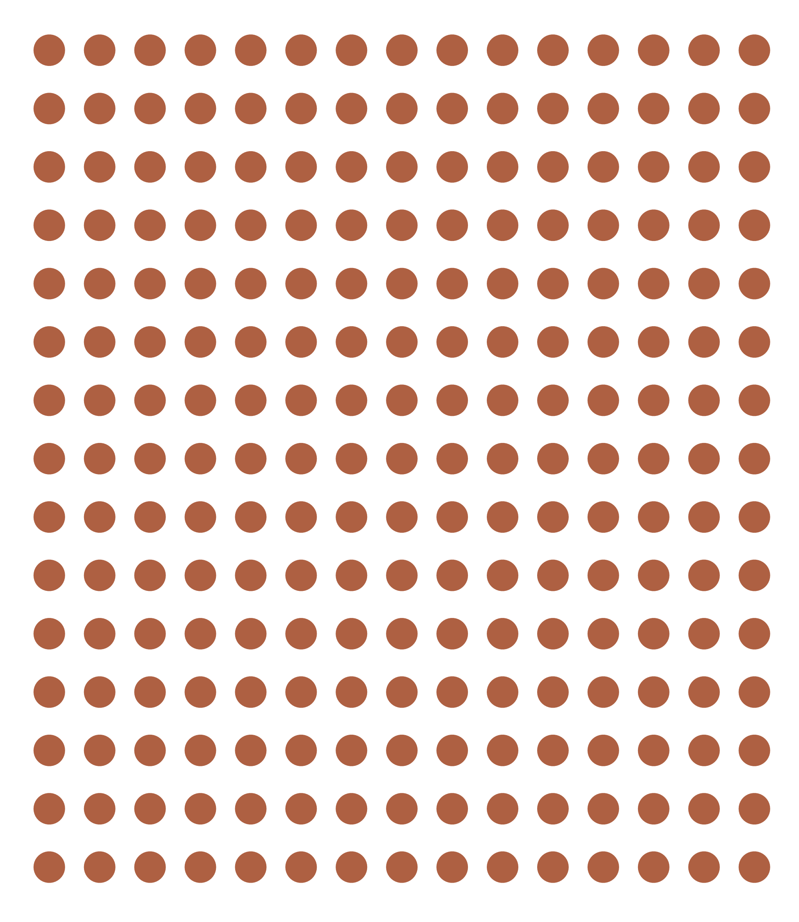
“The simplest definition of a population is a group of people who share characteristics or meet criteria that define membership in the population.”
Source: Lash TL, VanderWeel TJ, Haneuse S, Rothman KJ. Modern Epidemiology. fourth. Wolters Kluwer; 2021.
Notes:
Well, The simplest definition of a population is a group of people who share characteristics or meet criteria that define membership in the population.
In other words, we set some criteria of interest and then anyone who meets that criteria is a member of the population. In everyday language, we most often think about the criteria that defines population membership as being geographic. For example, all of the people who live in the United States make up the population of the United States. The criteria that defines them is the fact that they live in the United States.
But we certainly do not have to limit our criteria of interest to be geographic. We can use pretty much any criteria that is useful for our purposes. For example, people of a particular age, gender, or race or ethnicity; people who work in a particular occupation; people who participate in a particular behavior or activity; or people who have a particular disease. All the people who meet whatever the criteria are de facto members of the population.

Slide 5
“The simplest definition of a population is a group of people [during a defined time period] who share characteristics or meet criteria that define membership in the population.”
Source: Lash TL, VanderWeel TJ, Haneuse S, Rothman KJ. Modern Epidemiology. fourth. Wolters Kluwer; 2021.
Notes:
I would add the qualifier “during a defined time period” to this definition. As I hope to show you, the inclusion of the time period of interest is is a critical component of making almost every measure we will use in epidemiology meaningful.
A couple of slides from now, we will see some examples of different ways we can define time periods and some examples that demonstrate why the definition of the time period matters.

Slide 6
Closed population
After the population is defined…
Doesn’t add any new members over time.
Loses members only to death.
Open population
May gain members over time through birth or as new people meet the definition.
Loses members over time as people stop meeting the criteria or die.
Source: Lash TL, VanderWeel TJ, Haneuse S, Rothman KJ. Modern Epidemiology. fourth. Wolters Kluwer; 2021.
Notes:
But first, we will dig slightly deeper into our definition of populations. Specifically, populations may be further classified as open or closed.
[Read definitions]
So, the most obvious way that open and closed populations differ is that people can move in and out of open populations over time, but the same is not true for closed populations. As we will see, this has implications for the kinds of measures we can/should use when studying health. It also has implications for the meaning we make of our conclusions.
A second, more subtle, distinction between whether a population is closed or open is the time axis we choose to use to describe the population.
So, closed or open aren’t necessarily a property of the group of people under study. It is simply a consequence of the way we define the population.

Slide 7

Closed vs. Open Populations
Person
1
2
3
4
9/1
9/7
9/14
9/21
9/28
Week (Calendar Time)
Notes:
For example, let’s think about the population of people who use Aspirin. It may not initially be obvious, but we could use more than one time axis as we define this population.
For example, we have calendar time on the x-axis of the figure shown here -- week 0, 1, 2, 3, and 4 beginning on September 1st.
Using that definition, is this an example of an open or closed population?
This is an open population when defined in calendar time because new people are entering the population over time.
Although, not explicitly shown in this figure, if people leave the population for reasons other than death -- for example, stop taking Aspirin – then that would be another way this population meets the definition of an open population.

Slide 8
Closed vs. Open Populations
Person
1
2
3
4
0
1
2
3
4
Event Time
Notes:
However, that same population could also be defined as a closed population if the x-axis is measured from the start of their Aspirin use. So, in this figure, time is measured as weeks since the initiation of Aspirin use. This is an example of event time.
If, as in this example, membership in the population always starts with an event such as initiation of treatment and never ends thereafter, the population is closed along the time axis that marks this event as the index time for each member because all new members enter only when they experience this event. The same population will, however, be open along most other time axes. If membership can be terminated by later events other than death, the population is open along any time axis.
So, in this scenario, we are defining the population as people who have ever taken Aspirin as of this moment. People in later moments will not meet that definition and cannot be added to the population.

Slide 9

Closed vs. Open Populations
Person
1
2
3
4
0
1
2
3
4
Event Time
Notes:
It is also worth noting that any population that experiences loss to follow-up, even if the people who are lost to follow-up would still meet eligibility criteria if they were being followed, is an open population.
For example, let’s say that membership in our Aspirin population is defined by taking Aspirin once a week. However, person 2 moves and doesn't not leave us with any contact information. This is now, by definition, an open population.
This is actually a very common occurrence in practice, and we will discuss methods for analyzing the data from such populations at multiple times throughout this course.

Slide 10
Examples
Currently enrolled in Epi 3: Open population
Ever enrolled in Epi 3 as of today: Closed population
Resident of Texas: Open population
People aged 65+ as of today: Closed population
People aged 20 to 30 as of today: Open populationa

Slide 11
Populations
Source population: The source population is the population from which persons will be sampled and included in a measurement of disease frequency.
For example, the source population of the original Framingham Heart Study included men and women between the ages of 30 and 62 years who were residents of the town of Framingham, Massachusetts, in 1948.
Target population: The target population is the group of people about which our scientific or public-health question asks, and comprises the persons for whom information gleaned by the measurement of disease frequency will be relevant [we hope].
Information about risk factors for cardiac disease from the Framingham Heart Study has contributed to a nearly 75% decline in mortality related to cardiovascular disease in most industrialized societies.
Source: Lash TL, VanderWeel TJ, Haneuse S, Rothman KJ. Modern Epidemiology. fourth. Wolters Kluwer; 2021. Westreich D. Epidemiology by Design. Oxford University Press; 2019
Notes:
Closed and open are not the only ways you will often hear the word “population” qualified in epidemiology. It is also often common to hear epidemiologists refer to source populations, study populations, and target populations.

Slide 12
Sample
Study population: The study population is the subset, up to a complete census, of the source population whose experience is included in a measurement of disease frequency.
Not all men and women who were eligible to join the Framingham Heart Study were invited to participate, and not all who were invited to participate agreed to participate. Those who were invited, agreed, and were free of prevalent cardiovascular disease constituted the study population.
Sample: A selected subset of a population. A sample may be random or nonrandom and may be representative or nonrepresentative.
Source: Lash TL, VanderWeel TJ, Haneuse S, Rothman KJ. Modern Epidemiology. fourth. Wolters Kluwer; 2021. Porta M, ed. A Dictionary of Epidemiology. Oxford University Press; 2008.
Notes:
In epidemiology, we generally want to describe a population, predict the occurrence of something in a population, or explain the causes of something in a population. However, we generally cannot directly measure exposures and outcomes for every single member of the population. Instead, we must select a sample of people from the population to take measurements from.
Sample can be a noun or a verb. We often talk about “having” a sample and we often talk about sampling a population. In the latter case, sample can mean “recruit”. It can also mean using the records we have access to.
Because we almost never actually observe our measure of interest on every member of our target population, the measures we talk about in the remainder of the slides assume that we are talking about a study population or sample unless specifically stated otherwise.
Because samples are not the entire population by definition, then we cannot be sure that the value for the measurements we calculated from the sample is the same value we would have gotten if we had been able to observe our measures in every person in the target population. The value we get from our sample is called an estimate and the value we would have gotten from the target population is called the true population parameter. It’s important to note that the true population parameter is generally a theoretical quantity that exists, but is rarely ever actually known. The difference between our estimate (the value we got from our sample) and the true population parameter (the answer we would have from the target population) is called bias or error depending on the context. This is an idea that we will return to many times throughout the semester. Additionally, this is the primary source of the statistical uncertainty we spoke about earlier.

Slide 13
Cohorts
Cohort: a group of persons for whom membership is defined in a permanent fashion, or a population in which membership is determined by satisfying a set of defining events and so becomes permanent. Often used as a synonym for “sample” in the context of a cohort study.
Similar to a population. The key difference is that every member of the cohort is enumerated (i.e., known or listed). That is not necessarily true of a closed population.
Source: Lash TL, VanderWeel TJ, Haneuse S, Rothman KJ. Modern Epidemiology. fourth. Wolters Kluwer; 2021.
Notes:
So, maybe we talk about cohorts as a special type of sample.
An example of a cohort would be the members of the graduating class of a school in a given year. The list of cohort members is fixed at the time of graduation and will not increase. Other examples include the cohort of all persons who ever used a drug and the cohort of persons recruited for a follow-up study. In the latter case, the study population may begin with all the cohort members but may gradually dwindle to a small subset of that cohort as those initially recruited die or are loss to follow-up. Those lost to follow-up remain members of the initial-recruitment cohort, even though they are no longer being followed as part of the study population. With this definition, the members of any cohort constitute a closed population along the time axis in which the chronologically last defining event (e.g., birth with Down syndrome or study recruitment) is taken as the index time.
From Epidemiology by design: A cohort is any group of people, usually followed through time; this might be a study population in an observational or randomized study or another group of individuals. Epidemiologists speak of both closed and open cohorts. For our purposes, a closed cohort is a cohort where we start following everyone at the same time point. For example, we could start following individuals on their 40th birthdays; alternatively, we could start following them at time of randomization in a randomized trial. Further, a closed cohort never adds new members after enrollment ends; for example, no one is added to the “start on your 40th birthday” cohort on their 43rd birthday. As such, over time, a closed cohort either stays the same size or gets smaller (as people drop out of or exit a study, or die). An open cohort for our purposes is one that may add more people over time and so may get larger or smaller over time. For the remainder of the text, if we do not specify whether we are discussing a closed or open cohort, the reader should assume we are discussing a closed cohort.
Because we almost never actually observe our measure of interest on every member of our target population, the measures we talk about in the remainder of the slides assume that we are talking about a study population or sample unless specifically stated otherwise.

Slide 14
Measures
Observations
Experiments
Case
Descriptions
Ecological
Cross-sectional
Case-control
Cohort
Non-randomized
Randomized
Typically less convincing
Typically more convincing
Notes:
So, the next question might be, “how do we get the sample of people from the population we want to describe, make predictions about, and/or understand causes in?” Well, there are many different ways!
It’s important that we classify the different ways that we can sample people to take measurements from because each of the different ways has its own set of strengths and weaknesses that we need to be aware of. Today, we will just briefly introduce some of the most common ways to sample people to gather measurements from – also known as study designs – used in epidemiology.
At the first first level, we typically categorize a study designs as either experimental or observational.
Experiments are studies in which the researcher has control over who is exposed to something and who isn’t. We won’t talk a lot about how to do an experimental study in this course. However, we will will talk about a particular kind of experimental study – the randomized controlled trial – as a way to help us understand causal inference later in the course.
In observational studies, the person, nature, society, or some force other than the researcher controls who is exposed to something and who isn’t. Observational studies make up the vast majority of epidemiologic studies. In particular, we will focus heavily on cross-sectional studies, case-control studies, and cohort studies in this course.

Slide 15
Terminology Recap
Our Term | Definition | Examples
Population | A group of people [during a defined time period] who share characteristics or meet criteria that define membership in the population. | The population of the United States.
Closed population | Given a particular time frame (after the population is defined), a population that doesn’t add any new members over time and loses members only to death. | People who had a flu vaccine in 2022.
Open population | Given a particular time frame, a population that gains members over time through birth or as new people meet the criteria that define the population, and/or a population that loses members over time as people stop meeting the criteria or are lost to follow-up. | People who have the flu.

Slide 16
Terminology Recap
Our Term | Definition | Examples
Source population | The population from which persons will be sampled and included in a measurement of disease frequency. | The source population of the original Framingham Heart Study included men and women between the ages of 30 and 62 years who were residents of the town of Framingham, Massachusetts, in 1948.
Target population | The group of people about which our scientific or public-health question asks and comprises the persons for whom information gleaned by the measurement of disease frequency will be relevant [we hope]. | Information about risk factors for cardiac disease from the Framingham Heart Study has contributed to a nearly 75% decline in mortality related to cardiovascular disease in most industrialized societies.

Slide 17
Terminology Recap
Our Term | Definition | Examples
Study population | The subset, up to a complete census, of the source population whose experience is included in a measurement of disease frequency. | Not all men and women who were eligible to join the Framingham Heart Study were invited to participate, and not all who were invited to participate agreed to participate. Those who were invited, agreed, and were free of prevalent cardiovascular disease constituted the study population.
Sample | A selected subset of a population. A sample may be random or nonrandom and may be representative or nonrepresentative. | Another term (probably more common) for study population.

Slide 18
Terminology Recap
Our Term | Definition | Examples
Cohort | A group of persons for whom membership is defined in a permanent fashion, or a population in which membership is determined by satisfying a set of defining events and so becomes permanent. May be open or closed. Often used as a synonym for “sample” in the context of a cohort study. | Similar to a population. The key difference is that every member of the cohort is enumerated (i.e., known or listed).
Notes:
Because we almost never actually observe our measure of interest on every member of our target population, the measures we talk about in the remainder of the slides assume that we are talking about a study population or sample unless specficially stated otherwise.

