Slide 1
ID | Gender | Height | Weight
001 | Male | 71 | 190
002 | Male | 69 | 176
003 | Female | 64 | 130
004 | Female | 65 | 154

Slide 2
Special WHERE Operators
Symbol | Mnemonic | Definition
 | BETWEEN - AND | Inclusive range
 | IS NULL | Missing value
 | IS MISSING | Missing value
? | CONTAINS | Character string
 | LIKE | Character pattern
Notes:
In addition to the general categories of operators you’ve already seen, there are several special operators that can only be used in a WHERE statement. Let’s look more closely at these special where operators.

Slide 3
Special WHERE Operators
Symbol | Mnemonic | Definition
 | BETWEEN - AND | Inclusive range
 | IS NULL | Missing value
 | IS MISSING | Missing value
? | CONTAINS | Character string
 | LIKE | Character pattern
where count between 1000 and 2000;
where 1000 <= count <= 2000;
Notes:
The between-and operator selects observations in which the value of a variable falls within an inclusive range of values. For example, between 1000 and 2000 mosquitos. The second WHERE statement shown here is equivalent to the first, just written in without using the between-and operator.

Slide 4
Special WHERE Operators
Symbol | Mnemonic | Definition
 | BETWEEN - AND | Inclusive range
 | IS NULL | Missing value
 | IS MISSING | Missing value
? | CONTAINS | Character string
 | LIKE | Character pattern
where count is null;
where count is missing;
where loc is null;
where loc is missing;
Notes:
The is null and is missing operators select observations in which the value of a variable is missing. These operators can be used for both character and numeric variables.

Slide 5
Special WHERE Operators
Symbol | Mnemonic | Definition
 | BETWEEN - AND | Inclusive range
 | IS NULL | Missing value
 | IS MISSING | Missing value
? | CONTAINS | Character string
 | LIKE | Character pattern
where job_title contains ‘In’;
where job_title ? ‘In’;
Notes:
The contains operator selects observations that include the specified substring. The position of the substring within the variables value does not matter.

Slide 6
Special WHERE Operators
Symbol | Mnemonic | Definition
 | BETWEEN - AND | Inclusive range
 | IS NULL | Missing value
 | IS MISSING | Missing value
? | CONTAINS | Character string
 | LIKE | Character pattern
where job_title contains ‘In’;
where job_title ? ‘In’;
Infection Control Manager
Information Systems Manager
Special Initiatives Manager
Notes:
For example, the WHERE statements shown here select observations in which the value for job_title is infection control manager, information systems manager, or special initiatives manager. However, the contains operator is case sensitive, so you must specify the substring in the exact case you want it to match.

Slide 7
Special WHERE Operators
Symbol | Mnemonic | Definition
 | BETWEEN - AND | Inclusive range
 | IS NULL | Missing value
 | IS MISSING | Missing value
? | CONTAINS | Character string
 | LIKE | Character pattern
Symbol | Replaces
% | Any number of characters
_ | One character
where First_Name like ‘%M’;
where First_Name like ’T_M’;
Notes:
The like operator selects observations by comparing character values to specified patterns. There are two special characters available for specifying a pattern. The percent sign replaces any number of characters. The underscore replaces one character, and you may use consecutive underscores to replace multiple consecutive characters. Additionally, a percent sign and an underscore can be specified in the same pattern.
For example, the WHERE statement shown here selects observations in which the value of first name ends with a capital m, and is preceded by any number of characters. The second WHERE statement selects observations in which the value of first name begins with a capital t and ends with a capital m, and has any one character between the t and the m. This would include TIM or TOM.

Slide 8
Demonstration
Subsetting Observations in the DATA step

Slide 9
Practice: Subsetting Observations in the DATA Step
In this practice, you modify a DATA step to create a new temporary SAS data set that contains a subset of the observations in the ntrhd.staff data set.
Steps:
Copy and paste the program w5_lecture_practice_Subsetting Observations into the editor.
Add a WHERE statement to the DATA step to subset for female employees. Submit the program and view the results.
Modify the WHERE statement to subset for female employees who are in a management position, and then submit the program and view the results.
Modify the WHERE statement to subset for female managers whose salary is greater than or equal to $60,000.00 per year, and the submit the program and view the results.
Notes:
Now you practice opening SAS in windows.

Slide 10
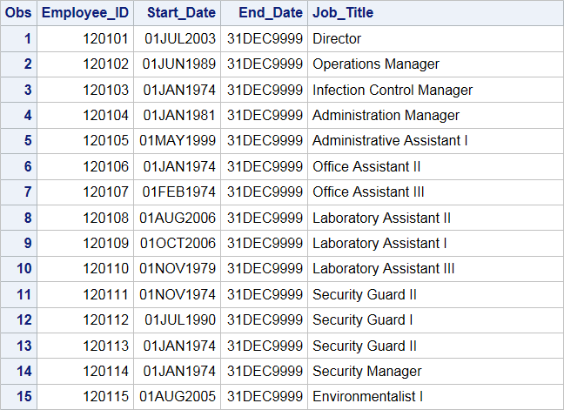
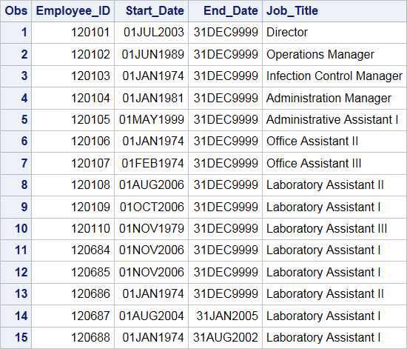
Notes:
You’ve seen how to modify a data set so that the output data set contains a subset of the observations contained in the input data set. Now suppose you need to create a new SAS data set that only includes a subset of the variables contained in the input data set.
You can control which variables are included in the output data set by using a drop or keep statement in your DATA step.

Slide 11
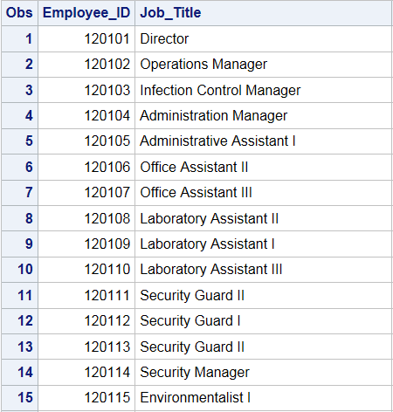
Notes:
You’ve seen how to modify a data set so that the output data set contains a subset of the observations contained in the input data set. Now suppose you need to create a new SAS data set that only includes a subset of the variables contained in the input data set.
You can control which variables are included in the output data set by using a drop or keep statement in your DATA step.

Slide 12
DROP variable-list;
KEEP variable-list;
Notes:
You can see the general form of the drop and keep statements here. The DROP statement lists the set of variables that you want to omit from the output data set. When you use a DROP statement, all variables not listed are included in the output data set.
The KEEP statement lists the set of variables that you wan to include in the output data set. When you use a KEEP statement, ONLY the variable list will be included in the output data set. All others will be omitted. You should not use a DROP and a KEEP statement in the same DATA step.
Additionally, you may want to use the KEEP statement instead of the DROP statement if the number of variables you want to keep is significantly smaller than they number of variables that you want to drop.
Another benefit of using the keep statement is that you are able to see the variables included in the data set just by looking at the DATA step.

Slide 13
data ntrhd.subset;
set ntrhd.original;
keep id height weight;
run;
Notes:
Here is an example of a KEEP statement in a data step. In this example, regardless of how many variables were in the data set ntrhd.original, only the variables id, height, and weight will be written to the new data set ntrhd.subset.
Importantly, however, all the variables from ntrhd.original are initialized in the PDV, and available for SAS expression. They just aren’t written out to the new data set.

Slide 14
id | bmi
1114 | 32
1115 | 30
1116 | 19
1120 | 28
1121 | 24
1127 | 20
1128 | 34
data ntrhd.subset;
set ntrhd.original;
keep id bmi;
bmi = (weight / (height^2)) * 703;
run;
Notes:
As you’ve already seen, if you want to create a new dataset that contains only a subset of the full dataset. But, let’s make things slightly more complicated. Building on the previous example, let’s say that in addition to only keeping the variables id and BMI, you only want to keep a subset of observations whose BMI is 30 or above.
Let’s think about what you need SAS to do. You don’t want to select observations based on variables in the input data set. You want to select observations based on variables that you’re creating. You could consider using a WHERE statement, but the WHERE statement selects observations as they are read from the input data set to the Program Data Vector. In this situation you want to subset observations based on the variable BMI, which is not a part of the ntrhd.original data set. So, you can’t use the WHERE statement in this situation.

Slide 15
IF expression;
Notes:
To subset observations based on the value of a variable you create, you can use the subsetting IF statement. The syntax for a subsetting IF statement is just the keyword IF followed by an expression that you want to evaluate.

Slide 16
id | bmi
1114 | 32
1115 | 30
1116 | 19
1120 | 28
1121 | 24
1127 | 20
1128 | 34
data ntrhd.subset;
set ntrhd.original;
keep id bmi;
bmi = (weight / (height^2)) * 703;
if bmi >= 30;
run;
Notes:
Now you can use the subsetting IF statement to select observations where BMI is greater than or equal to 30. Just remember that although the IF expressions functions much like a WHERE expressions, you cannot use the special where operators in IF expressions.

Slide 17
Practice: Using the Subsetting IF
In this practice, you modify a DATA step to create a new temporary SAS data set that contains a subset of the observations in the ntrhd.staff data set.
Steps:
Copy and paste the program w5_lecture_practice_Subsetting If into the editor.
Use an assignment statement and yrdif function to create the variable Age (as of today) from the variable Birth_Date.
In the same data step that you create Age, use a subsetting IF statement to select only employees in their 20’s to be written to the practice1 data set.
Submit the program and view the results.
Notes:
Now you practice opening SAS in windows.

Slide 18
References
SAS Institute. SAS Programming 1: Essentials [e-learning course]. Cary, NC: SAS Institute Inc.; 2012. Accessed: December, 2013
Cody R. Learning SAS by Example: A Programmer’s Guide. Cary, NC: SAS Institute Inc.; 2007.

