Slide 1
This slide deck is not a presentation. It’s to export diagrams and images in an image format for use in markdown files.

Slide 2
Instructions
Create the graphic on a blank slide
Select the slide
Click File -> Export
Name the file, select the directory to export it to
lesson_number order_brief description.png
Change the file format to PNG
Set the dimensions to 1800 x 1013

Slide 3

Notes:
store

Slide 4
Right on Camp Bowie Blvd.
Drive 1 mile
Left on Hulen St.
Drive .5 mile
Cross I-30
Turn right at second parking lot entrance
Notes:
directions

Slide 5
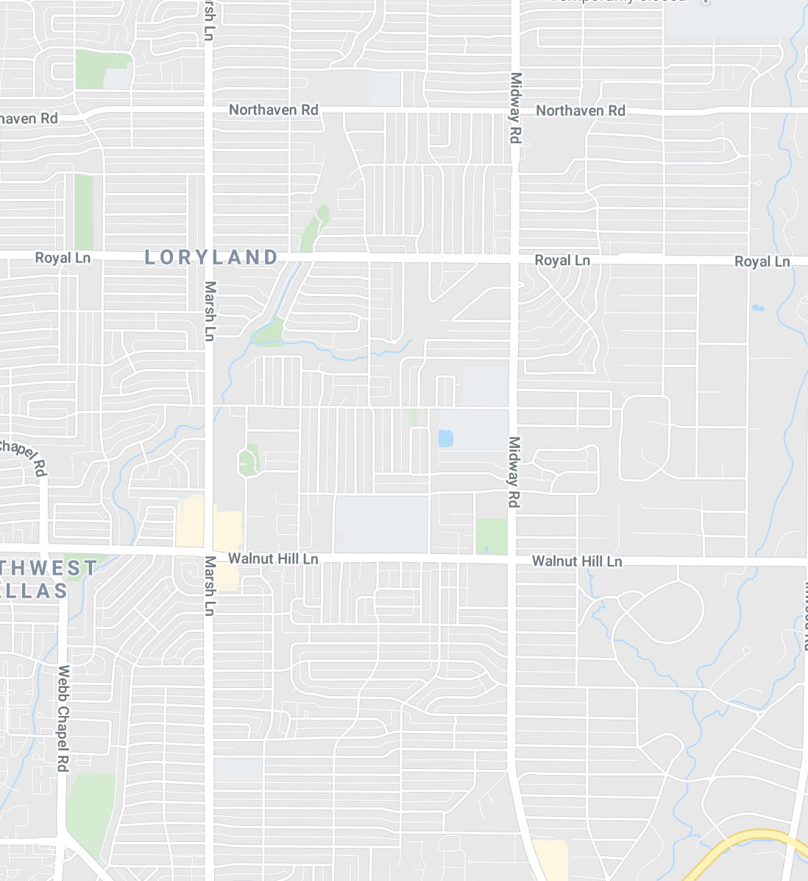

Notes:
locations

Slide 6

Notes:
ntrhd

Slide 7
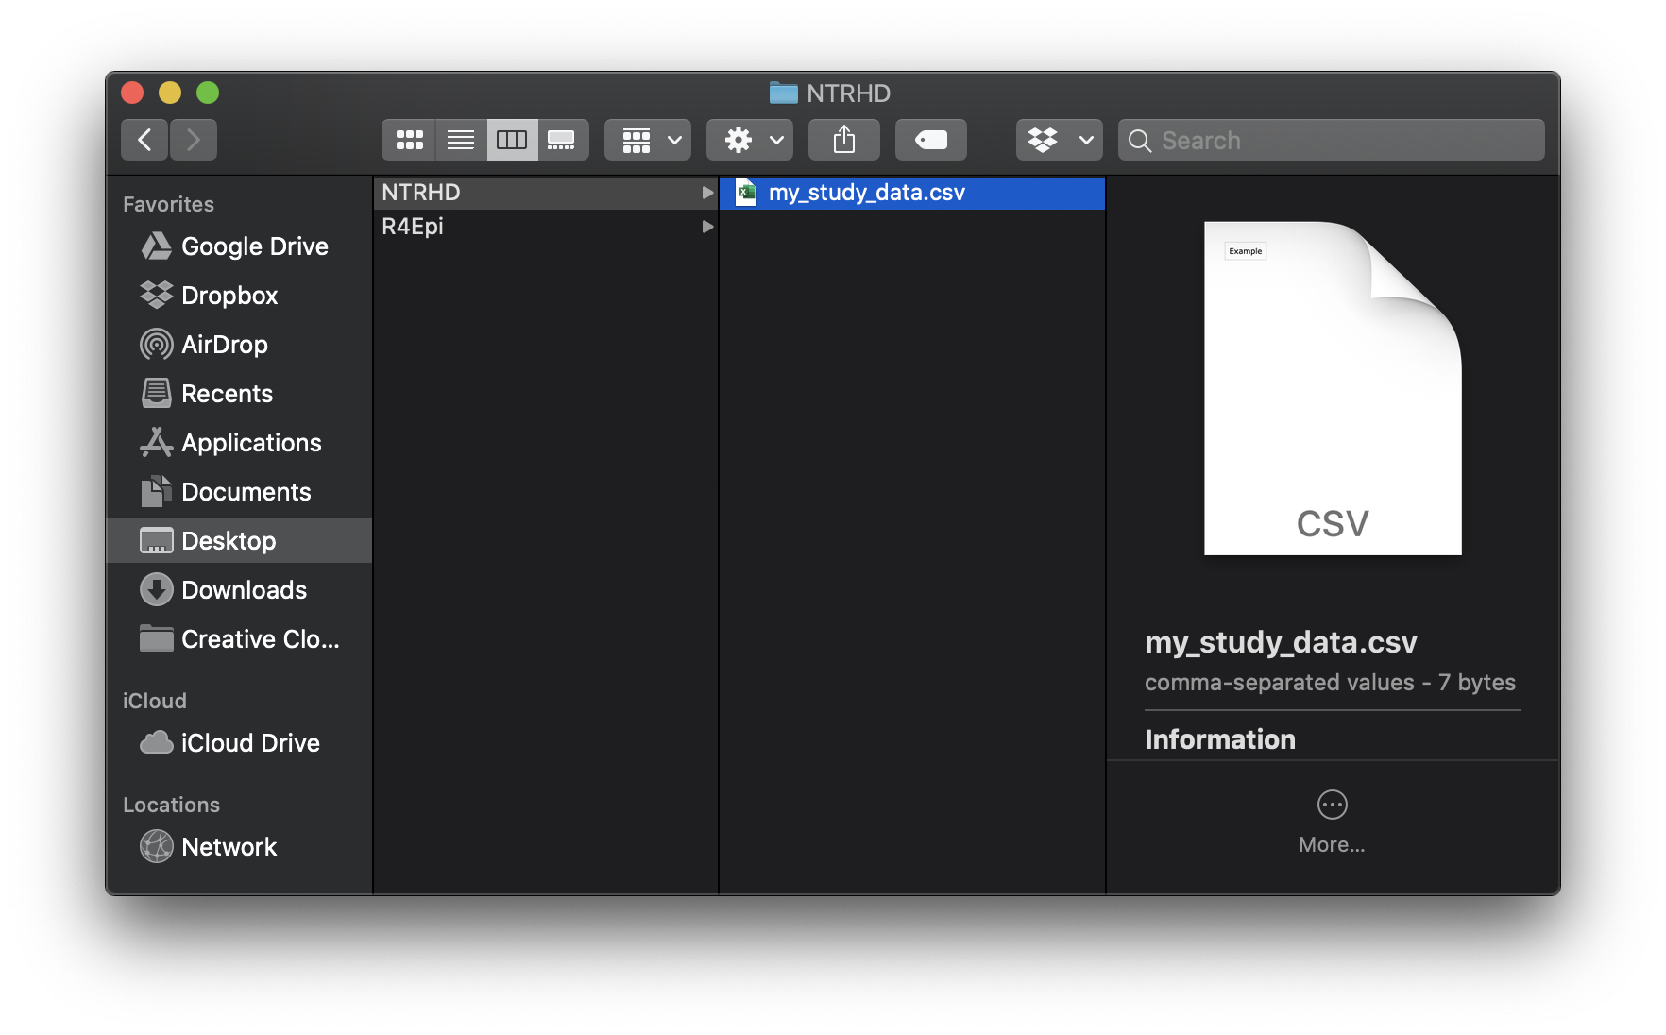
Notes:
my_study_data

Slide 8
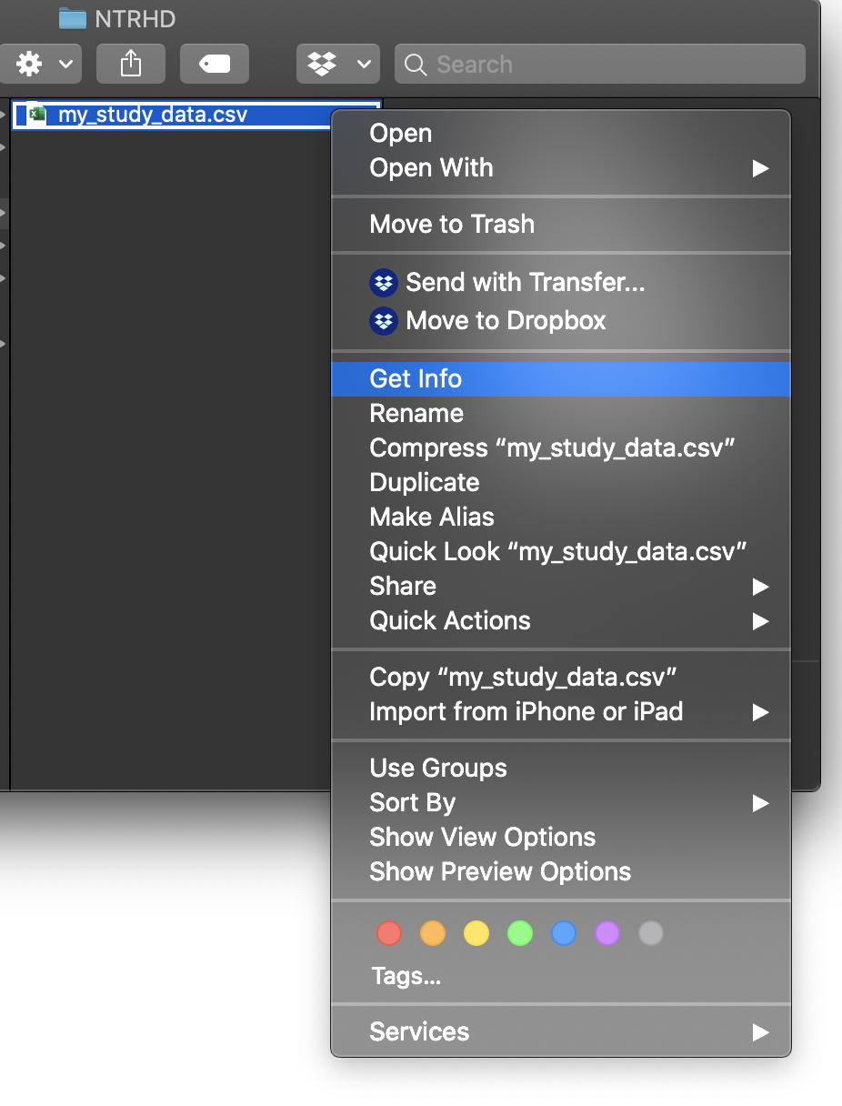
Notes:
get_info

Slide 9
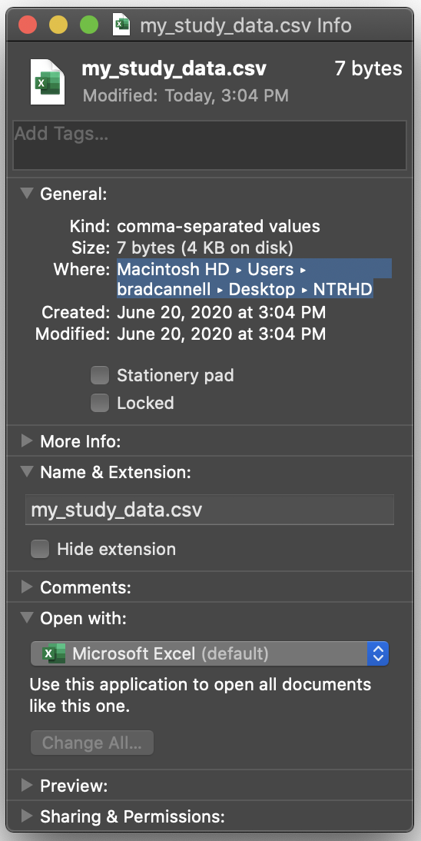
Notes:
where

Slide 10
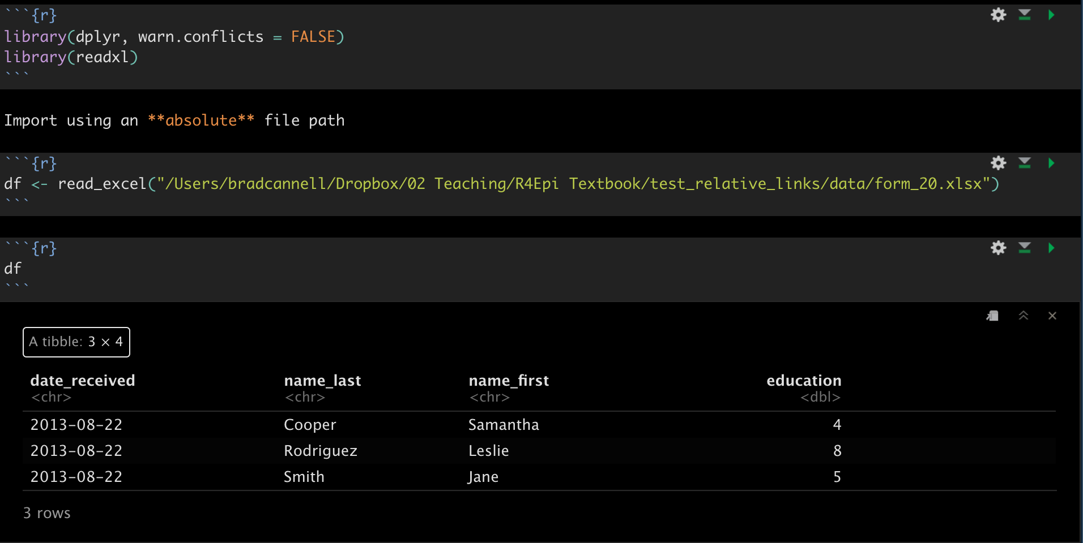

Slide 11
