Slide 1
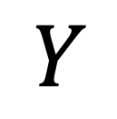
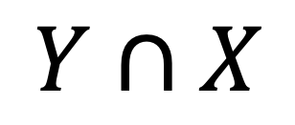
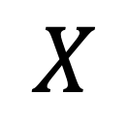
$$Y$$
$$Y∩X$$
$$X$$
Notes:
Intersection

Slide 2
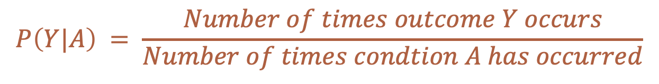
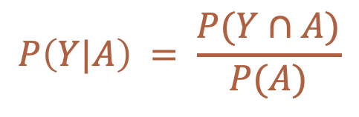
Conditional Probability
How likely an event is to happen given that something else has already happened.
$$P\left(Y|A\right) = \frac{P(Y∩A)}{P(A)}$$
$$P\left(Y|A\right) = \frac{Number of times outcome Y occurs}{Number of times condtion A has occurred}$$
Notes:
Or, we could write it out like this.

Slide 3
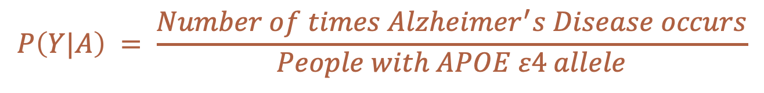
Conditional Probability
How likely an event is to happen given that something else has already happened.
$$P\left(Y|A\right) = \frac{P(Y∩A)}{P(A)}$$
$$P\left(Y|A\right) = \frac{Number of times Alzheimer^{′}s Disease occurs}{People with APOE ε4 allele}$$
Notes:
Or, we could write it out like this.

Slide 4
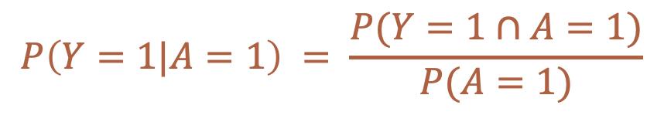
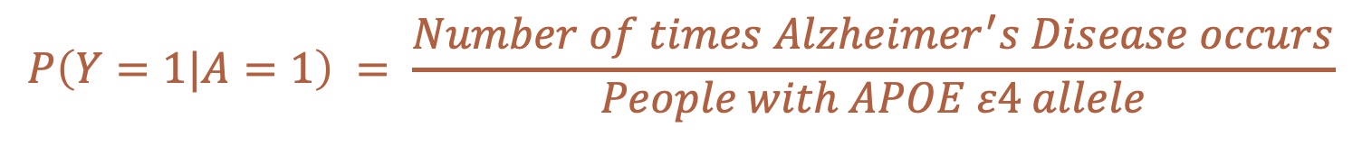
Conditional Probability
How likely an event is to happen given that something else has already happened.
$$P\left(Y=1|A=1\right) = \frac{P(Y=1∩A=1)}{P(A=1)}$$
$$P\left(Y=1|A=1\right) = \frac{Number of times Alzheimer^{′}s Disease occurs}{People with APOE ε4 allele}$$
Notes:
Finally, we could be even more explicit and write it out like this.

Slide 5

Association
$$\operatorname{Pr}\left[Y=1 | A=1\right]≠Pr⁡[Y=1|A=0]$$
Source: Hernán MA, Robins JM. Causal Inference: What If. CRC Press; 2020.
Notes:
association

Slide 6
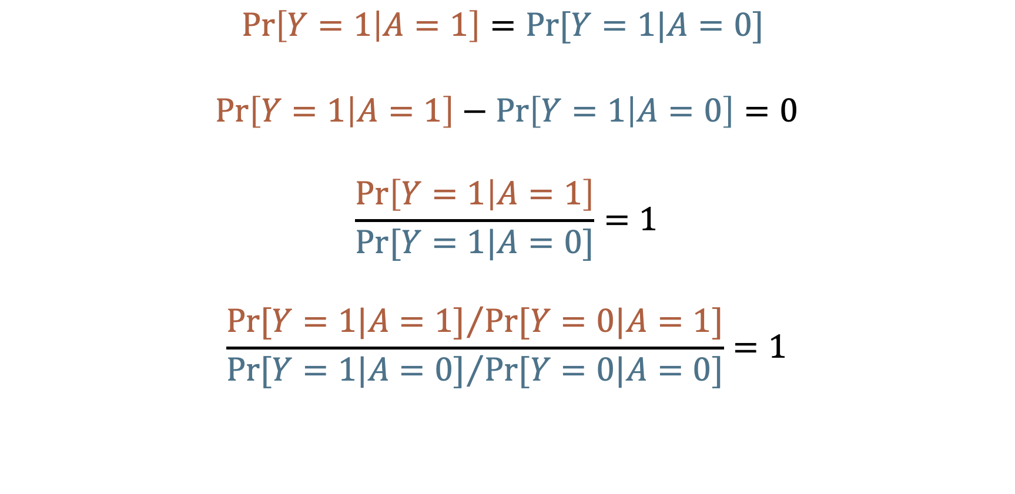
No Association (Independence)
$$\operatorname{Pr}\left[Y=1 | A=1\right]=Pr⁡[Y=1|A=0]$$
$$\operatorname{Pr}\left[Y=1 | A=1\right]−\operatorname{Pr}\left[Y=1 | A=0\right]=0$$
$$\frac{\operatorname{Pr}\left[Y=1 | A=1\right]}{Pr⁡[Y=1|A=0]}=1$$
$$\frac{{Pr⁡[Y=1|A=1]}/{Pr⁡[Y=0|A=1]}}{{Pr⁡[Y=1|A=0]}/{Pr⁡[Y=0|A=0]}}=1$$
Source: Hernán MA, Robins JM. Causal Inference: What If. CRC Press; 2020.
Notes:
independence

Slide 7
No Association (Independence)
$$\operatorname{Pr}\left[Y=1 | A=1\right]=Pr⁡[Y=1|A=0]$$
$$\operatorname{Pr}\left[Y=1 | A=1\right]−\operatorname{Pr}\left[Y=1 | A=0\right]=0$$
$$\frac{\operatorname{Pr}\left[Y=1 | A=1\right]}{Pr⁡[Y=1|A=0]}=1$$
$$\frac{{Pr⁡[Y=1|A=1]}/{Pr⁡[Y=0|A=1]}}{{Pr⁡[Y=1|A=0]}/{Pr⁡[Y=0|A=0]}}=1$$
No Incidence Proportion difference association
No Incidence Proportion ratio association
No Incidence odds ratio association
Source: Hernán MA, Robins JM. Causal Inference: What If. CRC Press; 2020.
Notes:
independence_02

Slide 8
No Association (Independence)
$$\operatorname{Pr}\left[Y=1 | A=1\right]=Pr⁡[Y=1|A=0]$$
$$\operatorname{Pr}\left[Y=1 | A=1\right]−\operatorname{Pr}\left[Y=1 | A=0\right]=0$$
$$\frac{\operatorname{Pr}\left[Y=1 | A=1\right]}{Pr⁡[Y=1|A=0]}=1$$
$$\frac{{Pr⁡[Y=1|A=1]}/{Pr⁡[Y=0|A=1]}}{{Pr⁡[Y=1|A=0]}/{Pr⁡[Y=0|A=0]}}=1$$
Incidence Proportion difference association
Null = 0
Incidence Proportion ratio association
Null = 1
Incidence odds ratio association
Null = 1
Source: Hernán MA, Robins JM. Causal Inference: What If. CRC Press; 2020.
Notes:
independence_03

Slide 9
Incidence Proportion Difference
$$\operatorname{Pr}\left[Y=1 | A=1\right]−\operatorname{Pr}\left[Y=1 | A=0\right]=…$$
$$\operatorname{Pr}\left[Y=1 | A=1\right]<\operatorname{Pr}\left[Y=1 | A=0\right]$$
$$\operatorname{Pr}\left[Y=1 | A=1\right]>\operatorname{Pr}\left[Y=1 | A=0\right]$$
Null = 0
-1, … -0.7, -0.8, -0.9
0.1, 0.2, 0.3, … 1
Association
No Association
Association
Notes:
incidence_proportion_difference_null

Slide 10

Incidence Proportion Ratio
$$\frac{\operatorname{Pr}\left[Y=1 | A=1\right]}{Pr⁡[Y=1|A=0]}=…$$
$$\operatorname{Pr}\left[Y=1 | A=1\right]<\operatorname{Pr}\left[Y=1 | A=0\right]$$
$$\operatorname{Pr}\left[Y=1 | A=1\right]>\operatorname{Pr}\left[Y=1 | A=0\right]$$
Null = 1
0, … 0.7, 0.8, 0.9
1, 2, 3, … Inf
Association
No Association
Association
Notes:
incidence_proportion_ratio_null

Slide 11
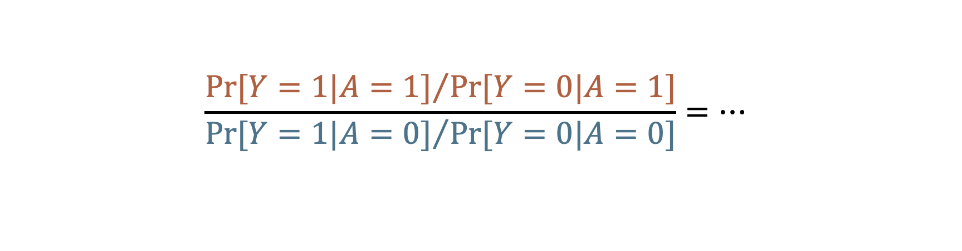
Odds Ratio
$$\frac{{Pr⁡[Y=1|A=1]}/{Pr⁡[Y=0|A=1]}}{{Pr⁡[Y=1|A=0]}/{Pr⁡[Y=0|A=0]}}=…$$
$$\operatorname{Pr}\left[Y=1 | A=1\right]<\operatorname{Pr}\left[Y=1 | A=0\right]$$
$$\operatorname{Pr}\left[Y=1 | A=1\right]>\operatorname{Pr}\left[Y=1 | A=0\right]$$
Null = 1
0, … 0.7, 0.8, 0.9
1, 2, 3, … Inf
Association
No Association
Association
Notes:
odds_ratio_null

Slide 12
Measures of Association
Absolute Measures
Differences
Relative Measures
Ratios
Proportions
Odds
Rates
Proportions
Odds
Rates
Source: Szklo M, Nieto FJ. Epidemiology: Beyond the Basics. Jones & Bartlett Learning; 2019.
Notes:
measures_of_association_tree_01

Slide 13
Measures of Association
“Measures based on absolute differences are often preferred when public health or preventive activities are evaluated, as their main goal is often an absolute reduction in the risk of an undesirable outcome.”
Absolute Measures
Differences
Relative Measures
Ratios
Proportions
Odds
Rates
Proportions
Odds
Rates
Source: Szklo M, Nieto FJ. Epidemiology: Beyond the Basics. Jones & Bartlett Learning; 2019.
Notes:
measures_of_association_tree_02

Slide 14
Measures of Association
“In contrast, etiologic studies that are searching disease determinants (causes) usually rely on relative differences in the occurrence of discrete outcomes.”
Absolute Measures
Differences
Relative Measures
Ratios
Proportions
Odds
Rates
Proportions
Odds
Rates
Source: Szklo M, Nieto FJ. Epidemiology: Beyond the Basics. Jones & Bartlett Learning; 2019.
Notes:
measures_of_association_tree_03

Slide 15
2x2 Contingency Table (Crosstab)
 | Outcome + | Outcome -
Exposure + | a | b
Exposure - | c | d
This order is important!!
Notes:
crosstab_01

Slide 16
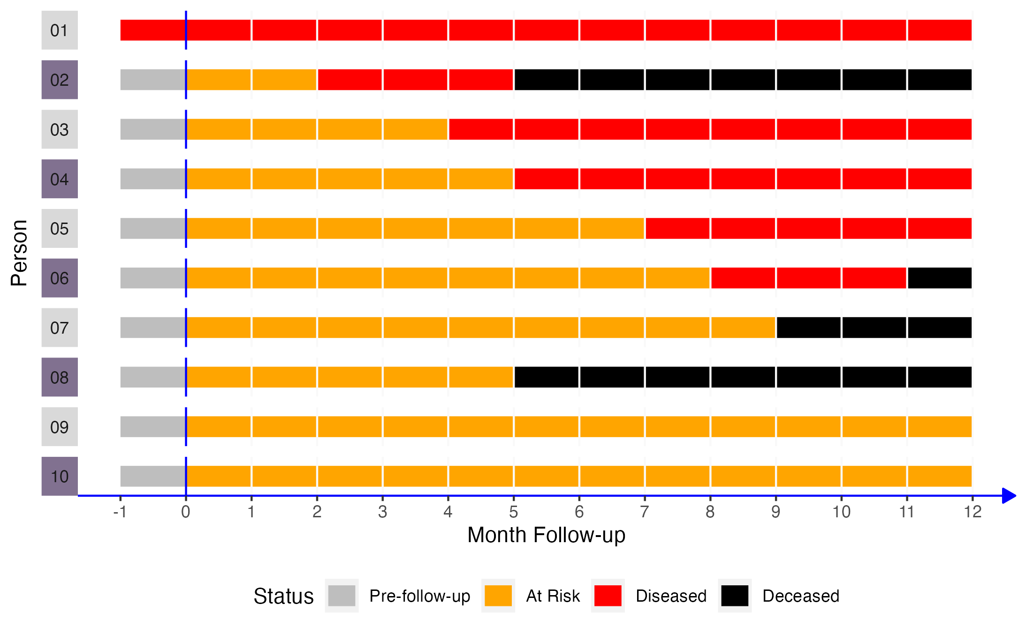
 | Disease + | Disease -
Exposure + | a | b
Exposure - | c | d
Notes:
crosstab_02

Slide 17
 | Disease + | Disease -
Exposure + | 3 | 2
Exposure - | 3 | 2
Notes:
crosstab_03

Slide 18
2x2 Contingency Table (Crosstab)
 | Outcome + | Outcome - | Row Total
Exposure + | a | b | a+b
Exposure - | c | d | c+d
Column Total | a+c | a+c | a+b+c+d
Table Margins
Marginal Totals
Notes:
crosstab_04

Slide 19
2x2 Contingency Table (Crosstab)
 | Outcome + | Outcome - | Row Total
Exposure + | 3 | 2 | 5
Exposure - | 3 | 2 | ?
Column Total | ? | ? | ?
Notes:
crosstab_05

Slide 20
2x2 Contingency Table (Crosstab)
 | Outcome + | Outcome - | Row Total
Exposure + | 3 | 2 | 5
Exposure - | 3 | 2 | 5
Column Total | 6 | 4 | 10
Notes:
crosstab_06

Slide 21
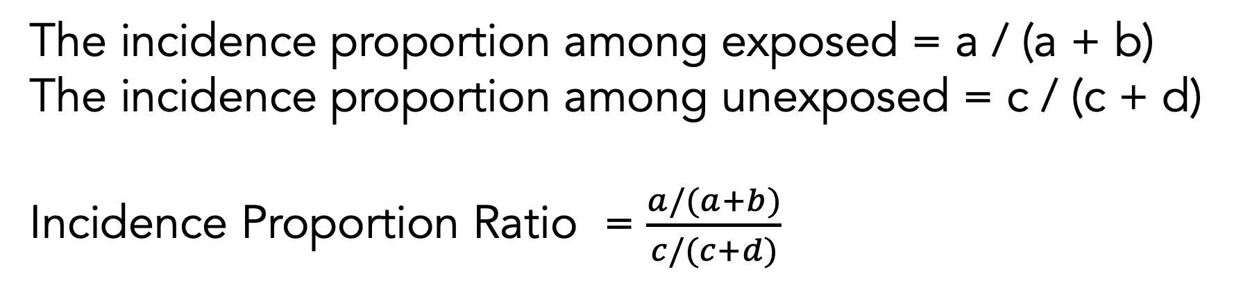
Incidence Proportion Ratio
 | Outcome + | Outcome - | Row Total
Exposure + | a | b | a+b
Exposure - | c | d | c+d
Column Total | a+c | a+c | a+b+c+d
The incidence proportion among exposed = a / (a + b)
The incidence proportion among unexposed = c / (c + d)
Incidence Proportion Ratio = $\frac{a/(a+b)}{c/(c+d)}$
Notes:
incidence_proportion_ratio_crosstab

Slide 22
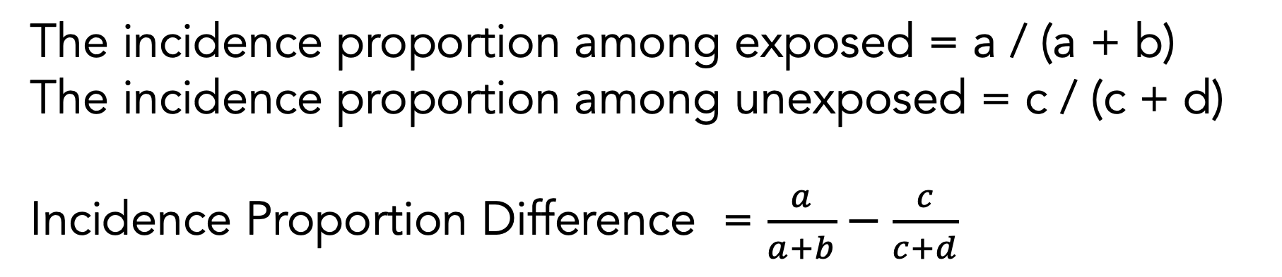
Incidence Proportion Difference
 | Outcome + | Outcome - | Row Total
Exposure + | a | b | a+b
Exposure - | c | d | c+d
Column Total | a+c | a+c | a+b+c+d
The incidence proportion among exposed = a / (a + b)
The incidence proportion among unexposed = c / (c + d)
Incidence Proportion Difference = $\frac{a}{a+b}−\frac{c}{c+d}$
Notes:
incidence_proportion_difference_crosstab

Slide 23
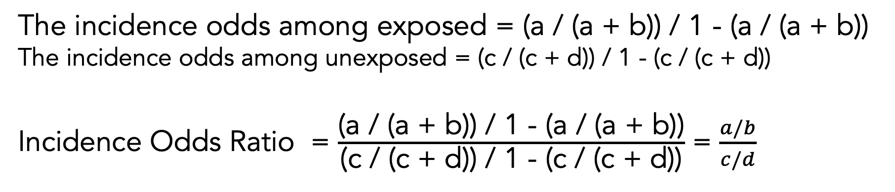
Incidence Odds Ratio
 | Outcome + | Outcome - | Row Total
Exposure + | a | b | a+b
Exposure - | c | d | c+d
Column Total | a+c | a+c | a+b+c+d
The incidence odds among exposed = (a / (a + b)) / 1 - (a / (a + b))
The incidence odds among unexposed = (c / (c + d)) / 1 - (c / (c + d))
Incidence Odds Ratio = $\frac{\text{(}\text{a}\text{ / (}\text{a}\text{ + }\text{b}\text{)) / 1 − (}\text{a}\text{ / (}\text{a}\text{ + }\text{b}\text{))}}{\text{(}\text{c}\text{ / (}\text{c}\text{ + }\text{d}\text{)) / 1 − (}\text{c}\text{ / (}\text{c}\text{ + }\text{d}\text{))}}$ = $\frac{a/b}{c/d}$
Notes:
incidence_odds_ratio_crosstab

Slide 24


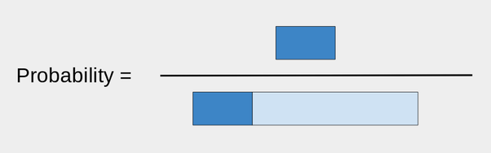
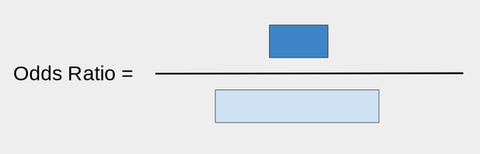
Odds ratio
First take a bar of length 1:
That will be the portion of what did not make it.
Now, take a bar of length r, where r is your ratio. For example, if r was 0.3, I would attach it like so:
The dark blue is the ones that did make it.
Notes:
odds_ratio_and_probability

