Slide 1
This slide deck is not a presentation. It’s to export diagrams and images in an image format for use in markdown files.

Slide 2
Instructions
Create the graphic on a blank slide
Select the slide
Click File -> Export
Name the file, select the directory to export it to
lesson_number order_brief description.png
Change the file format to PNG
Set the dimensions to 1800 x 1013

Slide 3




Slide 4
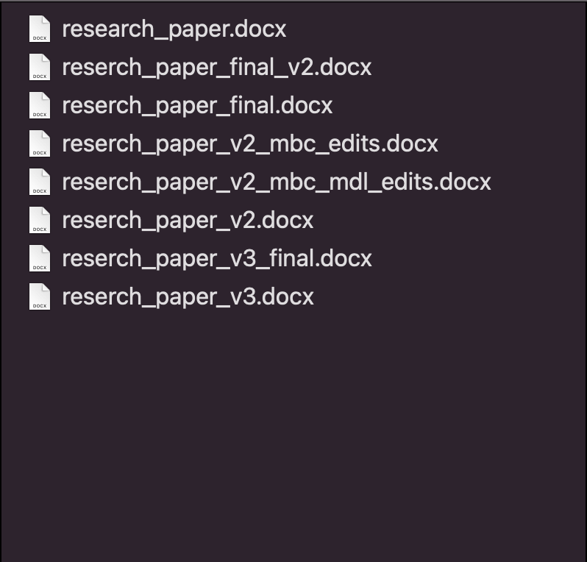

Slide 5
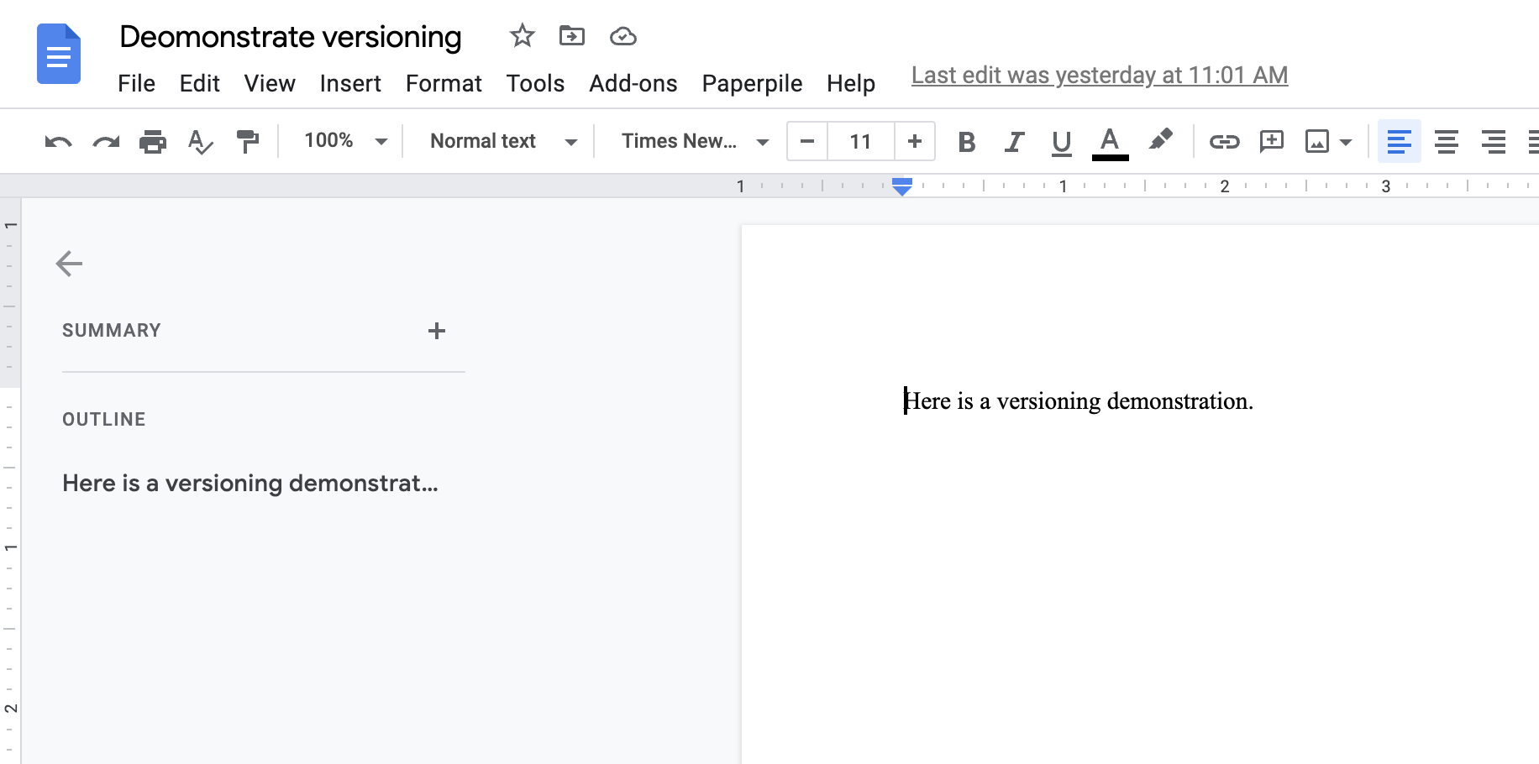

Slide 6
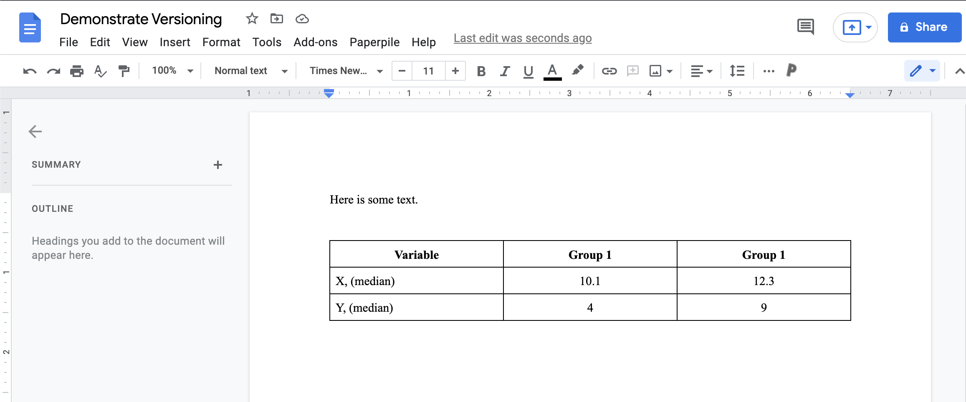

Slide 7
References
R4Epi
R Notes
Git book
Happy Git for the useR
Jenny’s Git paper on Paperpile

