Slide 1
Graphics for Measures of Occurrence
This PPT was originally created for use in the Epidemiology III lab session.
We moved it over from OneDrive and will adapt it for use in R4Epi.

Slide 2

Measures of Occurrence
Epidemiology III
Notes:
So far, we have discussed the basics of using R and RStudio, but there hasn’t been anything particularly “epi” about it. This week, we will turn our attention more towards reviewing some of the basic tools and concepts of epidemiology, and how to apply them to solve public health issues. As part of that process, we we will continue to learn how to use R and RStudio as tools that can help us in that pursuit.

Slide 3
Terms to introduce:
Counts
Numerator/denominator
Define ratio
Define proportion
Define probability
Conditional probability
Define odds
Relationship between continuous variables and event occurrence.
Dummy variables
When to group as “any “
Prevalence (Point, period, cumulative lifetime)
Incidence
Cumulative incidence (incidence proportion)
Survival analysis
Censoring
Life table
Kaplan-Meier method
Person-time
Incidence rate (incidence density)
Hazard rate
Notes:
For so many measures in epidemiology, then numerator stays the same. It is the denominator that changes.

Slide 4
Epidemiology
“the study of the occurrence and distribution of health-related states or events in specified populations, including the study of the determinants influencing such states, and the application of this knowledge to control the health problems.” (Porta 2008, page 81)
Notes:
This course is not an intro course, but it can often be interesting to revisit the basics of epidemiology often through the lens of additional knowledge you have gained. For example, let’s take a look at a commonly used definition of epidemiology that is taken from the Dictionary of Epidemiology.
[Read definition]
Our goal today is to learn a little bit about some of the ways we may study occurrence.

Slide 5



Measurement
Uncertainty
Study Design
Notes:
I expect that all of you have already had some exposure to the basics of epidemiology. However, I would like to briefly review a few aspects of epidemiology that we will emphasize in this course. Namely, I want to briefly discuss measurement, uncertainty, and study design.

Slide 6
“the study of the occurrence and distribution of health-related states or events in specified populations, including the study of the determinants influencing such states, and the application of this knowledge to control the health problems.”
Source: Porta M, ed. A Dictionary of Epidemiology. Oxford University Press; 2008.
Notes:
Epidemiology is typically defined as some version of, “the study of the occurrence and distribution of health-related states or events in specified populations, including the study of the determinants influencing such states, and the application of this knowledge to control the health problems.” (Porta 2008, page 81) I usually say, “who gets sick or stays healthy, and why.”
Because this isn’t an introductory course on epidemiology, I’m not going to attempt to pick apart all the nuances of that definition. However, it may be worth taking a step back and thinking about how we study the occurrence and distribution of these things. Do we consult powerful oracles or deities? Not typically. Do we go into a deep meditative state until the answers just occur to us? Not typically. At least doing that alone would not typically be very convincing evidence to most people.

Slide 7
“the study of the occurrence and distribution of health-related states or events in specified populations, including the study of the determinants influencing such states, and the application of this knowledge to control the health problems.”
Observe and assign values to relevant characteristics.
Look for patterns among those values.
Measurement
Source: Porta M, ed. A Dictionary of Epidemiology. Oxford University Press; 2008.
Notes:
Instead, we almost always study health-related states and populations by measuring characteristics of those states or populations.
And what do we mean by measure? Typically, that means that we observe some people, places, or events that are thought to be relevant to the population we are interested in. As we are observing, we assign and record values about the things we are observing that are thought to be relevant. For example, we might ask someone to step on a scale. We could observe their weight and record it somewhere. Or, we might ask someone to fill out a questionnaire about their thoughts and feelings. We could then record those responses somewhere as well.

Slide 8
“the study of the occurrence and distribution of health-related states or events in specified populations, including the study of the determinants influencing such states, and the application of this knowledge to control the health problems.”
Observe and assign values to relevant characteristics.
Look for patterns among those values.
Observe: “To be aware of” or “Have knowledge about”
Measurement
Notes:
Notice how we frequently use the word “observe” in epidemiology. In everyday speech, we tend to think of observe as meaning seeing something take place in front of your eyes. In epidemiology, it is common to use the word observe more broadly. Something closer to simply meaning ”to be aware of” or ”have knowledge about”.

Slide 9
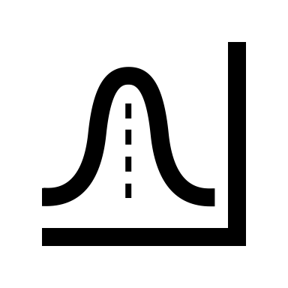
X | Y | Z
1 | A | 1
2 | B | 0
3 | C | 1
Measurement
Data
Statistics
Data
Notes:
Then we look for useful patterns in those measurements. Recording those measurements typically results in data and looking for useful patterns typically occurs by applying statistical procedures to the data — hence, data and statistics are probably the two most commonly used tools in an epidemiologist’s toolbox.

Slide 10
Description
Causation
Prediction
Notes:
If that all sounds a little too “deep” to be meaningful, I think the relevant take-away for our purposes is that a typical day in the life of most epidemiologists includes attempting to describe, predict, and/or causally explain health-related phenomena in populations of people, and we typically rely heavily on data, statistics, and assumptions to help us do that.
There may be some technical definitions somewhere that clearly distinguish each of these measurement and analysis goals, but in my experience, there is often some overlap between them in applied epidemiology. Further, the same study may attempt to do all three to varying degrees. Having said that, I think there is some value in taking a moment to discuss each individually.

Slide 11
Description
Not necessarily looking for associations.
Distributions (i.e., middle, spread, shape, count, proportion) of single variables.
Resource management and planning.
Examples:
How many ventilators are available in Texas?
What is the average age of people living in Florida?
How much time elapses, on average, between exposure to a pathogen and occurrence of disease symptoms.
Notes:
When we say describe in this context, we are not necessarily looking for associations in the data between two or more variables. Sometimes, we are simply looking at the distribution of a single variable/measure. Typically, this is done in the context of resource management and planning, or while conducting exploratory analysis.

Slide 12
Description
But, sometimes looking for associations.
Comparing distributions of single variables within levels of another variable.
Examples:
Are there more ventilators available in Texas or New York?
Are people older, on average, in Florida or Pennsylvania?
Is symptom onset quicker, on average, for Cholera or E. coli?
Notes:
However, there are also times when we want to compare the distribution of one variable within levels of another variable. Most people would consider these comparisons to be equivalent to measuring associations. You could also make the case that this starts to overlap with prediction. It sort of just depends on how the information is being used.

Slide 13
Description
Measures of occurrence.
Counts
Incidence
Prevalence
Odds
Can be useful on their own.
Can be useful for hypothesis generation.
Notes:
You can generally think of measures like incidence, prevalence, and odds as descriptive, and we will discuss them in greater detail shortly. Often, these descriptive measures can be very useful in their own right, but they are also used as a foundation for hypothesis generation, prediction, and causal explanation as well.
Prediction and causal explanation will be the topic of future modules.

Slide 14
Few checklists
Uncertainty
Notes:
In epidemiology generally, and parts of this course specifically, it will behoove us to become comfortable with uncertainty. When I say “uncertainty” here, I mean it in both a philosophical sense and in a very practical sense.
First, in a very practical sense, all students of epidemiology (including me) must get comfortable with the lack of reliable check-list procedures in epidemiology. What I mean is that students (including me) often wish that there was a simple checklist or algorithm that we could follow that will always lead us to the correct answer. Unfortunately, there are just very few such checklists in epidemiology – and in life for that matter. In reality, we will often have to rely on diligent research and experimentation to inform critical thinking and many (often untestable) assumptions. Clear-cut procedures that provide valid and reliable black and white answers are the exception rather than the rule. On the bright side, this should also provide us with some measure of job security for the foreseeable future. If epidemiology could simply be reduced to a checklist or algorithm, then our jobs would almost certainly be outsourced to computers in no time.

Slide 15
Few checklists
Statistical uncertainty
Uncertainty
Notes:
Second, we should also get comfortable with uncertainty in the statistical sense, which is something we will try to measure and quantify. Indeed, it may be an oversimplification, but not entirely inaccurate, to define statistics as the science of quantifying uncertainty. At least a certain type of uncertainty. It’s important to understand this type of uncertainty and become comfortable with it because, like we discussed earlier, data and statistics are probably the two most commonly used tools in the modern epidemiologist’s toolbox.

Slide 16
Few checklists
Statistical uncertainty
Causal uncertainty
Uncertainty
Notes:
And finally, we should get comfortable with uncertainty on the level of our conclusions. In epidemiology, the questions we are called to answer are often causal questions. Did this cause that? If we stop this, can we stop that? On one hand, these questions are usually incredibly exciting and have the potential to lead to real, tangible changes in population health. On the other hand, our two primary tools -- data and statistics -- are not typically not sufficient to answer such questions in and of themselves.
The conclusions that we are able to make are almost always loaded with caveats and assumptions. This is true even for many non-causal questions. However, the questions being asked are often so important that we don’t have the luxury of completely deferring our conclusions until some imaginary later date when the stars align, and the inner workings of the world are magically revealed to us with complete clarity. No, we must often do our best with the information and resources that are available to us now. Therefore, when we make conclusions, we will have to be comfortable with the fact that they may be wholly or partially incorrect, there may be important exceptions, and/or we may have to revisit them again in the future when circumstances, or the information available to us, changes. Even when they are entirely correct, we will often not be able to prove as much with complete certainty. Said another way, our conclusions will rarely, if ever, be exactly correct or provable; however, sometimes they will still be useful for a given purpose.
That is an unsettling thought for many people. But it is true nevertheless and we must accept it and become comfortable with it if we want to practice epidemiology. If it makes you feel any better, the history of public health, including epidemiology, is littered with notable examples of useful conclusions that were not entirely correct or not entirely proven, yet still extremely useful. For example, citrus fruit to prevent and cure scurvy, drinking tainted drinking water as a cause of cholera, and tobacco smoke as a cause of lung cancer (and many other diseases).

Slide 17
“the study of the occurrence and distribution of health-related states or events in specified populations, including the study of the determinants influencing such states, and the application of this knowledge to control the health problems.”
Source: Porta M, ed. A Dictionary of Epidemiology. Oxford University Press; 2008.
Notes:
Another important concept in epidemiology is that of populations. In fact, our concern with populations is embedded in our very definition. In epidemiology, we generally want to describe a population, predict the occurrence of something in a population, or explain the causes of something in a population.
But, what is a population?

Slide 18

“The simplest definition of a population is a group of people who share characteristics or meet criteria that define membership in the population.”
Source: Lash TL, VanderWeel TJ, Haneuse S, Rothman KJ. Modern Epidemiology. fourth. Wolters Kluwer; 2021.
Notes:
Well, The simplest definition of a population is a group of people who share characteristics or meet criteria that define membership in the population.
In other words, we set some criteria of interest and then anyone who meets that criteria is a member of the population. In everyday language, we most often think about the criteria that defines population membership as being geographic. For example, all of the people who live in the United States make up the population of the United States. The criteria that defines them is the fact that they live in the United States.
But we certainly do not have to limit our criteria of interest to be geographic. We can use pretty much any criteria that is useful for our purposes. For example, people of a particular age, gender, or race or ethnicity; people who work in a particular occupation; people who participate in a particular behavior or activity; or people who have a particular disease. All the people who meet whatever the criteria are de facto members of the population.

Slide 19
“The simplest definition of a population is a group of people [during a defined time period] who share characteristics or meet criteria that define membership in the population.”
Source: Lash TL, VanderWeel TJ, Haneuse S, Rothman KJ. Modern Epidemiology. fourth. Wolters Kluwer; 2021.
Notes:
I would add the qualifier “during a defined time period” to this definition. As I hope to show you, the inclusion of the time period of interest is is a critical component of making almost every measure we will use in epidemiology meaningful.
A couple of slides from now, we will see some examples of different ways we can define time periods and some examples that demonstrate why the definition of the time period matters.

Slide 20
Closed population
After the population is defined…
Doesn’t add any new members over time.
Loses members only to death.
Open population
May gain members over time through birth or as new people meet the definition.
Loses members over time as people stop meeting the criteria or die.
Source: Lash TL, VanderWeel TJ, Haneuse S, Rothman KJ. Modern Epidemiology. fourth. Wolters Kluwer; 2021.
Notes:
But first, we will dig slightly deeper into our definition of populations. Specifically, populations may be further classified as open or closed.
[Read definitions]
So, the most obvious way that open and closed populations differ is that people can move in and out of open populations over time, but the same is not true for closed populations. As we will see, this has implications for the kinds of measures we can/should use when studying health. It also has implications for the meaning we make of our conclusions.
A second, more subtle, distinction between whether a population is closed or open is the time axis we choose to use to describe the population.
So, closed or open aren’t necessarily a property of the group of people under study. It is simply a consequence of the way we define the population.

Slide 21

Closed vs. Open Populations
Person
1
2
3
4
9/1
9/7
9/14
9/21
9/28
Week (Calendar Time)
Notes:
For example, let’s think about the population of people who use Aspirin. It may not initially be obvious, but we could use more than one time axis as we define this population.
For example, we have calendar time on the x-axis of the figure shown here -- week 0, 1, 2, 3, and 4 beginning on September 1st.
Using that definition, is this an example of an open or closed population?
This is an open population when defined in calendar time because new people are entering the population over time.
Although, not explicitly shown in this figure, if people leave the population for reasons other than death -- for example, stop taking Aspirin – then that would be another way this population meets the definition of an open population.

Slide 22
Closed vs. Open Populations
Person
1
2
3
4
0
1
2
3
4
Event Time
Notes:
However, that same population could also be defined as a closed population if the x-axis is measured from the start of their Aspirin use. So, in this figure, time is measured as weeks since the initiation of Aspirin use. This is an example of event time.
If, as in this example, membership in the population always starts with an event such as initiation of treatment and never ends thereafter, the population is closed along the time axis that marks this event as the index time for each member because all new members enter only when they experience this event. The same population will, however, be open along most other time axes. If membership can be terminated by later events other than death, the population is open along any time axis.
So, in this scenario, we are defining the population as people who have ever taken Aspirin as of this moment. People in later moments will not meet that definition and cannot be added to the population.

Slide 23
Closed vs. Open Populations
Person
1
2
3
4
0
1
2
3
4
Event Time
Notes:
It is also worth noting that any population that experiences loss to follow-up, even if the people who are lost to follow-up would still meet eligibility criteria if they were being followed, is an open population.
For example, let’s say that membership in our Aspirin population is defined by taking Aspirin once a week. However, person 2 moves and doesn't not leave us with any contact information. This is now, by definition, an open population.
This is actually a very common occurrence in practice, and we will discuss methods for analyzing the data from such populations at multiple times throughout this course.

Slide 24
Examples
Currently enrolled in Epi 3: Open population
Ever enrolled in Epi 3 as of today: Closed population
Resident of Texas: Open population
People aged 65+ as of today: Closed population
People aged 20 to 30 as of today: Open populationa

Slide 25
Populations
Source population: The source population is the population from which persons will be sampled and included in a measurement of disease frequency.
For example, the source population of the original Framingham Heart Study included men and women between the ages of 30 and 62 years who were residents of the town of Framingham, Massachusetts, in 1948.
Target population: The target population is the group of people about which our scientific or public-health question asks, and comprises the persons for whom information gleaned by the measurement of disease frequency will be relevant [we hope].
Information about risk factors for cardiac disease from the Framingham Heart Study has contributed to a nearly 75% decline in mortality related to cardiovascular disease in most industrialized societies.
Source: Lash TL, VanderWeel TJ, Haneuse S, Rothman KJ. Modern Epidemiology. fourth. Wolters Kluwer; 2021. Westreich D. Epidemiology by Design. Oxford University Press; 2019
Notes:
Closed and open are not the only ways you will often hear the word “population” qualified in epidemiology. It is also often common to hear epidemiologists refer to source populations, study populations, and target populations.

Slide 26
Sample
Study population: The study population is the subset, up to a complete census, of the source population whose experience is included in a measurement of disease frequency.
Not all men and women who were eligible to join the Framingham Heart Study were invited to participate, and not all who were invited to participate agreed to participate. Those who were invited, agreed, and were free of prevalent cardiovascular disease constituted the study population.
Sample: A selected subset of a population. A sample may be random or nonrandom and may be representative or nonrepresentative.
Source: Lash TL, VanderWeel TJ, Haneuse S, Rothman KJ. Modern Epidemiology. fourth. Wolters Kluwer; 2021. Porta M, ed. A Dictionary of Epidemiology. Oxford University Press; 2008.
Notes:
In epidemiology, we generally want to describe a population, predict the occurrence of something in a population, or explain the causes of something in a population. However, we generally cannot directly measure exposures and outcomes for every single member of the population. Instead, we must select a sample of people from the population to take measurements from.
Sample can be a noun or a verb. We often talk about “having” a sample and we often talk about sampling a population. In the latter case, sample can mean “recruit”. It can also mean using the records we have access to.
Because we almost never actually observe our measure of interest on every member of our target population, the measures we talk about in the remainder of the slides assume that we are talking about a study population or sample unless specifically stated otherwise.
Because samples are not the entire population by definition, then we cannot be sure that the value for the measurements we calculated from the sample is the same value we would have gotten if we had been able to observe our measures in every person in the target population. The value we get from our sample is called an estimate and the value we would have gotten from the target population is called the true population parameter. It’s important to note that the true population parameter is generally a theoretical quantity that exists, but is rarely ever actually known. The difference between our estimate (the value we got from our sample) and the true population parameter (the answer we would have from the target population) is called bias or error depending on the context. This is an idea that we will return to many times throughout the semester. Additionally, this is the primary source of the statistical uncertainty we spoke about earlier.

Slide 27
Cohorts
Cohort: a group of persons for whom membership is defined in a permanent fashion, or a population in which membership is determined by satisfying a set of defining events and so becomes permanent. Often used as a synonym for “sample” in the context of a cohort study.
Similar to a population. The key difference is that every member of the cohort is enumerated (i.e., known or listed). That is not necessarily true of a closed population.
Source: Lash TL, VanderWeel TJ, Haneuse S, Rothman KJ. Modern Epidemiology. fourth. Wolters Kluwer; 2021.
Notes:
So, maybe we talk about cohorts as a special type of sample.
An example of a cohort would be the members of the graduating class of a school in a given year. The list of cohort members is fixed at the time of graduation and will not increase. Other examples include the cohort of all persons who ever used a drug and the cohort of persons recruited for a follow-up study. In the latter case, the study population may begin with all the cohort members but may gradually dwindle to a small subset of that cohort as those initially recruited die or are loss to follow-up. Those lost to follow-up remain members of the initial-recruitment cohort, even though they are no longer being followed as part of the study population. With this definition, the members of any cohort constitute a closed population along the time axis in which the chronologically last defining event (e.g., birth with Down syndrome or study recruitment) is taken as the index time.
From Epidemiology by design: A cohort is any group of people, usually followed through time; this might be a study population in an observational or randomized study or another group of individuals. Epidemiologists speak of both closed and open cohorts. For our purposes, a closed cohort is a cohort where we start following everyone at the same time point. For example, we could start following individuals on their 40th birthdays; alternatively, we could start following them at time of randomization in a randomized trial. Further, a closed cohort never adds new members after enrollment ends; for example, no one is added to the “start on your 40th birthday” cohort on their 43rd birthday. As such, over time, a closed cohort either stays the same size or gets smaller (as people drop out of or exit a study, or die). An open cohort for our purposes is one that may add more people over time and so may get larger or smaller over time. For the remainder of the text, if we do not specify whether we are discussing a closed or open cohort, the reader should assume we are discussing a closed cohort.
Because we almost never actually observe our measure of interest on every member of our target population, the measures we talk about in the remainder of the slides assume that we are talking about a study population or sample unless specifically stated otherwise.

Slide 28
Measures
Observations
Experiments
Case
Descriptions
Ecological
Cross-sectional
Case-control
Cohort
Non-randomized
Randomized
Typically less convincing
Typically more convincing
Notes:
So, the next question might be, “how do we get the sample of people from the population we want to describe, make predictions about, and/or understand causes in?” Well, there are many different ways!
It’s important that we classify the different ways that we can sample people to take measurements from because each of the different ways has its own set of strengths and weaknesses that we need to be aware of. Today, we will just briefly introduce some of the most common ways to sample people to gather measurements from – also known as study designs – used in epidemiology.
At the first first level, we typically categorize a study designs as either experimental or observational.
Experiments are studies in which the researcher has control over who is exposed to something and who isn’t. We won’t talk a lot about how to do an experimental study in this course. However, we will will talk about a particular kind of experimental study – the randomized controlled trial – as a way to help us understand causal inference later in the course.
In observational studies, the person, nature, society, or some force other than the researcher controls who is exposed to something and who isn’t. Observational studies make up the vast majority of epidemiologic studies. In particular, we will focus heavily on cross-sectional studies, case-control studies, and cohort studies in this course.

Slide 29
Terminology Recap
Our Term | Definition | Examples
Population | A group of people [during a defined time period] who share characteristics or meet criteria that define membership in the population. | The population of the United States.
Closed population | Given a particular time frame (after the population is defined), a population that doesn’t add any new members over time and loses members only to death. | People who had a flu vaccine in 2022.
Open population | Given a particular time frame, a population that gains members over time through birth or as new people meet the criteria that define the population, and/or a population that loses members over time as people stop meeting the criteria or are lost to follow-up. | People who have the flu.

Slide 30
Terminology Recap
Our Term | Definition | Examples
Source population | The population from which persons will be sampled and included in a measurement of disease frequency. | The source population of the original Framingham Heart Study included men and women between the ages of 30 and 62 years who were residents of the town of Framingham, Massachusetts, in 1948.
Target population | The group of people about which our scientific or public-health question asks and comprises the persons for whom information gleaned by the measurement of disease frequency will be relevant [we hope]. | Information about risk factors for cardiac disease from the Framingham Heart Study has contributed to a nearly 75% decline in mortality related to cardiovascular disease in most industrialized societies.

Slide 31
Terminology Recap
Our Term | Definition | Examples
Study population | The subset, up to a complete census, of the source population whose experience is included in a measurement of disease frequency. | Not all men and women who were eligible to join the Framingham Heart Study were invited to participate, and not all who were invited to participate agreed to participate. Those who were invited, agreed, and were free of prevalent cardiovascular disease constituted the study population.
Sample | A selected subset of a population. A sample may be random or nonrandom and may be representative or nonrepresentative. | Another term (probably more common) for study population.

Slide 32
Terminology Recap
Our Term | Definition | Examples
Cohort | A group of persons for whom membership is defined in a permanent fashion, or a population in which membership is determined by satisfying a set of defining events and so becomes permanent. May be open or closed. Often used as a synonym for “sample” in the context of a cohort study. | Similar to a population. The key difference is that every member of the cohort is enumerated (i.e., known or listed).
Notes:
Because we almost never actually observe our measure of interest on every member of our target population, the measures we talk about in the remainder of the slides assume that we are talking about a study population or sample unless specficially stated otherwise.

Slide 33
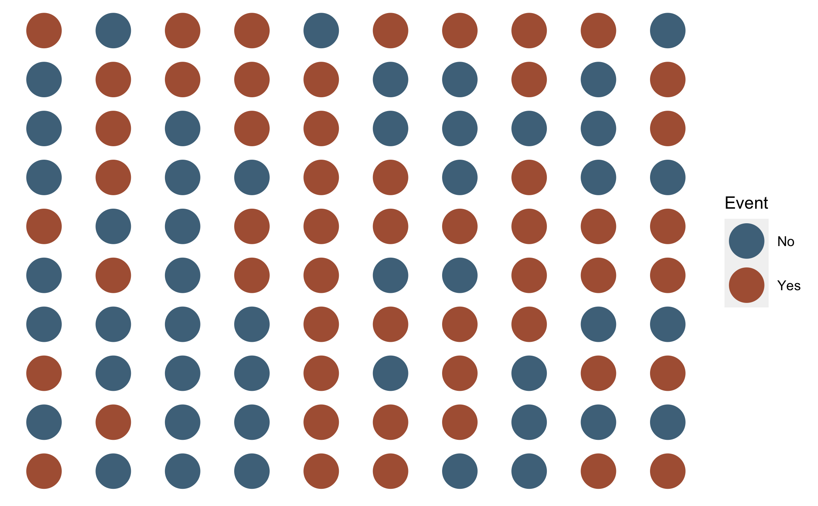
Counts (n)
Notes:
Perhaps the most basic measure of occurrence we can use. How many people have the characteristic or have experienced the event we are interested in? That is, we simply count the number of people in our sample who experience the event of interest.

Slide 34
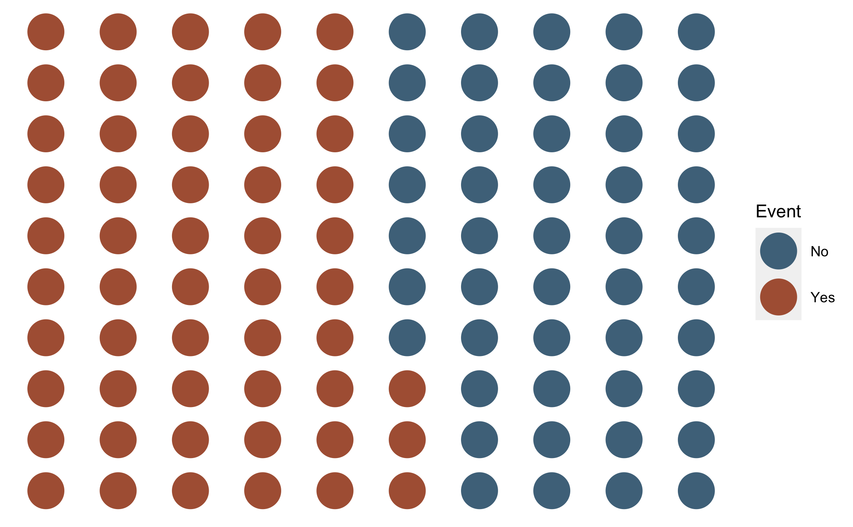
Counts (n)
Notes:
To make this a little easier, we will visually stratify our sample by event. That means we will gather together all of the people who experienced the event into one group and all of the people who did not experience the event into a second group. Each group can be called a strata.

Slide 35
Counts (n)
47
53
Notes:
After doing so, we can simply count the number of people in our event strata. In this case, the count of people who experienced the event is 53.
Is that enough information? It depends. What is our question?
- Do we have enough ventilators?
- Did a lot of people have the event?

Slide 36
Ratio
The quantitative relation between two amounts showing the number of times one value contains or is contained within the other. (Google)
RATIO The value obtained by dividing one quantity by another. RATE, PROPORTION, and percentage are types of ratios. The numerator of a proportion is included in the population defined by the denominator, whereas in other types of ratios numerator and denominator are distinct quantities, neither being included in the other. The dimensionality of a ratio is obtained through algebraic cancellation, summation, etc., of the dimensionalities of its numerator and denominator terms. Both counted and measured values may be included in the numerator and in the denominator. There are no general restrictions on the dimensionalities or ranges of ratios, but there are in some types of ratios (e.g., proportion, prevalence). Ratios are sometimes expressed as percentages (e.g., standardized mortality ratio). In these cases, the value may exceed 100. (Dictionary of Epidemiology)
Source: Porta M, ed. A Dictionary of Epidemiology. Oxford University Press; 2008.
Notes:
The count of events or cases can sometimes be useful all by itself. However, it is often more informative to put the count into context somehow.

Slide 37
Proportion
PROPORTION A type of ratio in which the numerator is included in the denominator. The ratio of a part to the whole, expressed as a “decimal fraction” (e.g., 0.2), as a “common fraction” (1/5), or as a percentage (20%). By definition, a proportion (p) must be in the range (decimal) 0.0 ≤ p ≤ 1.0. Since numerator and denominator have the same dimension, any dimensional contents cancel out, and a proportion is a dimensionless quantity. Where numerator and denominator are based on counts rather than measurements, the originals are also dimensionless, although it should be understood that proportions can be used for measured quantities (e.g., the skin area of the lower limb is x percent of the total skin area) as well as for counts (e.g., 15% of the population died). A PREVALENCE is a count-based proportion. The nondimensionality of a proportion, and its range limitations, do not necessarily apply to other kinds of ratios, of which “proportion” is a subset. See also RATE; RATIO. (Dictionary of Epidemiology)

Slide 38
Numerator and Denominator
NUMERATOR The upper portion of a fraction, used to calculate a rate or a ratio. See also DENOMINATOR. (Dictionary of Epidemiology)
DENOMINATOR The lower portion of a fraction, used to calculate a rate or ratio. The population (or population experience, as in person-years, passenger-miles, etc.) at risk in the calculation of a rate or ratio. Valid information on denominators is essential in clinical and epidemiological research and also in many public health activities. See also NUMERATOR. (Dictionary of Epidemiology)

Slide 39
Probability
1. Frequency probability: the limit of the relative frequency of an event in a sequence of N random trials as N approaches infinity, i.e., the limit of 2. Subjective probability: a measure, ranging from 0 to 1, of the degree of belief in a hypothesis or statement. Other definitions of probability exist (e.g., logical probability) but are rarely found in epidemiology, statistics, and clinical research. All probabilities obey the laws given by the axioms that: a. All probabilities are 0 or greater: for any event or statement A, Pr(A) ≥ 0. b. The probability of anything certain to happen is 1; i.e., if A is certain, Pr(A) = 1. c. If two events or statements A and B, cannot both be true at once (they are mutually exclusive), then the probability of their conjunction (A or B) is the sum of their separate probabilities: Pr(A or B) = Pr(A) + Pr(B). (Dictionary of Epidemiology)

Slide 40
Conditional Probability
The probability of an event given that another event has occurred. If D and E are two events and P (…) is “the probability of (…),” the conditional probability of D given that E occurs is denoted P(DIE), where the vertical slash is read “given” and is equal to P(D and E)/P(E). The event E is the “conditioning event.” Conditional probabilities obey all the axioms of probability theory. See also BAYES’ THEOREM; PROBABILITY THEORY. (Dictionary of Epidemiology)

Slide 41
Odds
The ratio of the probability of occurrence of an event to that of nonoccurrence, or the ratio of the probability that something is one way to the probability that it is another way. If 60% of smokers develop a chronic cough and 40% do not, the odds among smokers in favor of developing a cough are 60 to 40, or 1.5; this may be contrasted with the probability or risk that smokers will develop a cough, which is 60 over 100 or 0.6. See also LOGIT. (Dictionary of Epidemiology)

Slide 42
Continuous variables and event occurrence
In epidemiology, we commonly divide continuous measures at one or more levels.
We love our categorical variables in epi.
The place where we divide them is a called a cut point.
If two places, then we are dichotomizing.
Sometimes we will dichotomization categorical variables with more than two levels (e.g., “any” of the above)
Assumes homogeneity within group. If not, we will still get an estimate, but it will be nonsense. (Show an example with numbers)

Slide 43
Prevalence
Prevalence provides information about the presence or absence of a condition of interest (e.g., disease, exposure, or characteristic) in a population.
It describes the extent to which that condition is present in a population, in a given time frame.
For example, we might ask about the prevalence of diabetes in a population: what we are asking about is the number (or more likely proportion) of people currently living in that population who have diabetes.
Source: Westreich D. Epidemiology by Design. Oxford University Press; 2019

Slide 44
Prevalence Count
A count of the number of people in a population with the condition of interest in a given time frame.
As few as 0 people, and as many as all people, can be living with the condition of interest
Range 0 to infinity.
Source: Westreich D. Epidemiology by Design. Oxford University Press; 2019
Notes:
Prevalence counts are sometimes useful in communicating the public health importance of a disease condition or in contexts where incidence is difficult to define and so you want to have a sense of numbers of events for surveillance purposes. Unfortunately, prevalence counts are just as often used to overhype that importance by reporting large-sounding numbers without appropriate context. Prevalence counts are therefore of most use when their context is well-understood by the audience: for example, since most residents of the United States have a general sense of the total population of that country, a report to a US audience of the prevalence count of US residents living with COPD (at this writing, about 13 million) might be adequately contextualized. As with all counts, the prevalence count is an integer between 0 however many possible cases exist in the population being examined. For a recurrent event measured over a sufficiently long period of time (e.g., upper respiratory infections), the prevalence count might exceed the number of individuals in the population: however, in such a case, calculating an incidence might be more straightforward.

Slide 45
Prevalence Proportion
The proportion (or percentage) of the population that presently has the condition of interest or who presently has a history of the condition of interest of a specified duration in the past (e.g., “history of caner in the past 10 years”).
Since at fewest none and at most all of the members of a population can have a condition or a history of that condition, the prevalence proportion ranges from 0 to 1, much like a probability.
Source: Westreich D. Epidemiology by Design. Oxford University Press; 2019
Notes:
The count of prevalent cases is sometimes of interest all by itself. However, it is more common to report the prevalence as a proportion or percentage.

Slide 46
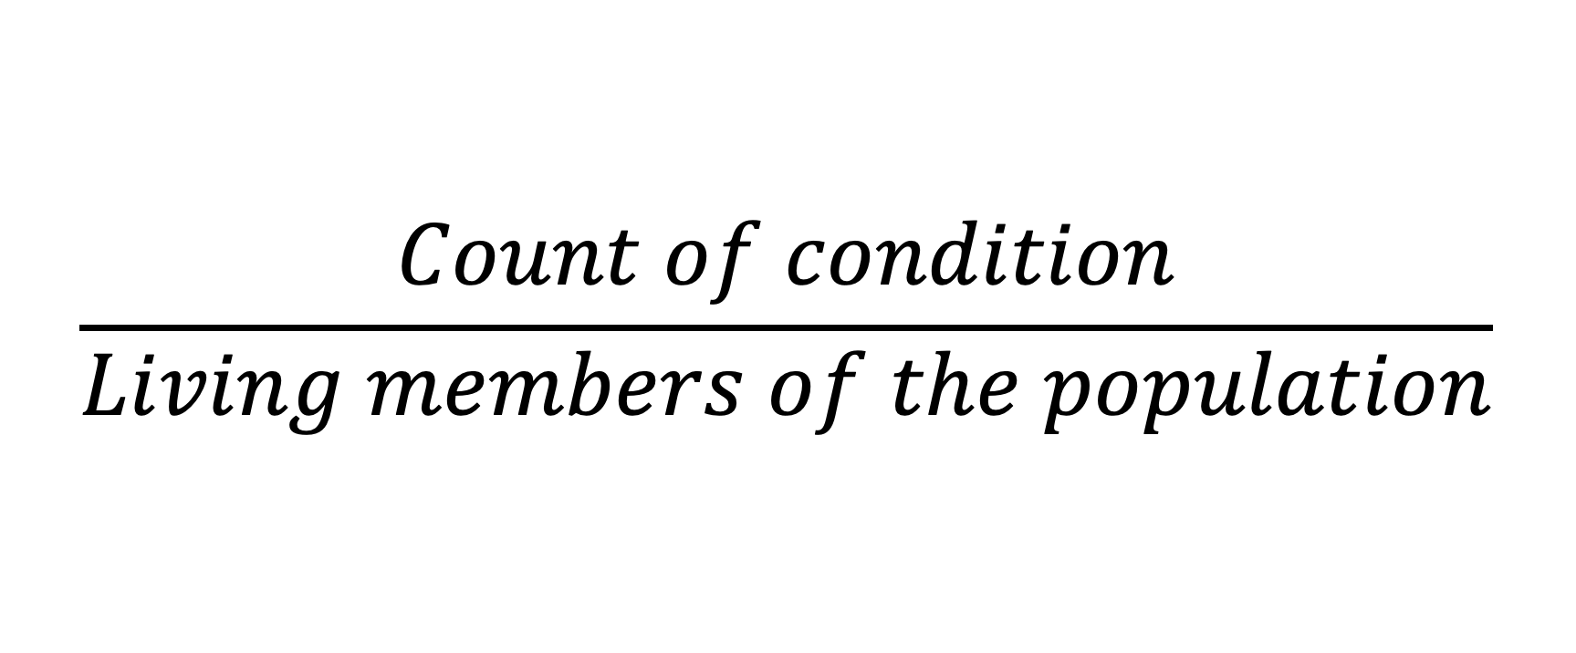
Prevalence Proportion
$$\frac{Count of condition}{Living members of the population}$$
Notes:
We can write the information from the previous slide in a slightly more mathy way like this.

Slide 47
Person
01
02
03
04
05
06
07
08
09
10
-01
00
01
02
03
04
05
06
07
08
09
10
11
12
Pre-Follow-Up
Diseased
Month Follow-up
At Risk
Deceased
Source: Lash TL, VanderWeel TJ, Haneuse S, Rothman KJ. Modern Epidemiology. fourth. Wolters Kluwer; 2021.
Notes:
So, if we came along and did a study of this group of people in month 2, the prevalence of disease would equal the number of people with disease divided by the number of people in the sample. In this case, that would be 2 people (p1 and p2) divided by 10.

Slide 48
Unintentional injuries among U.S. agricultural workers over 12 months of observation.
Person
1 |  |  |  |  |  |  |  | UI
2 |  |  | UI
3
4
5 |  |  |  |  |  | UI
6 |  |  |  |  |  |  |  |  |  |  | UI
7
8
9
10
11
12
Months | 1 | 2 | 3 | 4 | 5 | 6 | 7 | 8 | 9 | 10 | 11 | 12
Key
 | = At risk |  | = Unintentional injury
Notes:
To keep things relatively simple, let’s say that we only enrolled 12 workers in our cohort and we collected data about from them about unintentional injuries from them every month for one year. To further simplify things, let’s say that every person gave us complete and accurate information every month. Under those conditions, we could graphically depict our data like this.

Slide 49


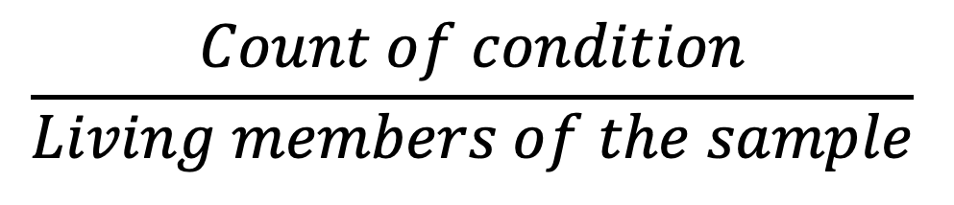
Person
Prevalence Proportion
01
02
$$\frac{Count of condition}{Living members of the sample}$$
03
04
=
05
06
$$\frac{2}{10}$$
07
08
=
09
10
$$0.2 or 20\%$$
-01
00
01
02
03
04
05
06
07
08
09
10
11
12
Pre-Follow-Up
Diseased
Month Follow-up
At Risk
Deceased
Notes:
So, if we came along and did a study of this group of people in month 2, the prevalence of the condition of interest – in this case disease -- would equal the number of people with disease divided by the number of people in the population. In this case, that would be 2 people (p1 and p2) divided by 10.

Slide 50
Person
Prevalence Proportion
01
02
Among the members of our population, the prevalence of disease in month two was 0.2. Said another way, 20% of our population had disease in month two.
03
04
05
06
07
08
09
10
-01
00
01
02
03
04
05
06
07
08
09
10
11
12
Pre-Follow-Up
Diseased
Month Follow-up
At Risk
Deceased

Slide 51

Source: https://www.r-project.org/logo/
Notes:
Now let’s look at some ways we can calculate a prevalence proportion in R.

Slide 52
Point prevalence and period prevalence
Point prevalence: is the prevalence of a condition of interest at a single point in time.
Period prevalence: is the prevalence of a condition of interest over a period of time.
As the duration of the period shrinks, period prevalence will converge to point prevalence.
There is no hard and fast rule about what window of time is sufficiently short to count a point prevalence.
Source: Westreich D. Epidemiology by Design. Oxford University Press; 2019
Notes:
On the other hand, point prevalence is often operationalized (put into practice) as “period prevalence over a reasonably short time window.” For example, if you want to know the prevalence of HIV infection in a cohort of 1,000 people, it is difficult to imagine getting blood samples to test from all those people simultaneously (e.g., if all 1,000 participants give blood at exactly 1:00 pm this Friday). In practice, you would obtain blood samples over as short a time period as possible and test them thereafter. Alternatively, you could also define such a prevalence as “point prevalence at time of testing” while acknowledging that the testing occurred at a different calendar time for each participant. (Epi by Design)
Some textbooks and authors spend a fair amount of time trying to draw a distinction between the two. Because the concept is pretty nebulous, I tend to not worry about it too much. Instead, I prefer to just be clear about the time frame used for the calculation.

Slide 53
Prevalence Odds
A prevalence odds is a simple function of the prevalence proportion, just as the odds in general is a simple function of probability, and are typically reported out of convenience or for their desirable statistical properties.
The prevalence odds, then, is simply the prevalence proportion divided by 1 minus the prevalence proportion.
Range 0 to infinity.
Source: Westreich D. Epidemiology by Design. Oxford University Press; 2019
Notes:
Why do we calculate this? Sometimes it is mathematically convenient.

Slide 54
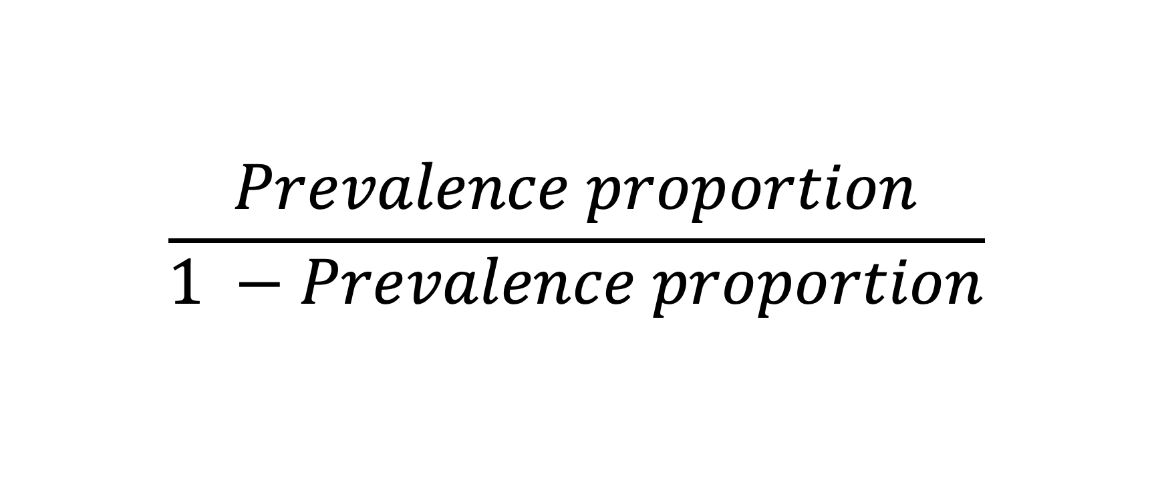
Prevalence Odds
$$\frac{Prevalence proportion}{1 −Prevalence proportion}$$
Notes:
We can write the information from the previous slide in a slightly more mathy way like this.

Slide 55
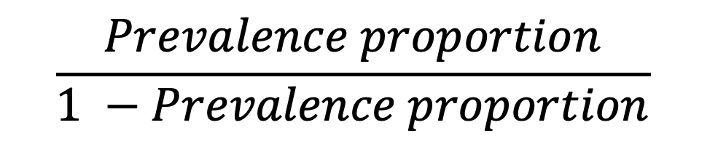


Person
Prevalence Odds
01
02
$$\frac{Prevalence proportion}{1 −Prevalence proportion}$$
03
04
=
05
06
$$\frac{0.2}{1 −0.2}$$
07
08
=
09
$$0.25$$
10
-01
00
01
02
03
04
05
06
07
08
09
10
11
12
Pre-Follow-Up
Diseased
Month Follow-up
At Risk
Deceased

Slide 56
Person
Prevalence Odds
01
Among the members of our population, the odds of disease in month two were 0.25.
Among the members of our population, for every person who had disease at month two there were four people who did not.
02
03
04
05
06
07
08
09
10
-01
00
01
02
03
04
05
06
07
08
09
10
11
12
Pre-Follow-Up
Diseased
Month Follow-up
At Risk
Deceased

Slide 57
Source: https://www.r-project.org/logo/
Notes:
Now let’s look at some ways we can calculate a prevalence odds in R.

Slide 58
Incidence
Where prevalence is a measure of how many cases of disease or condition are present at a given moment or over a period, incidence is a measure of how many new cases of a disease arise over a specified period of time.
A critical difference between prevalence and incidence is that, unlike prevalence, incidence is a measure of occurrences, or events: incidence counts the number of transitions from a condition being absent in an individual to that condition being present over a specified period of time.
Source: Westreich D. Epidemiology by Design. Oxford University Press; 2019
Notes:
We can measure the incidence of both one-time events (incidence of Parkinson’s disease or incidence of first cancer diagnosis) and recurrent events (number of respiratory infections in a calendar year). Thus, to measure incidence, we must start from a population at risk of the disease outcome: for example, to measure the incidence of Parkinson’s disease in our cohort, we must not include people who already have Parkinson’s disease at cohort inception. It is important to note that we can turn a recurrent event into a one-time event by restricting our study to the first occurrence of that event: for example, first respiratory infection for each individual in the calendar year. We measure incidence in many of the same ways as we measure prevalence: as incidence proportions, incidence odds, and incidence counts (i.e., counts of new cases of disease in a population). In addition, we use incidence rates and measures of elapsed time to an event. All of these measures, however, can be productively viewed as derivations, or simplifications, of a survival curve or cumulative incidence curve. Thus, we discuss the survival curve.

Slide 59
Incidence
Incidence proportion and “risk” are sometimes used interchangeably in epidemiology.
Risk can be ambiguous. Incidence proportion is less so.
Source: Westreich D. Epidemiology by Design. Oxford University Press; 2019

Slide 60
Incidence Count
A count of the number of new occurrences of some condition in a population at risk for the occurrence in a given time frame.
Range: 0 to infinity
Source: Westreich D. Epidemiology by Design. Oxford University Press; 2019

Slide 61
Incidence Proportion
The proportion of the population who experiences a new occurrence of the condition of interest among those in the population who are at risk of experiencing a new occurrence the condition of interest during a given time frame.
Like all proportions, falls between 0 and 1.
Source: Westreich D. Epidemiology by Design. Oxford University Press; 2019
Notes:
The incidence proportion can be estimated without reference to the survival curve: you could obtain the same estimate of risk as from Figure 1.2 (or the data in Table 1.1) directly, simply by observing that 930 individuals were alive at age 40, noting that this means 70 had died, and dividing 70 by the original number in the study (1,000) to get 7%.
It is critical to reiterate that incidence proportions are only meaningful when paired with a fixed period of time. This may be illustrated most clearly with the outcome of death: the “risk of death” in humans is universally 1, in that all humans will eventually die. Thus, telling someone that, in your study, the “risk of death was 10%” is unhelpful; more helpful would be to tell them that, for example, the “1-year risk of death was 10%.”

Slide 62
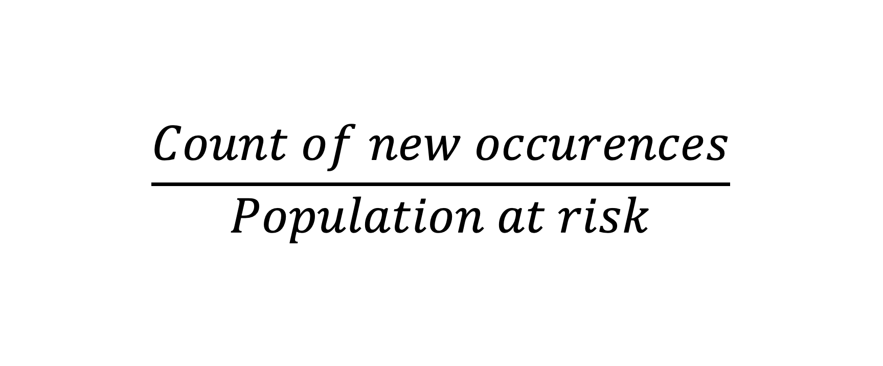
Incidence Proportion
$$\frac{Count of new occurences}{Population at risk}$$
Notes:
We can write the information from the previous slide in a slightly more mathy way like this.

Slide 63
Person
01
02
03
04
05
06
07
08
09
10
-01
00
01
02
03
04
05
06
07
08
09
10
11
12
Pre-Follow-Up
Diseased
Month Follow-up
At Risk
Deceased
Source: Lash TL, VanderWeel TJ, Haneuse S, Rothman KJ. Modern Epidemiology. fourth. Wolters Kluwer; 2021.
Notes:
So, let’s take another look at our example population.
How many were at risk of experiencing a new occurrence of disease during the period of observation? 9 (person 1 was not at risk).
How many of the people at risk developed a new occurrence of disease? 5 (p2, p3, p4, p5, p6).

Slide 64
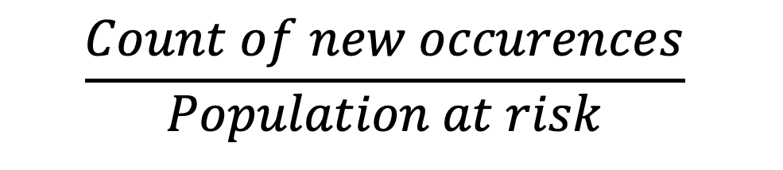


Person
Incidence Proportion
01
02
$$\frac{Count of new occurences}{Population at risk}$$
03
04
=
05
06
$$\frac{5}{9}$$
07
08
=
09
$$0.56 or 56\%$$
10
-01
00
01
02
03
04
05
06
07
08
09
10
11
12
Pre-Follow-Up
Diseased
Month Follow-up
At Risk
Deceased

Slide 65
Person
Incidence Proportion
01
Among the members of our population, the incidence of disease over 12 months of follow-up was 0.56.
Fifty six percent of the members of our population developed disease over 12 months of follow-up .
02
03
04
05
06
07
08
09
10
-01
00
01
02
03
04
05
06
07
08
09
10
11
12
Pre-Follow-Up
Diseased
Month Follow-up
At Risk
Deceased

Slide 66
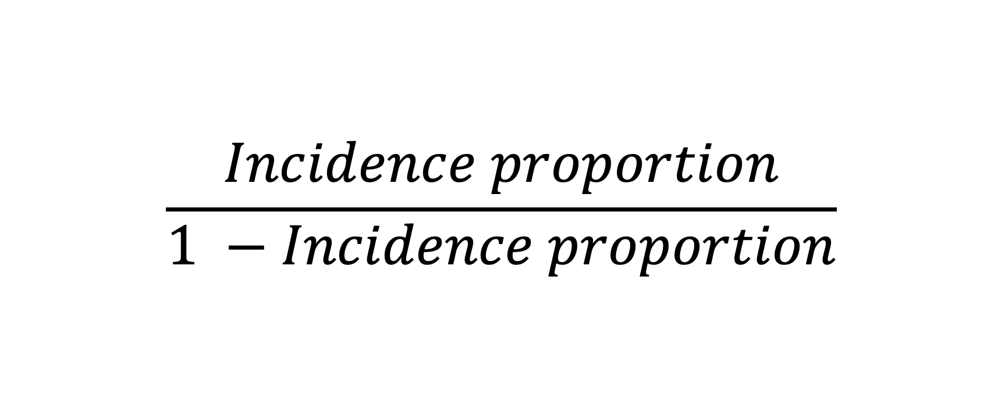
Incidence Odds
$$\frac{Incidence proportion}{1 −Incidence proportion}$$
Notes:
We can write the information from the previous slide in a slightly more mathy way like this.

Slide 67
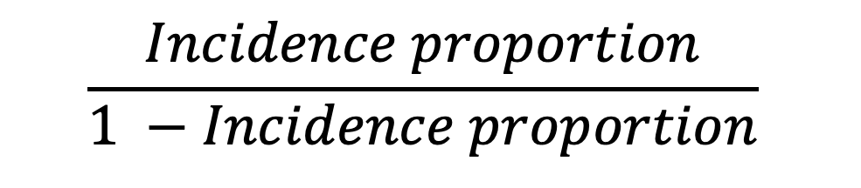


Person
Incidence Odds
01
02
$$\frac{Incidence proportion}{1 −Incidence proportion}$$
03
04
=
05
06
$$\frac{0.56}{1 −0.56}$$
07
08
=
09
$$1.27$$
10
-01
00
01
02
03
04
05
06
07
08
09
10
11
12
Pre-Follow-Up
Diseased
Month Follow-up
At Risk
Deceased

Slide 68
Person
Incidence Odds
01
Among the members of our population, the odds of incident disease over 12 months of follow-up were 1.27.
Among the members of our population, for every 127 people develop incident disease over 12 months of follow-up there were 100 people who did not.
02
03
04
05
06
07
08
09
10
-01
00
01
02
03
04
05
06
07
08
09
10
11
12
Pre-Follow-Up
Diseased
Month Follow-up
At Risk
Deceased

Slide 69
Incidence Rate
A measure of the average intensity at which an event occurs in the experience of people over time, and, for a population followed from baseline, it is calculated as the number of cases in that population divided by the amount of person-time at risk accumulated by that population.
Range: 0 to infinity
NOT a proportion
The denominator is reciprocal time (usually person-time)
The numeric value of an incidence rate in itself has no interpretability because it depends on the selection of the time unit.
Source: Westreich D. Epidemiology by Design. Oxford University Press; 2019
Notes:
Accurately calculating the incidence proportion requires complete follow-up of a closed population. In other words, no new members once enrollment is complete, and no members leave the population except through death. Unfortunately, these conditions are pretty rare in the real world.
One way to deal with this complication is to develop measures that take into account the length of time each individual was in the population at risk for the event. This length or span of time is called the person-time contribution of the individual.

Slide 70
Person-time
Person-time is the amount of time observed for all people under study while at risk of experiencing an incident outcome.
Source: Westreich D. Epidemiology by Design. Oxford University Press; 2019
Notes:
if a woman is followed for 1 month, then she experiences (and contributes to analysis) 1 person-month of time. If 10 women are followed for 1 year, they contribute 10 × 1 = 10 person-years; if 1 woman is followed for 10 years, she also contributes 1 × 10 = 10 person-years. This calls attention to a basic assumption of person-time: that any unit of person-time is exchangeable with any other unit of person-time under study.

Slide 71
Person
01
02
03
04
05
06
07
08
09
10
-01
00
01
02
03
04
05
06
07
08
09
10
11
12
Pre-Follow-Up
Diseased
Month Follow-up
At Risk
Deceased
Source: Lash TL, VanderWeel TJ, Haneuse S, Rothman KJ. Modern Epidemiology. fourth. Wolters Kluwer; 2021.
Notes:
So, let’s take another look at our example population.
How many were at risk of experiencing a new occurrence of disease during the period of observation? 9 (person 1 was not at risk).
For how many months were these 9 people under observation and at risk of developing a new occurrence of disease?

Slide 72
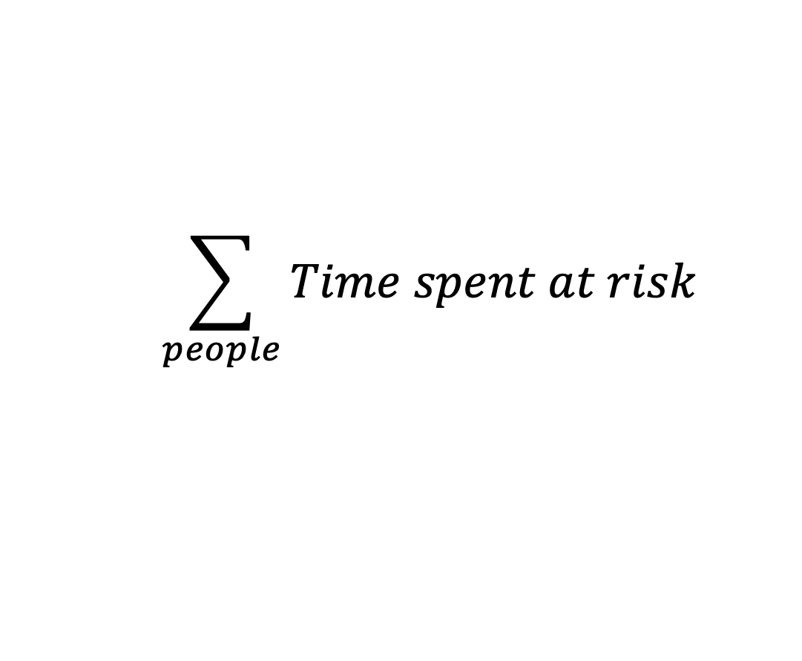

Person
Person-time
01
02
$$\sum_{people}{Time spent at risk}$$
03
04
05
=
06
0 + 2 + 4 + 5 + 7 + 8 + 9 + 5 +12 + 12
07
08
=
09
$$64$$
10
-01
00
01
02
03
04
05
06
07
08
09
10
11
12
Pre-Follow-Up
Diseased
Month Follow-up
At Risk
Deceased

Slide 73
Person
Person-time
01
02
The members of our population accumulated 64 person-months at risk during 12 months of follow-up.
The members of our population accumulated 5.33 person-years at risk during 12 months of follow-up.
03
04
05
06
07
08
09
10
-01
00
01
02
03
04
05
06
07
08
09
10
11
12
Pre-Follow-Up
Diseased
Month Follow-up
At Risk
Deceased

Slide 74
Person
01
02
03
04
05
06
07
08
09
10
-01
00
01
02
03
04
05
06
07
08
09
10
11
12
Pre-Follow-Up
Diseased
Month Follow-up
At Risk
Deceased
Source: Lash TL, VanderWeel TJ, Haneuse S, Rothman KJ. Modern Epidemiology. fourth. Wolters Kluwer; 2021.
Notes:
How many of the people at risk developed a new occurrence of disease? 5 (p2, p3, p4, p5, p6).

Slide 75
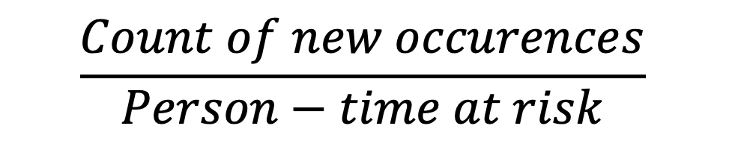

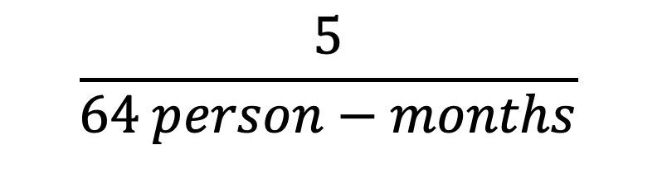
Person
Incidence Rate
01
02
$$\frac{Count of new occurences}{Person−time at risk}$$
03
04
=
05
06
$$\frac{5}{64 person−months}$$
07
08
or
09
$$8 per 100 pm$$
10
-01
00
01
02
03
04
05
06
07
08
09
10
11
12
Pre-Follow-Up
Diseased
Month Follow-up
At Risk
Deceased

Slide 76
Person
Incidence Rate
01
02
The incidence rate of disease among the members of our population was 5 cases per 64 person-months during 12 months of follow-up.
The incidence rate of disease among the members of our population was 7.8 cases per 100 person-months during 12 months of follow-up.
03
04
05
06
07
08
09
10
-01
00
01
02
03
04
05
06
07
08
09
10
11
12
Pre-Follow-Up
Diseased
Month Follow-up
At Risk
Deceased

Slide 77
Incidence Rate
Because person-time is flexible, incidence rates can be reported on a variety of scales. For example, note that 100 events per person-year is equivalent to 100 events per 12 person-months is equivalent to 8.33 events per person-month is equivalent to 10,000 events per 100 person-years. Because we can scale up or down the actual numbers of an incidence rate as we need to, the range of the incidence rate is 0 to infinity; in general, incidence rates should be reported on a scale appropriate or standard to the substantive context. (Epi by Design)

Slide 78







Relation between Incidence and Prevalence
Prevalence ~ Incidence x duration
Source: Westreich D. Epidemiology by Design. Oxford University Press; 2019
Notes:
Briefly, it is worth explaining how prevalence and incidence relate to each other, conceptually and mathematically. Conceptually, prevalence over a time period is a function of both incidence (how many new cases are showing up?) and duration of disease (how long does each case last?). This is because the longer the duration of disease, the more incident cases accumulate during a time period. Consider a population of 100 people, 10 of whom get an upper respiratory infection on the first day of each month. If the infection lasts a full month, then, on average, the prevalence of such infections over time will be 10%: 10/100 for the first month, then a new 10/100 for the second month. But if the infection lasts 2 months, then, after the first month, the prevalence of infection will be about 20%: 10 cases from the first month and 10 more from the second month.6 This suggests a rough equivalency between prevalence, incidence, and duration, of the form:
where the squiggly equals sign (≈) means “approximately equal to.” More precisely, the relationship is
where the left side of the equation is exactly prevalence odds. This relationship will hold when the population is in “steady-state”; that is, constant (or nearly so) in composition and size and with constant (or nearly so) incidence rate and disease duration (Rothman, 2012; Rothman, Greenland, & Lash, 2008). If prevalence of the disease is low (typically, <10%), then this calculated prevalence odds will approximately equal to the prevalence proportion.

Slide 79







Relation between Incidence Proportion and Incidence Rate
Source: Westreich D. Epidemiology by Design. Oxford University Press; 2019
Notes:
In our preceding example, we might not get 10 cases in the second month: after the first month, there are only 90 people left who are not infected. If the incidence were 10% per month, we would expect 9 new cathan 10, because the population at risk of infection declines over time. This points to the relationship between the incidence rate and the incidence proportion (sometimes in this context called the cumulative incidence). In a closed cohort with a constant incidence rate, these two measures are related by the exponential formula as follows:ses, rather than 10, because the population at risk of infection declines over time. This points to the relationship between the incidence rate and the incidence proportion (sometimes in this context called the cumulative incidence). In a closed cohort with a constant incidence rate, these two measures are related by the exponential formula as follows:
where and time is the amount of time over which we wish to estimate risk (Rothman et al., 2008). Note again that here we are assuming a closed cohort (such that the number of individuals is diminishing over time), whereas in the relationship between prevalence and incidence, we assumed a steady-state population (people who leave the cohort are replaced by people entering the cohort). However, in parallel to the preceding relationship between prevalence and incidence, when risk is <10%, this relationship can be estimated as

Slide 80
Incidence Rate vs. Incidence Proportion
Two key differences between the incidence proportion and incidence rate are worth highlighting.
First, consider a situation in which we have data on 10 people, each followed-up for a different length of time. In this case a straightforward risk calculation would likely be invalid: the proportion of those 10 people who experienced an outcome would not be in a fixed period of time and thus would not typically or simply be interpretable as an incidence proportion. On the other hand, we could calculate the total person-time accumulated by those individuals and use that as the denominator for an incidence rate without concern that each individual contributed a different amount of time over follow-up.
Second, the incidence rates can account for recurrent events, whereas incidence proportions cannot. Recall that the incidence proportion is constrained to be between 0 and 1: thus, with N people, the incidence proportion may falter at fully describing the occurrence of 2N events (as might happen if we were studying the number of upper respiratory infections experienced by individuals over a period of 6 months). Where an incidence rate can accumulate both a count of events and an experience of cumulative person-time among study participants and calculate an incidence rate, the incidence proportion might be forced to study the risk of first upper respiratory infection (and then, among those who had a first upper respiratory infection, the risk of a second and then third). These are different scientific questions and might both be of interest to public health.
All from Epi by Design
Source: Westreich D. Epidemiology by Design. Oxford University Press; 2019

Slide 81
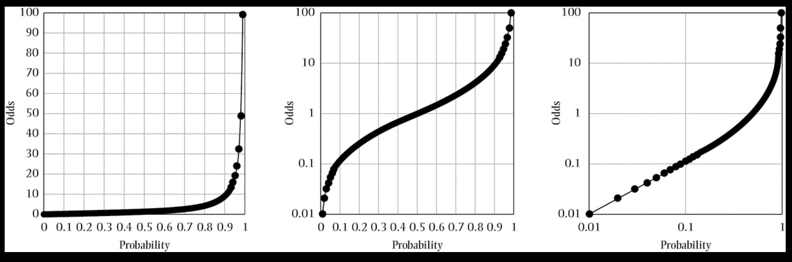
Odds and proportions
Source: Westreich D. Epidemiology by Design. Oxford University Press; 2019
Notes:
”Low” is generally considered to mean less than 10%. You can see why in the far right panel here.
As shown in Figure 1.1, as the prevalence proportion (the probability, on the x-axis) ranges from 0 to 1, the prevalence odds (y-axis) ranges from 0 to infinity.
Prevalence odds will approximate the prevalence proportion when the prevalence proportion is low but may otherwise overstate prevalence proportion.

Slide 82
Matrix
matrices or more generally arrays are multi-dimensional generalizations of vectors. In fact, they are vectors that can be indexed by two or more indices and will be printed in special ways. See Arrays and matrices. (https://cran.r-project.org/doc/manuals/R-intro.html)
As noted above, a matrix is just an array with two subscripts. However it is such an important special case it needs a separate discussion. (https://cran.r-project.org/doc/manuals/R-intro.html#Arrays-and-matrices)
An array can be considered as a multiply subscripted collection of data entries, for example numeric. R allows simple facilities for creating and handling arrays, and in particular the special case of matrices.
A dimension vector is a vector of non-negative integers. If its length is k then the array is k-dimensional, e.g. a matrix is a 2-dimensional array. The dimensions are indexed from one up to the values given in the dimension vector. (https://cran.r-project.org/doc/manuals/R-intro.html#Arrays-and-matrices)

