Slide 1
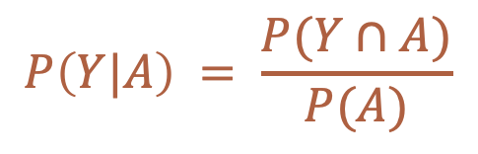



Conditional Probability
How likely an event is to happen given that something else has already happened.
$$P\left(Y|A\right) = \frac{P(Y∩A)}{P(A)}$$
$$Y$$
$$Y∩A$$
$$A$$
Notes:
Visually, it looks like this.

Slide 2
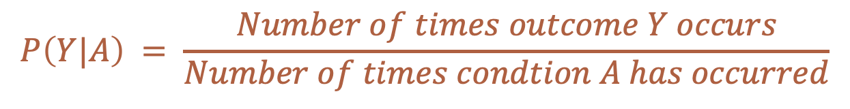
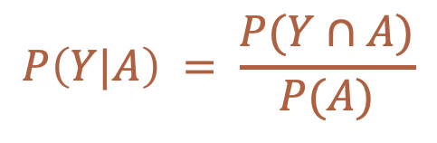
Conditional Probability
How likely an event is to happen given that something else has already happened.
$$P\left(Y|A\right) = \frac{P(Y∩A)}{P(A)}$$
$$P\left(Y|A\right) = \frac{Number of times outcome Y occurs}{Number of times condtion A has occurred}$$
Notes:
Or, we could write it out like this.

Slide 3
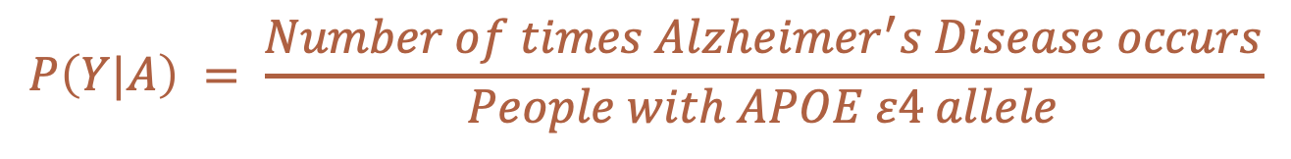
Conditional Probability
How likely an event is to happen given that something else has already happened.
$$P\left(Y|A\right) = \frac{P(Y∩A)}{P(A)}$$
$$P\left(Y|A\right) = \frac{Number of times Alzheimer^{′}s Disease occurs}{People with APOE ε4 allele}$$
Notes:
Or, we could write it out like this.

Slide 4
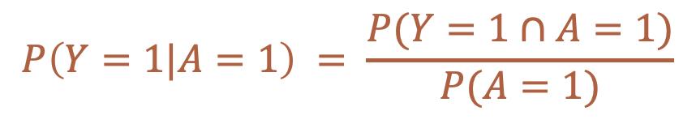
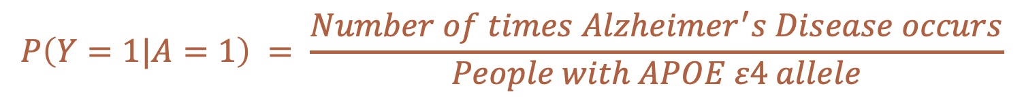
Conditional Probability
How likely an event is to happen given that something else has already happened.
$$P\left(Y=1|A=1\right) = \frac{P(Y=1∩A=1)}{P(A=1)}$$
$$P\left(Y=1|A=1\right) = \frac{Number of times Alzheimer^{′}s Disease occurs}{People with APOE ε4 allele}$$
Notes:
Finally, we could be even more explicit and write it out like this.

Slide 5

Association
$$\operatorname{Pr}\left[Y=1 | A=1\right]≠Pr⁡[Y=1|A=0]$$
Source: Hernán MA, Robins JM. Causal Inference: What If. CRC Press; 2020.
Notes:
With all of this new terminology, we can return to our definition of association.

Slide 6
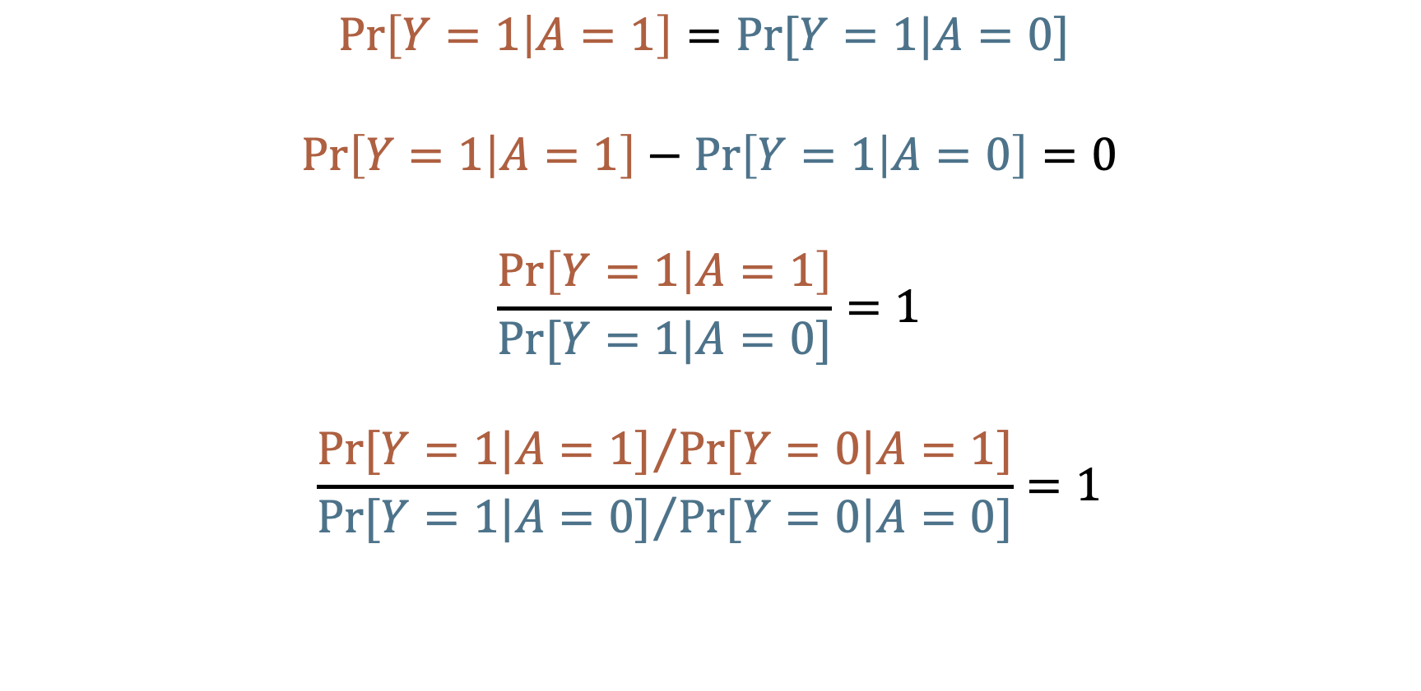
No Association (Independence)
$$\operatorname{Pr}\left[Y=1 | A=1\right]=Pr⁡[Y=1|A=0]$$
$$\operatorname{Pr}\left[Y=1 | A=1\right]−\operatorname{Pr}\left[Y=1 | A=0\right]=0$$
$$\frac{\operatorname{Pr}\left[Y=1 | A=1\right]}{Pr⁡[Y=1|A=0]}=1$$
$$\frac{{Pr⁡[Y=1|A=1]}/{Pr⁡[Y=0|A=1]}}{{Pr⁡[Y=1|A=0]}/{Pr⁡[Y=0|A=0]}}=1$$
Source: Hernán MA, Robins JM. Causal Inference: What If. CRC Press; 2020.
Notes:
And sometimes, when trying to understand what something is, it can be helpful to understand what it is not.
In this case, the opposite of an association is statistical independence.
[Read together as a class]

Slide 7
No Association (Independence)
$$\operatorname{Pr}\left[Y=1 | A=1\right]=Pr⁡[Y=1|A=0]$$
$$\operatorname{Pr}\left[Y=1 | A=1\right]−\operatorname{Pr}\left[Y=1 | A=0\right]=0$$
$$\frac{\operatorname{Pr}\left[Y=1 | A=1\right]}{Pr⁡[Y=1|A=0]}=1$$
$$\frac{{Pr⁡[Y=1|A=1]}/{Pr⁡[Y=0|A=1]}}{{Pr⁡[Y=1|A=0]}/{Pr⁡[Y=0|A=0]}}=1$$
No Incidence Proportion difference association
No Incidence Proportion ratio association
No Incidence odds ratio association
Source: Hernán MA, Robins JM. Causal Inference: What If. CRC Press; 2020.
Notes:
These formulas represent the lack of an association on the risk difference, risk ratio, and odds ration scales respectively.
And notice what these equations are equal to when there is no association.

Slide 8
Null value
“The null value of a measure of association is the value that measure takes when there is no difference between the two groups being compared.”
Source: Westreich D. Epidemiology by Design. Oxford University Press; 2019
Notes:
These values are called Null values.

Slide 9
No Association (Independence)
$$\operatorname{Pr}\left[Y=1 | A=1\right]=Pr⁡[Y=1|A=0]$$
$$\operatorname{Pr}\left[Y=1 | A=1\right]−\operatorname{Pr}\left[Y=1 | A=0\right]=0$$
$$\frac{\operatorname{Pr}\left[Y=1 | A=1\right]}{Pr⁡[Y=1|A=0]}=1$$
$$\frac{{Pr⁡[Y=1|A=1]}/{Pr⁡[Y=0|A=1]}}{{Pr⁡[Y=1|A=0]}/{Pr⁡[Y=0|A=0]}}=1$$
Incidence Proportion difference association
Null = 0
Incidence Proportion ratio association
Null = 1
Incidence odds ratio association
Null = 1
Source: Hernán MA, Robins JM. Causal Inference: What If. CRC Press; 2020.
Notes:
These formulas represent the lack of an association on the risk difference, risk ratio, and odds ration scales respectively.

Slide 10
Risk Difference
$$\operatorname{Pr}\left[Y=1 | A=1\right]−\operatorname{Pr}\left[Y=1 | A=0\right]=…$$
$$\operatorname{Pr}\left[Y=1 | A=1\right]<\operatorname{Pr}\left[Y=1 | A=0\right]$$
$$\operatorname{Pr}\left[Y=1 | A=1\right]>\operatorname{Pr}\left[Y=1 | A=0\right]$$
Null = 0
-1, … -0.7, -0.8, -0.9
0.1, 0.2, 0.3, … 1
Association
No Association
Association

Slide 11

Risk Ratio
$$\frac{\operatorname{Pr}\left[Y=1 | A=1\right]}{Pr⁡[Y=1|A=0]}=…$$
$$\operatorname{Pr}\left[Y=1 | A=1\right]<\operatorname{Pr}\left[Y=1 | A=0\right]$$
$$\operatorname{Pr}\left[Y=1 | A=1\right]>\operatorname{Pr}\left[Y=1 | A=0\right]$$
Null = 1
0, … 0.7, 0.8, 0.9
1, 2, 3, … Inf
Association
No Association
Association

Slide 12
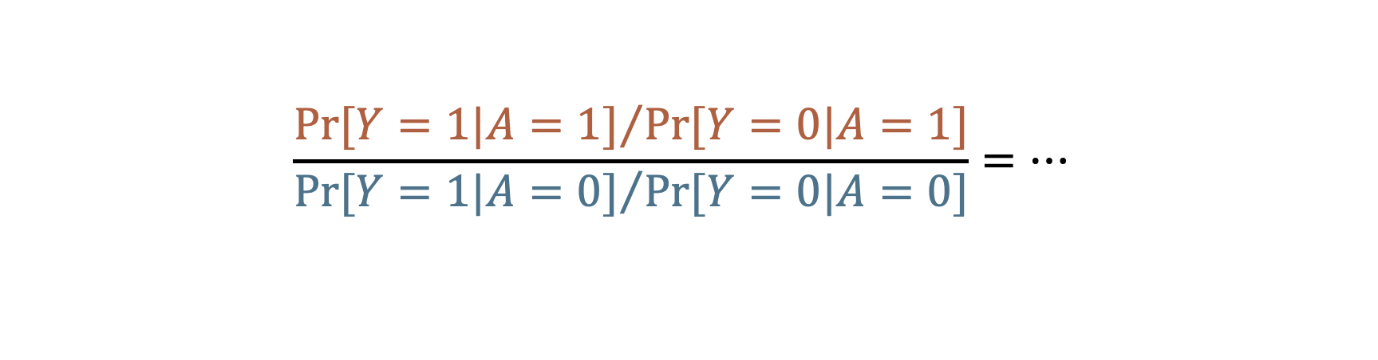
Odds Ratio
$$\frac{{Pr⁡[Y=1|A=1]}/{Pr⁡[Y=0|A=1]}}{{Pr⁡[Y=1|A=0]}/{Pr⁡[Y=0|A=0]}}=…$$
$$\operatorname{Pr}\left[Y=1 | A=1\right]<\operatorname{Pr}\left[Y=1 | A=0\right]$$
$$\operatorname{Pr}\left[Y=1 | A=1\right]>\operatorname{Pr}\left[Y=1 | A=0\right]$$
Null = 1
0, … 0.7, 0.8, 0.9
1, 2, 3, … Inf
Association
No Association
Association

Slide 13
Association
The distribution (i.e., middle, spread, shape, proportion of people in each category) of the thing we are measuring is different, on average, in two groups.
Knowing something about X tells you something about Y.
Source: Hernán MA. Causal Diagrams: Draw Your Assumptions Before Your Conclusions. edX. Accessed September 27, 2022. https://learning.edx.org/course/course-v1:HarvardX+PH559x+2T2022/home
Notes:
Association exists when the distribution of the thing we are measuring is different, on average, in two groups. Alternatively, we can say that Knowing something about X tells you something (or helps you predict) about Y.

Slide 14
Association
The distribution (i.e., middle, spread, shape, proportion of people in each category) of the thing we are measuring is different, on average, in two groups.
Knowing something about X tells you something about Y.
Source: Hernán MA. Causal Diagrams: Draw Your Assumptions Before Your Conclusions. edX. Accessed September 27, 2022. https://learning.edx.org/course/course-v1:HarvardX+PH559x+2T2022/home
Notes:
Association exists when the distribution of the thing we are measuring is different, on average, in two groups. Alternatively, we can say that Knowing something about X tells you something (or helps you predict) about Y.

Slide 15
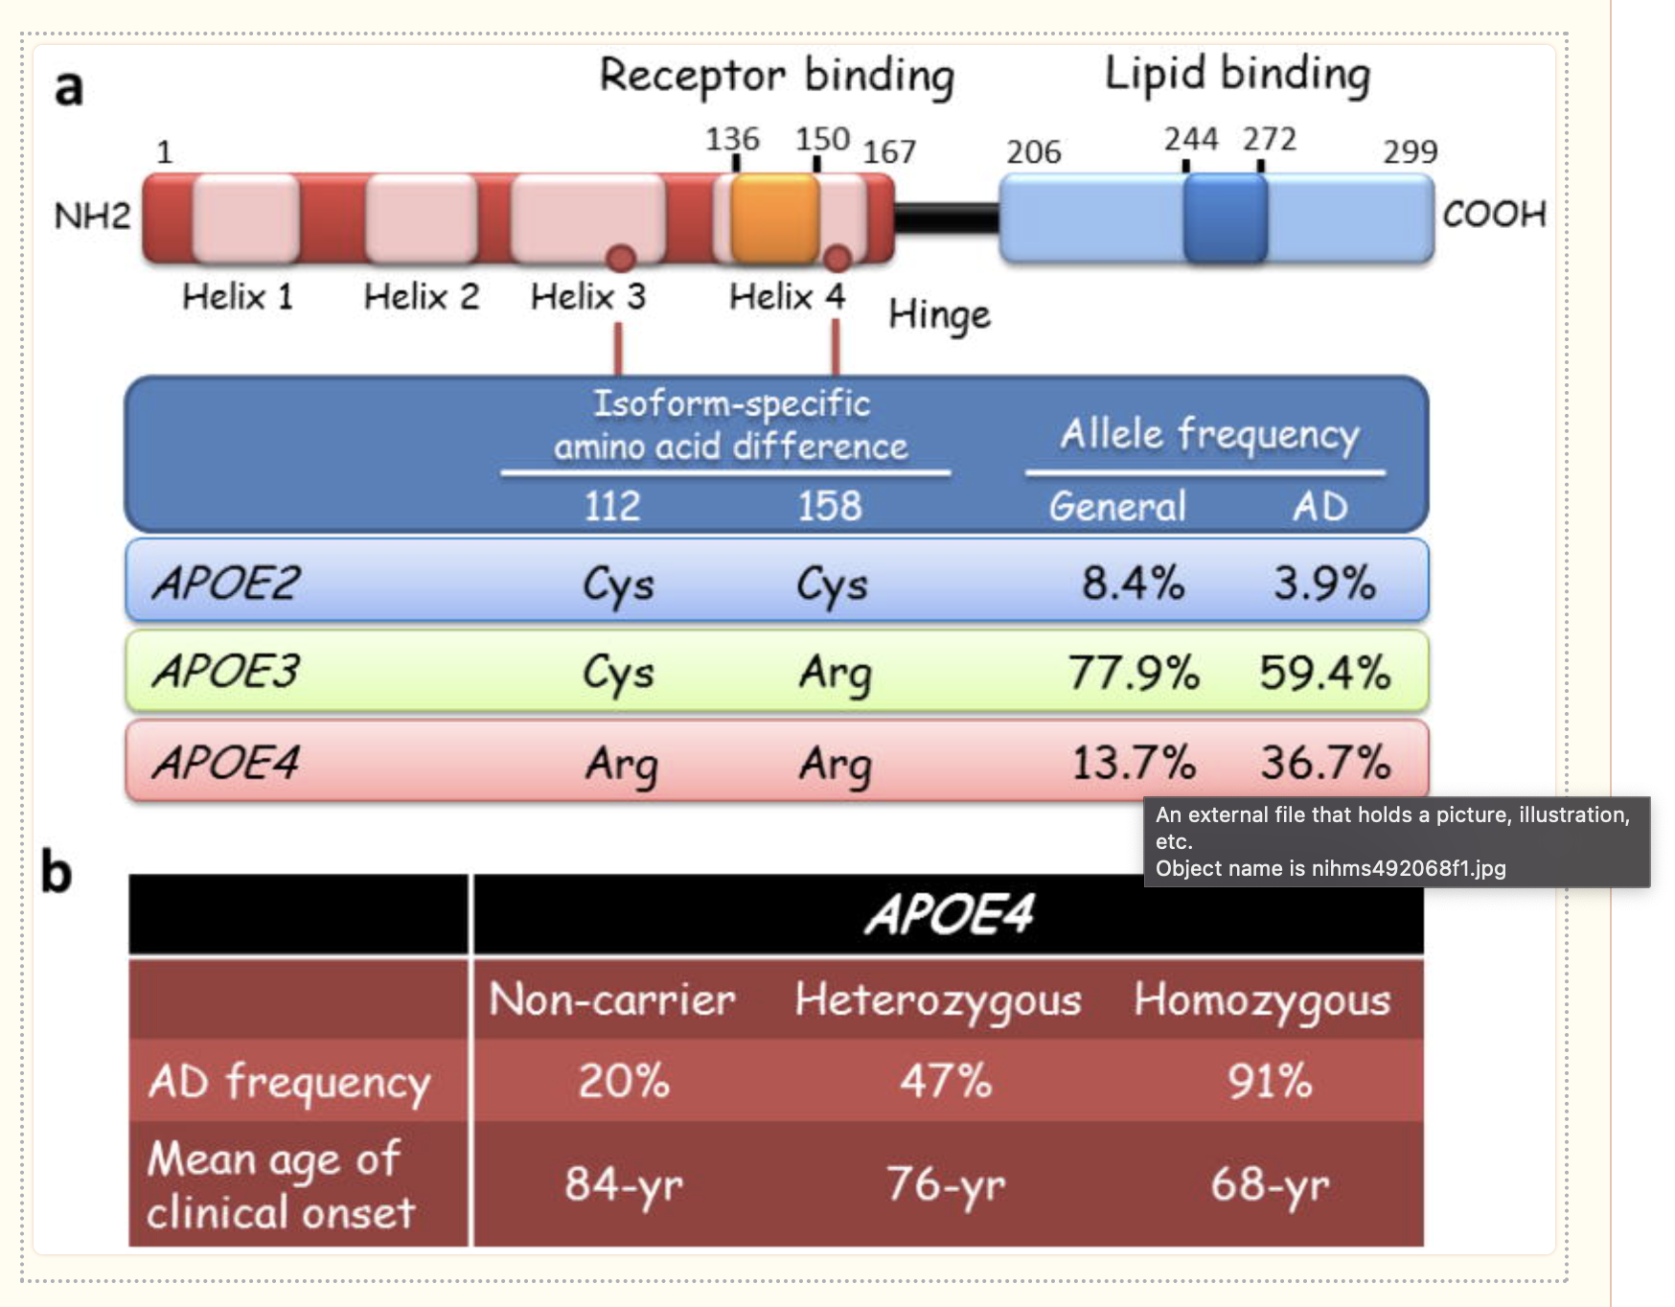

Slide 16
Prediction
Implies associations.
Examples
People of a certain race/ethnicity are more likely to get a particular cancer.
Older adults who have trouble managing finances are more likely to get dementia.
Can be useful on its own.
Often, in epidemiology, the ultimate goal is causal inference.
“the study of the occurrence and distribution of health-related states or events in specified populations, including the study of the determinants influencing such states, and the application of this knowledge to control the health problems.” (Porta 2008, page 81)
Notes:
Predictions, especially good ones, can obviously be useful on their own. We may know that people of a certain race/ethnicity are most likely to get a particular form of cancer. Knowing that may allow us to concentrate screening efforts more effectively. We may know that older adults who begin to have trouble managing their finances are more likely to develop dementia. We may be able to use that information as an early indicator of important health problems to come.
However, in epidemiology, we are very often not content with predictions alone. It is extremely common for our questions and studies to either directly ask causal questions or imply causal relationships between variables. The reason we are often more interested in causal associations than mere predictions can be found directly in our definition of epidemiology. We want to control health problems. Said another way, we want to know why ”bad” things happen so that we can stop them from happening and/or why “good” things happen so that we can make them happen more often.
This idea is simultaneously so straightforward and so complex. As we will see throughout the semester.
Notice that in the cases above these predictions may be perfectly valid, but do they get us any closer to our ultimate goal of “controlling health problems?” We can’t change anyone’s race or ethnicity, can we? Even if we could, I’m hard-pressed to think of an example of a health outcome that is caused directly by a person’s race or ethnicity. Race and ethnicity are just a proxy for the true unmeasured cause. Likewise, do you really believe that if we hired an accountant to help an older person manage their finances that they would no longer develop dementia? Of course not.

Slide 17
Measures of Association
Absolute Measures
Differences
Relative Measures
Ratios
Proportions
Odds
Rates
Proportions
Odds
Rates
Source: Szklo M, Nieto FJ. Epidemiology: Beyond the Basics. Jones & Bartlett Learning; 2019.
Notes:
We gather these measurements…

Slide 18
Measures of Association
“Measures based on absolute differences are often preferred when public health or preventive activities are evaluated, as their main goal is often an absolute reduction in the risk of an undesirable outcome.”
Absolute Measures
Differences
Relative Measures
Ratios
Proportions
Odds
Rates
Proportions
Odds
Rates
Source: Szklo M, Nieto FJ. Epidemiology: Beyond the Basics. Jones & Bartlett Learning; 2019.

Slide 19
Measures of Association
“In contrast, etiologic studies that are searching disease determinants (causes) usually rely on relative differences in the occurrence of discrete outcomes.”
Absolute Measures
Differences
Relative Measures
Ratios
Proportions
Odds
Rates
Proportions
Odds
Rates
Source: Szklo M, Nieto FJ. Epidemiology: Beyond the Basics. Jones & Bartlett Learning; 2019.
Notes:
We will look at how to calculate some of the most commonly used of these next.

Slide 20
Example
Smoking and pill
Smoking and smoking cessation program
1,000,000 smokers
100,000 will die
Pill will save 50% who take it, 10% can afford it.
IP = 0.50, 5,000 lives saved
Smoking cessation program will save 10%, but 100% get it.
IP = 0.01, 10,000 lives saved

Slide 21
Terminology Recap
Our Term | Definition | Equation
Marginal Probability | Frequency probability: The limit of the relative frequency of an event in a sequence of N random trials as N approaches infinity. Subjective probability: A measure, ranging from 0 to 1, of the degree of belief in a hypothesis or statement.
Conditional Probability
Null Value
Statistical Independence
Association

Slide 22
Terminology Recap
Our Term | Definition | Other Terms
Incidence proportion difference |  | Risk difference
Incidence proportion ratio |  | Risk ratio
Incidence odds ratio |  | Odds ratio

Slide 23
Break
Leaving conceptual stuff and starting to discuss how to calculate measures of association.
Notes:
So, how do we calculate these measures of association?

Slide 24
2x2 Contingency Table (Crosstab)
 | Outcome + | Outcome -
Exposure + | a | b
Exposure - | c | d
This order is important!!
Notes:
Many of the contrast measures in this chapter (risk differences, risk ratios, odds ratios, and others) will rely on explanations and illustrations from 2 × 2 tables—a central tool in the teaching of epidemiologic methods.
Westreich, Daniel. Epidemiology by Design (p. 28). Oxford University Press. Kindle Edition.

Slide 25
Person
01
02
03
04
05
06
07
08
09
10
-01
00
01
02
03
04
05
06
07
08
09
10
11
12
Pre-Follow-Up
Diseased
Month Follow-up
At Risk
Deceased
Source: Lash TL, VanderWeel TJ, Haneuse S, Rothman KJ. Modern Epidemiology. fourth. Wolters Kluwer; 2021.
Notes:
Here is our graphic from last week. So, if we came along and did a study of this group of people in month 2, the prevalence of disease would equal the number of people with disease divided by the number of people in the sample. In this case, that would be 2 people (p1 and p2) divided by 10.

Slide 26
Person
01
02
03
04
05
06
Exposed
07
08
09
10
-01
00
01
02
03
04
05
06
07
08
09
10
11
12
Pre-Follow-Up
Diseased
Month Follow-up
At Risk
Deceased
Source: Lash TL, VanderWeel TJ, Haneuse S, Rothman KJ. Modern Epidemiology. fourth. Wolters Kluwer; 2021.
Notes:
One little tweak -- exposed

Slide 27
Person
01
02
03
04
 | Disease + | Disease -
Exposure + | 3 | ?
Exposure - | ? | ?
05
06
07
08
09
10
-01
00
01
02
03
04
05
06
07
08
09
10
11
12
Pre-Follow-Up
Diseased
Month Follow-up
At Risk
Deceased

Slide 28
Person
01
02
03
04
 | Disease + | Disease -
Exposure + | 3 | 2
Exposure - | 3 | 2
05
06
07
08
09
10
-01
00
01
02
03
04
05
06
07
08
09
10
11
12
Pre-Follow-Up
Diseased
Month Follow-up
At Risk
Deceased

Slide 29
2x2 Contingency Table (Crosstab)
 | Outcome + | Outcome - | Row Total
Exposure + | a | b | a+b
Exposure - | c | d | c+d
Column Total | a+c | b+d | a+b+c+d
Notes:
Once we fill in this table, we can easily calculate many measures of interest in epidemiology.

Slide 30
2x2 Contingency Table (Crosstab)
 | Outcome + | Outcome - | Row Total
Exposure + | a | b | a+b
Exposure - | c | d | c+d
Column Total | a+c | a+c | a+b+c+d
Table Margins
Marginal Totals

Slide 31
2x2 Contingency Table (Crosstab)
 | Outcome + | Outcome - | Row Total
Exposure + | 3 | 2 | 5
Exposure - | 3 | 2 | ?
Column Total | ? | ? | ?

Slide 32
2x2 Contingency Table (Crosstab)
 | Outcome + | Outcome - | Row Total
Exposure + | 3 | 2 | 5
Exposure - | 3 | 2 | 5
Column Total | 6 | 4 | 10

Slide 33

Source: https://www.r-project.org/logo/
Notes:
How can we build a 2x2 table in R?

Slide 34
Incidence Proportion
The proportion of the population who experiences a new occurrence of the condition of interest among those in the population who are at risk of experiencing a new occurrence the condition of interest during a given time frame.
Like all proportions, falls between 0 and 1.
Source: Westreich D. Epidemiology by Design. Oxford University Press; 2019
Notes:
Remember that…

Slide 35
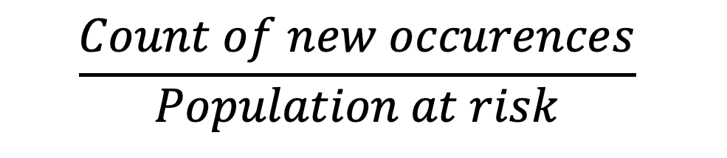


Person
Incidence Proportion
01
02
$$\frac{Count of new occurences}{Population at risk}$$
03
04
=
05
06
$$\frac{5}{9}$$
07
08
=
09
$$0.56 or 56\%$$
10
-01
00
01
02
03
04
05
06
07
08
09
10
11
12
Pre-Follow-Up
Diseased
Month Follow-up
At Risk
Deceased

Slide 36
Person
01
02
03
04
05
06
Exposed
07
08
09
10
-01
00
01
02
03
04
05
06
07
08
09
10
11
12
Pre-Follow-Up
Diseased
Month Follow-up
At Risk
Deceased
Source: Lash TL, VanderWeel TJ, Haneuse S, Rothman KJ. Modern Epidemiology. fourth. Wolters Kluwer; 2021.
Notes:
When we have two groups – e.g., exposed and unexposed – one way we can contrast outcomes in those groups is by calculating the ratio of the incidence prevalence in the exposed to the incidence prevalence in the unexposed.

Slide 37
Incidence Proportion Ratio
More commonly called
Relative risk
Risk ratio
Notes:
I like incidence proportion ratio because it is unambiguous and consistent with the previous terminology we have been using.

Slide 38
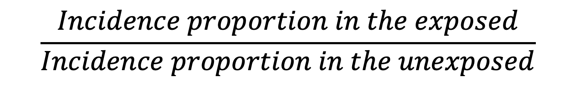
Incidence Proportion Ratio
$$\frac{Incidence proportion in the exposed}{Incidence proportion in the unexposed}$$
Notes:
We can write the information from the previous slide in a slightly more mathy way like this.

Slide 39
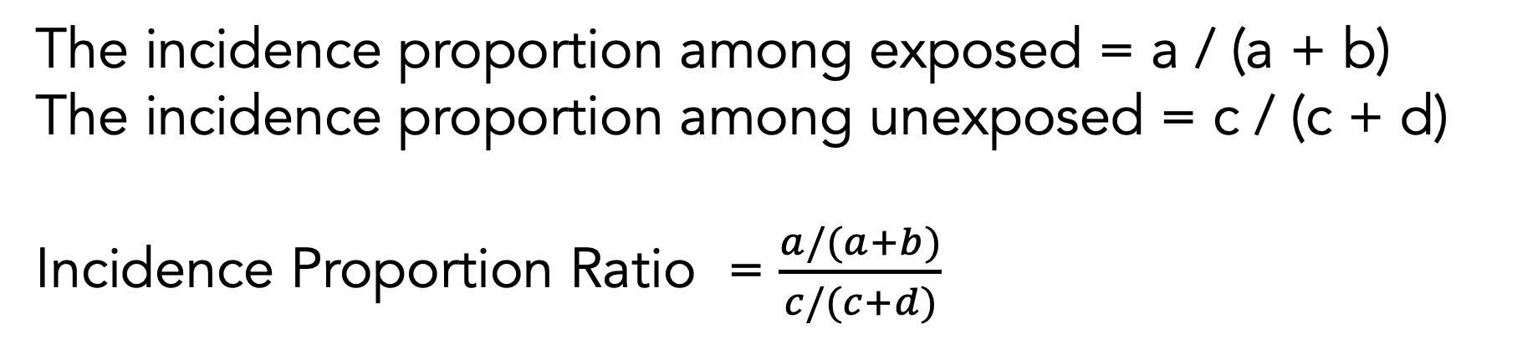
Incidence Proportion Ratio
 | Outcome + | Outcome - | Row Total
Exposure + | a | b | a+b
Exposure - | c | d | c+d
Column Total | a+c | a+c | a+b+c+d
The incidence proportion among exposed = a / (a + b)
The incidence proportion among unexposed = c / (c + d)
Incidence Proportion Ratio = $\frac{a/(a+b)}{c/(c+d)}$

Slide 40
Person
01
02
03
04
 | Disease + | Disease -
Exposure + | 3 | 2
Exposure - | 2 | 2
05
06
07
08
09
10
-01
00
01
02
03
04
05
06
07
08
09
10
11
12
Pre-Follow-Up
Diseased
Month Follow-up
At Risk
Deceased

Slide 41
Source: https://www.r-project.org/logo/

Slide 42
Person
Incidence Proportion Ratio
01
02
Among the members of our population, those who were exposed had 1.2 times the incidence of disease compared to those who were not exposed over the 12 months of follow-up period.
03
04
05
06
07
08
09
10
-01
00
01
02
03
04
05
06
07
08
09
10
11
12
Pre-Follow-Up
Diseased
Month Follow-up
At Risk
Deceased

Slide 43
Incidence Proportion Difference
More commonly called
Risk difference
Notes:
I like incidence proportion ratio because it is unambiguous and consistent with the previous terminology we have been using.

Slide 44
Incidence Proportion Difference
$$Incidence proportion in the exposed −Incidence proportion in the unexposed$$
Notes:
We can write the information from the previous slide in a slightly more mathy way like this.

Slide 45
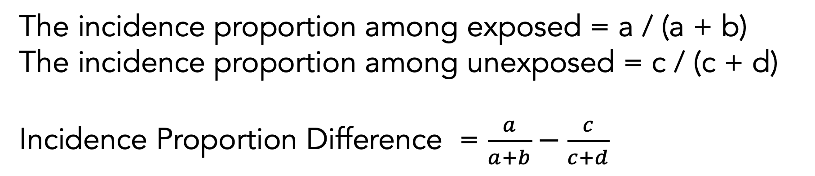
Incidence Proportion Difference
 | Outcome + | Outcome - | Row Total
Exposure + | a | b | a+b
Exposure - | c | d | c+d
Column Total | a+c | a+c | a+b+c+d
The incidence proportion among exposed = a / (a + b)
The incidence proportion among unexposed = c / (c + d)
Incidence Proportion Difference = $\frac{a}{a+b}−\frac{c}{c+d}$

Slide 46
Person
01
02
03
04
 | Disease + | Disease -
Exposure + | 3 | 2
Exposure - | 2 | 2
05
06
07
08
09
10
-01
00
01
02
03
04
05
06
07
08
09
10
11
12
Pre-Follow-Up
Diseased
Month Follow-up
At Risk
Deceased

Slide 47
Source: https://www.r-project.org/logo/

Slide 48
Person
Incidence Proportion Difference
01
02
Among the members of our population, those who were exposed had 0.1 additional cases of disease per person compared to those who were not exposed over the 12 months of follow-up period.
03
04
05
06
07
08
09
10
-01
00
01
02
03
04
05
06
07
08
09
10
11
12
Pre-Follow-Up
Diseased
Month Follow-up
At Risk
Deceased

Slide 49
Incidence Odds Ratio
More commonly called
Odds ratio
Notes:
I like incidence proportion ratio because it is unambiguous and consistent with the previous terminology we have been using.

Slide 50
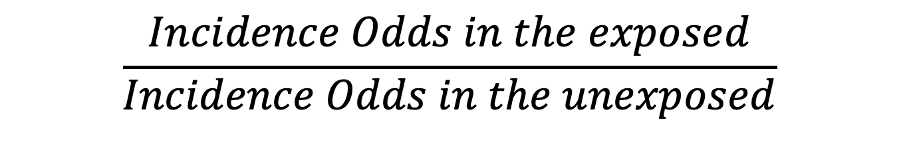
Incidence Odds Ratio
$$\frac{Incidence Odds in the exposed}{Incidence Odds in the unexposed}$$
Notes:
We can write the information from the previous slide in a slightly more mathy way like this.

Slide 51
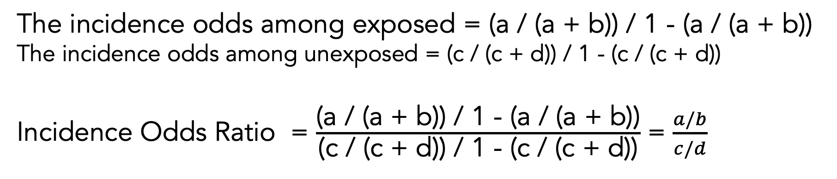
Incidence Odds Ratio
 | Outcome + | Outcome - | Row Total
Exposure + | a | b | a+b
Exposure - | c | d | c+d
Column Total | a+c | a+c | a+b+c+d
The incidence odds among exposed = (a / (a + b)) / 1 - (a / (a + b))
The incidence odds among unexposed = (c / (c + d)) / 1 - (c / (c + d))
Incidence Odds Ratio = $\frac{\text{(}\text{a}\text{ / (}\text{a}\text{ + }\text{b}\text{)) / 1 − (}\text{a}\text{ / (}\text{a}\text{ + }\text{b}\text{))}}{\text{(}\text{c}\text{ / (}\text{c}\text{ + }\text{d}\text{)) / 1 − (}\text{c}\text{ / (}\text{c}\text{ + }\text{d}\text{))}}$ = $\frac{a/b}{c/d}$

Slide 52
Source: https://www.r-project.org/logo/

Slide 53
Person
Incidence Odds Ratio
01
02
Among the members of our population, those who were exposed had 1.5 times the odds of incident disease compared to those who were not exposed over the 12 months of follow-up period.
03
04
05
06
07
08
09
10
-01
00
01
02
03
04
05
06
07
08
09
10
11
12
Pre-Follow-Up
Diseased
Month Follow-up
At Risk
Deceased

Slide 54
Incidence Rate Ratio
Sometimes called incidence density.

Slide 55
Incidence Odds Ratio
$$\frac{Incidence Odds in the exposed}{Incidence Odds in the unexposed}$$
Notes:
We can write the information from the previous slide in a slightly more mathy way like this.

Slide 56
Incidence Odds Ratio
 | Outcome + | Outcome - | Row Total
Exposure + | a | b | a+b
Exposure - | c | d | c+d
Column Total | a+c | a+c | a+b+c+d
The incidence odds among exposed = (a / (a + b)) / 1 - (a / (a + b))
The incidence odds among unexposed = (c / (c + d)) / 1 - (c / (c + d))
Incidence Odds Ratio = $\frac{\text{(}\text{a}\text{ / (}\text{a}\text{ + }\text{b}\text{)) / 1 − (}\text{a}\text{ / (}\text{a}\text{ + }\text{b}\text{))}}{\text{(}\text{c}\text{ / (}\text{c}\text{ + }\text{d}\text{)) / 1 − (}\text{c}\text{ / (}\text{c}\text{ + }\text{d}\text{))}}$ = $\frac{a/b}{c/d}$

Slide 57
Source: https://www.r-project.org/logo/

Slide 58
Person
Incidence Odds Ratio
01
02
Among the members of our population, those who were exposed had 1.5 times the odds of incident disease compared to those who were not exposed over the 12 months of follow-up period.
03
04
05
06
07
08
09
10
-01
00
01
02
03
04
05
06
07
08
09
10
11
12
Pre-Follow-Up
Diseased
Month Follow-up
At Risk
Deceased

Slide 59
Odds
The ratio of the probability of occurrence of an event to that of nonoccurrence, or the ratio of the probability that something is one way to the probability that it is another way. If 60% of smokers develop a chronic cough and 40% do not, the odds among smokers in favor of developing a cough are 60 to 40, or 1.5; this may be contrasted with the probability or risk that smokers will develop a cough, which is 60 over 100 or 0.6. See also LOGIT. (Dictionary of Epidemiology)
Source: Porta, Miquel. A Dictionary of Epidemiology (pp. 8-9). Oxford University Press. Kindle Edition.

Slide 60
Odds ratio
Say the proportion of applicants getting admitted to Cambridge is 𝑝=0.3p=0.3, therefore the odd of getting into Cambridge is 𝑝1−𝑝=0.30.7=0.4286p1−p=0.30.7=0.4286. This number means for every 0.4286 who are admitted there is 1 who are not admitted, or perhaps more clearly for every 4286 who are admitted there are 10000 who are not admitted.
Now we say the proportion of male getting admitted is 0.2 and the proportion of female getting admitted is 0.3, their respective odds will be 0.25 and 0.4286, then the odds ratio for admission of male over female is 0.250.4286=0.58330.250.4286=0.5833. This translates to, if the numbers of applicants for male and female are the same for every 5833 male who are admitted there are 10,000 female who are admitted if the numbers of applicants for both genders are the same.
Notes:
Source: https://www.quora.com/How-do-I-interpret-an-odds-ratio-less-than-1-in-a-logistic-regression

Slide 61


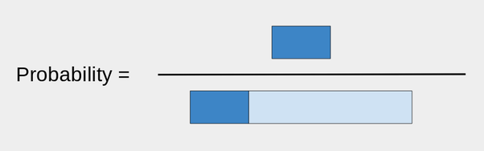
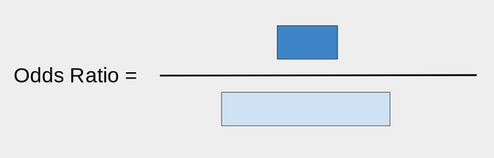
Odds ratio
First take a bar of length 1:
That will be the portion of what did not make it.
Now, take a bar of length r, where r is your ratio. For example, if r was 0.3, I would attach it like so:
The dark blue is the ones that did make it.

Slide 62
OR < 1

Slide 63
Equivalence between exposure OR and disease OR

Slide 64
Add difference between relative and absolute difference example from GPLI presentation

Slide 65
Use Rothman's investment analogy for absolute vs. relative differences
Difference measures such as RD and IRD measure the absolute effect of an exposure. It is also possible to measure the relative effect. As an analogy, consider how to assess the performance of an investment over a period of time. Suppose that an initial investment of $100 became $120 after 1 year. The difference in the value of the investment at the end of the year and the value at the beginning, $20, measures the absolute performance of the investment. The relative performance is obtained by dividing the absolute increase by the initial amount, which gives $20/$100, or 20%. Contrast this investment experience with that of another investment, in which an initial sum of $1000 grew to $1150 after 1 year. For the latter investment, the absolute increment is $150, far greater than the $20 from the first investment, but the relative performance of the second investment is $150/$1000, or 15%, which is worse than the first investment.
Rothman, Kenneth J.. Epidemiology: An Introduction (p. 59). Oxford University Press. Kindle Edition.

Slide 66
Add sensitivity, specificity. Confusion matrix.

Slide 67
Risk difference
“The 5-year risk difference comparing study participants exposed to the contaminant to those who were unexposed was 4%.” (Epi by Design)
for every 1,000 persons who are observed to be exposed to the contaminant (and if those people resemble those we studied), we would expect to likewise observe an additional 40 new cancer cases above the background cancer rate over 5 years. (Epi by Design)
Notes:
Several somewhat technical points about the risk difference measure should be called out here. First, the range of the risk difference is from −1 to +1, inclusive (which we express as [−1, 1]). This is because the highest possible risk is 1, while the lowest is 0; if, as in Table 2.2, the risk in the exposed is higher than in the unexposed, then the risk cannot be higher than 1 − 0 = 1. Similarly, when the risk in the exposed is lower than in the unexposed, then the risk cannot be lower than 0 − 1 = −1. A negative risk difference would occur if the exposure was protective; for instance, if we were considering the association of daily aspirin use with risk of heart attack. Whether the exposure is associated with increased or decreased risk, the risk difference is considered relative to the null value. Again, this is the value which reflects no differences between the two groups being compared. No differences here would mean that the risk in exposed participants and the risk in unexposed participants are the same value P. Therefore, the null for the risk difference is P − P = 0.

Slide 68
Risk Ratio
“The 5-year risk ratio comparing exposed to unexposed study participants is 2.33.” (Epi by Design)
“Over 5 years, we would expect to see 2.33 times the incidence of cancer among exposed study participants compared to unexposed study participants.” (Epi by Design)

Slide 69
Attributable risk in exposed
This might simply be causality applied to risk difference.
Modern epi uses risk difference and excess risk. Not attributable risk.

Slide 70
Percent attributable risk

Slide 71
Absolute risk reduction

Slide 72
Number needed to treat

Slide 73
Population attributable risk

Slide 74
Point prevalence rate ratio

Slide 75
Multiple testing

Slide 76
Etiologic Fraction
Need to look this up

Slide 77
Effectiveness efficacy
Not sure where to put this…

Slide 78
Matrix
matrices or more generally arrays are multi-dimensional generalizations of vectors. In fact, they are vectors that can be indexed by two or more indices and will be printed in special ways. See Arrays and matrices. (https://cran.r-project.org/doc/manuals/R-intro.html)
As noted above, a matrix is just an array with two subscripts. However it is such an important special case it needs a separate discussion. (https://cran.r-project.org/doc/manuals/R-intro.html#Arrays-and-matrices)
An array can be considered as a multiply subscripted collection of data entries, for example numeric. R allows simple facilities for creating and handling arrays, and in particular the special case of matrices.
A dimension vector is a vector of non-negative integers. If its length is k then the array is k-dimensional, e.g. a matrix is a 2-dimensional array. The dimensions are indexed from one up to the values given in the dimension vector. (https://cran.r-project.org/doc/manuals/R-intro.html#Arrays-and-matrices)

Slide 79

Few checklists
Statistical uncertainty
Causal uncertainty
Uncertainty
Notes:
Last week, we also discussed the importance of uncertainty in epidemiology. One of the three types of uncertainty we discussed was statistical uncertainty.

Slide 80
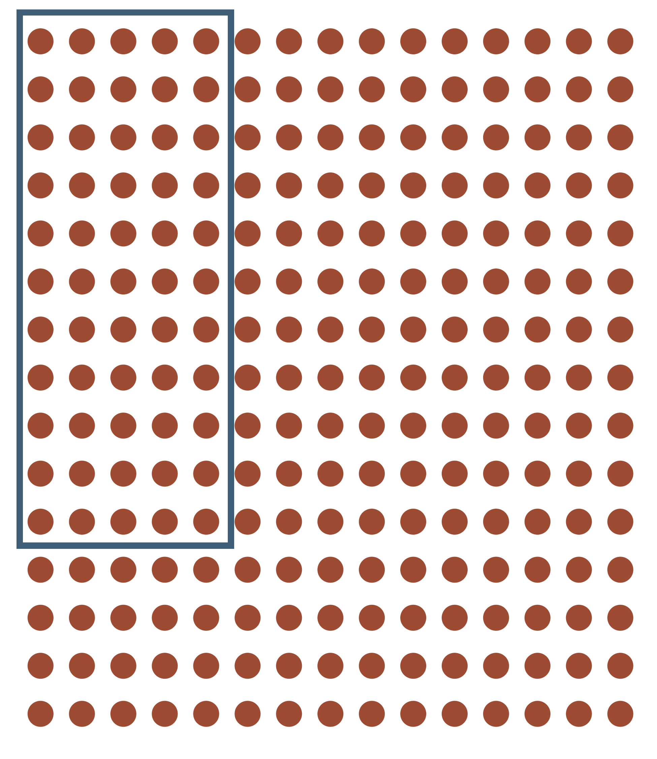
Uncertainty
Notes:
Population vs. sample one of the primary sources of statistical uncertainty.
So, what do we do about that uncertainty? I mean, none of us generally like uncertainty, right? Can we get rid of it? Not usually. Even if we take measure from the entire population, it rarely includes all people who theoretically could be in the population (sometimes called a superpopulation).

Slide 81
Measures of sampling variability
P-values
P-value functions
95% Confidence intervals
Start with that sheet of quotes you sent out as an announcement a couple of semesters ago.

