Slide 1
Erdrich-Phipps Compensation Plan

Slide 2
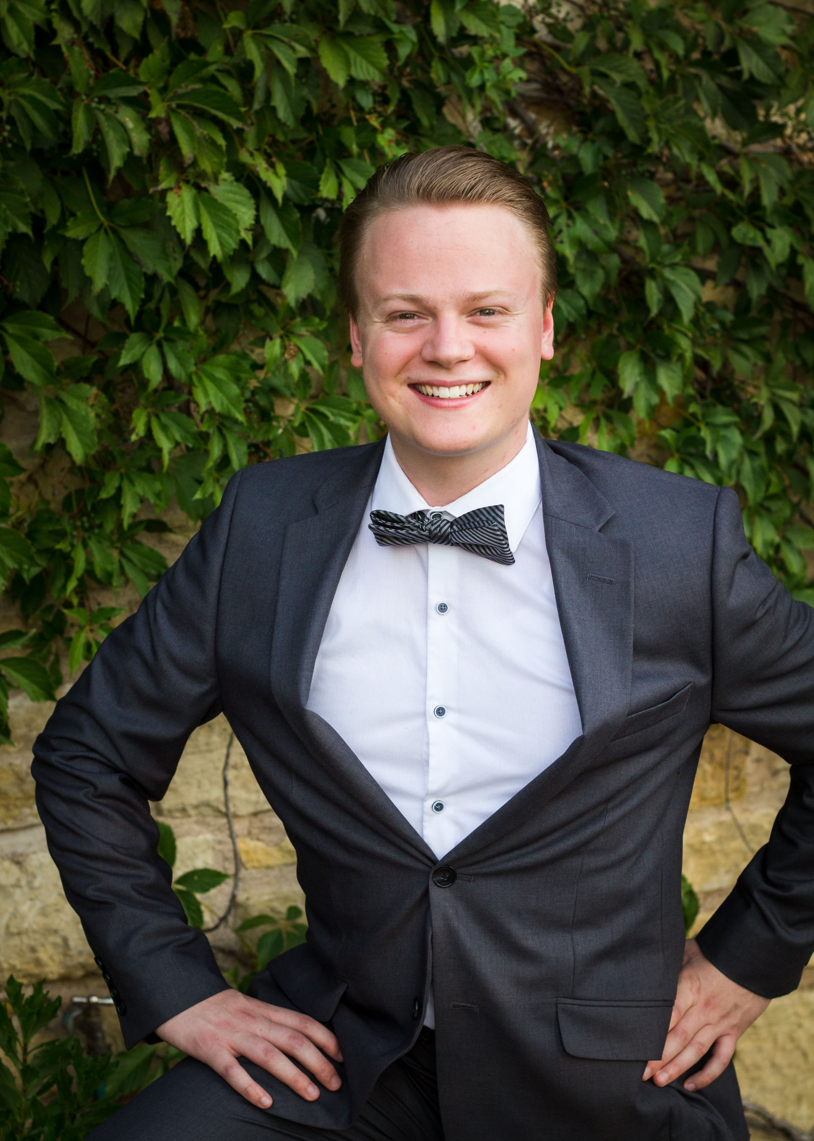
I have been working for the Phipps as an independent digital marketing contractor since the previous executive director, Darby, stepped down in November 2022. My original role was to continue digital marketing activities—including emails, social media, and website management—at a minimum until the job duties of the executive director position was rewritten and a new executive director was found. At that point, it was understood that this role would be reevaluated.
Over this time, the role has grown from simple digital marketing to a more comprehensive technical communication presence. Since Ben’s arrival in June, a consistent and effective workflow has been established to the benefit of both the digital marketing professional (me, Brian Erdrich) and the Phipps.
This proposal site establishes a timeline of my achievements at the Phipps, a comprehensive list of duties, and a proposal for establishment

