Slide 1

Database Systems (SEng 2204)
Chapter 7: Database Recovery Techniques
Members Id Group
1) Getamesay Mamo... UGR/38240/17………...1
2) Eman Abdulaziz…....UGR/36779/17….......1
3) Bereket Tadese………UGR/36541/17…………..2
4) Bereket Tarekegn….UGR/36542/17.…..….…1
5) Dagim Asmamaw…… UGR/36651/17.........1
6) Hilina Zewdu………….UGR/37099/17.........2
Instructor: Alemayehu Megersa Keba

Slide 2
Introduction
Database recovery helps restore databases after failures such as crashes or power outages. In this presentation, we will discuss recovery methods including logging, checkpointing, undo/redo operations, and the ARIES recovery algorithm used in modern DBMSs.

Slide 3
Database Recovery
Process of restoring database after failure.
Its essential because several challenges can compromise data integrity .

Slide 4
Roles of Managers
Transaction Manager
  Handles begin, commit, abort
Log Manager
  Stores logs in buffer and disk
Recovery Manager
  Restores database after failure

Slide 5
Purpose of Recovery
Restore database to the last consistent state prior to failure.
Prevent data loss
Maintain transaction integrity
Recovery Manager:
  Ensures Atomicity by undoing uncommitted transactions.
  Ensures Durability by redoing committed transactions after a crash.

Slide 6
Types of Failures
Transaction Failure:
  Logical errors in transaction code
  user-initiated aborts
  Deadlocks between transactions
System Failure:
  OS crash
  RAM failure
  power outages affecting servers
Media Failure:
  Disk head crashes
  Power failure
  physical storage damage.

Slide 7
Recovery Strategies
To recover from a system failure, the system keeps information about the change in the system log
Catastrophic Failure:
  If there is extensive damage to the wide portion of the database.
  Requires restoring a backup copy from storage.
  Reconstructs operations from the log up to the crash.
Non-Catastrophic Failure:
  Database is physically intact but inconsistent.
  Uses Undo and Redo operations to fix states.
Example of Failure Handling
  If committed but not saved → Redo
  If not committed → Undo

Slide 8
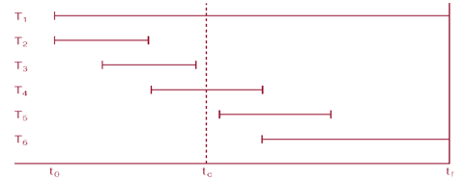
If transaction had not committed at failure time, recovery manager has to undo (rollback) any effects of that transaction for atomicity.
  DBMS starts at time t₀, but fails at time t_{f}.
  T₁ and T₆ have to be undone. In the absence of any other information, the recovery manager has to redo T₂, T₃, T₄, and T₅

Slide 9
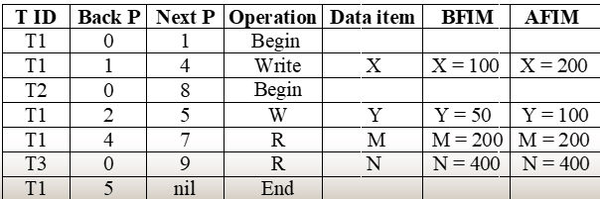
The Transaction Log
A sequential file storing all database changes for recovery purposes(Restore system after crash)
Stores:
  BFIM (Before Image): Data value before the change.
  AFIM (After Image): Data value after the change.
  Pointers: Back P and Next P link records of the same transaction.
  prior to failure: Read/Write/Commit/Abort
  Transaction ID: Identifies the transaction

Slide 10
Data Caching
Data items to be modified are first stored into database cache by the Cache Manager (CM) and after modification they are flushed (written) to the disk
Cache Management Process
  DBMS checks if requested item is in database cache
  If not present, disk blocks are copied to cache
  If cache is full, buffer replacement policy is applied
Buffer Replacement Policies
  LRU (Least Recently Used)
  FIFO (First In First Out)
When replacing buffers, updated values must be saved to disk first

Slide 11
Write-Ahead Logging (WAL)
Ensures log availability for the recovery manager
Guarantees atomicity and durability
Before any database change is written to disk, the corresponding log record must be written to stable storage
For UNDO:
  Before AFIM is flushed to the database disk, BFIM must be written to the log and saved on stable storage
For REDO:
  Before the transaction executes a commit, all AFIMs must be written to the log and saved on stable storage

Slide 12
Steal vs No-Steal / Force vs No-Force
Policy | Definition | Advantage
No-Steal | Cache cannot flush before transaction commit | No UNDO needed
Steal | Cache can flush before transaction commit | Smaller buffer space required
Force | All cache updates immediately flushed at commit | No REDO needed
No-Force | Cache flushed when needed after commit | Reduces I/O for multi-transaction pages
Four Recovery Combinations
Steal/No-Force: UNDO + REDO
Steal/Force: UNDO only
No-Steal/No-Force: REDO only
No-Steal/Force: Neither (fastest recovery, slowest commit)

Slide 13
Checkpointing
A synchronization point between the DB and log file to minimize recovery time.
Checkpoint Operation Steps
  Suspend transaction execution temporarily
  Force write modified buffer data to disk
  Write [checkpoint] record to log, save to disk
  Resume normal transaction execution
Checkpoint Benefits
  Reduces log scanning
  Improves recovery speed

Slide 14
Transaction Roll-back (Undo) and Roll-Forward (Redo)
Undo: Removes AFIMs and restores BFIMs to disk.
Redo: Restores AFIMs to the disk to ensure durability.
Cascading Rollback:
  If one transaction fails:
  → others, depending on it, must rollback
  If T1 is undone, any transaction that reads T1's data must also be undone.

Slide 15
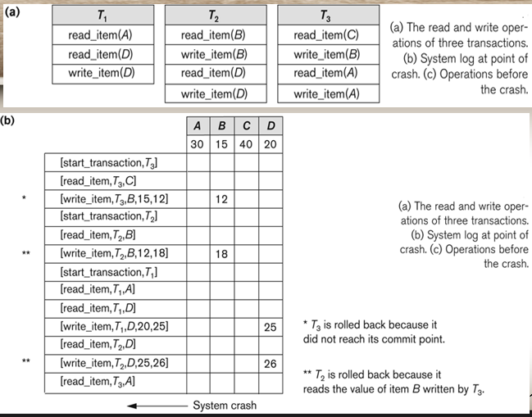
Example

Slide 16
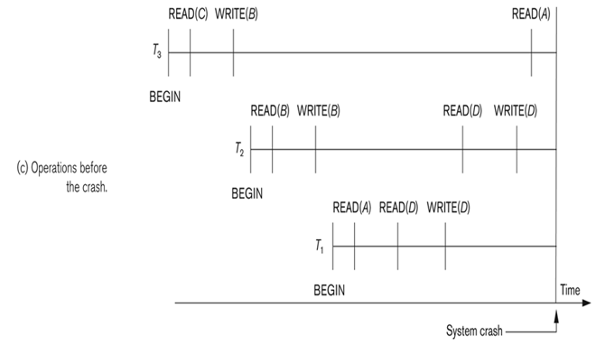
Roll-back: One execution of T1, T2 and T3 as recorded in the log.

Slide 17
2)DATA UPDATE & RECOVERY SCHEMES
Types of Recovery Schemes
  Deferred Update
  Immediate Update
  Shadow Paging

Slide 18
A. Deferred Update (No Undo/Redo)
How It Works
  Transaction records all updates in log only
  Updates held in cache buffer until commit
  At commit: updates saved to database disk (under WAL)
  No AFIM flushed before commit
Recovery Process
  No UNDO needed (database unchanged by uncommitted transactions)
  REDO all committed transactions from log
Limitation
  Risk of out of buffer space - transaction changes must stay in cache until commit
Single-User vs Multi-User
  Single-user: No concurrency concerns
  Multi-user: Requires concurrency control mechanism + Active Table + Commit Table
Tables Used
  Active Table: Tracks running transactions
  Commit Table: Tracks committed transactions
Idempotent REDO
  REDO operation can be applied multiple times without inconsistency

Slide 19
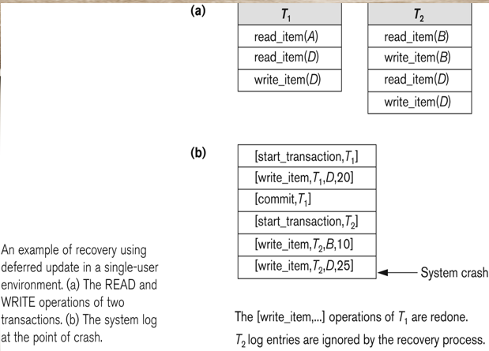
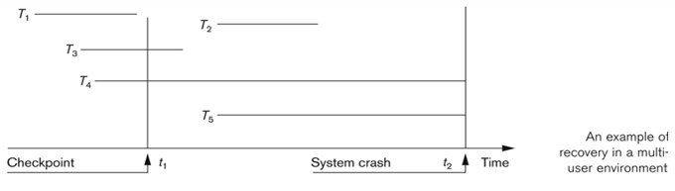

Slide 20
B. Immediate Update ( Undo/No-redo Algorithm)
How It Works
  AFIMs flushed to database disk before transaction commits (under WAL)
  Updates recorded on log first, then disk via force writing
Recovery Process
  UNDO all transactions (uncommitted AND prepared-to-commit)
  No REDO performed
Why UNDO needed?
  Transaction might have modified database but not yet committed - must be rolled back

Slide 21
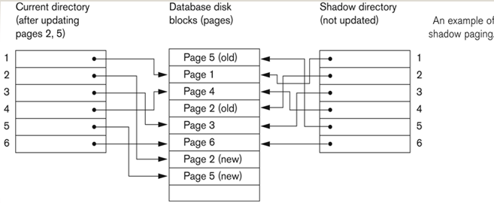
C. Shadow Paging (NO-UNDO/NO-REDO)
Process
  Transaction starts: both tables point to same pages
  Updates go to new copies (shadow pages)
  On commit: current table becomes shadow table
  On abort: shadow table restored
Operation:
  Shadow table is never changed; it's the "safety" copy.
  Current table records all new updates in new disk blocks.
Advantages
  No log needed for recovery
  Fast recovery
Disadvantages
  Complex management
  Extra memory usage

Slide 22
The ARIES(Algorithm for Recovery and Isolation Exploiting Semantics.) Recovery Algorithm
Works with: Steal + No-Force
Based on:
  WAL: Algorithm for Recovery and Isolation Exploiting Semantics.
  Repeat History during redo: Redoes all actions (even uncommitted ones) to reach the crash state.
  Logging during Undo: Records "undo" actions to prevent repeating them if a second crash occurs.
Principles
  Log first → then update database
  Redo all actions
  Undo uncommitted transactions

Slide 23
Data Update
Method | UNDO | REDO | Log Required? | Concurrency
Deferred Update | No | Yes | Yes | Limited
Immediate Update | Yes | No | Yes | Better
Shadow Paging | No | No | No | Low (page locks)
In-Place Update | Yes | Yes | Yes | Best
Deferred Update:- Changes stay in workspace until commit
-Potential buffer space issue
Immediate Update:-Disk updated immediately after cache modification
        -Requires UNDO for uncommitted transactions
Shadow Paging:- Multiple versions maintained
-Requires garbage collection
In-Place Update:- Disk version overwritten by cache version
        -Standard approach in modern DBMS

Slide 24
s
ARIES Log & LSN
  LSN (Log Sequence Number): Unique, monotonic ID for every log record.
  PageLSN: Each data page stores the LSN of its latest change.
  Log Record Types: Update, Commit, Abort, End, and Undo.
ARIES Tables
  Transaction Table: Tracks active Transaction IDs, Status, and Last_LSN.
  Dirty Page Table: Tracks pages in buffer modified but not yet on disk.
Fuzzy Checkpointing: Allows transactions to continue running while checkpointing.
The Three Phases of ARIES
  Phase 1: Analysis: Identifies dirty pages and transactions active at crash.
  Phase 2: Redo: Replays history from the earliest dirty page forward.
  Phase 3: Undo: Scans backward to roll back all uncommitted transactions

Slide 25
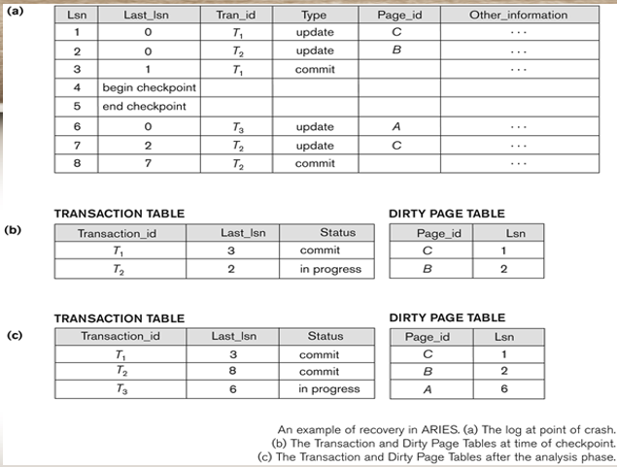

Slide 26
Conclusion
In conclusion, database recovery techniques help maintain data integrity and system reliability after failures. Methods such as logging, checkpointing, undo/redo operations, and the ARIES algorithm ensure that databases can recover and return to a consistent state while preserving committed transactions.

Slide 27
Reference
Database System Concepts – Abraham Silberschatz, Henry F. Korth, S. Sudarshan, Database System Concepts, McGraw-Hill.
Fundamentals of Database Systems – Ramez Elmasri and Shamkant B. Navathe, Fundamentals of Database Systems, Pearson Education.
Database Management Systems – Raghu Ramakrishnan & Johannes Gehrke, Database Management Systems, McGraw-Hill.
Lecture notes and course materials provided by Alemayehu Megersa Keba for Database Systems (SEng 2204).

