Slide 1
TRABAHANAP.COM
New Version Inputs

Slide 2
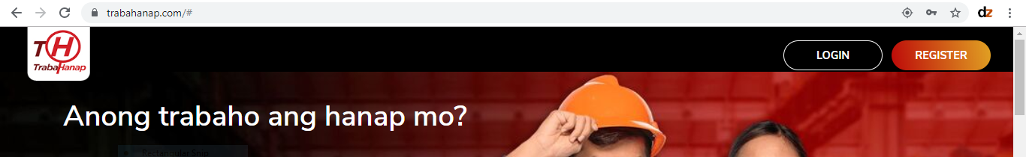

HEADER
Please put a HOME button in the menu.
Can we put a space below the buttons?
Can we use this logo for branding consistency purposes, please? File is attached to in the Email

Slide 3
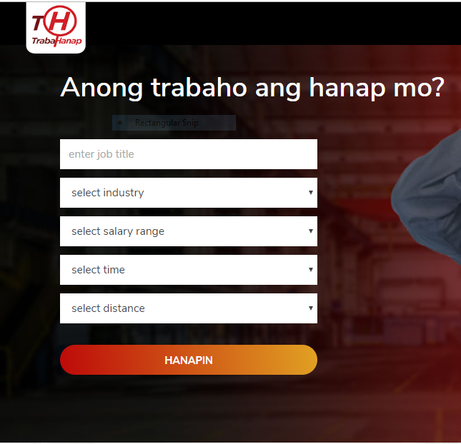
BANNER
Please replace “Select Time” to “Select Employment Type”
Can we add another?
“Select Company”

Slide 4
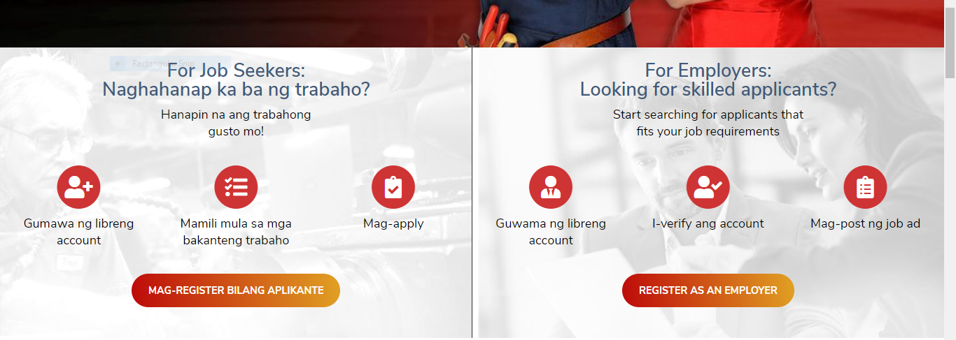


REGISTRATION SECTION
Please replace the overlayed images with these. (Images are attached in the email)

Slide 5
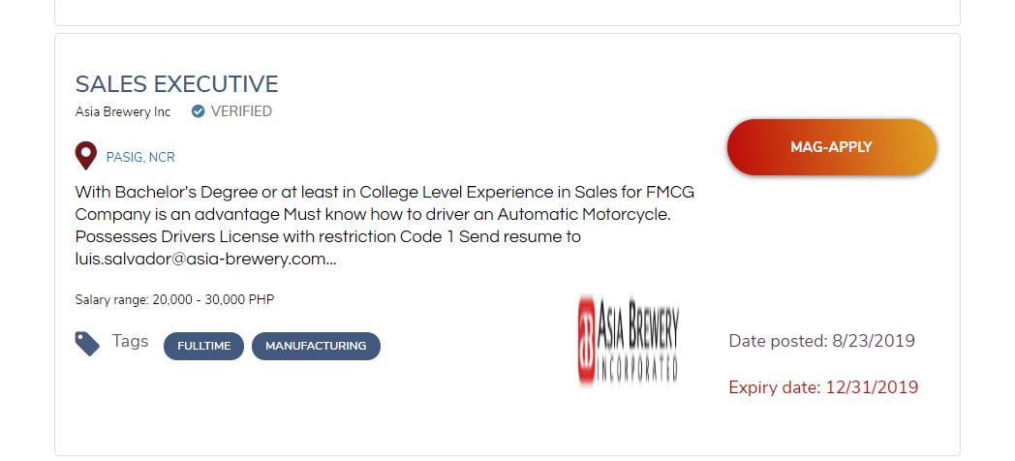
JOB SECTION
Can we also add the “number or vacancies” on this age?
Please put the logo to the left side soon.
What is the file size needed so we can request our clients to provided.

Slide 6
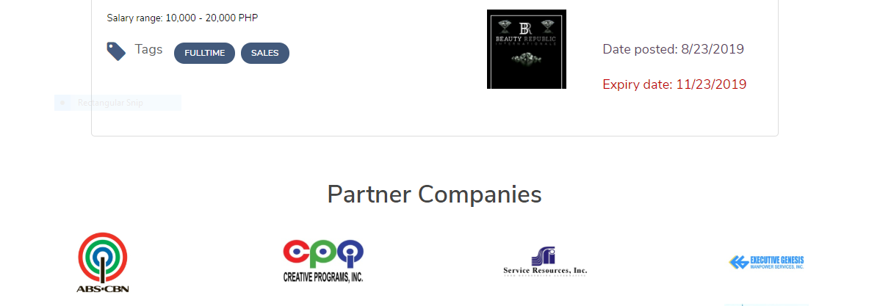
JOB SECTION
MORE JOBS

Slide 7

Partner Companies
Please see attached featured company logos to replace the current.

Slide 8
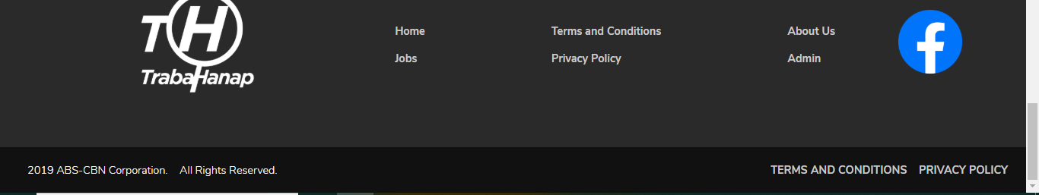
FOOTER
Please replace ABS-CBN Corporation with Trabahanap.com
JOB APPLICANTS
FAQ
Login
Browse Jobs
Contact Us
JOB EMPLOYER
FAQ
Login
Browse Candidates
Contact Us
Please remove “ADMIN” from the public. Ideally, this portal should only be communicated internatlly.

Slide 9

FOOTER
Ang TrabaHanap ay isang job-hunting site na tutulong sa mga aplikanteng makahanap ng trabaho na malapit sa iyo.

Slide 10

Other Items
FACEBOOK ACCOUNT - https://www.facebook.com/trabahanapofficial/
Can we add a “Facebook Messenger” widget in the site?

