Slide 1
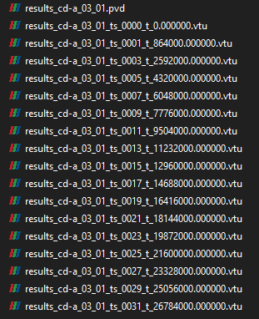
ts_0000: 18.09.2019
ts_0001: 18.09.2019 + 10 days => End of September 2019
ts_0003: ts_001 + 1 month => End of October 2019
ts_0005: ts_003 + 1 month => End of November 2019
…

Slide 2
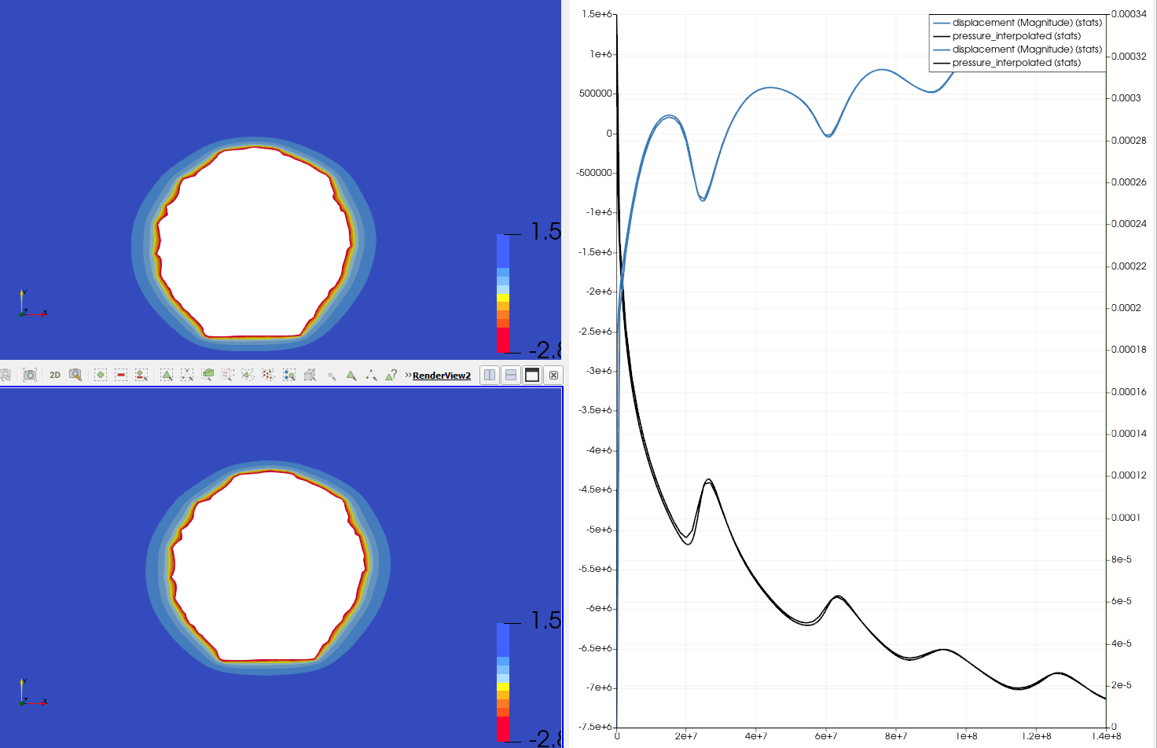
Quick convergence check at arbitrary point
Quick check at point ID 127:
\Delta t = 1 d
\Delta t = 10 d; 15.2187 d

Slide 3
t0 = 18.09.2019
\Delta t = 10 d (864000 s)
\Delta t = 15.2187 d (1314900 s)
(365.25 d / y / 12 months = 30.4375 d / m; *0.5 = 2 weeks)

