Slide 1


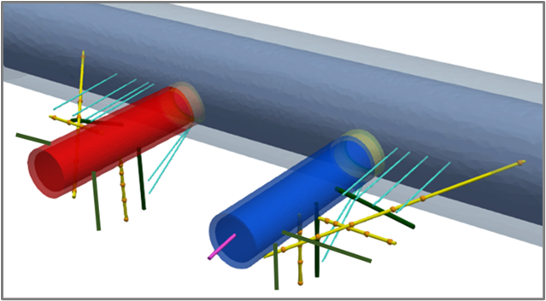
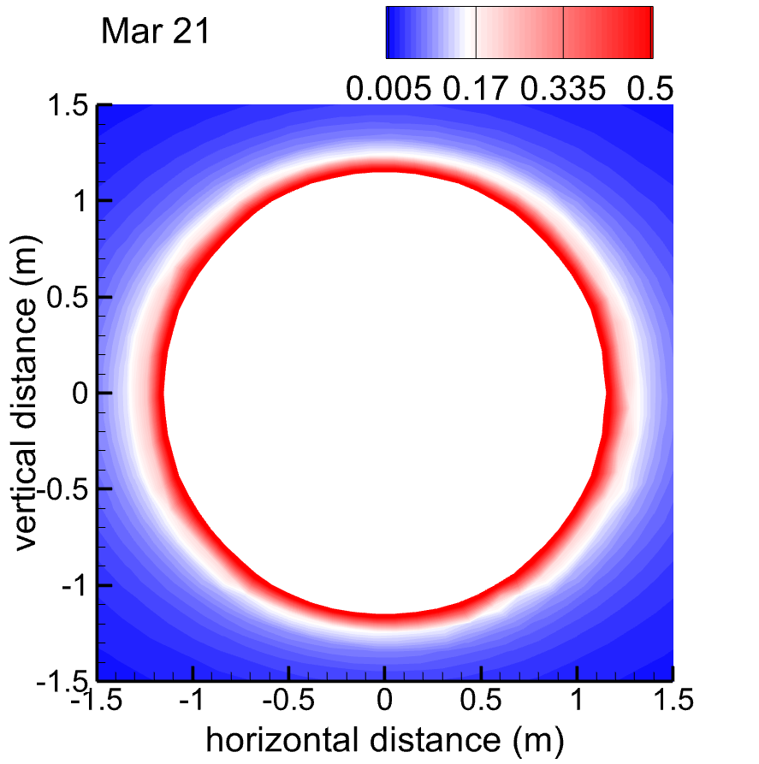
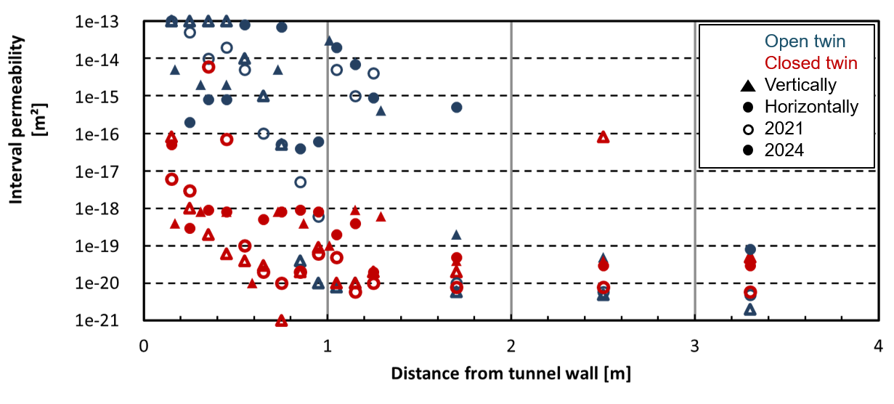
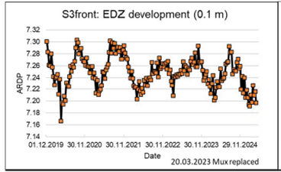
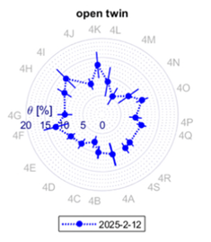
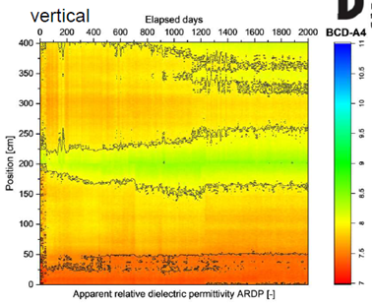
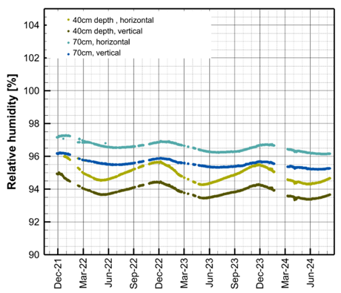
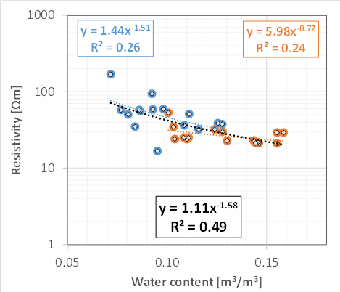
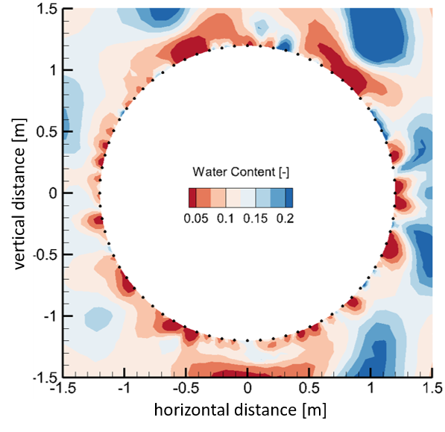


Enhancing Numerical Models via Improved Parameter Estimates from Diverse Geophysical Measurements
Starting point
Extensive use of measurements
Aiming on
Improvement of model approaches by combining physical and data-driven models
Numerical model
EDZ around niche
2
Measurements from Mont Terri Project (CD-A Experiment)
Ziefle, Cajuhi
Beres, luber

