Slide 1
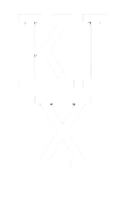
ON DEMAND
Jeremy Bangala

Slide 2
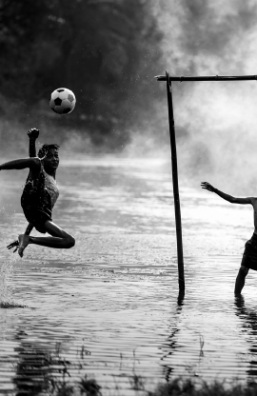
The Summary
PURPOSE
Soccer is the most popular sport in the world and there are and will always be new players that are interested in the sport and want join. A lot of times for these new players they don’t know too much about the sport, so they end up buying the first pair of cleats they see without knowing anything about it. This project aims to solve that problem
OBJECTIVE: PLAYER SATISFACTION
The goal here is to create a well functioning AI system
that will enhance experiences for players. Satisfaction
from our users comes in the form of them playing at
their best and performing at their highest level

Slide 3

Approach
Research for a compatible dataset
Pre-process, clean and manipulate the data
Find the best classification model to recommend cleats
Develop a friendly UI

Slide 4

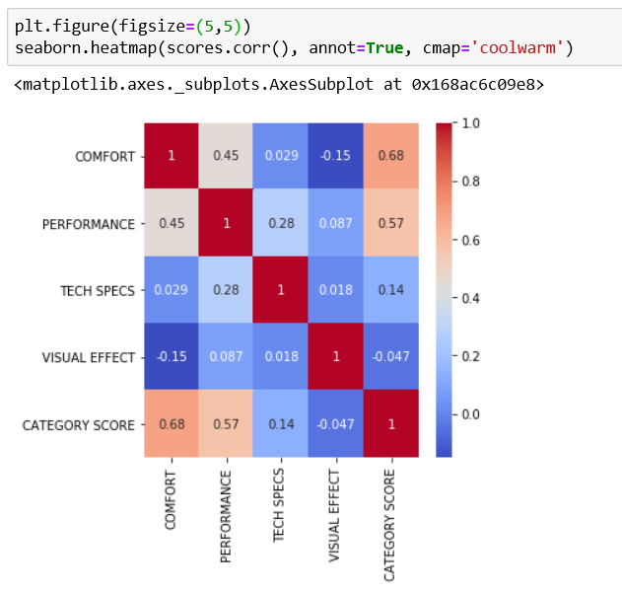
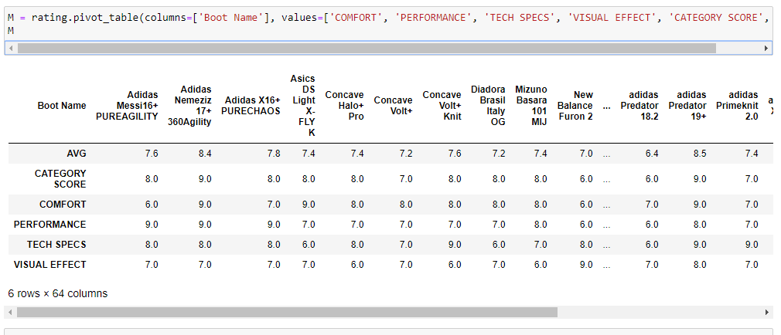
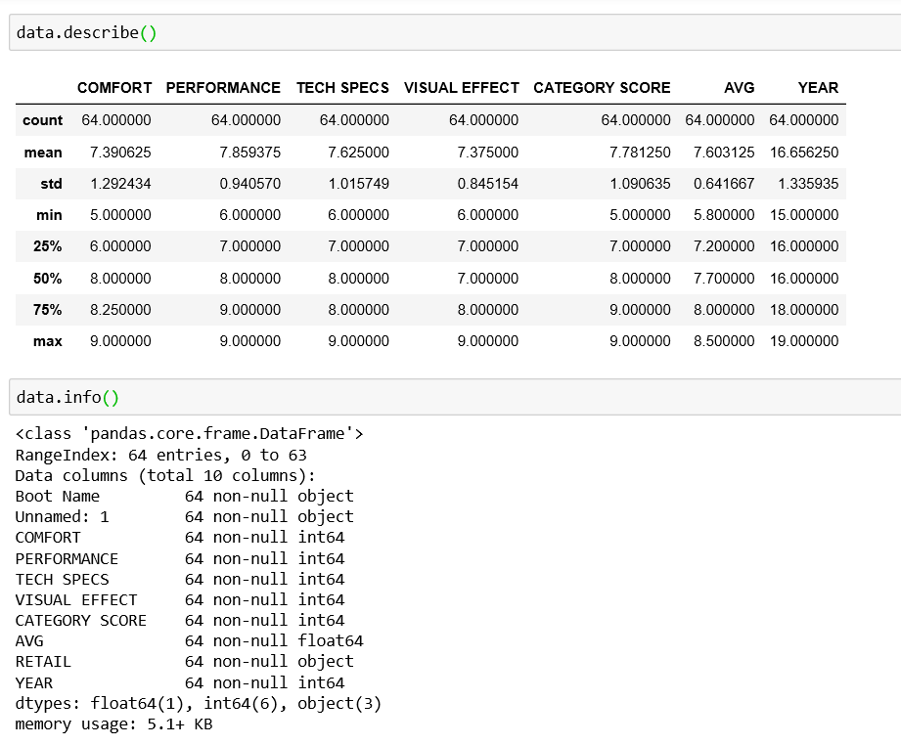
EDA
Figure 1
Figure 1: I have a correlation heatmap that shows a little bit of the correlation between the different variables. We can conclude that the highest correlation is sitting at 0.68 while the lowest is at -0.15
Figure 2: With data.describe() I can get a better understanding of the distribution between the variables. I can information on the count, mean, standard deviation etc.
Here I created “M” which is a rating pivot table, it specifies boot names and pulls all the columns I need for the recommendation
Figure 2

Slide 5
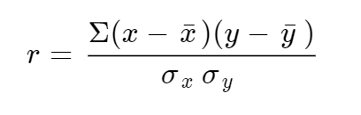
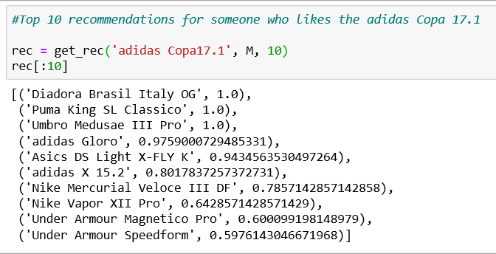
Pearson’s R
For the prediction model I decided to go with Pearson’s R. With this formula we can calculate the Pearson’s R between different pairs of boots, see which corelate well together and make a good recommendation
This is a look at what the recommender would look like. These are the top 10 recommendations for a player who is interested in the Adidas Copa 17.1

Slide 6
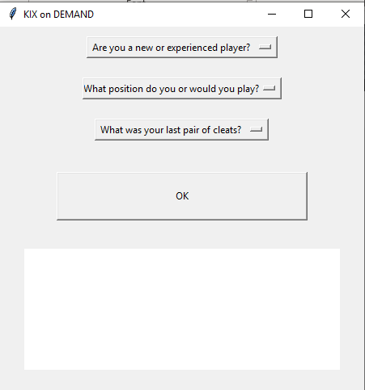
Front-end

