Slide 1
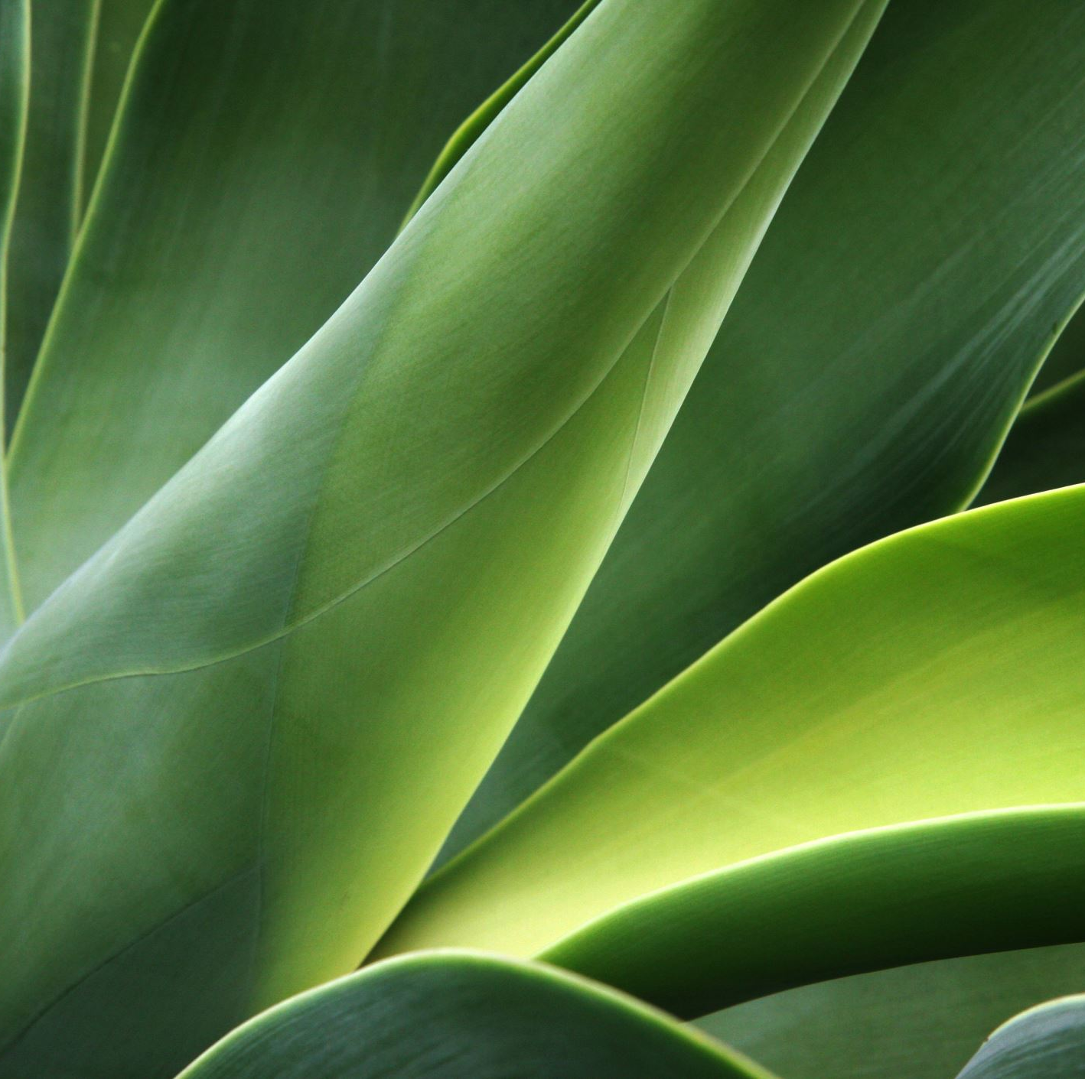
PlantsVisor
by
Cristian Nicolae Lupascu,
Veronica Zanella
Check the health of your plants whenever and wherever you want

Slide 2
PROJECT’S GOALS
Learn new technologies and hardware
Visualisation and management of plant data
Learning to build an infrastructure from scratch
Notes:
We made this project with 3 main goals in mind: Firstly, to learn new technologies and hardware, secondly, to visualise sensor data to manage our plants accordingly, and lastly, to learn how to design and build a system infrastructure from scratch.

Slide 3
INFRASTRUCTURE
Backend
Database
Sensors’ Hub
App
Notes:
The backend plays the most important role in the infrastructure, since it connects all the components and allows them to communicate with each other:
The App receive the necessary data to visualize the plants and send data to the backend when a new plant is added
The Database stores data coming from sensor readings and plants and send requested data through the backend.
The Hubs send their data to the backend that then inserts them into the database

Slide 4
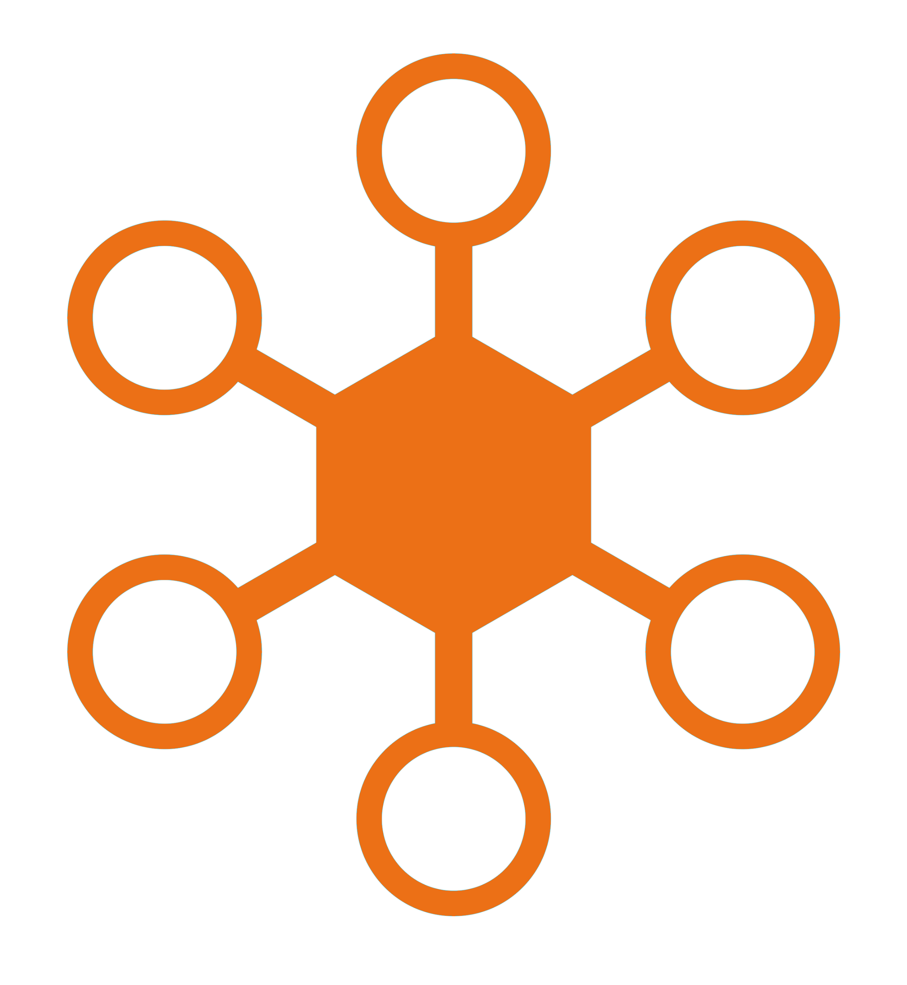

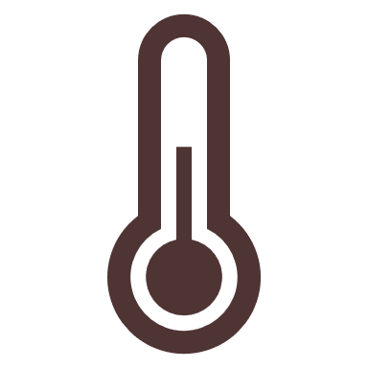


SENSORS
DHT11: Temperature and humidity sensor
LDR: light sensor
3 Capacitive soil moisture sensor
Notes:
The first step was to figure out how to organize the sensors. We thought to organize them in HUBS.
A single hub is handled by an esp32 and has:
- a sensor that measures temperature and humidity (DHT11 Temperature and Humidity Sensor)
a LDR that measures light intensity
Several soil moisture sensors each of them in a different plant
This structure allows a user to have more hubs in the house as well as in the same room.
To keep it simple we have implemented only hubs with 3 plants each, but the app leaves it open to add more plants for hubs, so that in the future, if the hardware is available, it can be easily implemented.

Slide 5

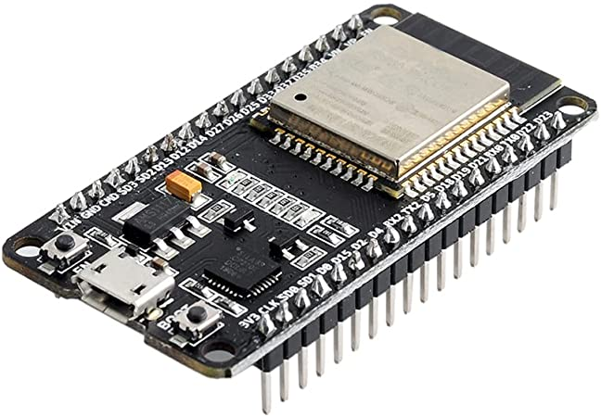
SENSORS SENDING DATA
+
Our Hub: ESP32DevkitV1 with Mongoose OS installed
Hub
Backend
Database
POST /batch/{username}/{hub}
Insert data
Notes:
The core of our hubs is the ESP32 DEVKIT V1, that is quite well equipped with Bluetooth and Wifi.
We have installed Mongoose OS to easily program the device using Javascript or C (we have used javascript). The system uses docker to transpile from javascript to C, which in turn gets compiled into the firmware using Espressif’s toolchain in a docker container.
The esp32 sends an http request to the backend containing all sensor readings at once, divided by plant, to minimize the number of http requests.

Slide 6
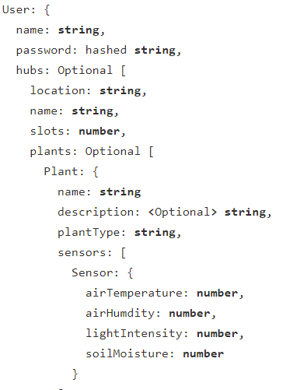
DATABASE
Mongo DB on a Raspberry Pi 4
Using subdocuments, it is possible to have a JSON-like structure
Sensor readings are a time series
Notes:
For the database, we chose MongoDB, since it’s ideal for real-time data and doesn’t have lots of constraits, making it fast to develop with. The structure is JSON like, thanks to subdocuments:
A User might have list of hubs, which in turn might have a list of plants, maximum slots amount, and the plants will constantly receive sensor data, so they are structures as a time series document.

Slide 7



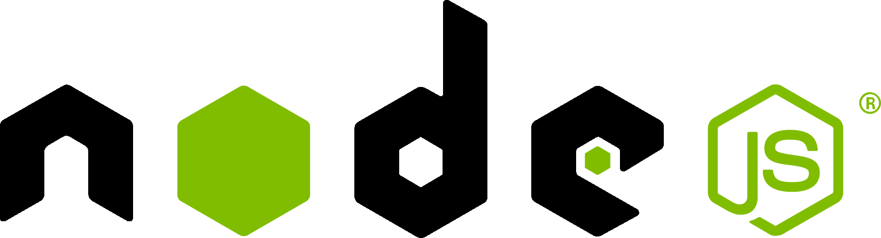
BACKEND
NodeJS-Express-Typescript stack
Mongoose to interface with the database
Notes:
For the backend, we went with a classic Node JS stack: Mongoose-Express-Typescript. Typescript ensures type safety and expands Javascript in a way it makes it less tedious to use; Express allows for an easy way of creating APIs and Mongoose provides methods for interacting with a MongoDB databse.

Slide 8
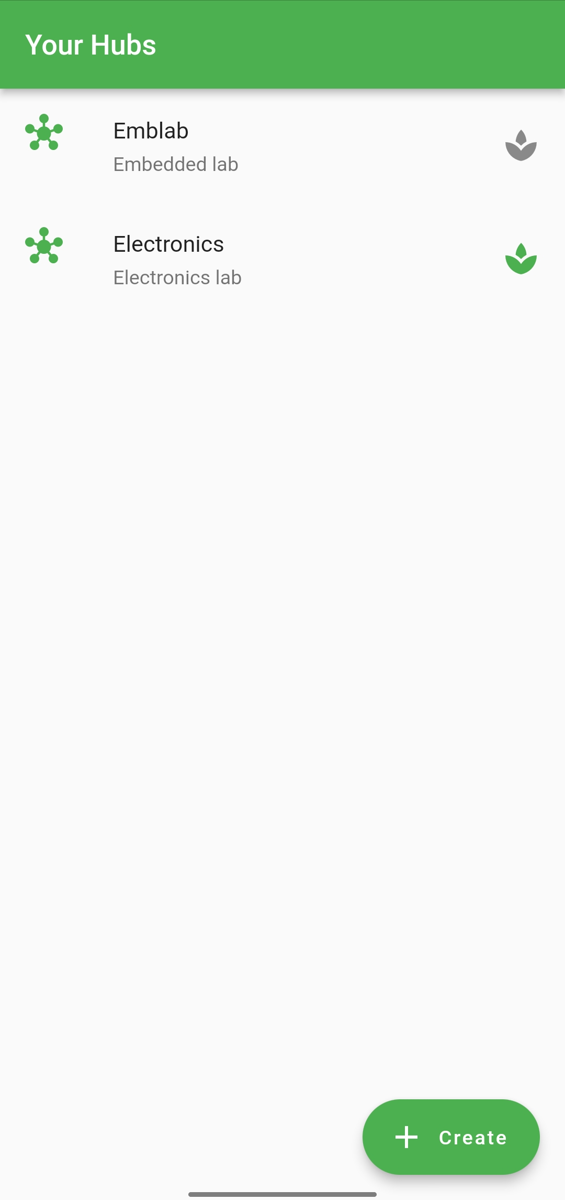
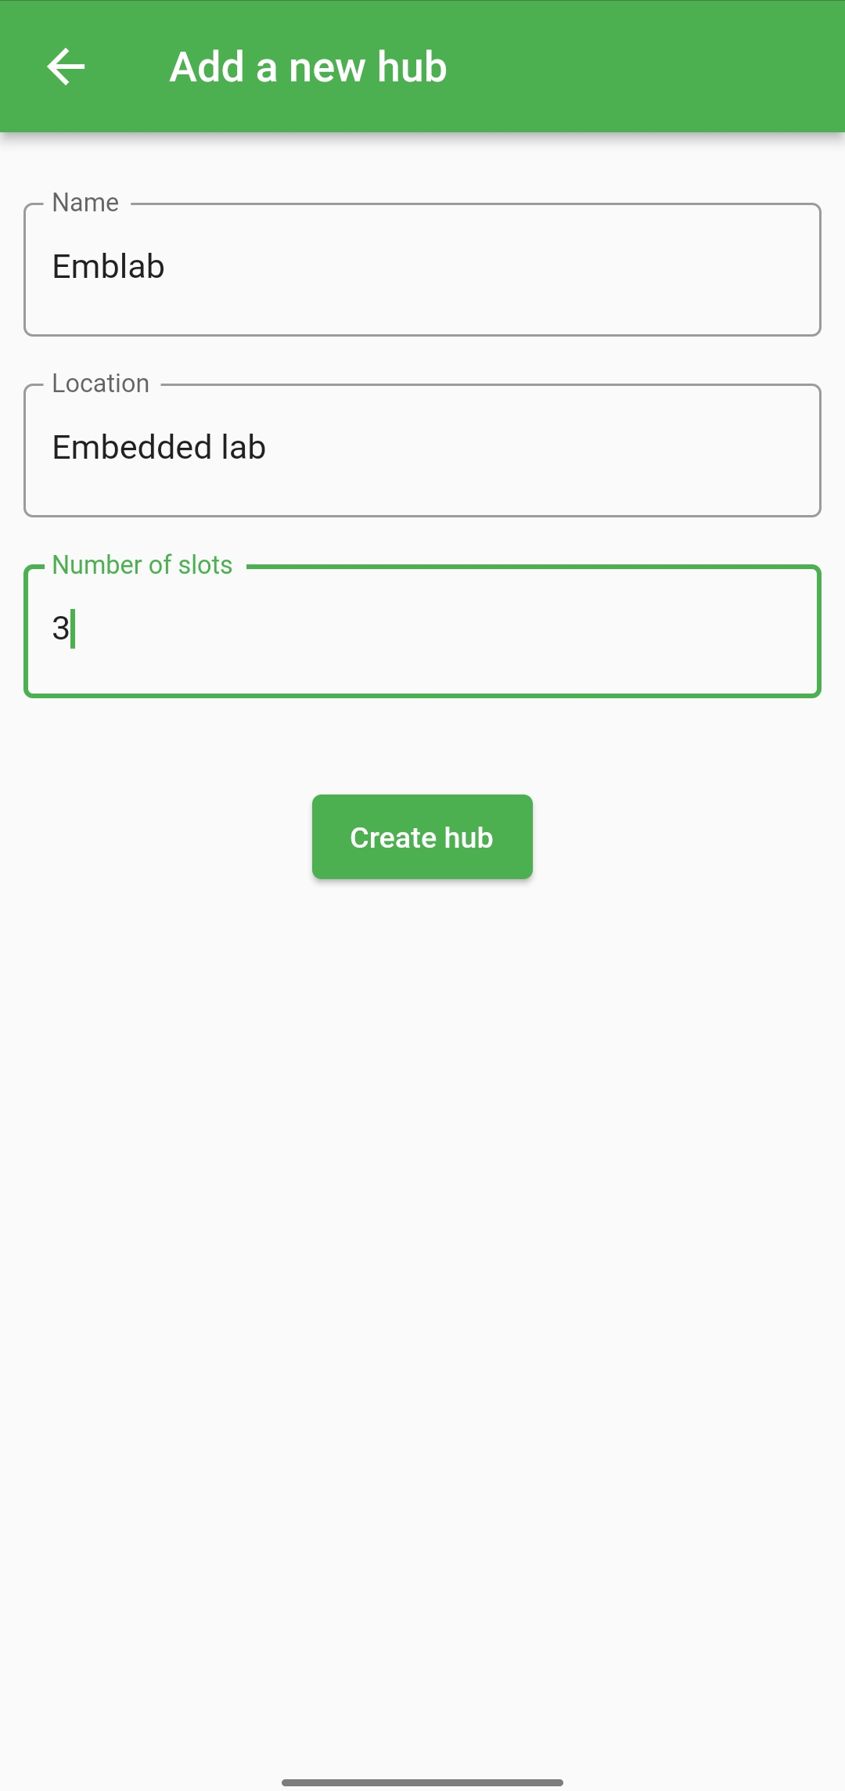


APP in flutter: hubs
Show your hubs
Create a new one
Easily check slots availability
Notes:
For the development of the mobile App we have used Flutter, a framework for dart made by Google.
The landing page is the Login screen with all the usual functions.
Once the user has logged in, they can visualize all their hubs.
The hubs with free spots to put other plants have a green plant icon, instead if it’s full the icon is grey.
On the bottom right the user can tap to create a new hub.
The creation of the hub requires the number of slots, that is the number of plants that can be added to the hub (no more than 3 in our case), a name and a location.

Slide 9
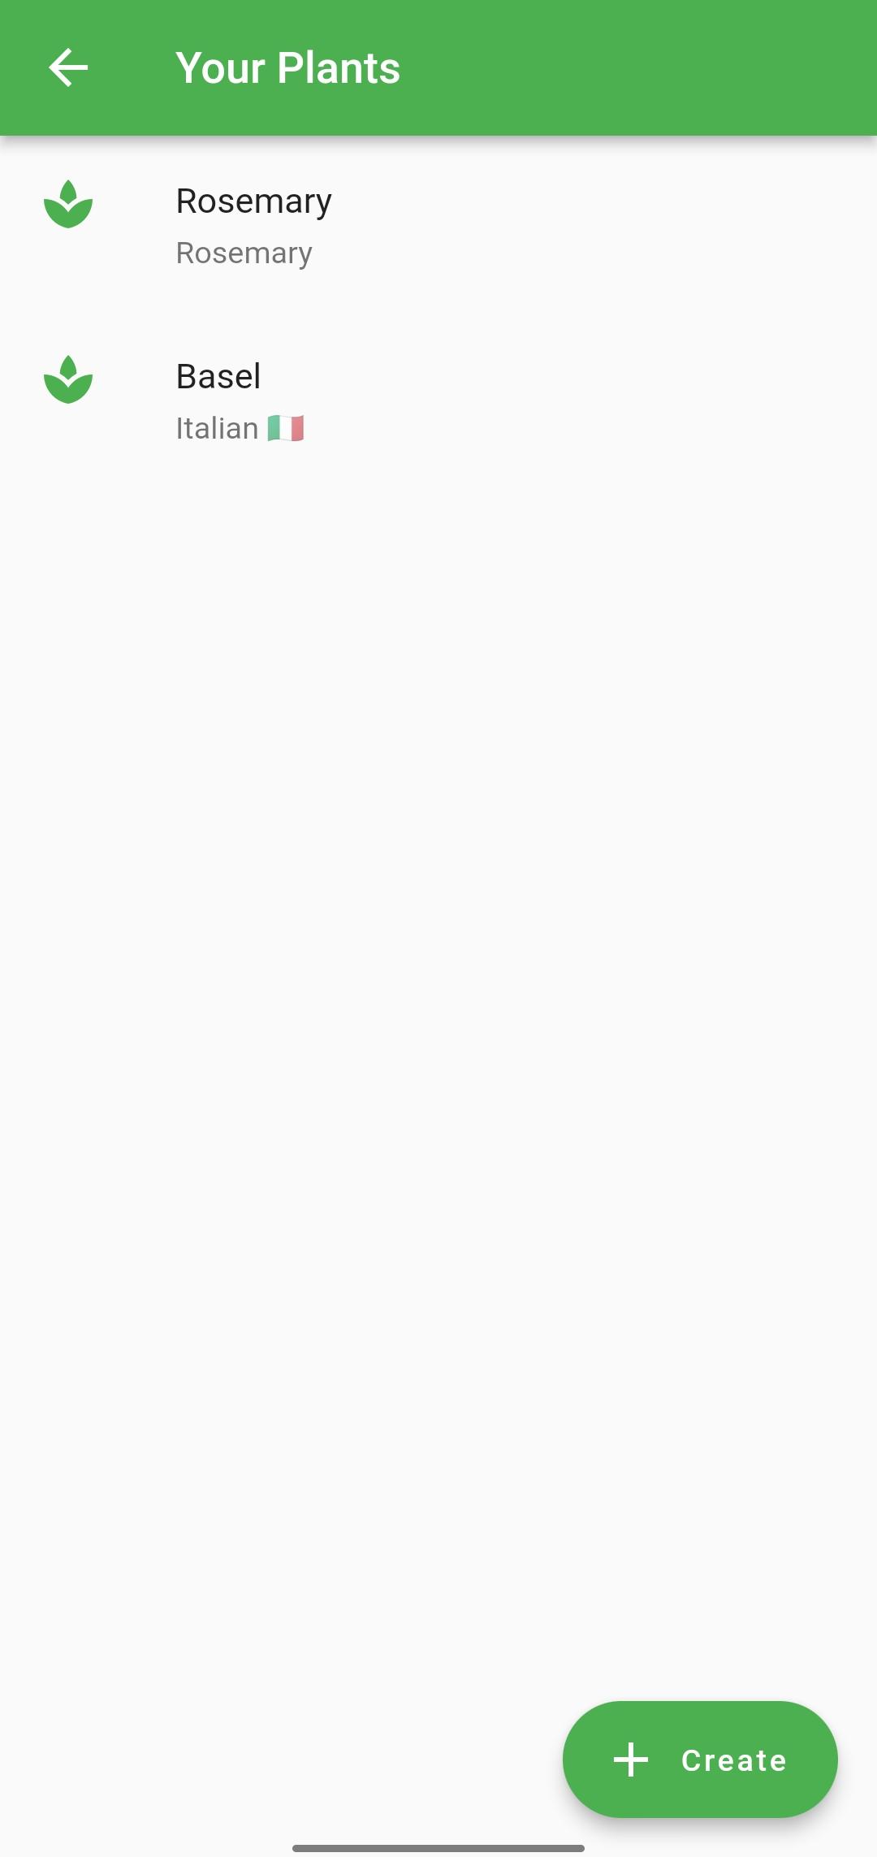
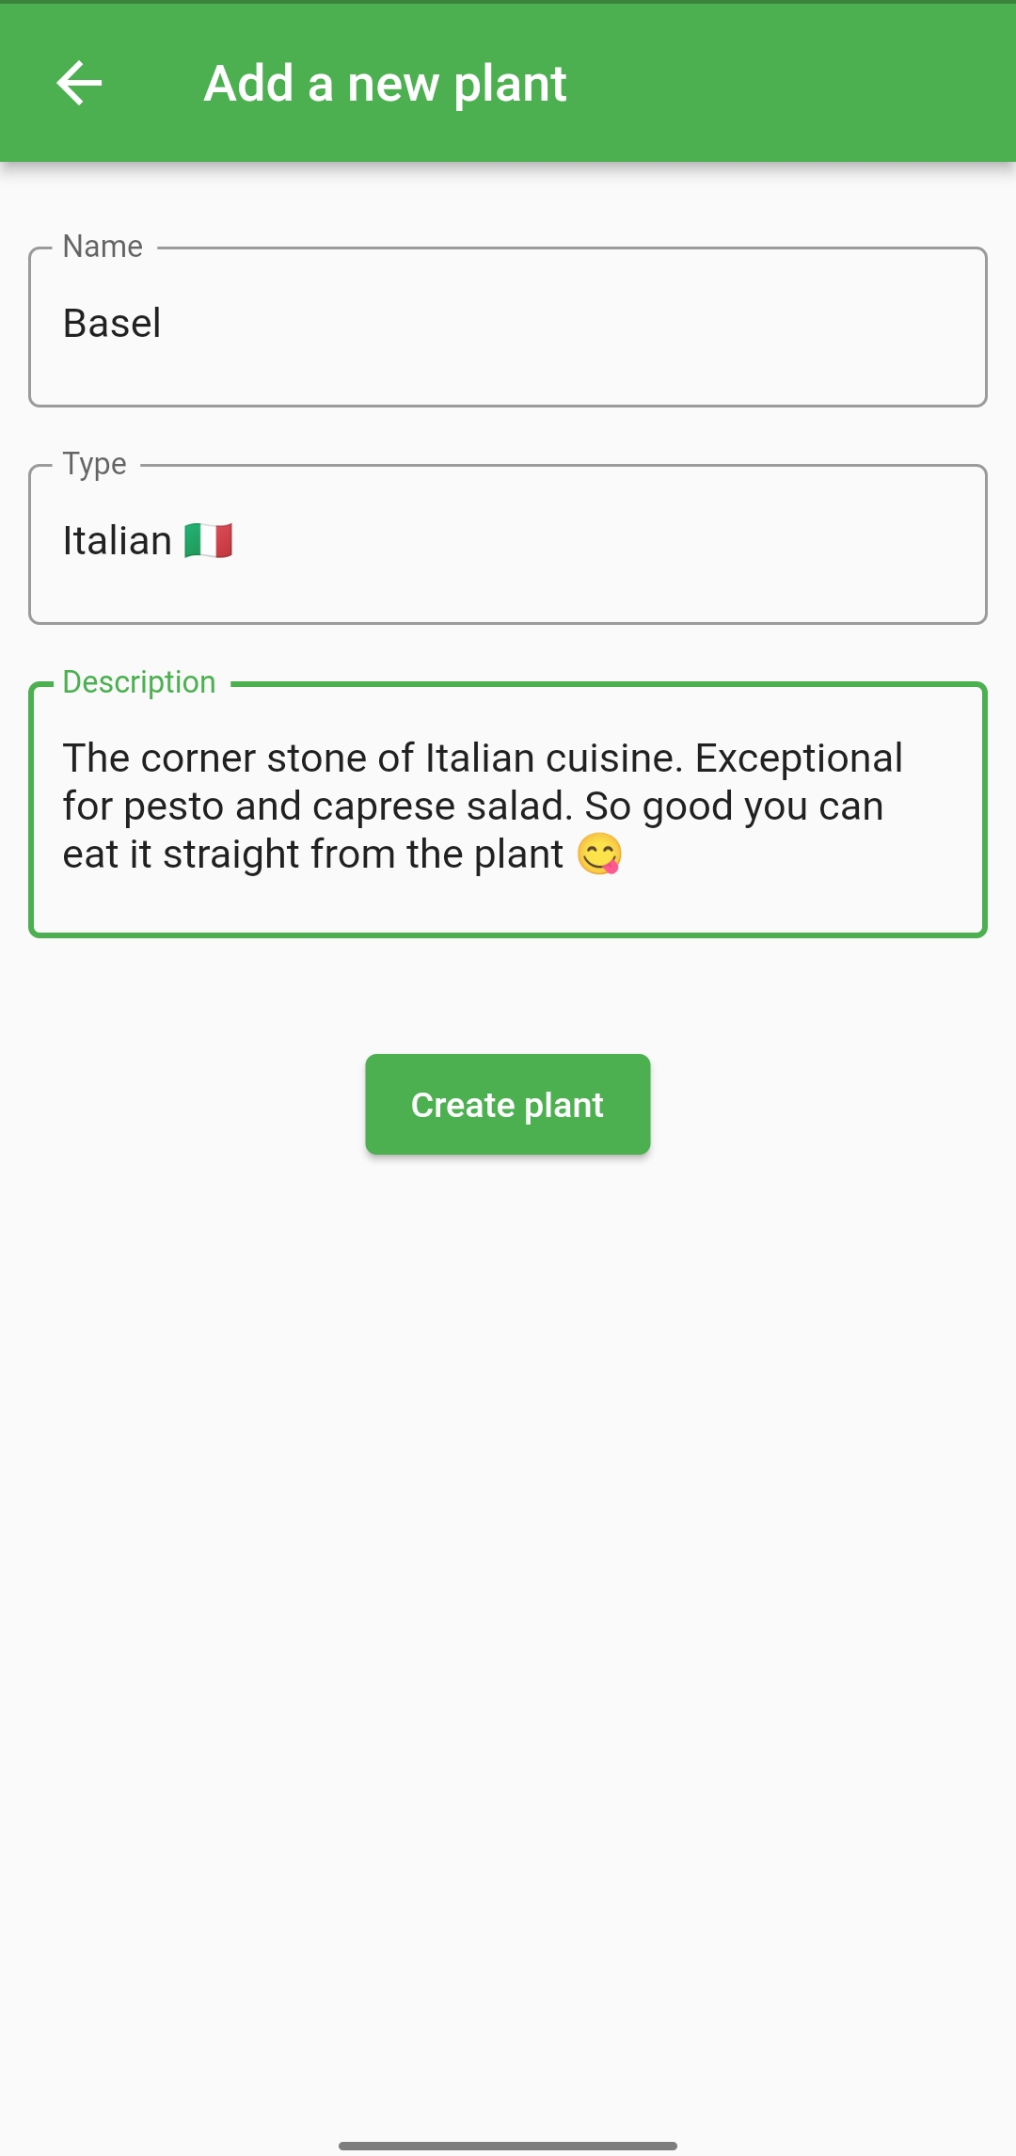
APP in flutter: Plants
Show your plants in the selected hub
Create a new plant, if slots available
Tap to check stats of the plant
Notes:
Tapping on a hub the user can visualize the connected plants.
If some slots are free it is possible to add a new plant by tapping on the button.
The creation of the plant requires a name, a type and a description.
Tapping on the plants leads to the individual status screen.

Slide 10
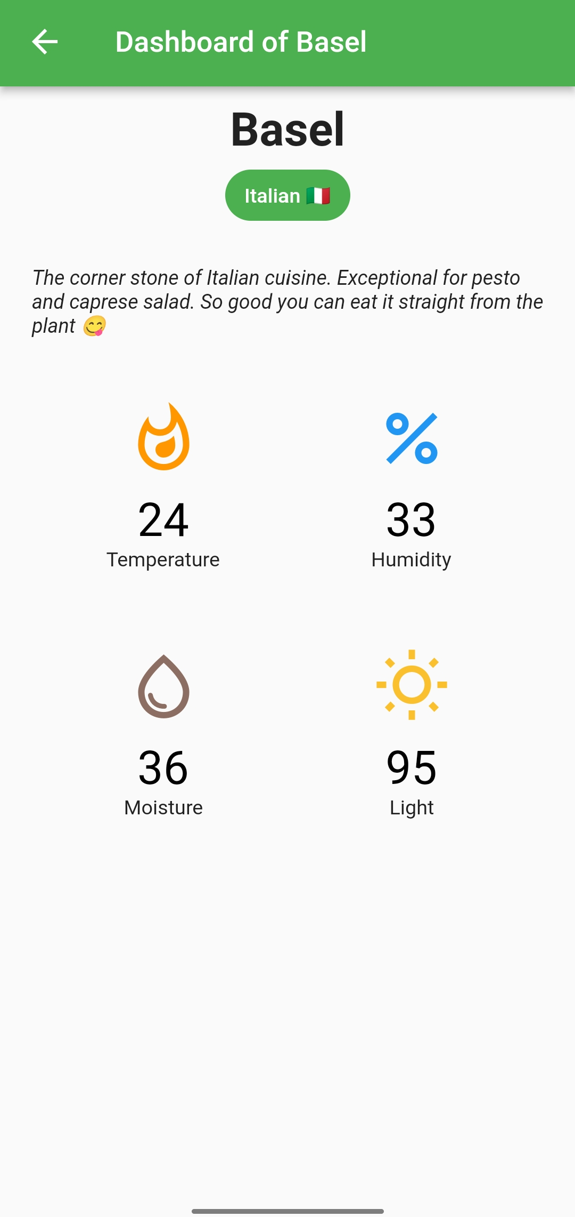
APP in flutter: Plant stats
Check your plant stats:
Temperature
Humidity
Light
Soil Moisture
Notes:
The single plant screen statically displays the plant’s information, as well as the dynamically changing sensor readings.

Slide 11
PROBLEMS AND POSSIBLE IMPROVEMENTS
IMPROVEMENTS
A single temperature and humidity sensor for more hubs
Hub initial configuration (not done due to lack of time)
Changing icons colour and shape according to different data values
Historical data visualisation and analysis
PROBLEMS
Mongoose OS certificates expired during our project, the device has to be built locally… remember to start Docker!!!
Time…
Notes:
There are several things that would have been nice to have, but due to a lack of time are going to be implemented in the future, such as having a single temperature and humidity sensor for multiple hubs, for example when they are located in the same room/small area, properly configuring the hubs using Bluetooth, as well as changing the icons color and shape according to the sensor reading values and plant requirements. Also, we are currently in the very early stages of designing a data analysis systems to understand the optimal conditions for each type of plant.
As for the problems, Mongoose OS relied on remote docker deployment, but the SSL certificates have exprired, so we had to set up the toolchain locally, and…. Time!

Slide 12

Thanks for the attention

