Slide 1
Daniil Berezhoi data update
May 28

Slide 2
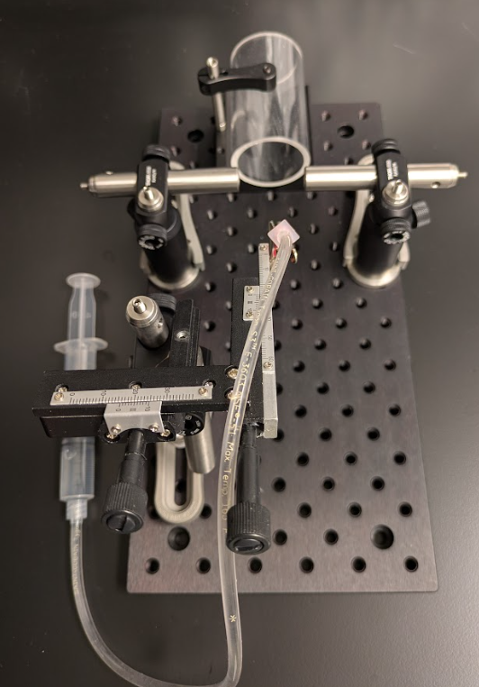
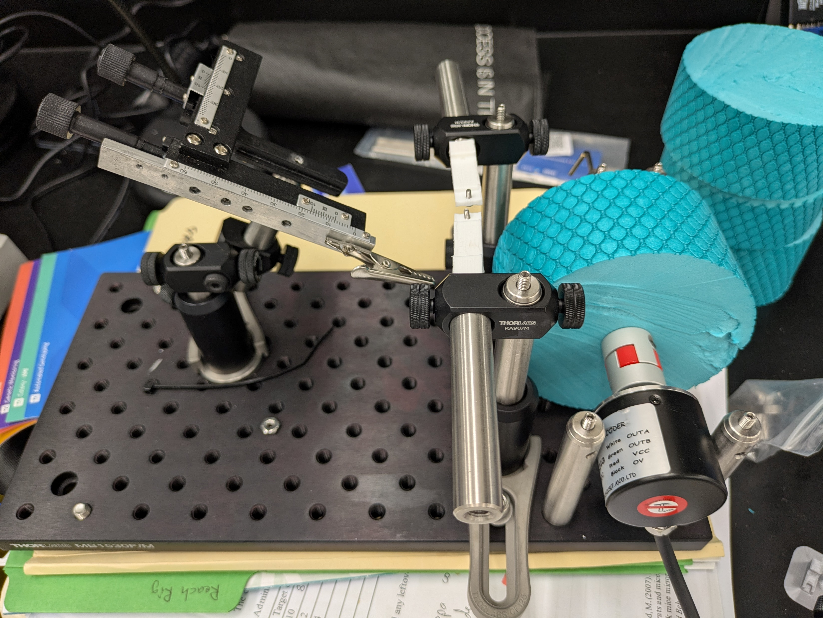
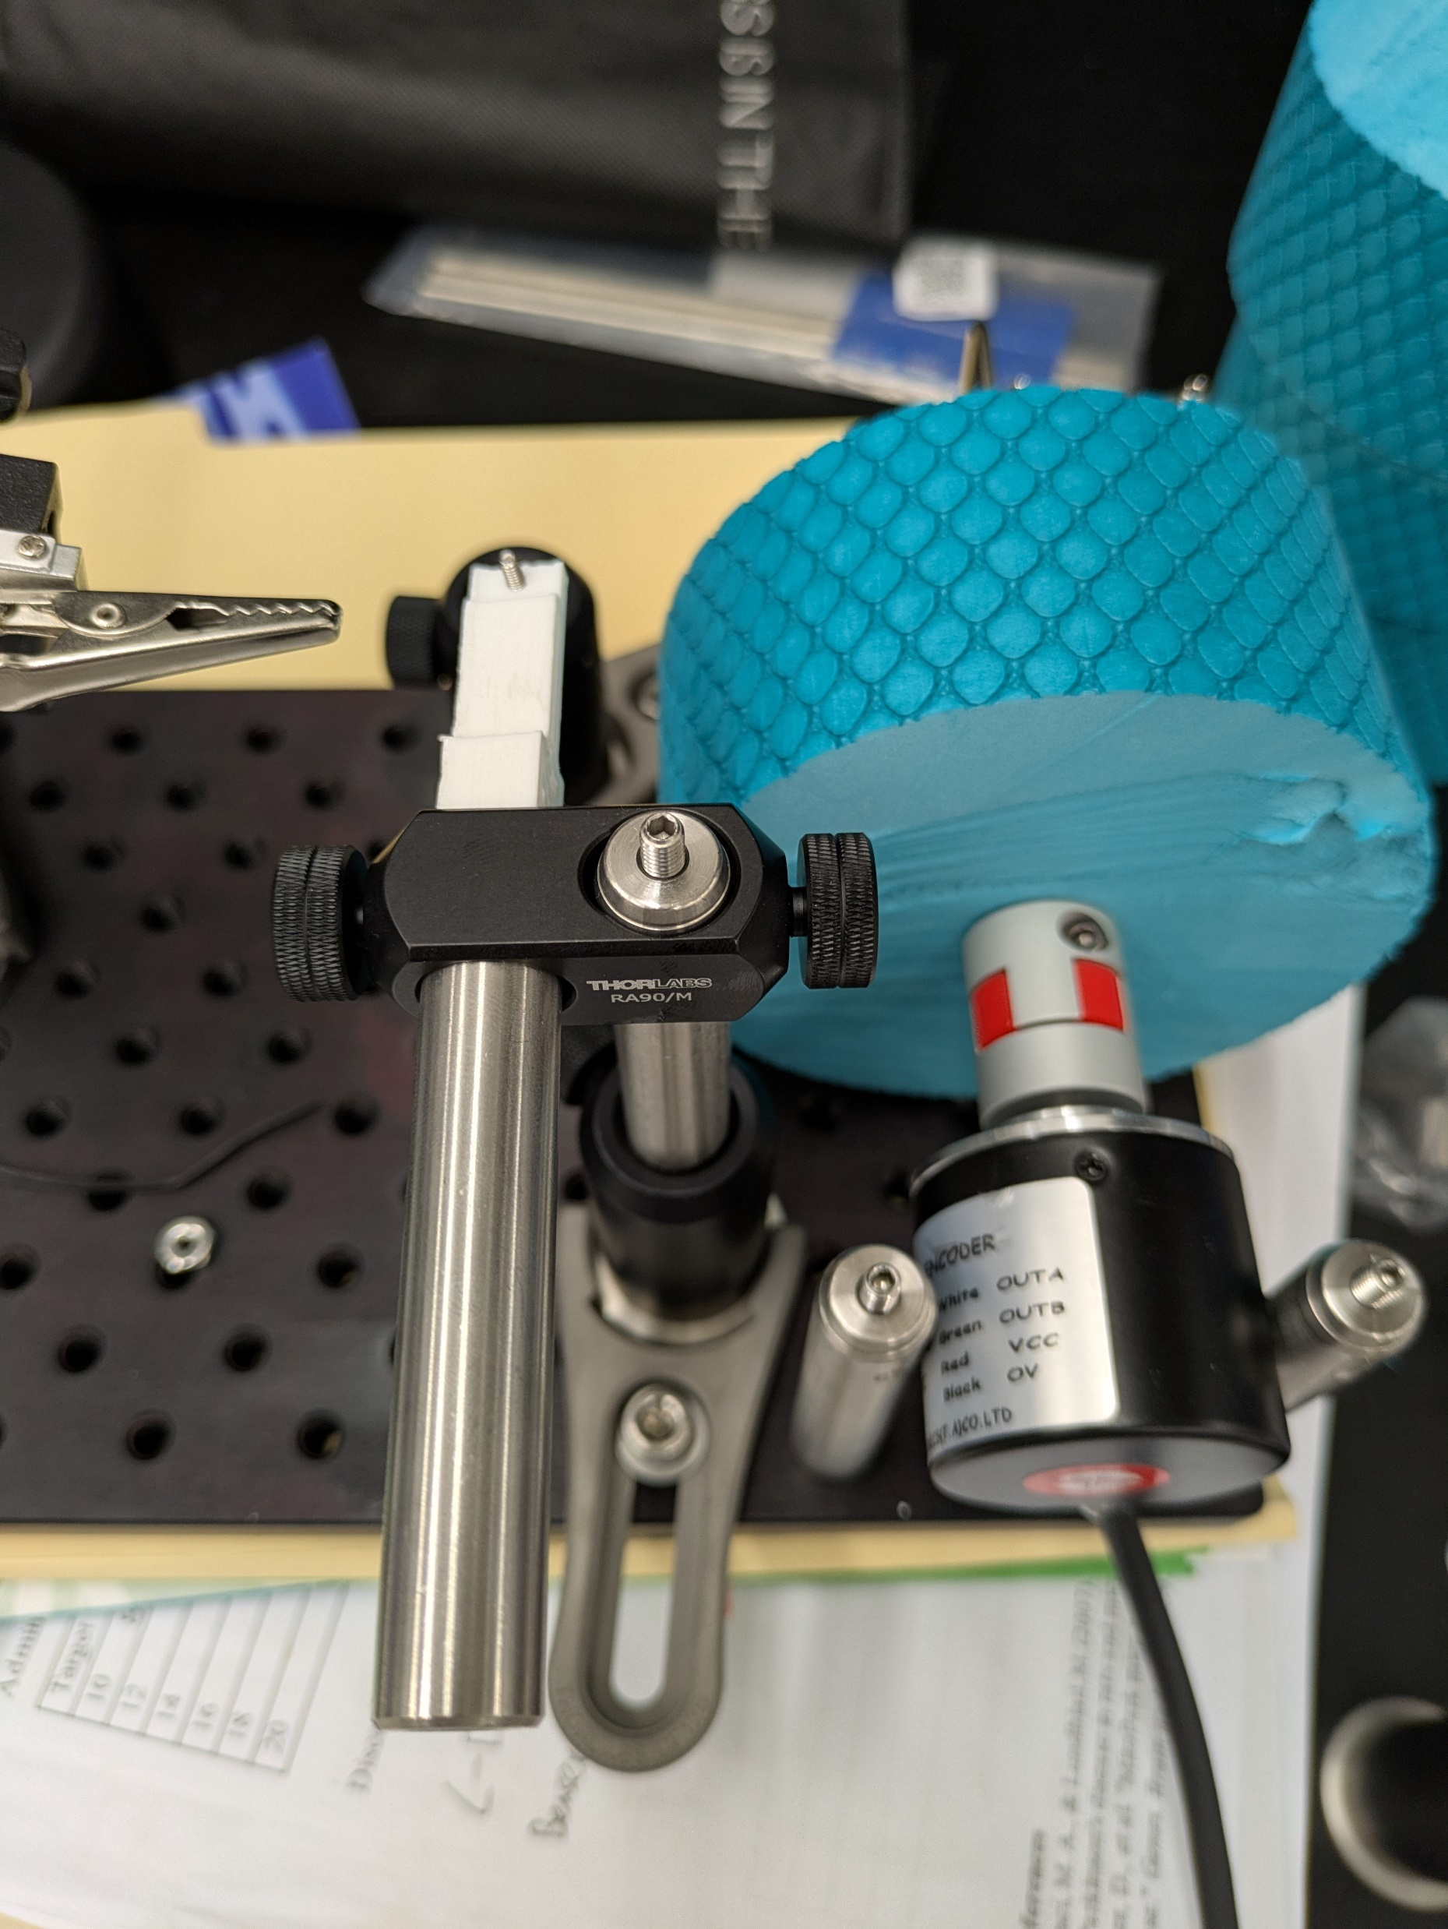
Head fixation and treadmill system
Manual positioner

Slide 3
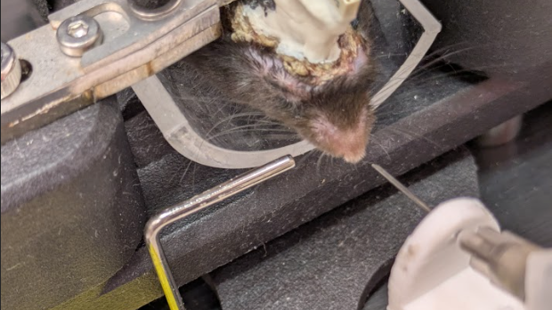
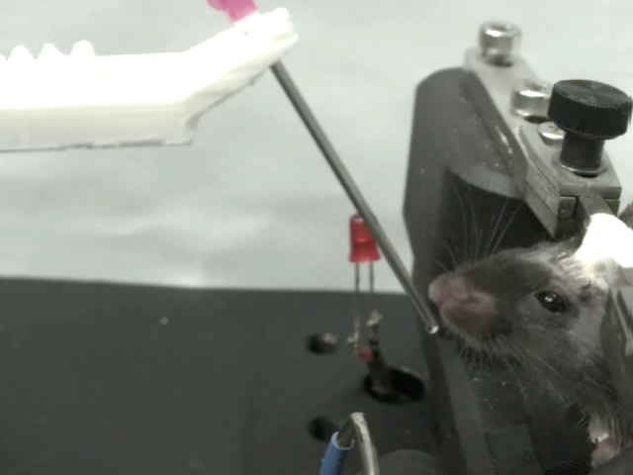
Animal training
Sound - CS
Habituation
Water - CR
Sound - CS
Initial training
Water - CR
Sound - CS
CS training
Water - CR
Sound - CS
Delay training
Water - CR

