Slide 1
Shift Staffing via Task Load Prediction
Marcos Fabietti, Ph.D.
Activity and Access Team @ Digital and Information
Nottingham University Hospitals Trust
Email: marcos.fabietti@nhs.net
Notes:
Hello, welcome to the talk named shift staffing via task load prediction, my name is Marcos Fabietti, I am a data scientist at Nottingham University Hospitals Trusts.

Slide 2
Introduction
We want to measure how many tasks (e.g. cannulation, drug prescribing, get analysis results, etc.) will be generated throughout an out of hours shift to have enough staffing.
Our data consists of all the tasks generated, with January 2022 as cut-off date to avoid any Covid bias.
Notes:
Originally, the request came as an inquiry to know the task load in the future.
However, after a discussion with the stakeholders it was apparent that the actual problem was how optimise staffing to meet demand.
With this in mind, we used the data from 2022 onwards.

Slide 3
First Challenge: Defining the Problem
We are trying to predict a numerical value (amount of certain task) given the patient’s information.
For a regression, the Feature set MUST be Larger than the number of regression outputs.
This scenario
doesn’t work!
How do we solve this issue?
Notes:
The first challenge was how to frame this problem.
The first draft was a regression model where for each patient we had a profile of the number of tasks, but as we had more outputs than inputs, we had to go back to the drawing board.

Slide 4
First Proposed Solutions
Single Model
Less costly computationally to train/optimise
Will likely UNDERFIT (i.e., give a poor approximation)
N models:
Direct Multioutput: Develop an independent model for each numerical value to be predicted.
Chained Multioutput: Develop a sequence of dependent models to match the number of numerical values to be predicted.
Likely most Accurate
Computationally costly to train/run/update N models.
Clustering
Group patients into similar clusters automatically via ML
Obtain the mean/median # of tasks per task
Compare the sum of the averages per patient vs the known used resources
Computationally simple
Likely less accurate than N models.
Notes:
We then defined 3 possible methodologies, the single model previously mentioned, n models and clustering.
Each one had its pros and cons, and with that we dove into the data before furthering into the modelling.

Slide 5






Exploratory Data Analysis
Notes:
So, for the exploratory we have the usual tools for python.

Slide 6
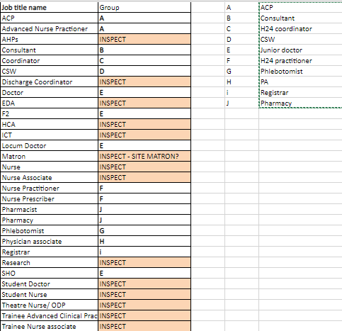
Data Labelling
First, we explored WHO carried out each task, as we might want to group it by that category.
There were incomplete staff job title names, overlapping roles and irrelevant ones.
We manually re-labelled job title name to actual staffing groups (by a group of specialists)
Removed those tasks with ‘nothing’ in the job title name, as well as those with ‘inspect’ (not representative).
TAG | GROUP | INCLUDES
C | H24 coordinator | Coordinator
D | CSW | CSW
E | Junior doctor | SHO, Locum Doctor, F2, Doctor
F | H24 practitioner | Nurse Prescriber, Nurse Practitioner
i | Registrar | Registrar
Notes:
First, we explored WHO carried out each task, as we might want to group it by that category.
For data quality, we had to re-label the job titles and remove those not representative and empty.

Slide 7
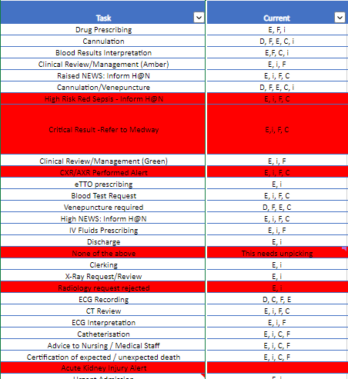
Task Labelling
We removed tasks that are system alerts
For each Task, we delete if it doesn’t match the manual labelling (by a Specialist) of who should actually be doing them (removing incorrect assignments and wrong title assignments).
This leaves us with 82 tasks out of 350.
Notes:
Similarly, after manually labelling tasks, we removed system alerts, and those carried out by people with the incorrect staff, cutting down the number from 350 to 82.

Slide 8
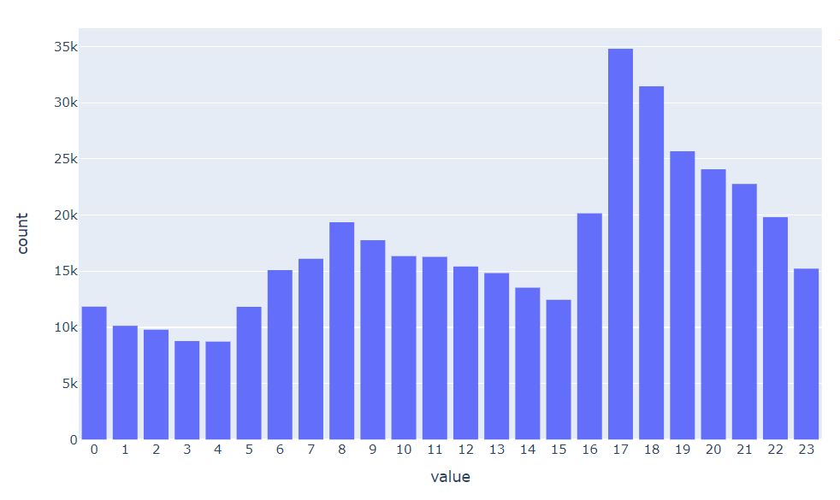
Distribution of the hour the task were raised.
There are peaks before the handovers at 7 am and 18 pm.
Most tasks are raised at 17:00 pm
Notes:
As part of the exploratory data analysis, we observe the tasks by the hour they were raised, with most of them before handover at 17.

Slide 9
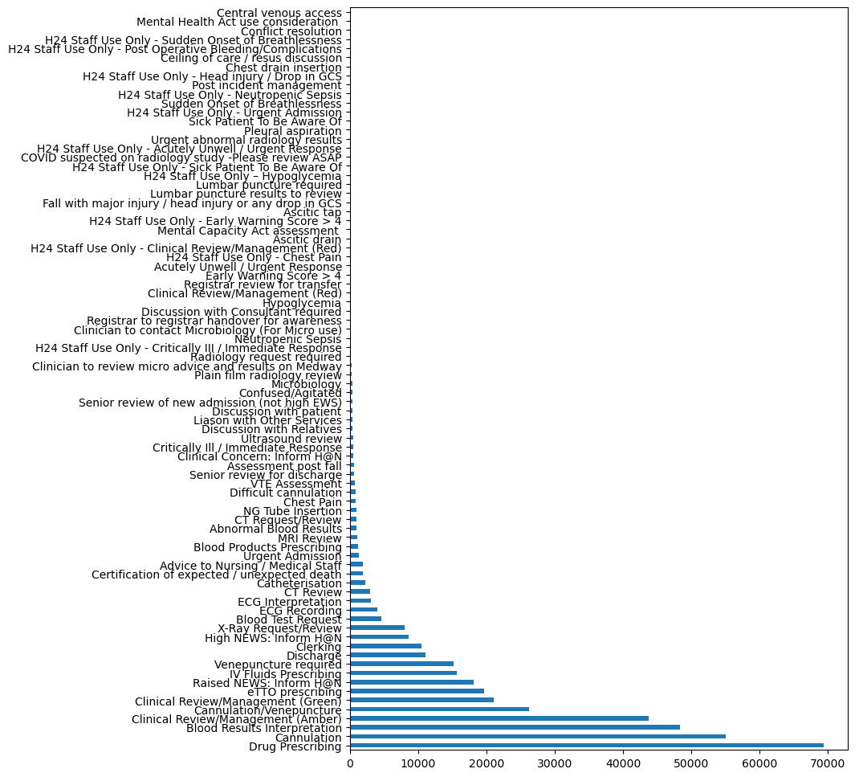
Frequency Count of Tasks
Drug Prescribing, Cannulation, Clinical Review are the most frequent tasks.
Notes:
Also, Drug Prescribing, Cannulation, Clinical Review are the most frequent tasks.

Slide 10
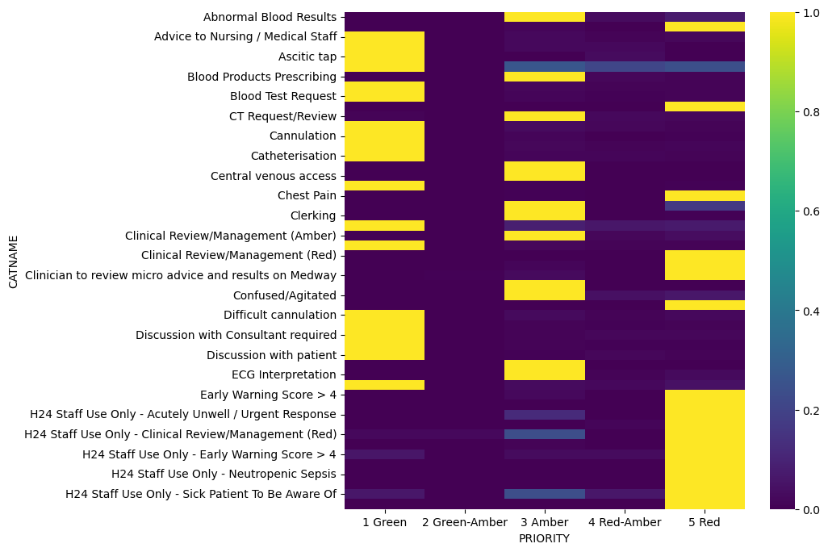
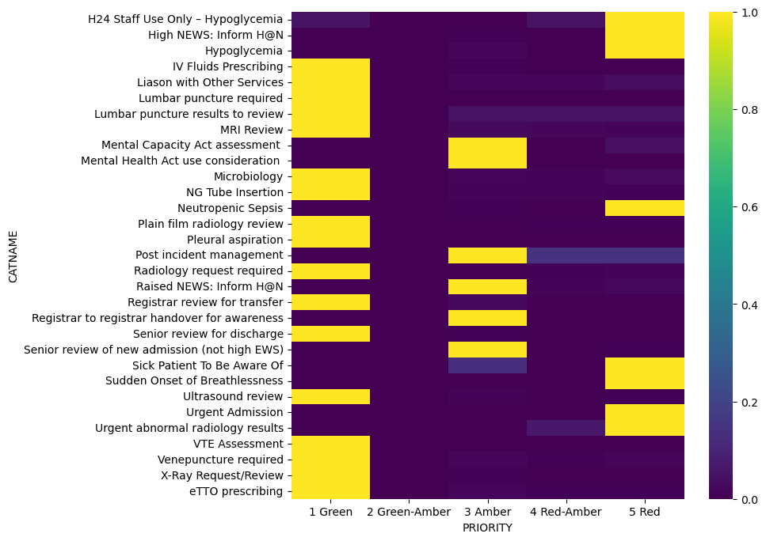
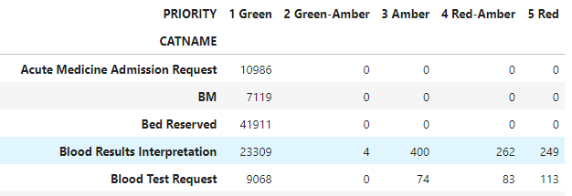
Grade of Tasks
We see very little variation among the grade of tasks.
For each task, there is a clear preference in grading.
For example, blood test request is green 98% of times.
Notes:
We also looked at the grade of tasks that indicate priority, where we see very little variation among the grade of each respective tasks.

Slide 11
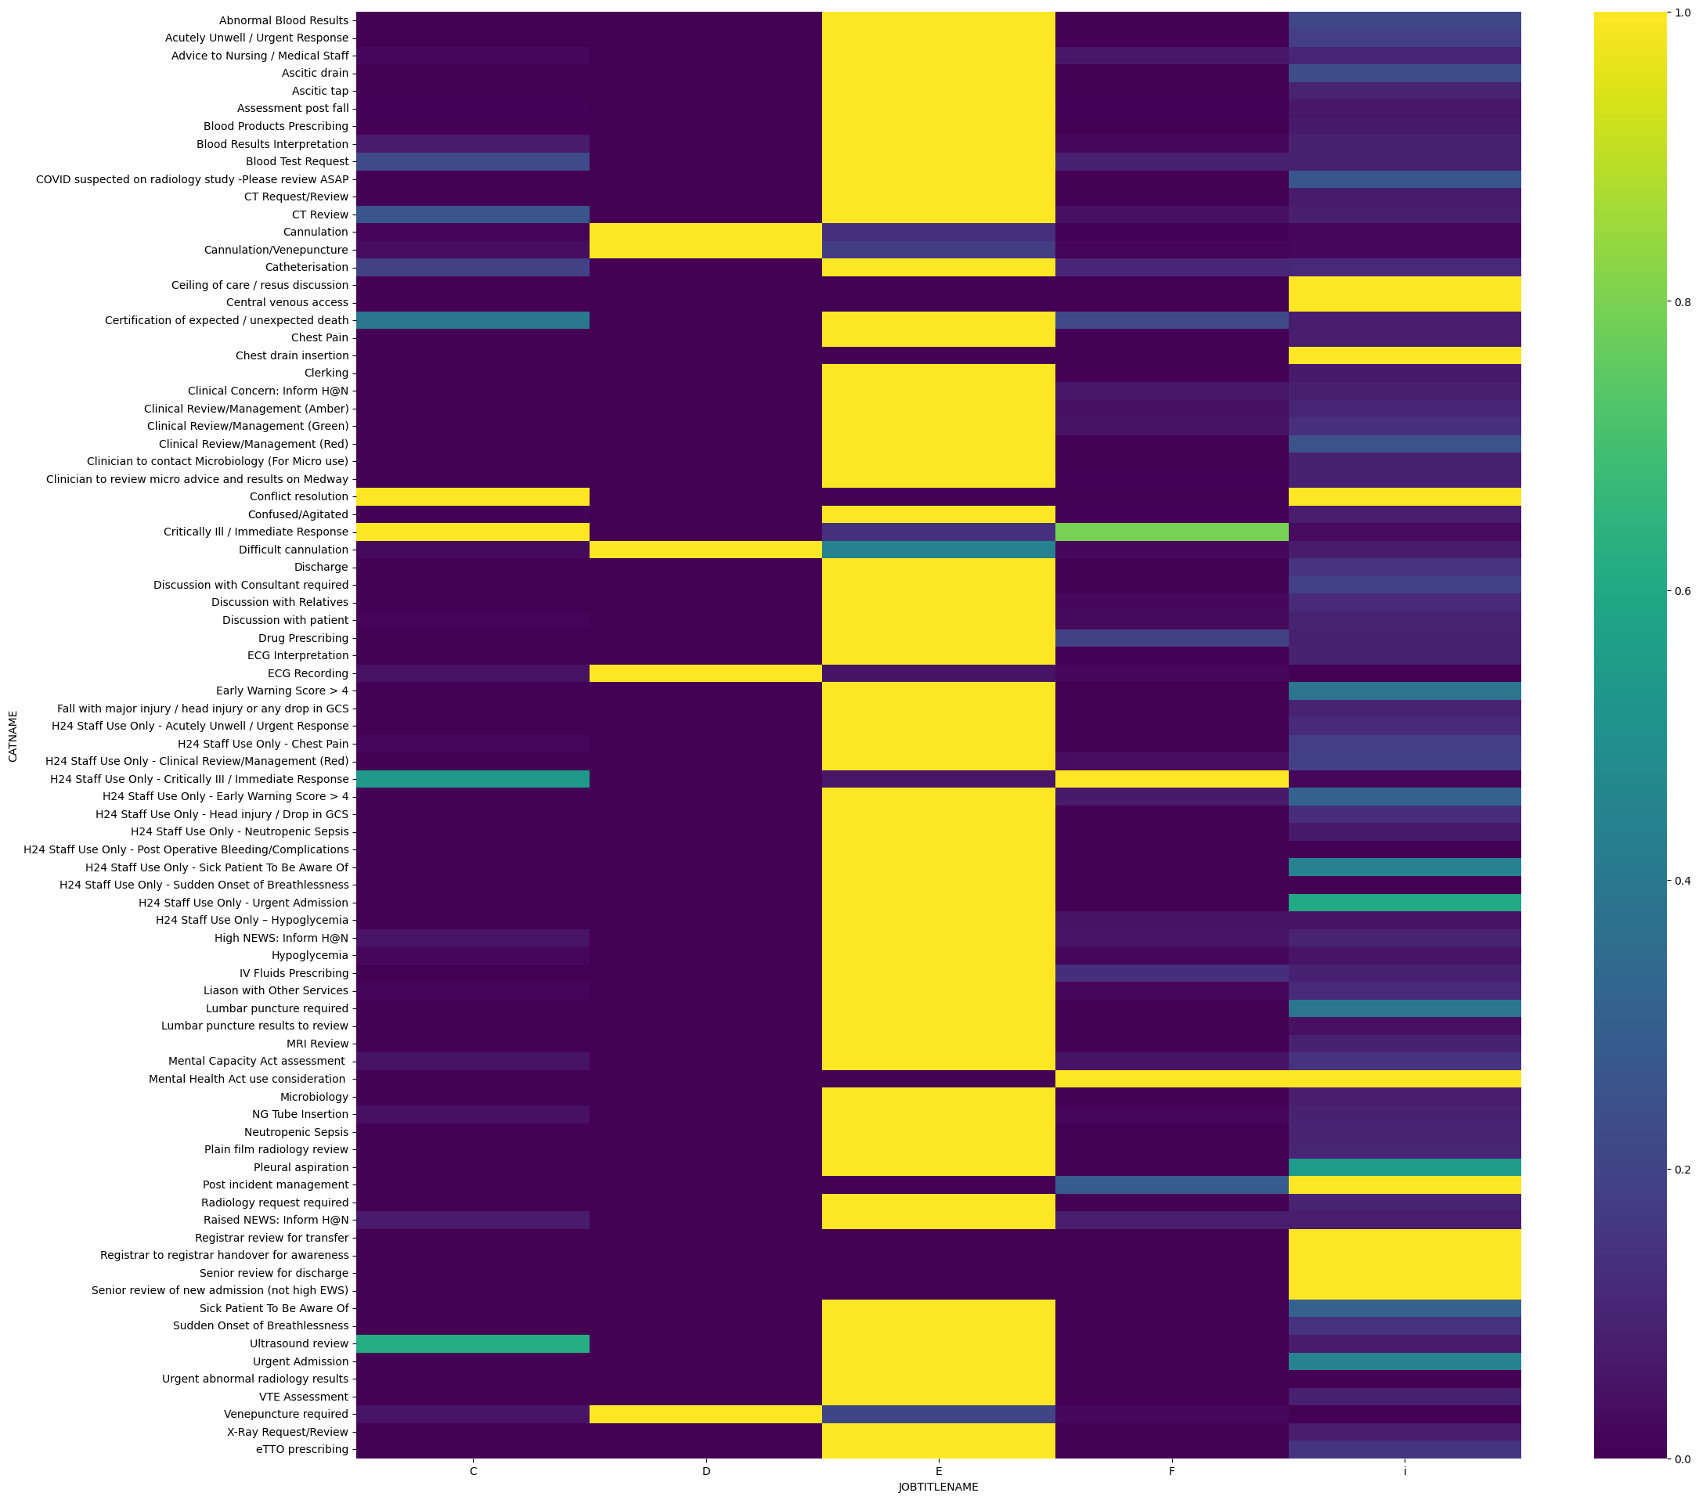
Staff per Tasks
There are 5 job title names after re-labelling.
Unlike Grade, we see more variation among the job title names used per task.
However, most tasks have a main role that carries them out.
Notes:
Similarly, we also looked at staff per tasks after aggregating the job title names into 5 main categories.
Unlike Grade, we see more variation, but most tasks have a main role that carries them out.

Slide 12
Proposed Solutions

Slide 13
Solution 1: Clustering
FEATURE 1 |  |  |  |  |  | TARGET
WEIGHT | AGE | HEALTH METRIC | DAYS IN HOSPITAL | Day of Week | ETC | CLUSTER patient profile
Assign for each patient admitted at a time a cluster with a task load profile and add them at the start of each shift.
Notes:
After disregarding the underfitting model, the first solution was clustering, where we would assign for each patient admitted a cluster with a task load profile and aggregate them at the start of each shift to get the total count.

Slide 14
Solution 1: Clustering
TAG | GROUP
C | H24 coordinator
D | CSW
E | Junior doctor
F | H24 practitioner
i | Registrar
Over 69% only require E (junior doctor) for 1 or more tasks.
Most patients would be assigned to that cluster, so it would be heavily biased.
Notes:
However, 69% only require E (junior doctor) for 1 or more tasks.
Most patients would be assigned to that cluster, so it would be heavily biased.
Thus we looked at another method.

Slide 15
Solution 2: N regressors
Feature 1 | Feature 2 | Target
F1 E | F2 E | #E
F1 D | F2 E | #D
F1 F | F2 F | #F
F1 G | F2 G | #G
F1 H | F2 H | #H
TAG | GROUP
C | H24 coordinator
D | CSW
E | Junior doctor
F | H24 practitioner
i | Registrar
Do a regression of current occupation to number of tasks per staff group.
Notes:
The second solution was to create N regressors, one for each staff group,
Where we want to predict the number of tasks raised.

Slide 16
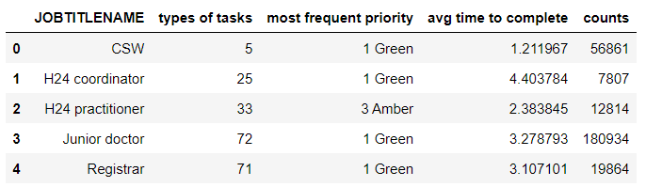
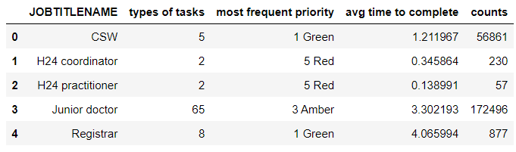
By mapping all task to the staff category that does it the most:
After 1-1 mapping
We lose significant number of examples in the smaller categories.
Instead, we re-assign tasks to those who perform them more than 50% of the time, and together with a second group if the second group does so at least 10% of the time.
Notes:
First, we attempted to mapping all task to the staff category that does it the most.
However, we lose significant number of examples in the smaller categories.
Instead, we re-label tasks into those who do it over 50% and a second group if they who do it over at least another 10%.

Slide 17
Solution 2: N regressors v2
TAG | GROUP
C | H24 coordinator
D | CSW
E | Junior doctor
F | H24 practitioner
i | Registrar
Group | Tasks | # of tasks over time | %
[E] | 35 | 89284 | 35.10%
[D, E] | 4 | 62476 | 59.66%
[E, F] | 2 | 54033 | 80.91%
[E, i] | 23 | 36914 | 95.42%
[C, E] | 5 | 7645 | 98.43%
[D] | 1 | 2672 | 99.48%
[i] | 7 | 871 | 99.82%
[C, F] | 2 | 450 | 99.996%
[F, i] | 1 | 8 | 99.999%
[C, i] | 1 | 2 | 100.000%
[F] | 1 | 1 | 100.000%
Task-Centric Groups Instead:
Discard
Due to few examples
Now we have 8 “classes” with enough examples to do a forecast/regression.
It also allows for flexibility when staffing, as the classes overlap and can be filled at discretion.
Notes:
This translates to these 8 new “staff groups” with enough examples to do a forecast/regression.
Additionally, It also allows for flexibility when staffing, as the classes overlap and can be filled at discretion.

Slide 18




Modelling
Notes:
We used these python packages for the modelling, and I particularly recommend darts, that aggregates everything you need for time series analysis and forecast.

Slide 19
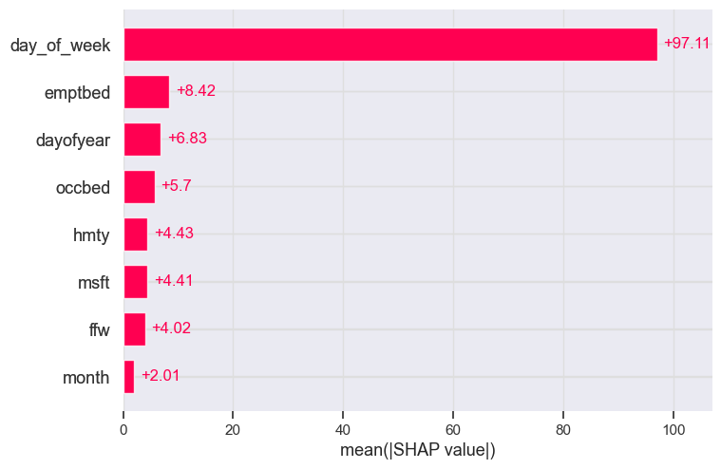
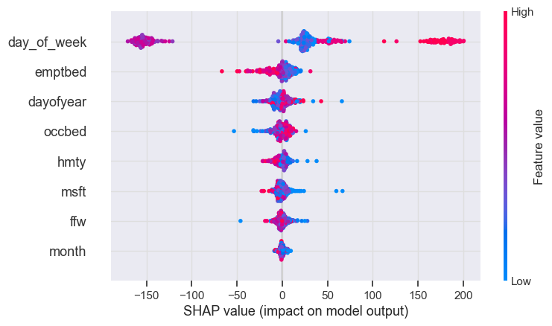
Feature Importance
We trained a regression model (XGBoost) to evaluate what features were important to predict the number of tasks, based on SHAP values. Features used were:
Day of the week, day of the year, month.
# OF PATIENTS WITH FIT FOR WARD FLAG (people that will end up creating tasks)
OVERALL CAPACITY (free space to accommodate them as well as occupied beds)
# DISCHARGES (PATIENTS WITH MSFT AND HOME TODAY FLAG – people that will reduce the task load)
Assuming the decision is taken at 8 AM, so this means counting all of the fftw, msft and htf from midnight till 7:59 am.
Notes:
We trained a regression model (XGBoost) to evaluate what features were important to predict the number of tasks, based on SHAP values. Features used were:
Day of the week, day of the year, month.
# OF PATIENTS WITH FIT FOR WARD FLAG (people that will end up creating tasks)
OVERALL CAPACITY (free space to accommodate them as well as occupied beds)- the 8 am snapshot.
# DISCHARGES (PATIENTS WITH MSFT AND HOME TODAY FLAG – people that will reduce the task load)
Assuming the decision is taken at 8 AM, so this means counting all of the fftw, msft and htf from midnight till 7:59 am.

Slide 20
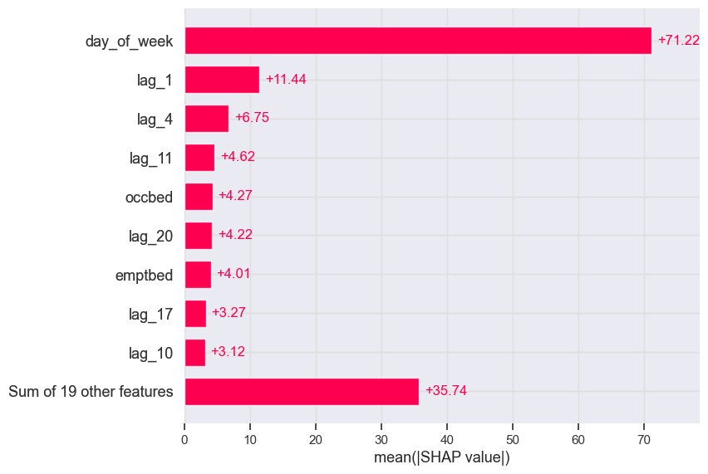
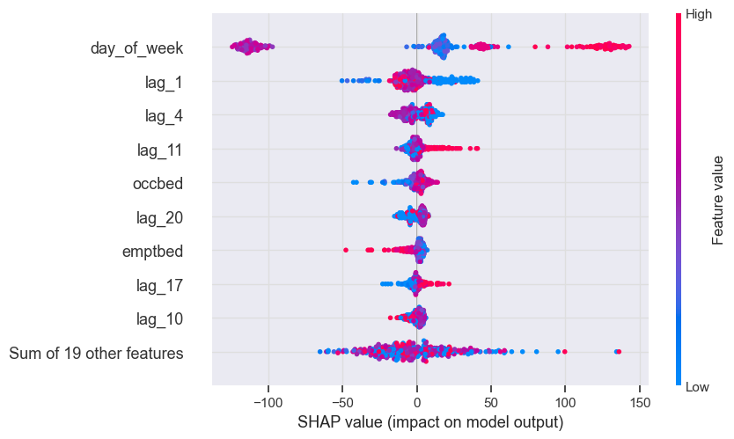
Feature Importance Pt.2
If we also add time lags (i.e. number of tasks of previous days up to 3 weeks):
The day before, 4 days before, 11 days before seem more relevant than the current occupation.
It is more important than to focus this problem as a ‘time series problem’ that looks at seasonalities, rather than identifying external regressors.
Notes:
However, If we also add time lags (i.e. number of tasks of previous days):
The day before, 4 days before, 11 days before seem more relevant than the current occupation.
It is more important than to focus this problem as a ‘time series problem’ that looks at seasonalities, rather than identifying external regressors.

Slide 21
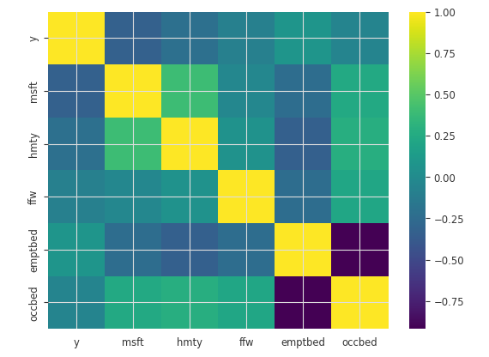
External regressors correlation
Notes:
This is backed by the correlation matrix that shows low correlation between the regression variable Y and the external regressors.

Slide 22
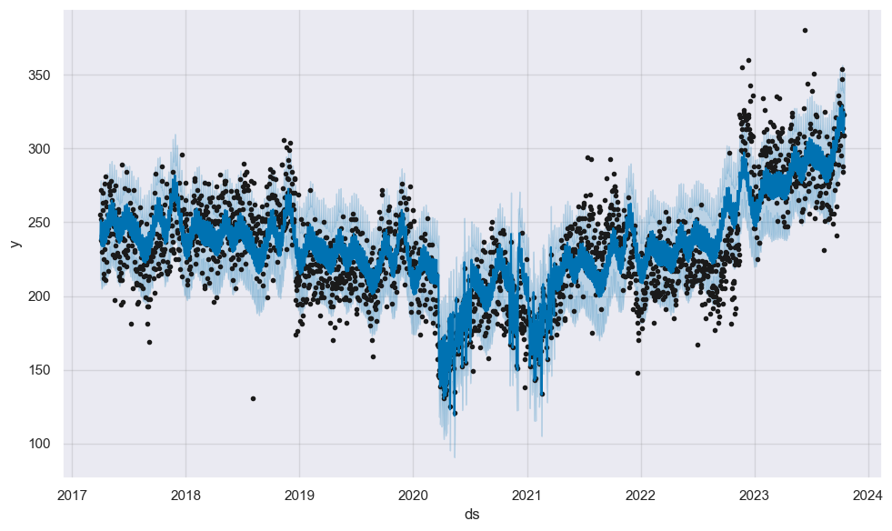
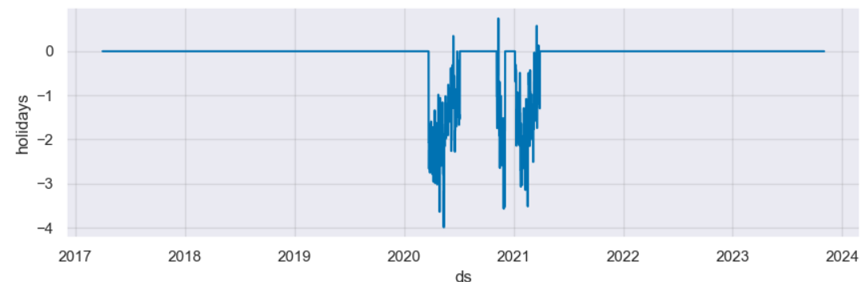
Facebook Prophet Model
Prophet is a procedure for forecasting time series data based on an additive model where non-linear trends are fit with yearly, weekly, and daily seasonality, plus holiday effects.
Back dots are actual data points
Blue line is the fitted model, with light blue upper/lower bounds (confidence interval at 80%)
It works best with time series that have strong seasonal effects and several seasons of historical data. Prophet is robust to missing data and shifts in the trend, and typically handles outliers well.
It also allows for external regressors.
Training
Validation
Notes:
Thus, we employed the facebook prophet model for time series forecast.
Prophet is a procedure for forecasting time series data based on an additive model where non-linear trends are fit with yearly, weekly, and daily seasonality, plus holiday effects.
Back dots are actual data points, Blue line is the fitted model, with light blue upper/lower bounds (confidence interval at 80%)
It works best with time series that have strong seasonal effects and several seasons of historical data. Prophet is robust to missing data and shifts in the trend, and typically handles outliers well. It also allows for external regressors, such as ED pressures and capacity.

Slide 23
Results

Slide 24
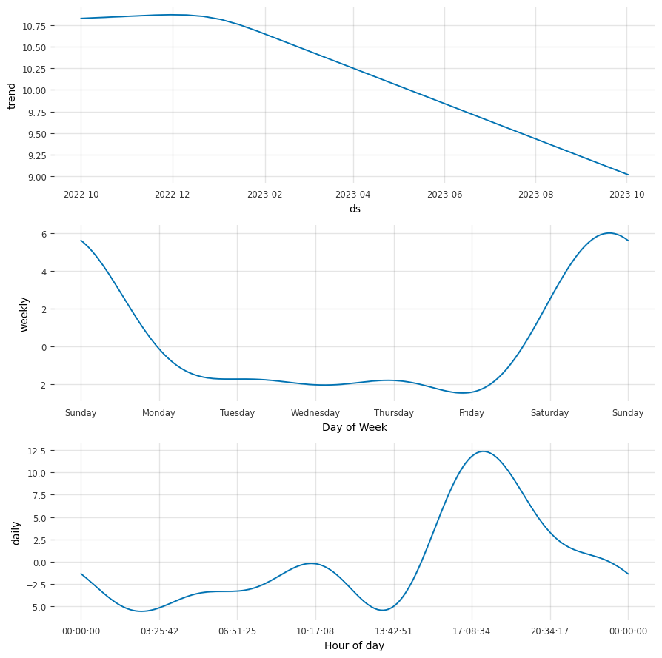
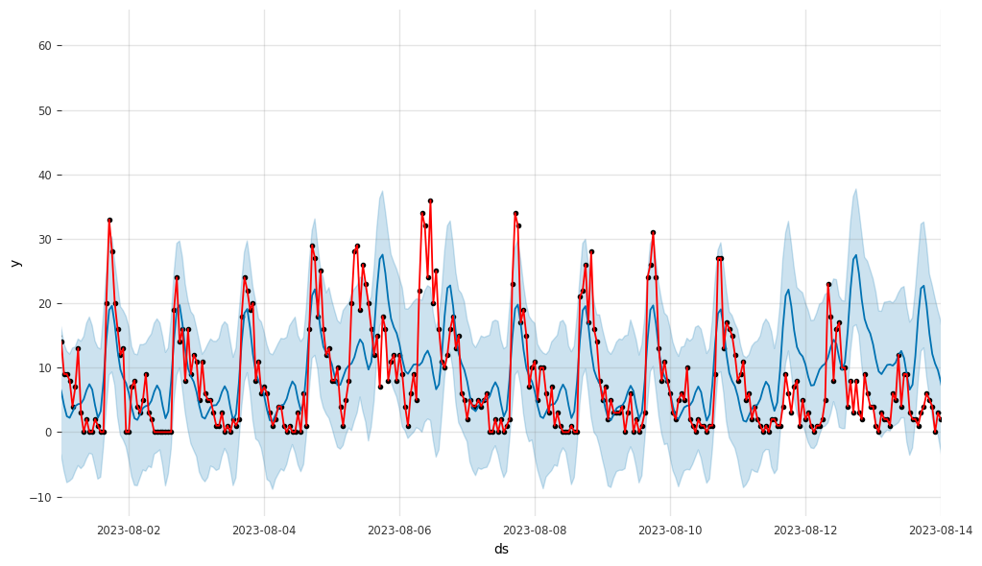
Example: Class ‘Junior doctor only’ Model fitting
Model fitting (blue) and real time data (red)
Seasonality Decomposition
Notes:
The prophet model showcases the strong seasonality in our response variable after decomposition.
It has been able to fit to the real data as shown in the figure in the right.

Slide 25
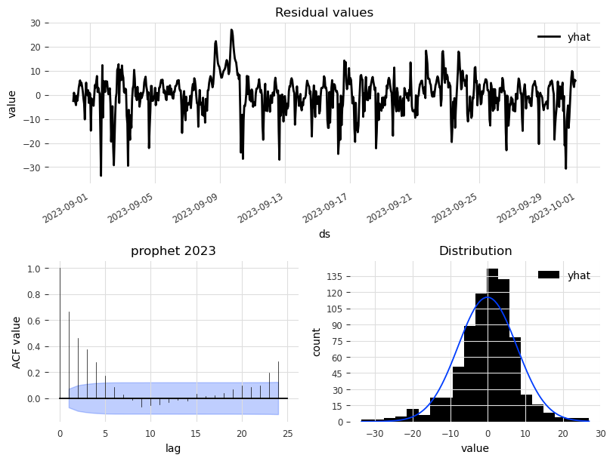
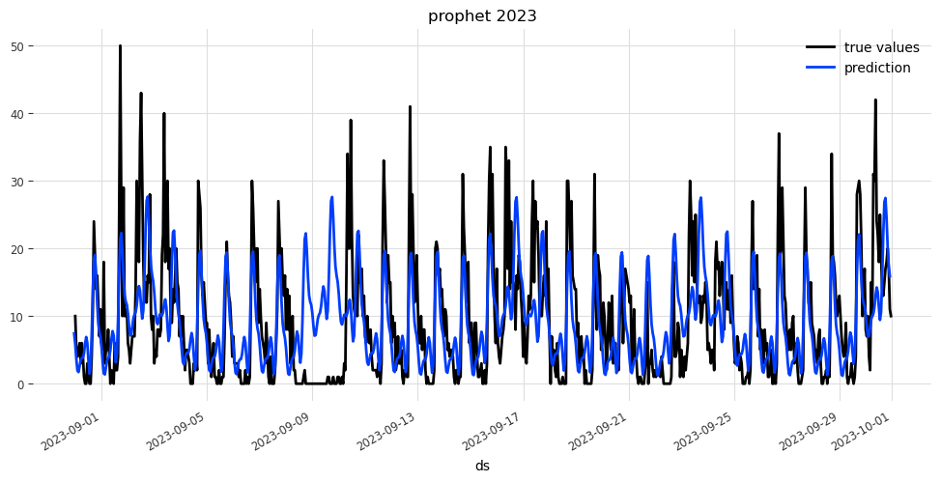
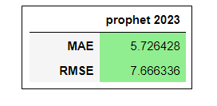
Example: Class ‘Junior doctor only’ Model validation
Residuals
Model fitting (blue) and real time data (black)
Performance
Metrics
Notes:
We evaluated the forecast with 1 months' worth of actual data, that produced an accurate forecast with normally distributed Residuals, and good performance scores using regressions metrics such as mean absolute error and root mean squared error

Slide 26
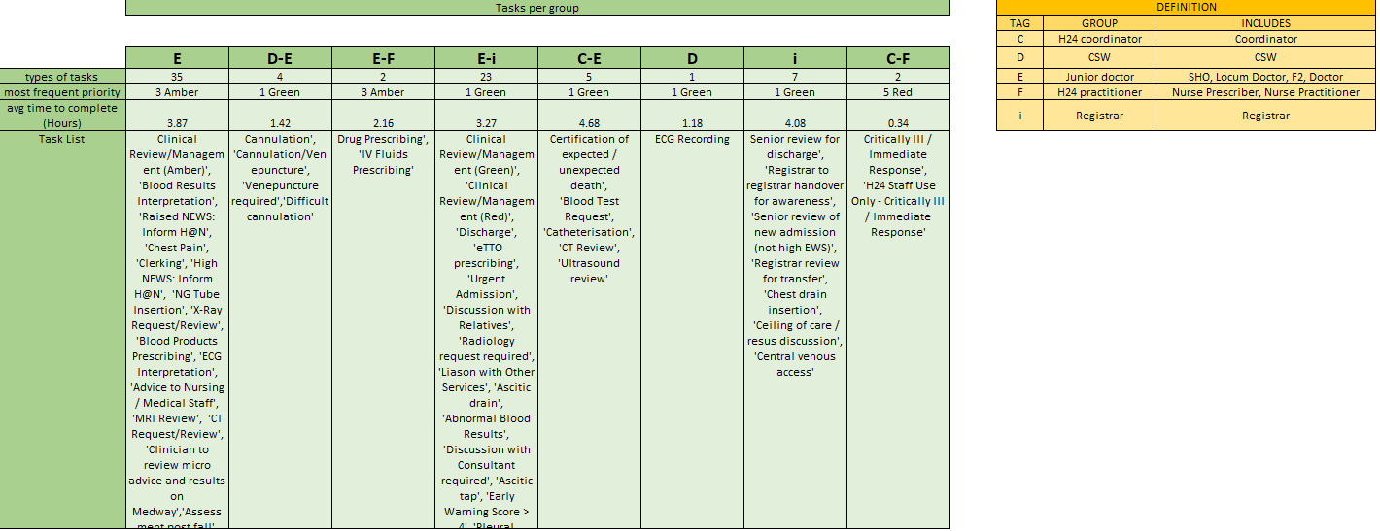
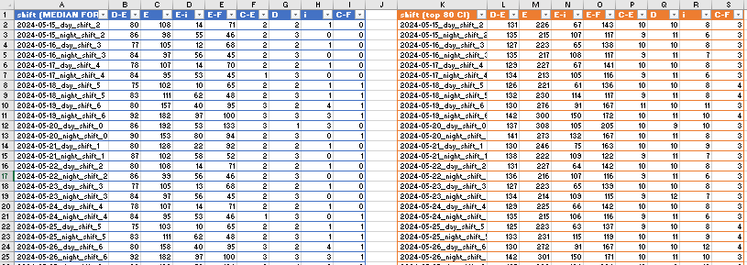
Delivery
Monthly Excel report with:
Data Definitions
Tasks per Shift (median and upper 80th Con. Int.)
Taks per Hour (median and upper 80th Con. Int.)
Notes:
To hand over the forecasts, we generate monthly excel reports with data definition, as well as the forecasts at the 50th and upper 80th centile.

Slide 27
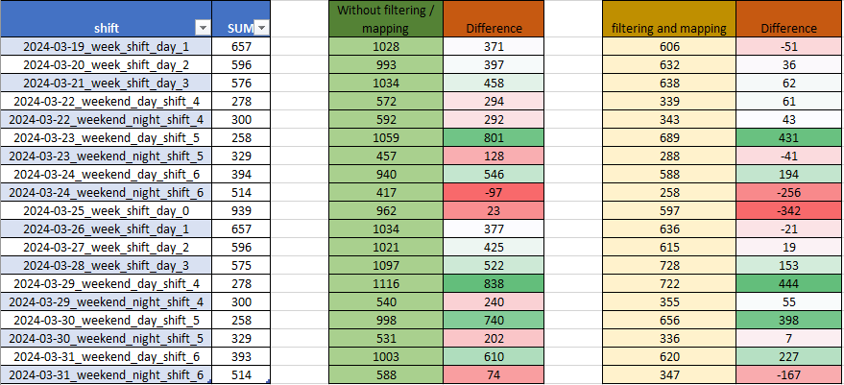
Model Validation after Handover
forecast
(total picked up by the system)
(after processing)
White is very accurate (10 days)
Green is overpredicted (6 days)
Red is underpredicted (3 days)
However, this does not account for shared resources when staff is calculated. In other words, if we overestimate in a group and underestimate the other, it potentially evens out if the staffing resource is shared.
This are all tasks logged into the system, across all job types and cat names.
Notes:
We have continued to validate this model, month by month, since September this year.
After processing the data, we achieve a good performance, however, this does not account for shared resources when staff is calculated.
In other words, if we overestimate in a group and underestimate the other, it potentially evens out if the staffing resource is shared.

Slide 28
Conclusion and next steps

Slide 29
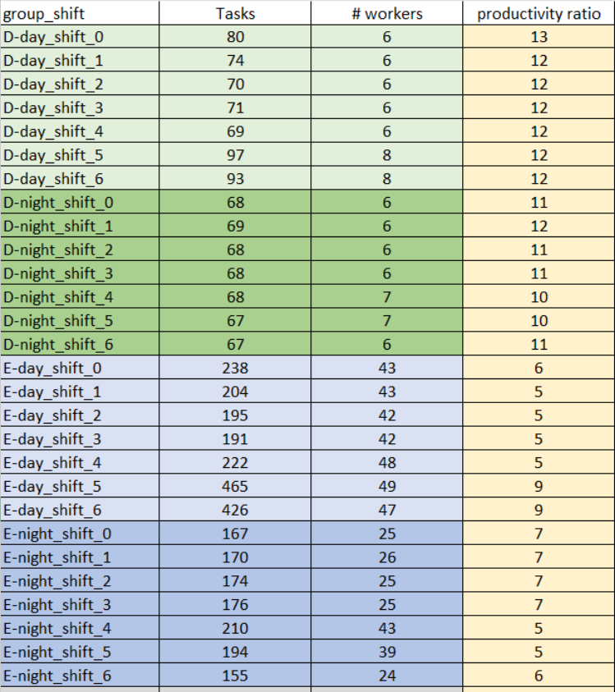
Conclusion
We were able to group out of hours tasks load data in order to make accurate predictions of demand.
The demand can be mapped to staffing based on flexible grouping and measure of historic daily shift productivity.
Current method of delivery is a spreadsheet but looking to improve it with a feedback form.
Tuning the model via feedback on its accuracy, as understaffing must not happen, for example by looking at a higher centile of the forecast.
Improve performance with other time series models such as N-HiTs, N-BEATS, etc.
Example of productivity measure
Notes:
To sum up, We were able to group out of hours tasks load data in order to make accurate predictions of demand.
The demand can be mapped to staffing based on flexible grouping and measure of historic daily shift productivity like the table on the right.
Current method of delivery is a spreadsheet but looking to improve it with a feedback form.
Tuning the model via feedback on its accuracy, as understaffing must not happen, for example by looking at a higher centile of the forecast.
Improve performance with other time series models such as N-HiTs, N-BEATS, etc.

Slide 30

Thank you!
Marcos Fabietti
Activity and Access Team @ Digital and Information
Nottingham University Hospitals Trust
Email: marcos.fabietti@nhs.net
Notes:
Thank you for your time, if you wish to contact me my details are in the screen.

