Slide 1
Reimagining the maternity services data
An experiment in open source dashboarding
Presented by: Jennifer Struthers
Notes:
Standard title slide

Slide 2
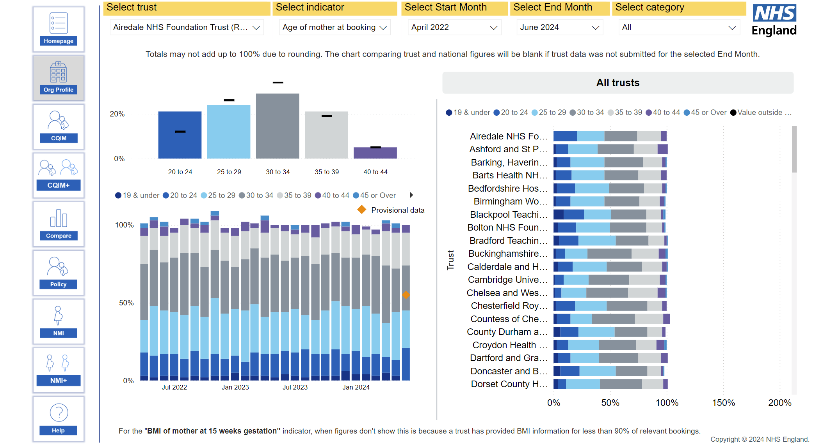
Current maternity services dashboard
https://digital.nhs.uk/data-and-information/data-collections-and-data-sets/data-sets/maternity-services-data-set/maternity-services-dashboard

Slide 3

Plotly-Dash
Pros:
Open source
Fully customisable
Integrates with python libraries
Can build in interactive elements
Cons:
Requires intermediate to advanced python skills for complex dashboards
Manual set up
No built-in data management

Slide 4

Development Strategy: Thin Slice
Singular output:
A map of the regions of England, showing the rate of babies born per 1000 people.
Org_Name | Dimension | Value
LONDON COMMISSONING REGION | TotalBabies | 102465
SOUTH WEST COMMISSIONING REGION | TotalBabies | 46565
SOUTH EAST COMMISSIONING REGION | TotalBabies | 81005
MIDLANDS COMMISIONING REGION | TotalBabies | 98420
https://nhsdigital.github.io/rap-community-of-practice/our_RAP_service/thin-slice-strategy/

Slide 5
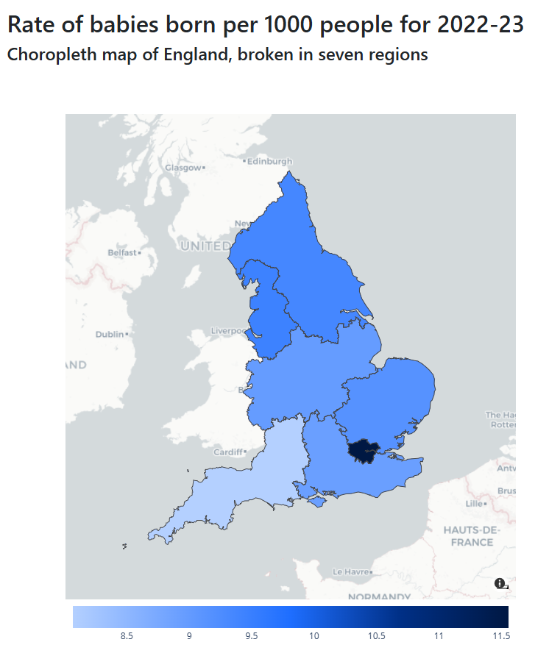
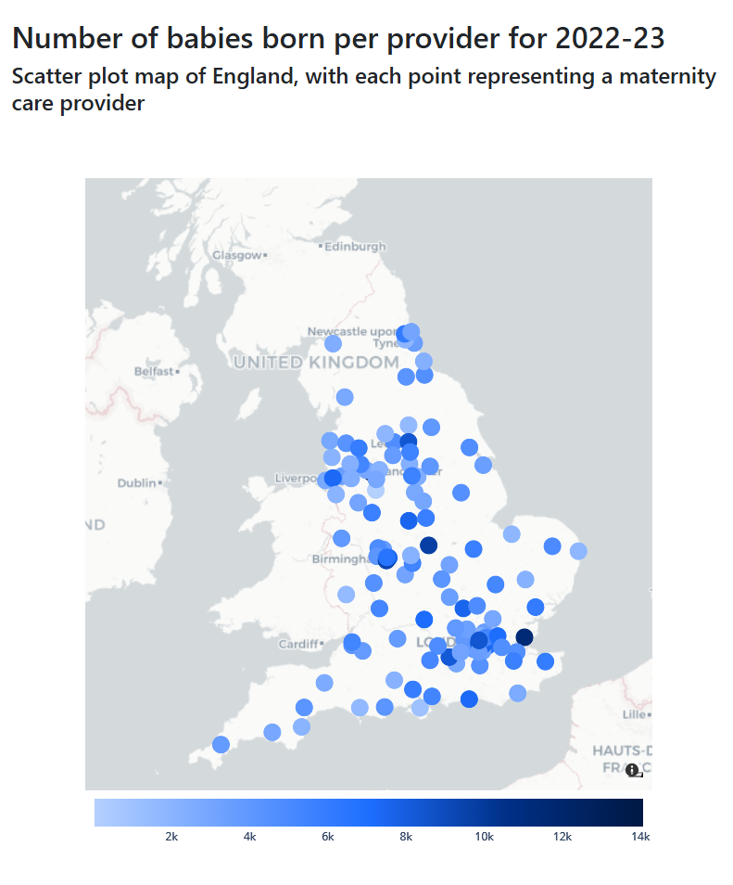
Thin Slice Output

Slide 6
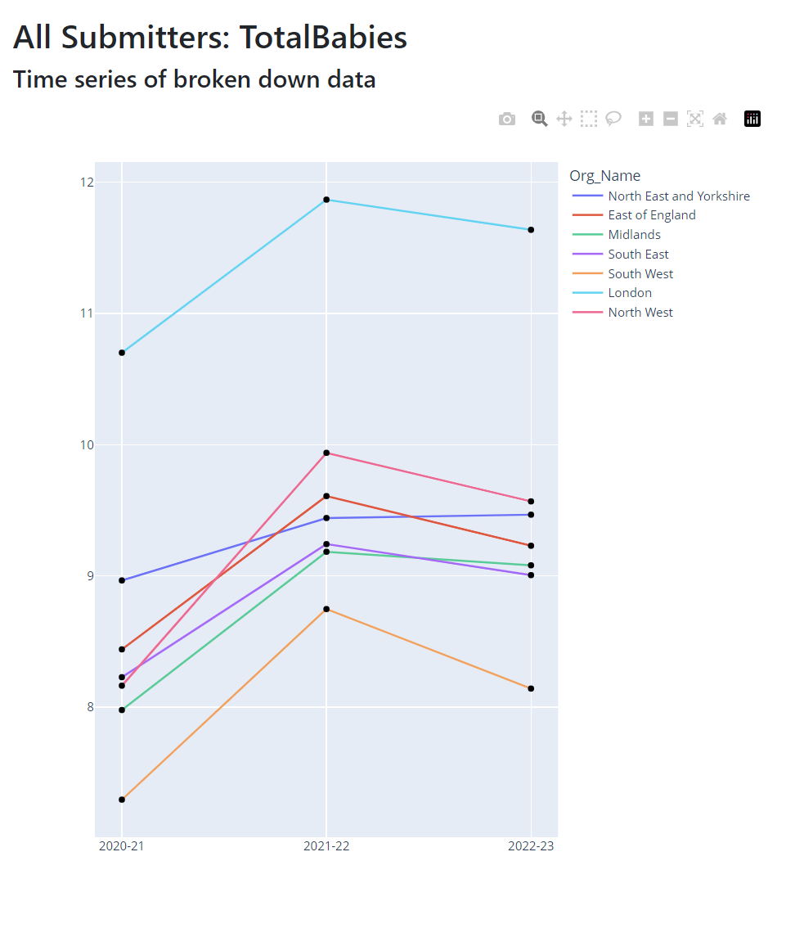
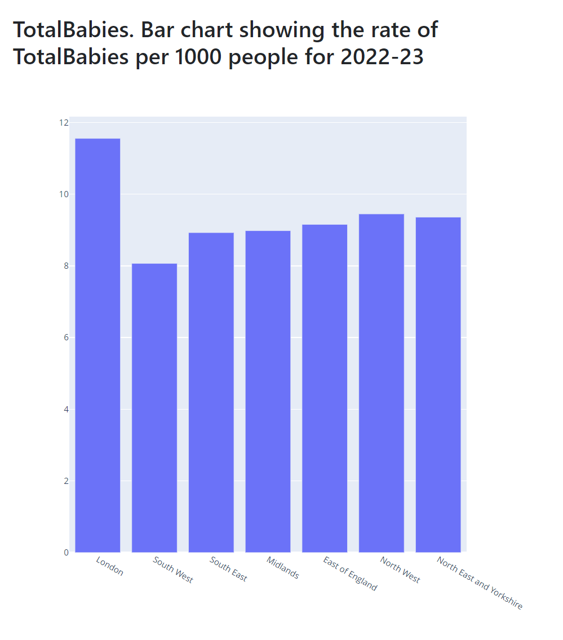
Thin Slice Expansion

Slide 7
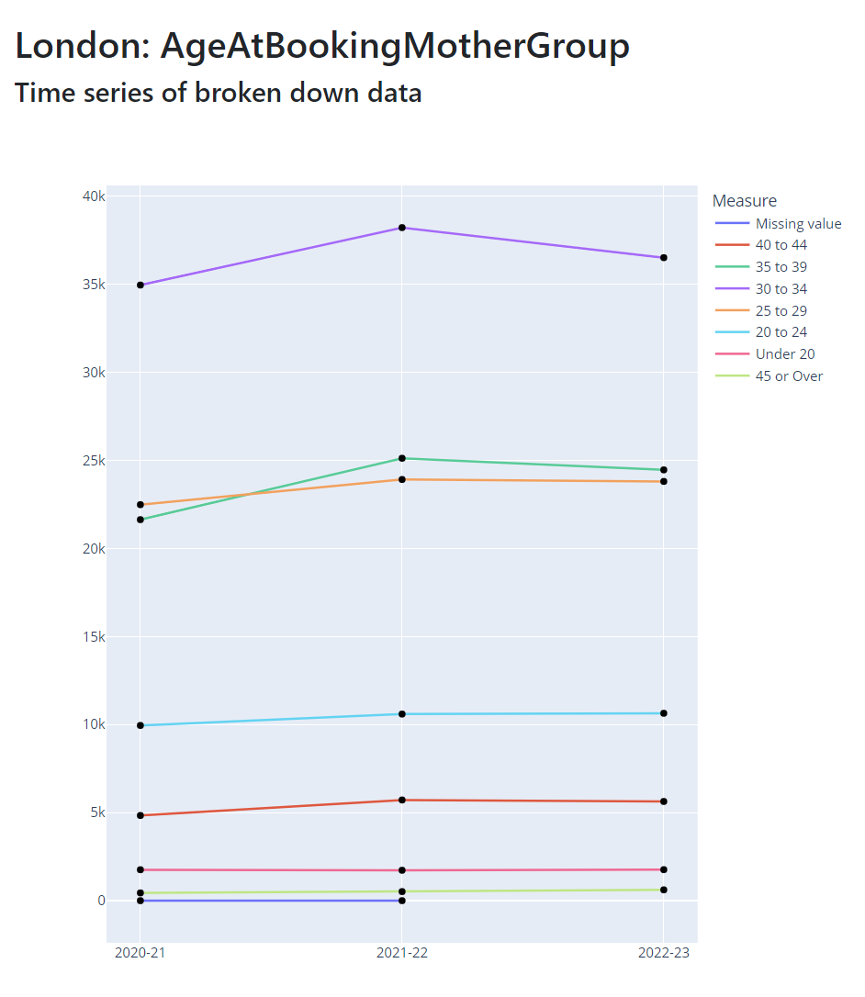
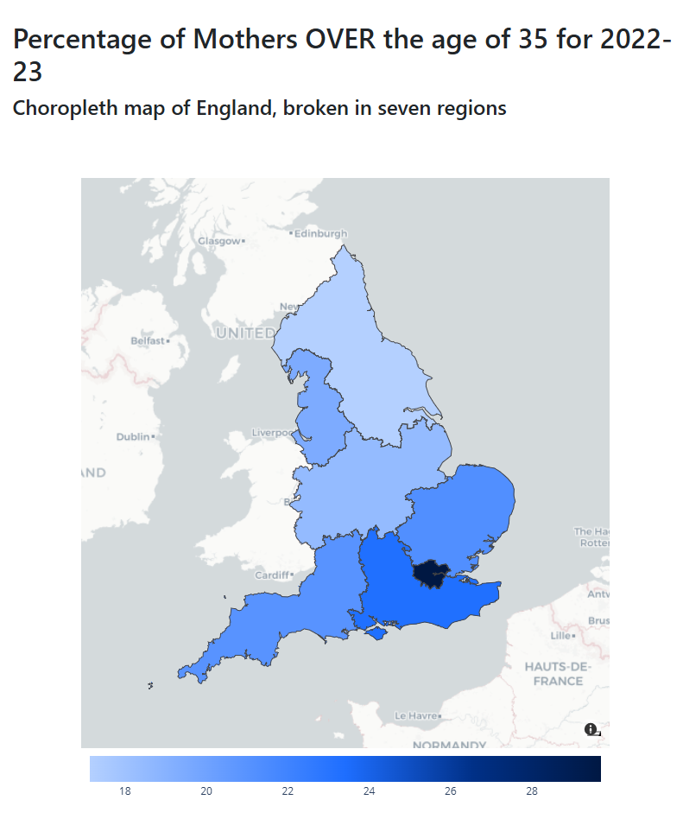
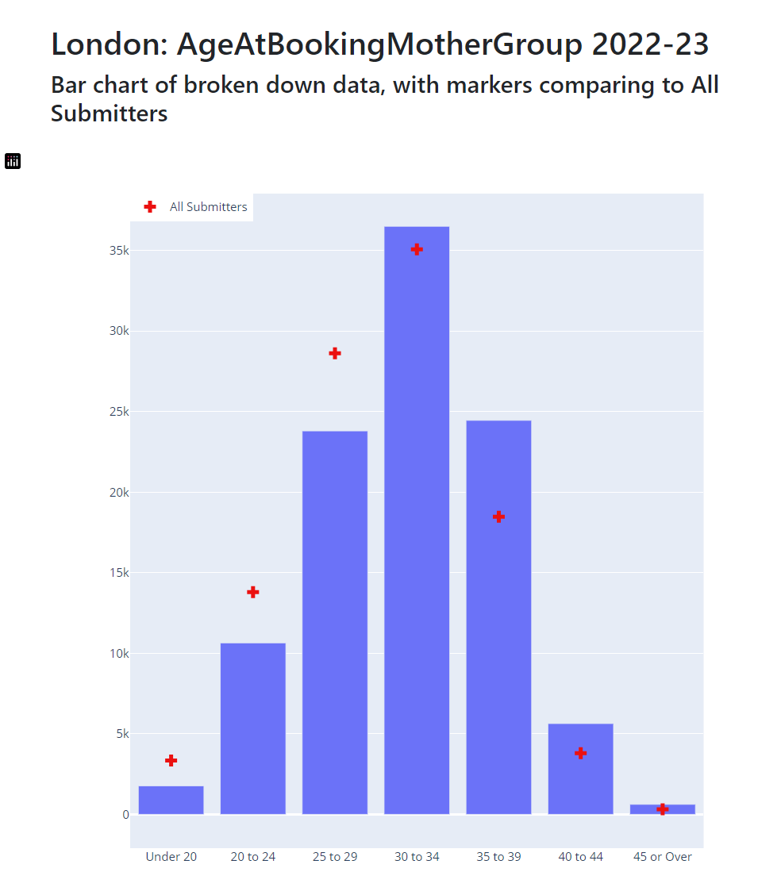

Slide 8
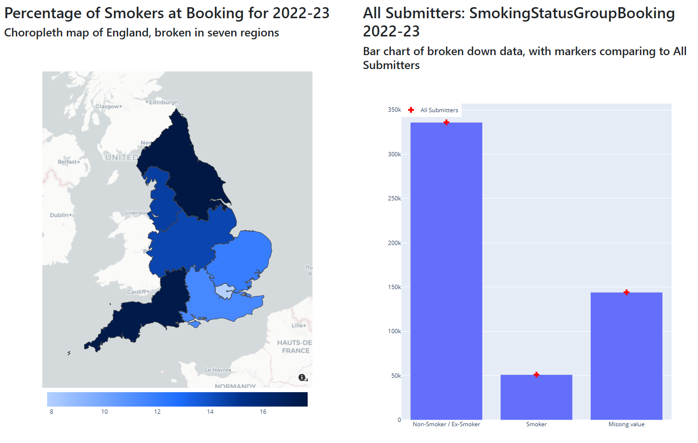
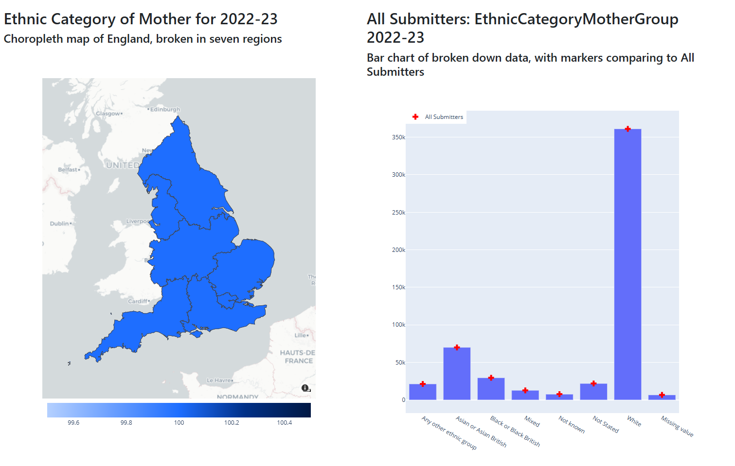
Learnings
Maps are fun! But not always the best way to show data
Setting up a dashboard from scratch is a lot of work
Bugs on bugs on bugs
Nothing is truly free forever

Slide 9



Links + Contact
Link to code:
Feel free to fork and try it out yourself!
https://github.com/nhsengland/opensource_maternity_dashboard_project
Live site (for the next few minutes):
https://ds-vis-acc-maternity.onrender.com/
Contact:
jennifer.struthers1@nhs.net

Slide 10
End slide

