Slide 1
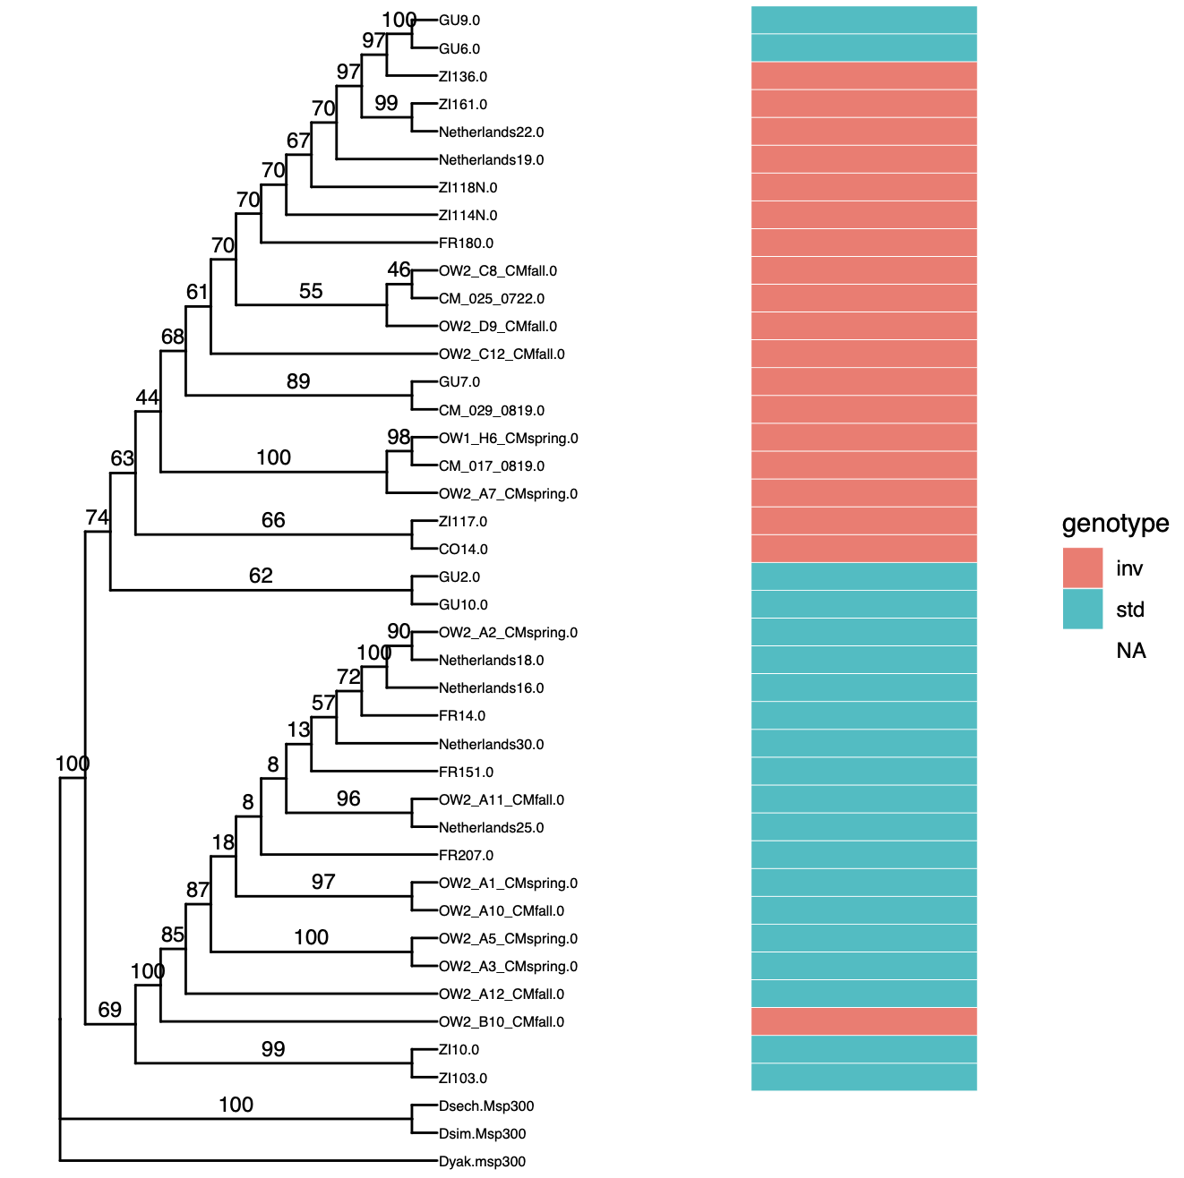
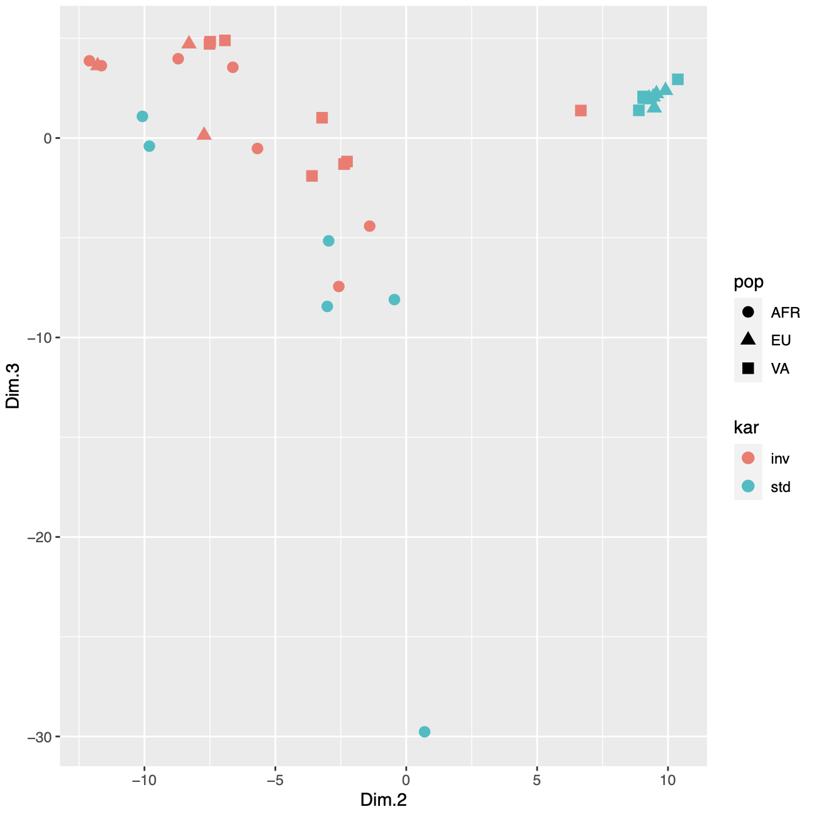
MSP300
2L:5188342-5195460

Slide 2
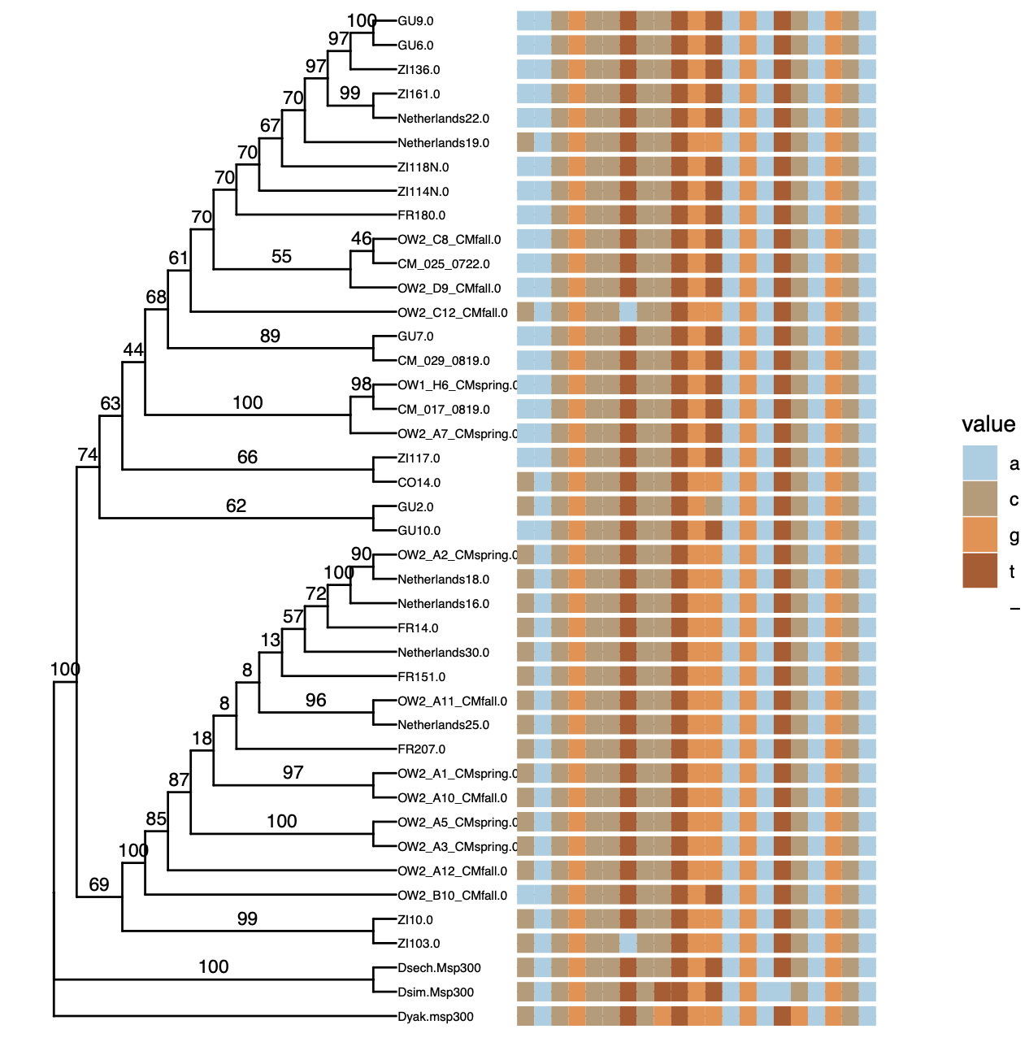

There is a third allele in Africa!
In Sechelia is T
In Simulans is T
In Yakuba is G!

Slide 3
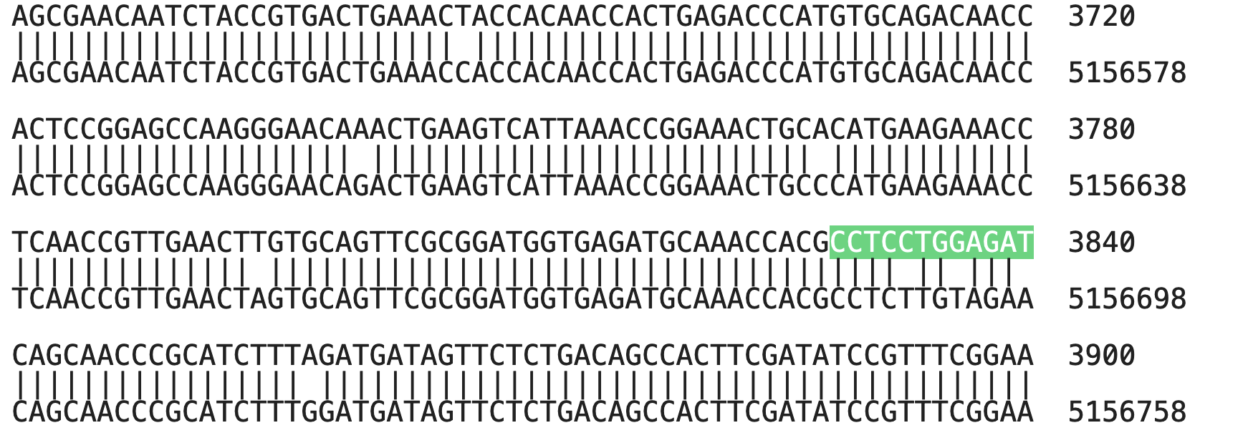

Msp300.Exon
SIM
Msp300.AA

Slide 4
