Slide 1
Updates to paper
April 29, 2020

Slide 2
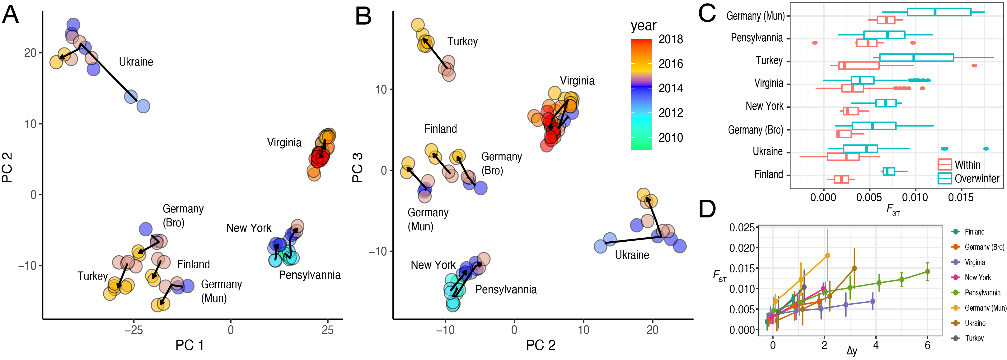

Slide 3
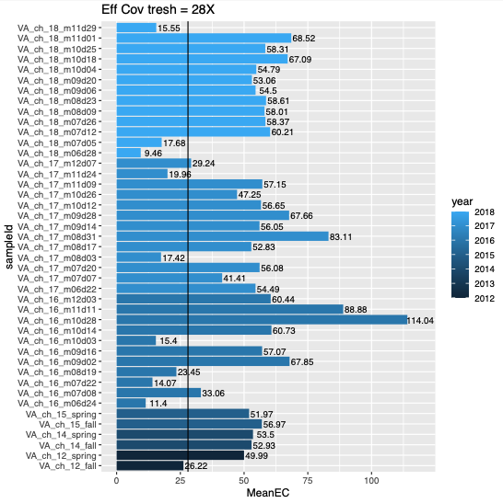
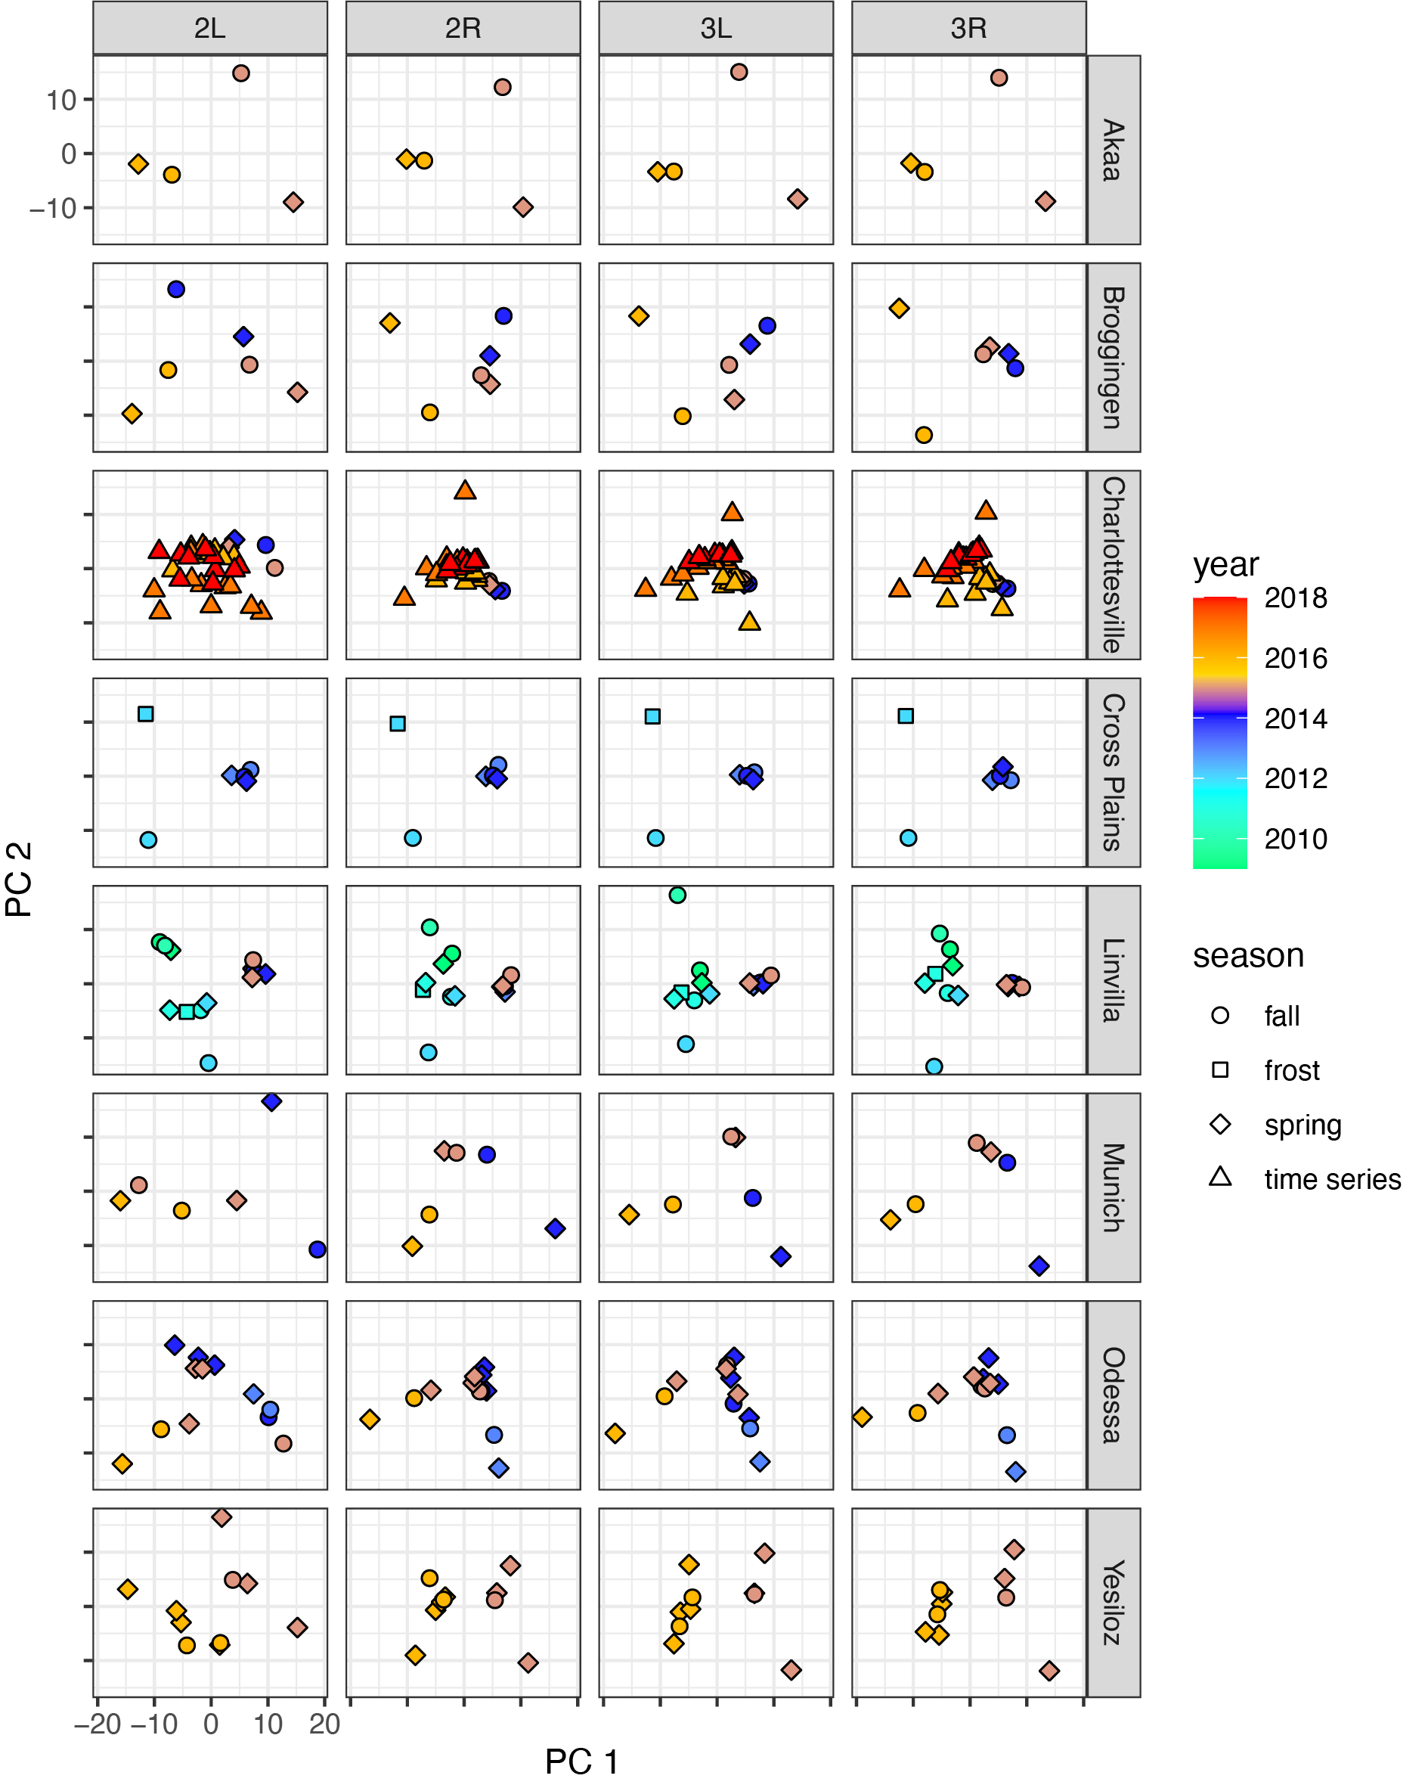

Slide 4
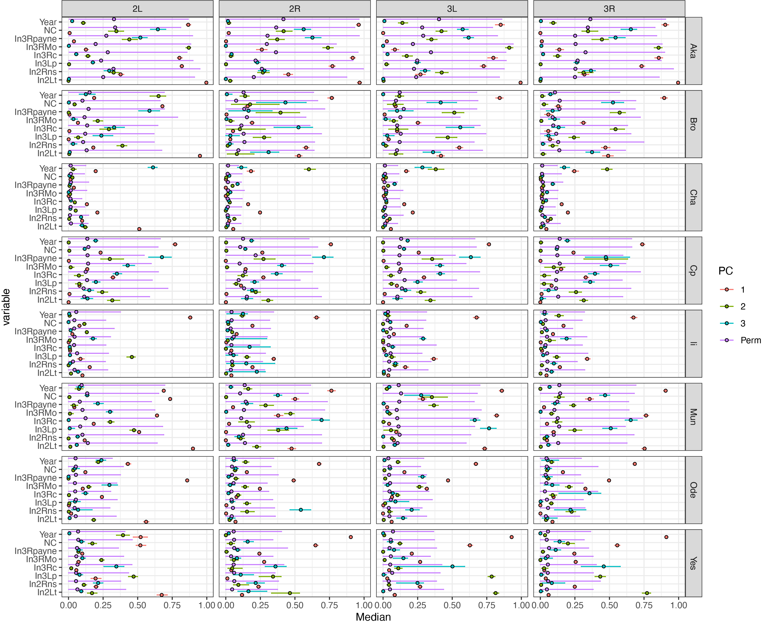

Slide 5
Improving simulations
Exploring various stats

Slide 6
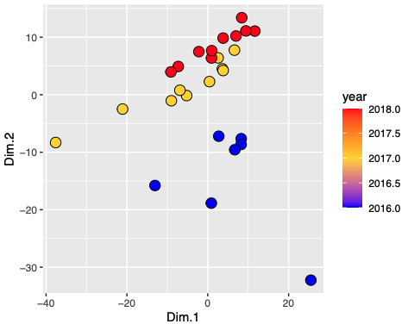
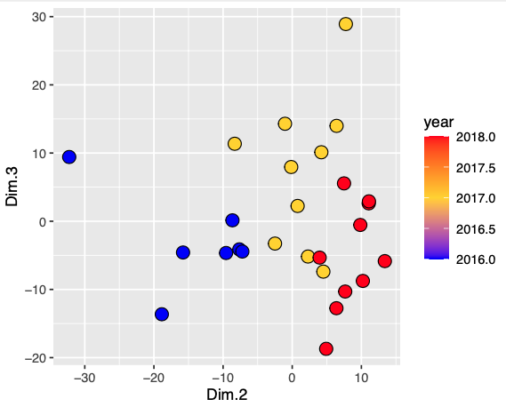
What we currently use (PCA on all genome):

Slide 7
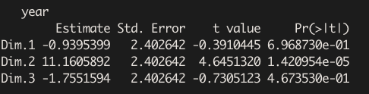

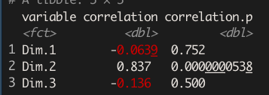
Lm models with time
Is PC2 “time” in our sims??
Lm models
Correlation models

Slide 8
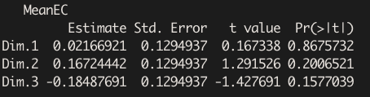
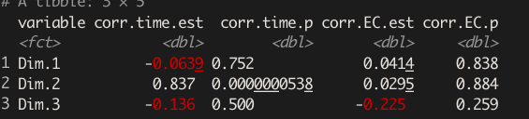
Lm models with NC
Lm models
Correlation models

Slide 9
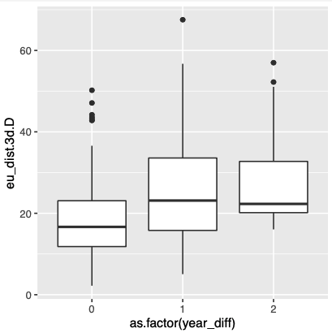
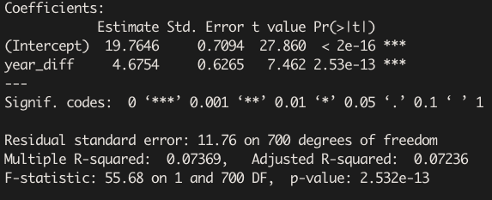
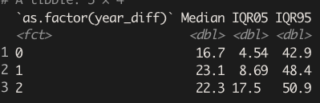
Euclidean distances (on 3D)

Slide 10

Can we do better?
Maybe!

Slide 11
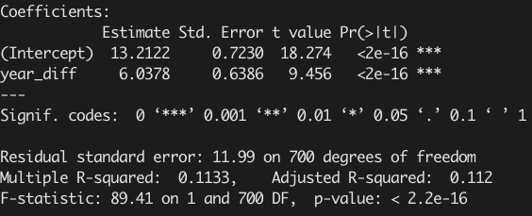
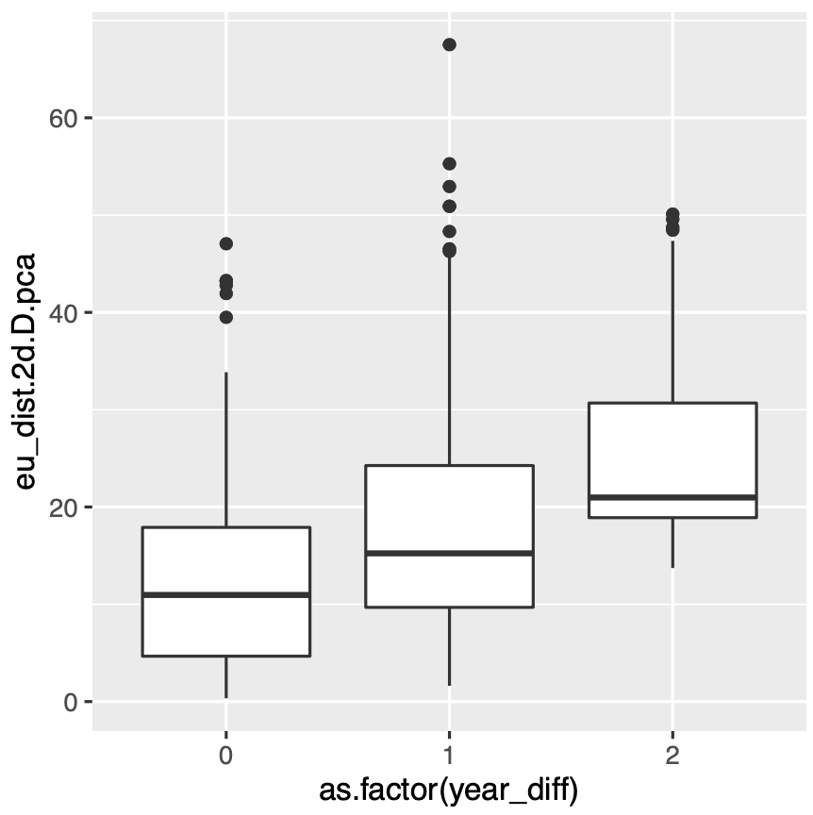
Only retains PCs 1 and 2?

Slide 12
Only retains PCs 1 and 2?
But then.. We run into familiar ascertainment problems:
Why not keep PC2 only?
Why not keep PC2 and PC3?
Is PC2 in the real data equivalent to PC2 in simulated data?
Why not remove 2L, in2lt?
Why not count all the peaches in the orchard? … etc …

Slide 13
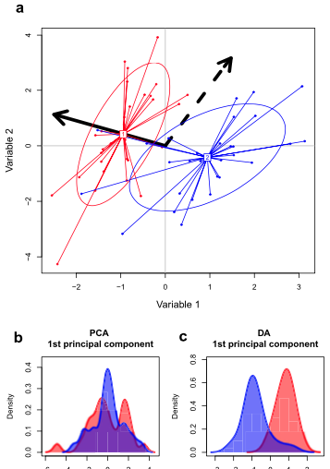
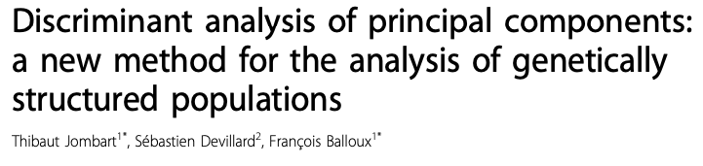
LD (Supervised)
PCA (Unsupervised)

Slide 14
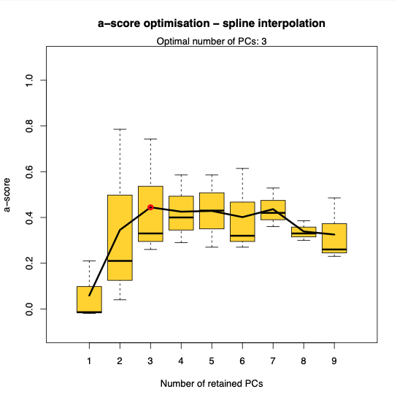
Turns out our intuition of retaining the first 3 components was correct. (we smart.. Or lucky?)
Yet, DACP doesn’t just stop there…

Slide 15
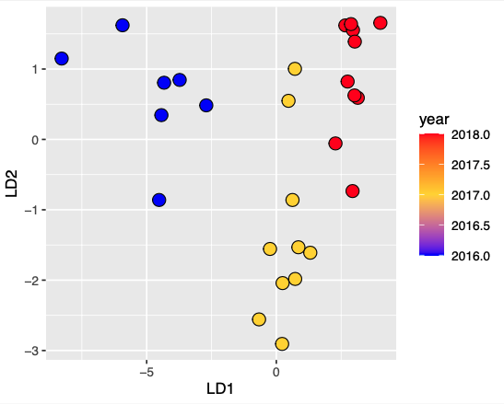
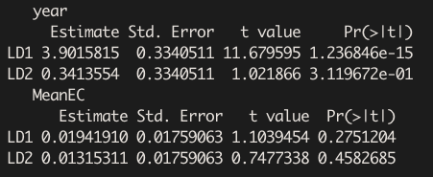

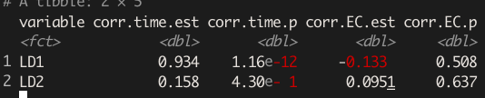
A supervised, optimized, approach (DAPC on all genome):
R2
Entire signal maximizes in 2 LDs!

Slide 16
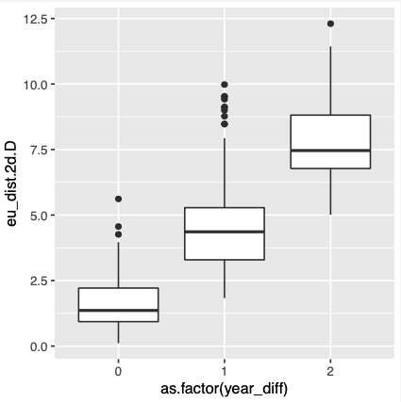
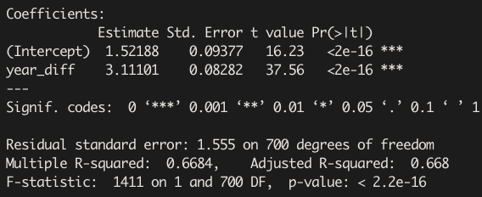
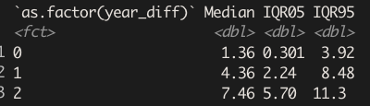
Euclidean distances (on 2D; since only 2LDs)

Slide 17
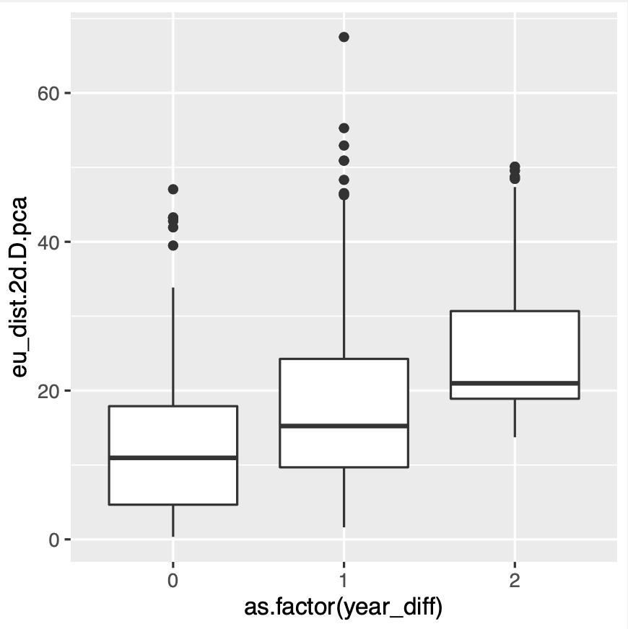
PCA
DAPC
3D
2D

Slide 18
So what should we use for ABC
Simulate 3 years of data, 2 overwinters
Mean FST within, Mean FST between … (for delta y = 0, 1 , 2)?
DAPC correlations to LD1 and LD2
Euclidian distance LD1-LD2 within and between for delta y = 0, 1 , 2
Other ideas:
Regression betas (abs val)?
Variance in allele frequency over 3 years (VAR AF)

