Slide 1
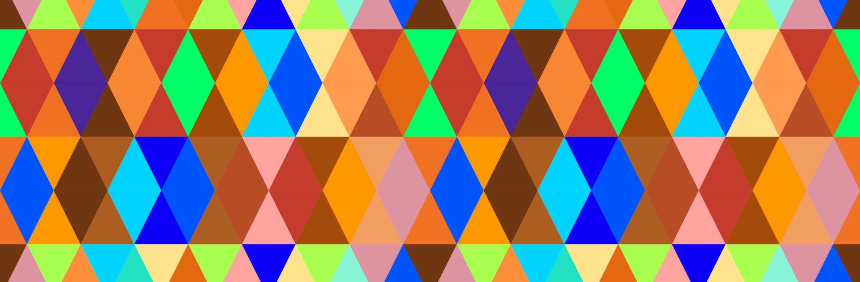
Figures

Slide 2
Figure 1

Slide 3
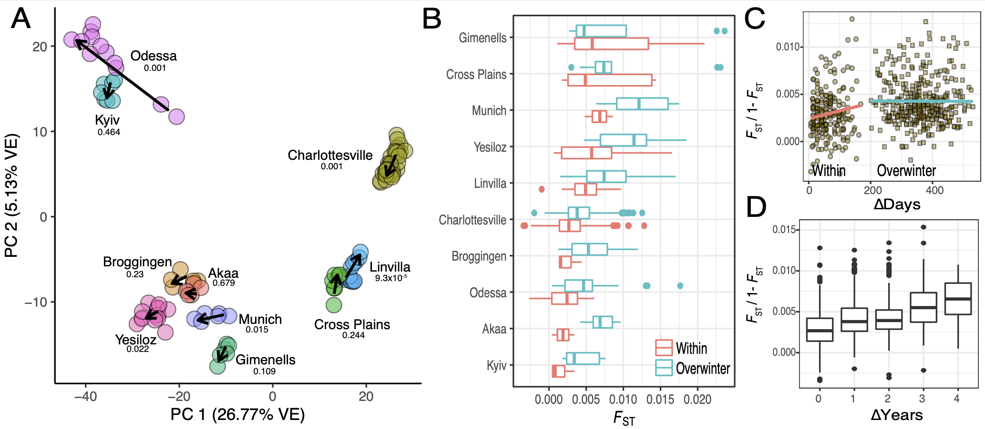
Notes:
Figure 1:

Slide 4
Figure 2

Slide 5
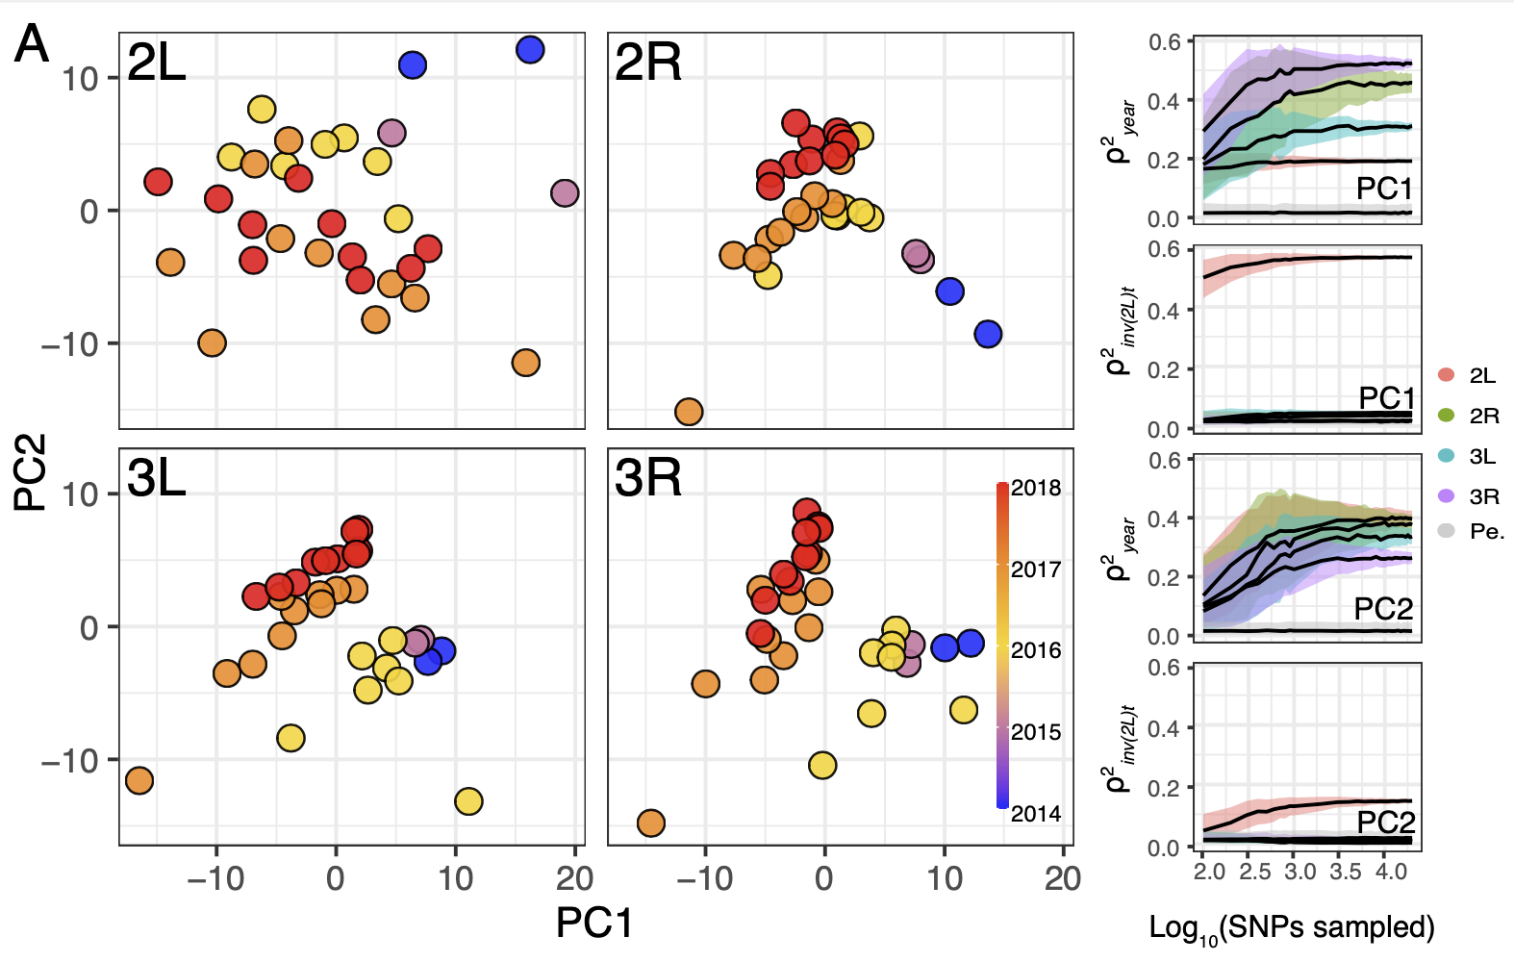

Slide 6
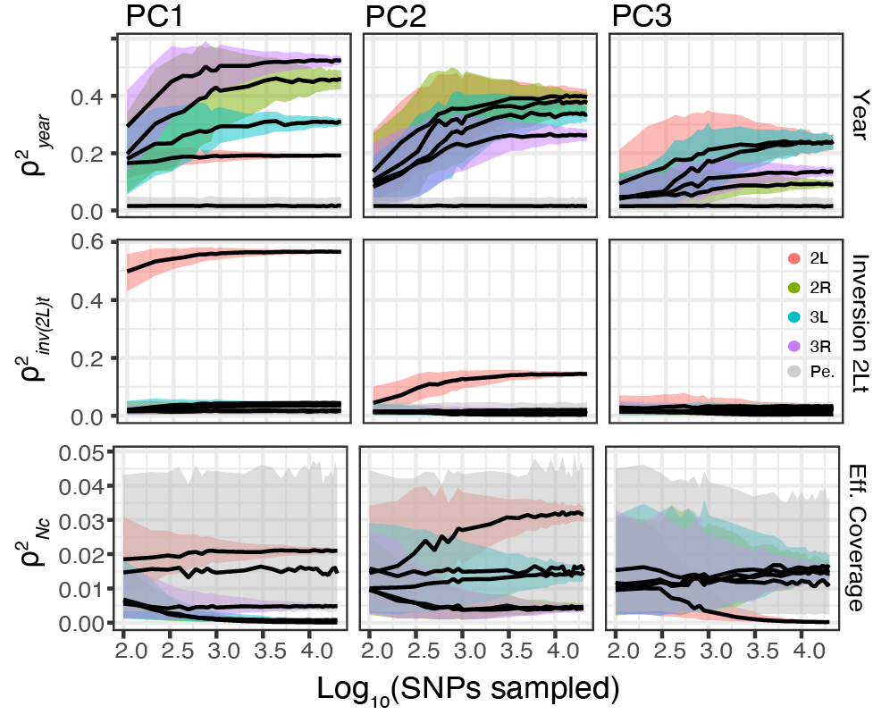

Slide 7
Figure 3

Slide 8
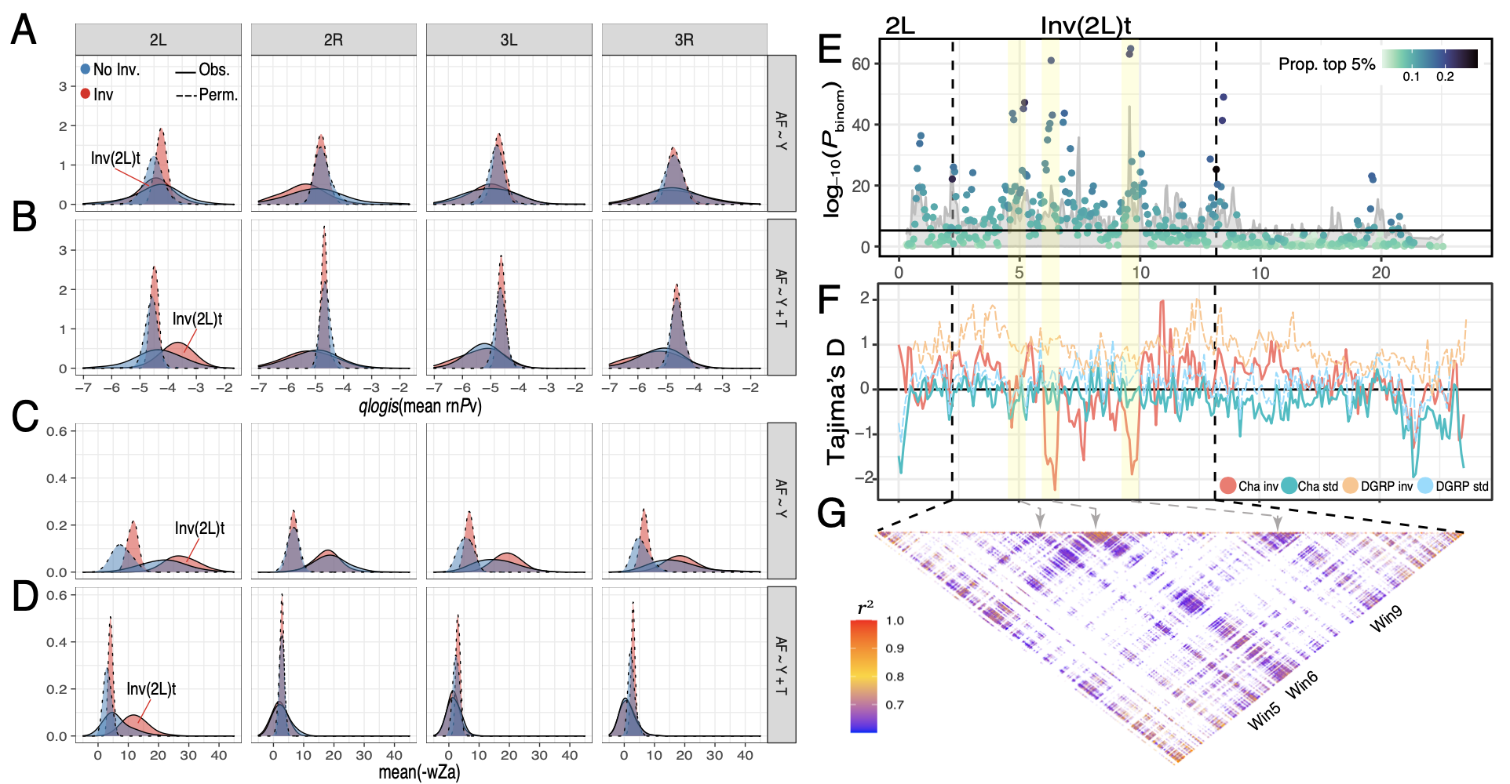

Slide 9
Figure 4

Slide 10
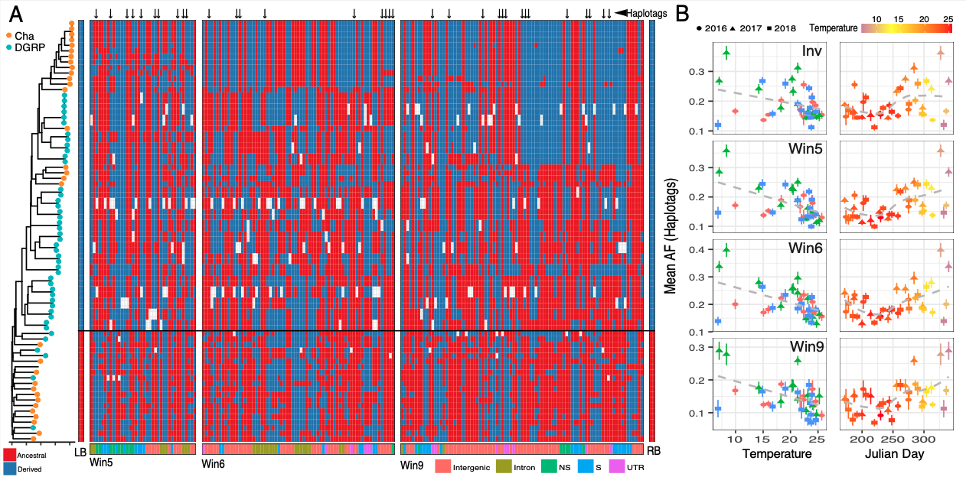

Slide 11
Methodological Figures

Slide 12


Slide 13
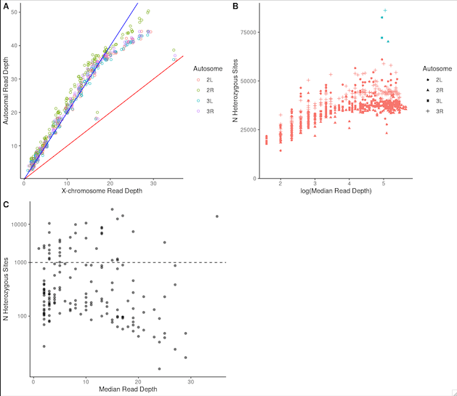

Slide 14


