Slide 1

March 7
Update

Slide 2
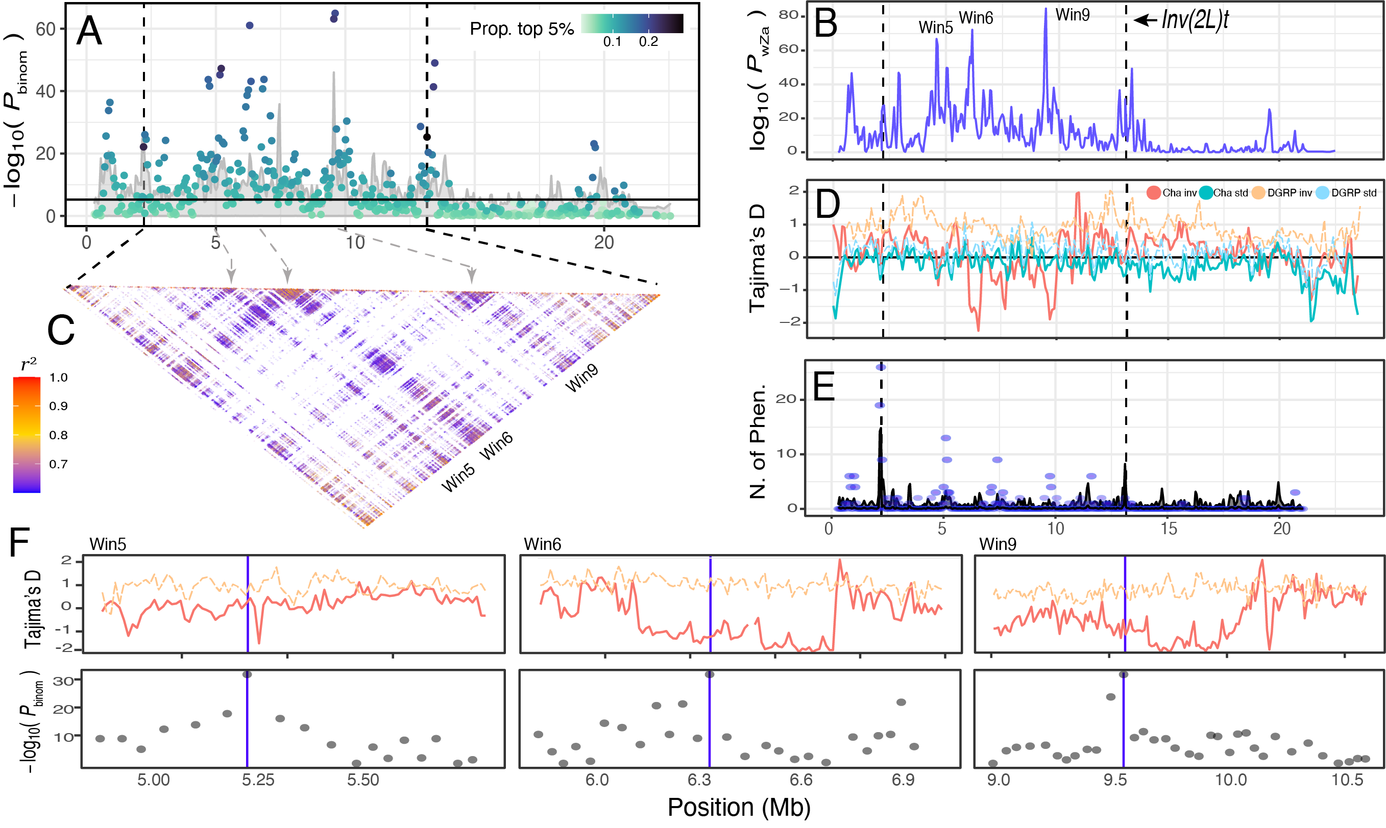

Slide 3
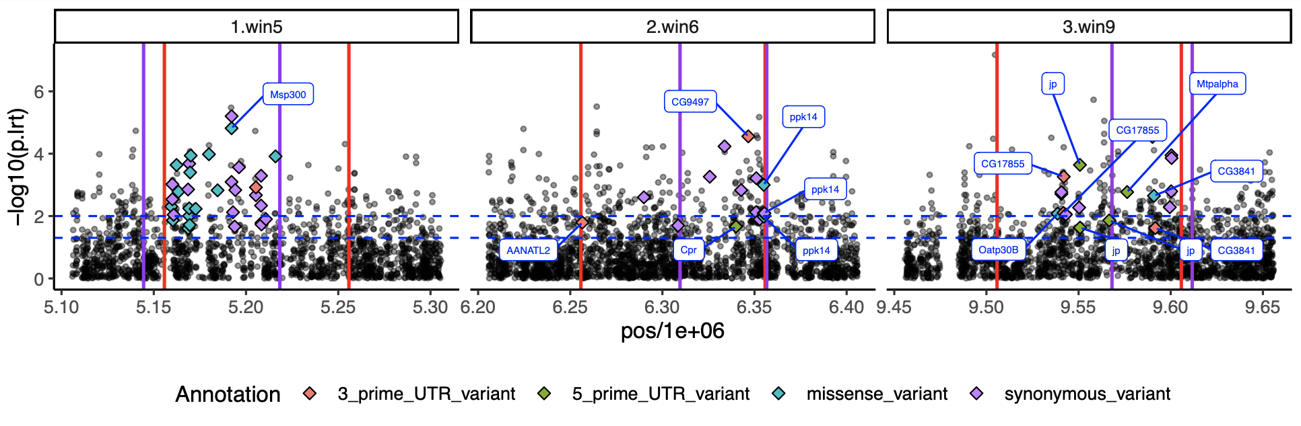
What genes are being targeted (Brk.pts pending)

Slide 4
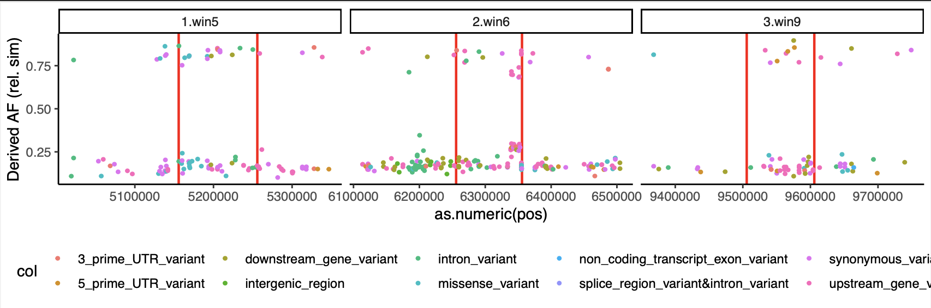
Temperature SNPs are derived and rose to high frequency

Slide 5
"missense_variant",”
3_prime_UTR_variant",
"5_prime_UTR_variant"

Slide 6
"missense_variant",”
3_prime_UTR_variant",
"5_prime_UTR_variant"
Target of recent Sweep

Slide 7
"missense_variant",”
3_prime_UTR_variant",
"5_prime_UTR_variant"

Slide 8
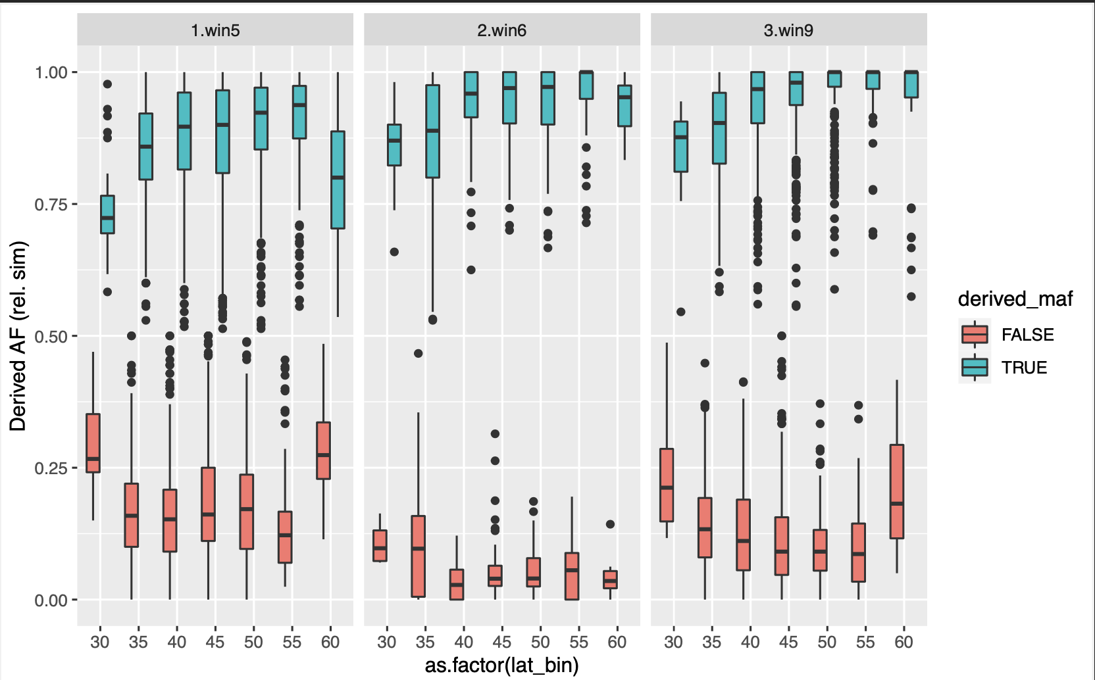

Slide 9
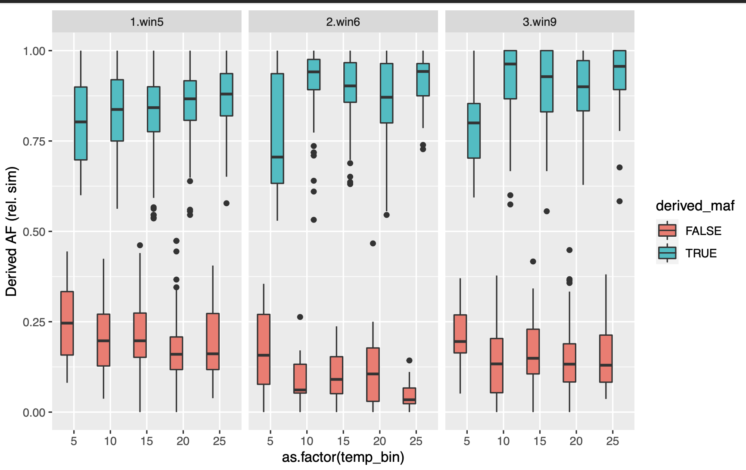

Slide 10
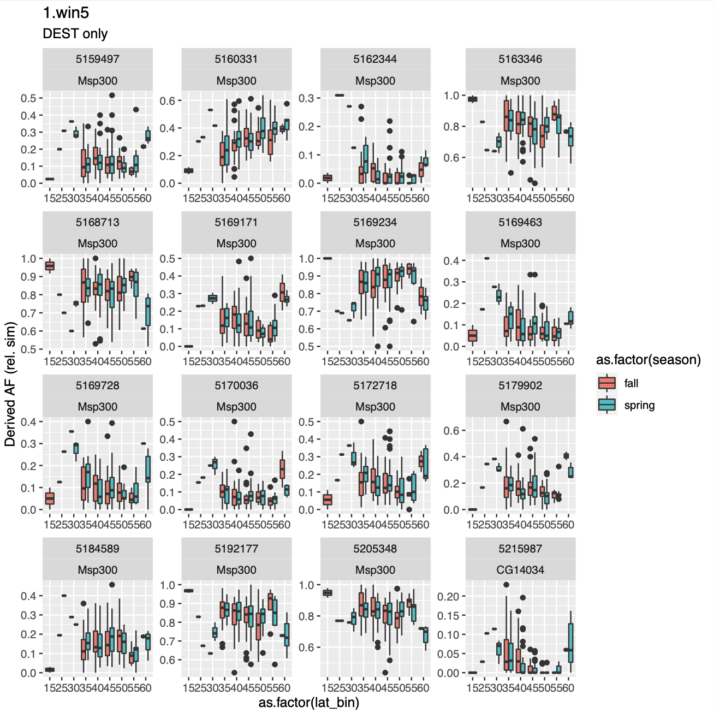
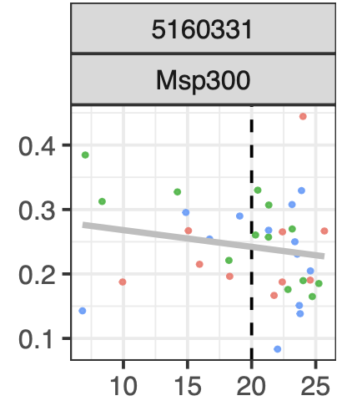
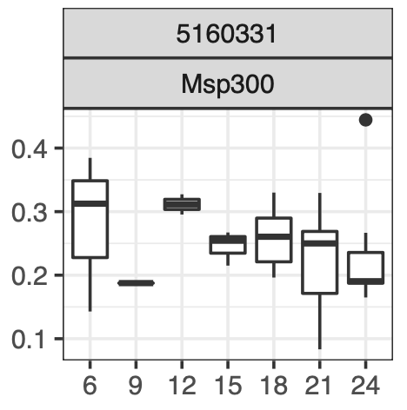
This SNP in
MSP 300 is both seasonal and clinal
Non-syn
Asn > Thr
“conservative”
Cville
?
Cville
?
Temp
Temp

Slide 11
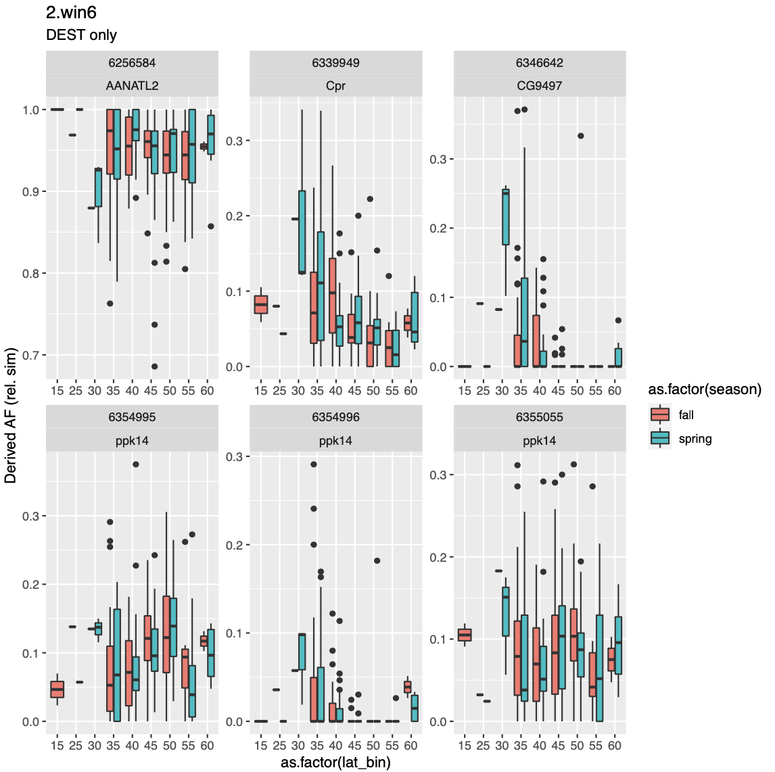
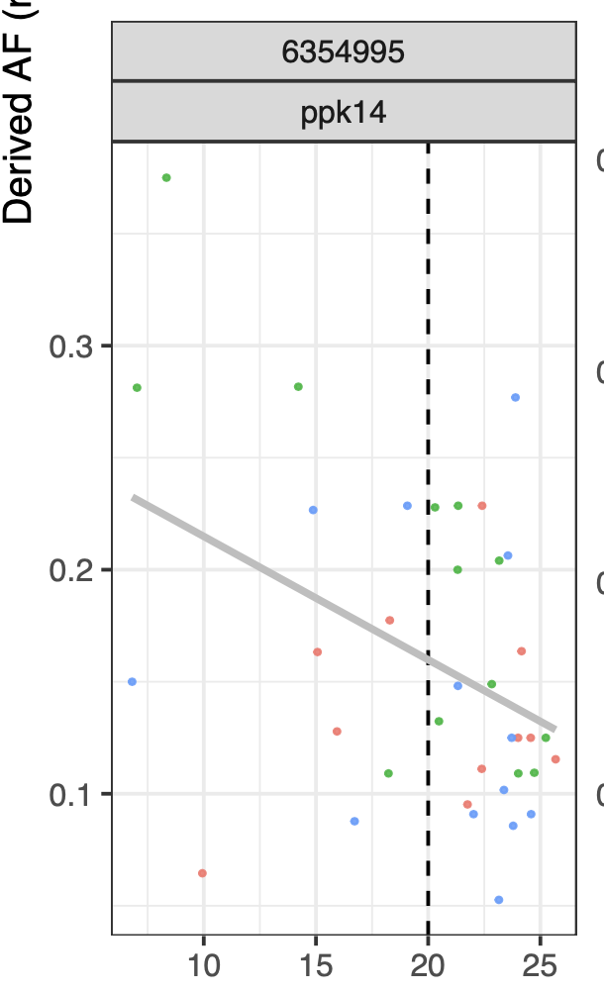
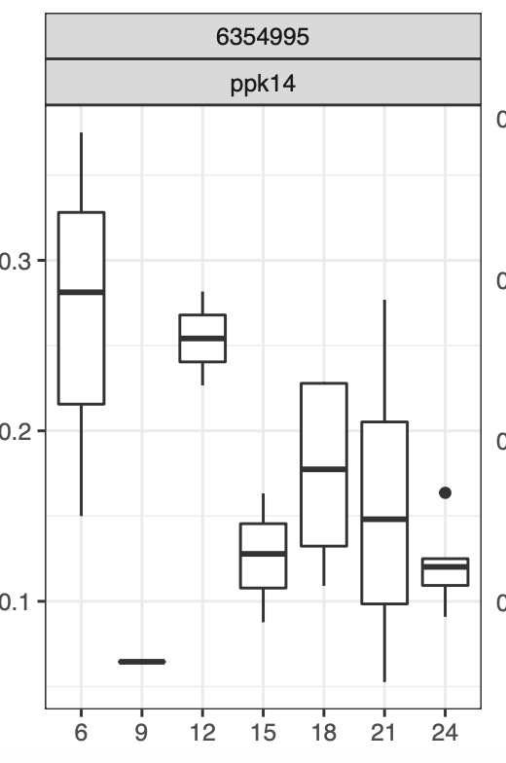
This SNP in
Ppk14 is both seasonal and clinal
Non-syn
Ala > Pro
“not-conservative”

Slide 12
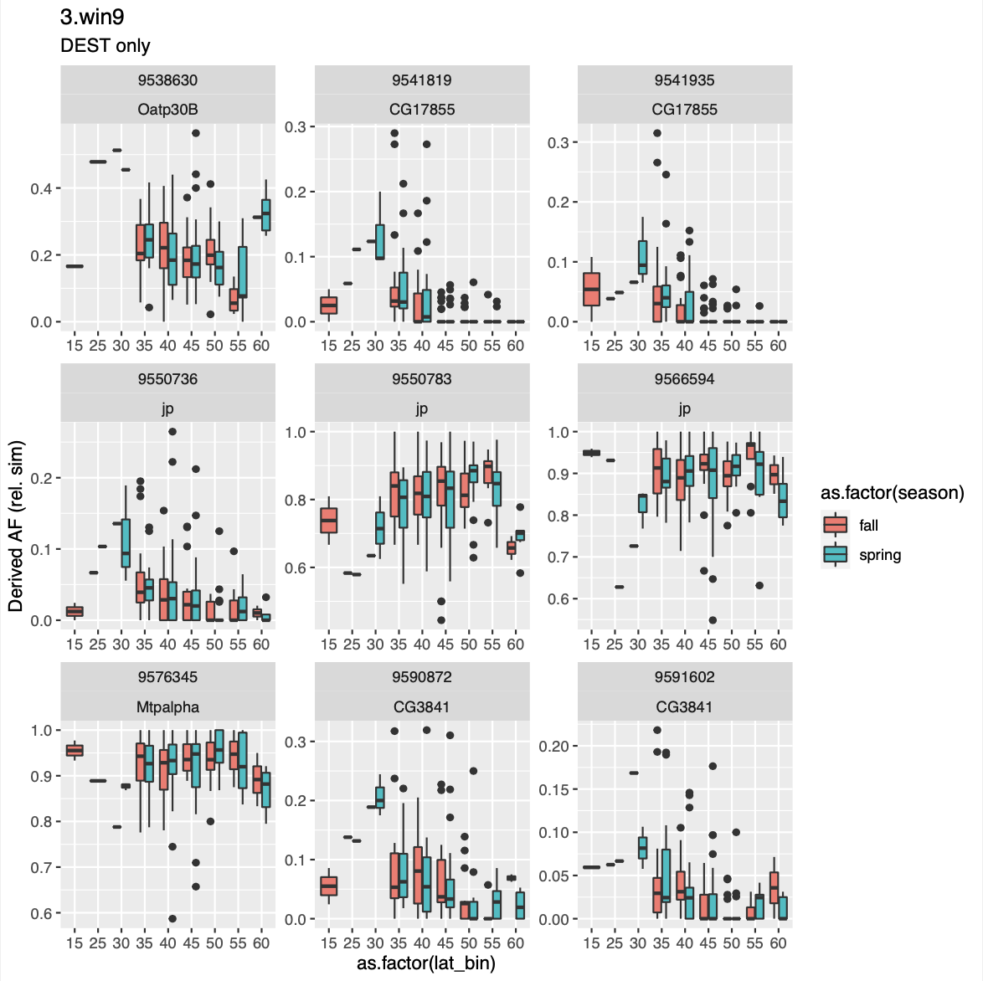
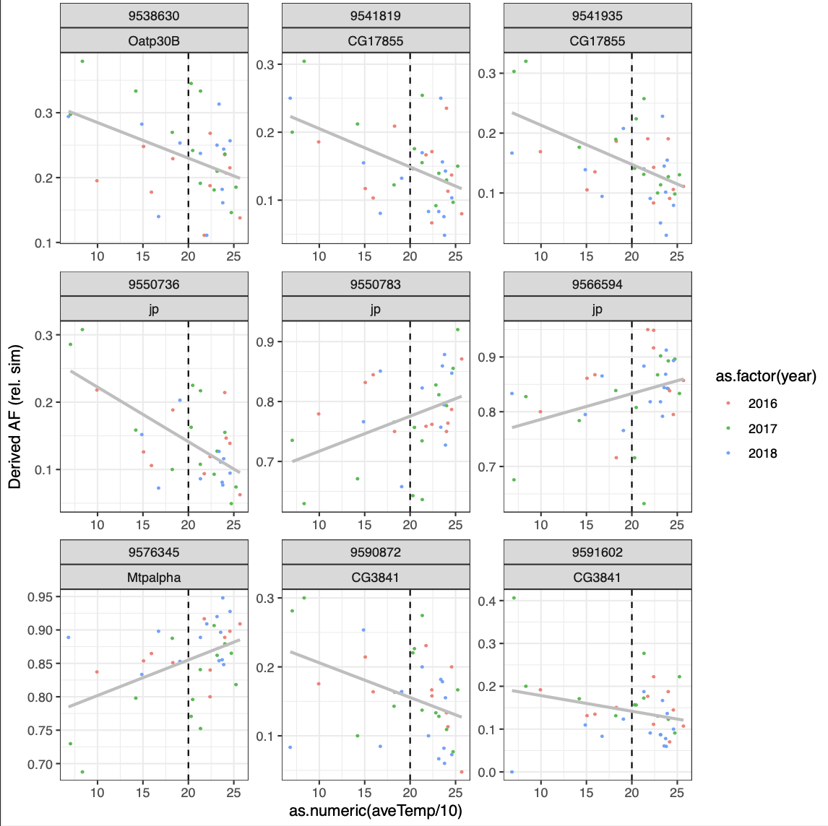

Slide 13
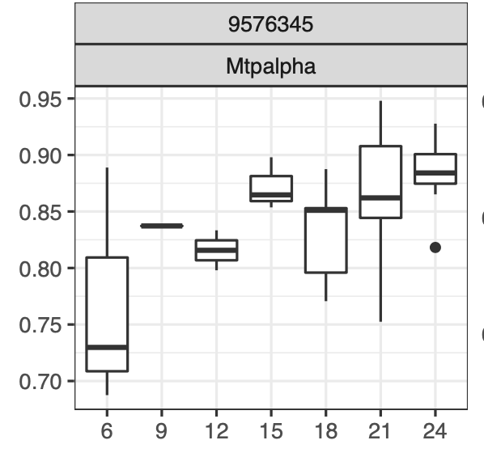
Mtp-alpha is not clinal
But it is seasonal
5_prime_UTR_variant MODIFIER
Remember this mutation is a derived that rose to high frequency

