Slide 1

Pyduino
Es gibt verschiedene Wege, um ins Programmieren einzusteigen
Python
Arduino
Vorteile
Syntax einfach zu lernen
Grundlegende Konzepte intuitiv verständlich
Keine Zeitverzögerung beim Ausführen
Vorteile
Praktische Anwendung
Programmieren mit Elektronik kombiniert
C++ braucht wenig Leistung -> läuft auch auf dem Arduino
Nachteile
Anfangs sehr theoretisch, keine Praktische Anwendung
Sehr Ressourcenintensiv -> läuft nicht auf dem Arduino
Nachteile
Wird in C++ programmiert, einer vor allem für Anfänger schwierigen Programmiersprache
Große Zeitverzögerung beim Ausführen durch Compilieren und Hochladen
Pyduino
Syntax an Python inspiriert -> intuitiv und einfach zu lernen
Wird in C++ übersetzt -> braucht wenig Leistung
Läuft auf dem Arduino -> Praktische Anwendung mit Elektronik
Läuft auch auf dem PC -> Geringere Zeitverzögerung beim Ausführen, da das Hochladen entfällt
Programme können auf dem Arduino und auf dem PC parallel mit einer Verbindung über den Seriellen Port ausgeführt werden -> Der Arduino kann die Rechenleistung des PCs nutzen und der PC kann die Sensoren und Aktoren am Arduino steuern
Programme müssen nicht jedes mal auf den Arduino hochgeladen werden, der Arduino kann als Empfänger verwendet werden, während das Programm auf dem PC läuft und nur die Befehle für die Sensoren und Aktoren müssen an den Arduino gesendet werden.
elif char == " " or any(char == t for t in NO_SPACE_TOKENS_LEN1): tokens.append(Token.get_token(string[last_space.col - start.col:i], Range.fromPositions(last_space, Position(start.line, start.col + i)))) last_space = Position(start.line, start.col + i) if char == " ": continue tokens.append(Token.get_token(char, Range.fromPositions(last_space, last_space.add_col(1)))) last_space = last_space.add_col(1) tokens.append(Token.get_token(string[last_space.col - start.col:], Range.fromPositions(last_space, Position(start.line, start.col + len(string))))) return [t for t in tokens if t is not None] @staticmethod def is_token(value): return isinstance(value, Token) @staticmethod def get_token(string: str, range: Range) -> 'Token': range = Range.fromPositions(range.start.add_col(len(string) - len(string.lstrip())), range.end.add_col(-len(string) + len(string.rstrip()))) string = string.strip() if string == "": return None if string in TOKENS.keys(): return Token(TOKENS[string], range) if string[0] in "([": type = Brackets.ROUND if string[0] == "(" else Brackets.SQUARE return Brackets(type, range, Token.tokenize(string[1:-1], range.start.add_col(1)), string[-1] == string[0]) if StringUtils.is_identifier(string): return Word(Word.IDENTIFIER, range, string) return Word(Word.VALUE, range, string) def __repr__(self): if self.type is Brackets.ROUND or self.type is Brackets.SQUARE: return f"{self.type.name} {[str(s) for s in self.inside]} {self.location}" return f"{self.type.name}{f' {self.value} ' if self.value is not None else ''} ({self.location})" class Operator(Token): def __init__(self, type: TokenType, location: Range, _): super().__init__(type, location, None) class Math_Operator(Operator): PLUS = TokenType("+", "MATH_OPERATOR.PLUS") MINUS = TokenType("-", "MATH_OPERATOR.MINUS") MULTIPLY = TokenType("*", "MATH_OPERATOR.MULTIPLY") DIVIDE = TokenType("/", "MATH_OPERATOR.DIVIDE") MODULO = TokenType("%", "MATH_OPERATOR.MODULO") FLOOR_DIVIDE = TokenType("//", "MATH_OPERATOR.FLOOR_DIVIDE") class Compare_Operator(Operator): EQUAL = TokenType("==", "Compare_Operator.EQUAL") NOT_EQUAL = TokenType("!=", "Compare_Operator.NOT_EQUAL") GREATER = TokenType(">", "Compare_Operator.GREATER") GREATER_EQUAL = TokenType(">=", "Compare_Operator.GREATER_EQUAL") LESS = TokenType("<", "Compare_Operator.LESS") LESS_EQUAL = TokenType("<=", "Compare_Operator.LESS_EQUAL") class Bool_Operator(Operator): AND = TokenType("and", "Bool_Operator.AND") OR = TokenType("or", "Bool_Operator.OR") NOT = TokenType("not", "Bool_Operator.NOT") class Word(Token): IDENTIFIER = TokenType("identifier", "Word.IDENTIFIER") VALUE = TokenType("value", "Word.VALUE") def __init__(self, type, range, value): super().__init__(type, range, value) class Brackets(Token): ROUND = TokenType("()", "Brackets.ROUND") SQUARE = TokenType("[]", "Brackets.SQUARE") def __init__(self, type, location: Range, inside: list[Token], closed: bool): super().__init__(type, location, None) self.closed = closed self.inside = inside class Separator(Token): COMMA = TokenType(",", "Separator.COMMA") COLON = TokenType(":", "Separator.COLON") SEMICOLON = TokenType(";", "Separator.SEMICOLON") HASHTAG = TokenType("#", "Separator.HASHTAG") ASSIGN = TokenType("=", "Separator.ASSIGN") class Keyword(Token): IF = TokenType("if", "Keyword.IF") ELSE = TokenType("else", "Keyword.ELSE") ELIF = TokenType("elif", "Keyword.ELIF") WHILE = TokenType("while", "Keyword.WHILE") FOR = TokenType("for", "Keyword.FOR") IN = TokenType("in", "Keyword.IN") RETURN = TokenType("return", "Keyword.RETURN") BREAK = TokenType("break", "Keyword.BREAK") CONTINUE = TokenType("continue", "Keyword.CONTINUE") class Datatype(Token): INT = TokenType("int", "Datatype.INT") FLOAT = TokenType("float", "Datatype.FLOAT") STRING = TokenType("str", "Datatype.STRING") BOOL = TokenType("bool", "Datatype.BOOL") VOID = TokenType("void", "Datatype.VOID") NO_SPACE_TOKENS_LEN1 = ["+", "-", "*", "/", "%", ",", ":", "<", ">", "=", ":"] NO_SPACE_TOKENS_LEN2 = ["==", ">=", "<=", "!=", "//"] TOKENS = { "+": Math_Operator.PLUS, "-": Math_Operator.MINUS, "*": Math_Operator.MULTIPLY, "/": Math_Operator.DIVIDE, "%": Math_Operator.MODULO, "//": Math_Operator.FLOOR_DIVIDE, "==": Compare_Operator.EQUAL, "!=": Compare_Operator.NOT_EQUAL, ">": Compare_Operator.GREATER, ">=": Compare_Operator.GREATER_EQUAL, "<": Compare_Operator.LESS, "<=": Compare_Operator.LESS_EQUAL, "and": Bool_Operator.AND, "or": Bool_Operator.OR, "not": Bool_Operator.NOT, ",": Separator.COMMA, ":": Separator.COLON, "#": Separator.HASHTAG, "=": Separator.ASSIGN, "if": Keyword.IF, "else": Keyword.ELSE, "elif": Keyword.ELIF, "while": Keyword.WHILE, "for": Keyword.FOR, "in": Keyword.IN, "return": Keyword.RETURN, "break": Keyword.BREAK, "continue": Keyword.CONTINUE, "int": Datatype.INT, "float": Datatype.FLOAT, "str": Datatype.STRING,
Notes:
mitte

Slide 2
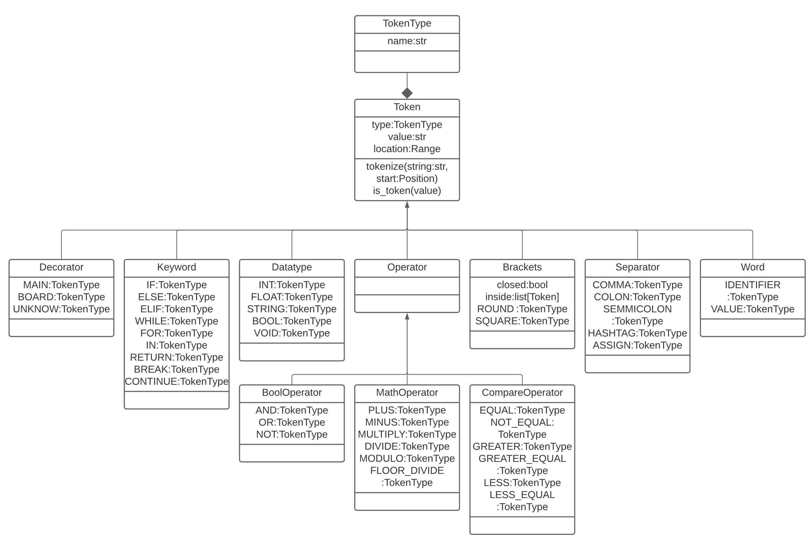
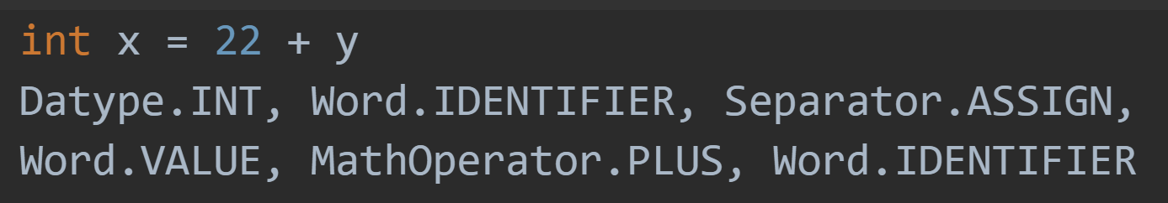
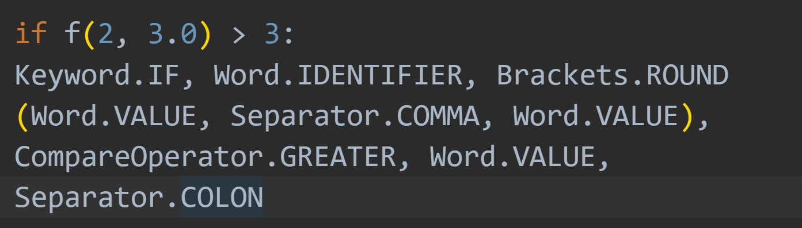
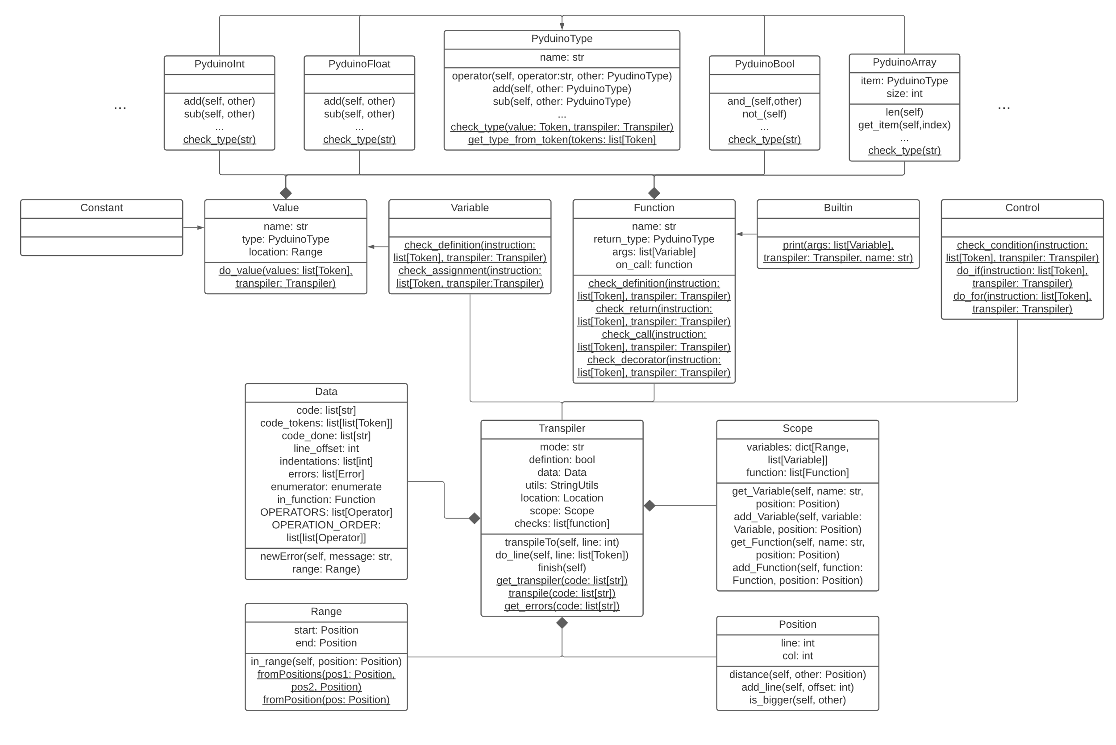
from pyduino_utils import * class TokenType: def __init__(self, code, name): self.code = code self.name = name class Token: def __init__(self, type: TokenType, location: Range, value=None): self.type = type self.value = value self.location = location @staticmethod def tokenize(string: str, start: Position) -> list['Token']: bracket_levels = [0, 0, 0] last_space = start last_bracket = start enumerator = enumerate(string) tokens = [] for i, char in enumerator: if char in "([{": if bracket_levels == [0, 0, 0]: last_bracket = Position(start.line, start.col + i) bracket_levels["([{".index(char)] += 1 elif char in ")]}": bracket_levels[")]}".index(char)] -= 1 if bracket_levels == [0, 0, 0]: if last_space.col != last_bracket.col: tokens.append(Token.get_token(string[last_space.col - start.col:last_bracket.col - start.col], Range.fromPositions(last_space, last_bracket))) tokens.append(Token.get_token(string[last_bracket.col - start.col:i + 1], Range.fromPositions(last_bracket, Position(start.line, start.col + i + 1)))) last_space = Position(start.line, start.col + i + 1) continue if char == "\"": for j, char2 in enumerator: if char2 == "\"": break else: break if bracket_levels != [0, 0, 0]: continue if any(string[i:i + 2] == t for t in NO_SPACE_TOKENS_LEN2): tokens.append( Token.get_token(string[last_space.col - start.col:i], Range.fromPositions(last_space, Position(start.line, start.col + i)))) last_space = Position(start.line, start.col + i) tokens.append(Token.get_token(string[i:i + 2], Range.fromPositions(last_space, last_space.add_col(2)))) next(enumerator) last_space = last_space.add_col(2) elif char == " " or any(char == t for t in NO_SPACE_TOKENS_LEN1): tokens.append(Token.get_token(string[last_space.col - start.col:i], Range.fromPositions(last_space, Position(start.line, start.col + i)))) last_space = Position(start.line, start.col + i) if char == " ": continue tokens.append(Token.get_token(char, Range.fromPositions(last_space, last_space.add_col(1)))) last_space = last_space.add_col(1) tokens.append(Token.get_token(string[last_space.col - start.col:], Range.fromPositions(last_space, Position(start.line, start.col + len(string))))) return [t for t in tokens if t is not None] @staticmethod def is_token(value): return isinstance(value, Token) @staticmethod def get_token(string: str, range: Range) -> 'Token': range = Range.fromPositions(range.start.add_col(len(string) - len(string.lstrip())), range.end.add_col(-len(string) + len(string.rstrip()))) string = string.strip() if string == "": return None if string in TOKENS.keys(): return Token(TOKENS[string], range) if string[0] in "([": type = Brackets.ROUND if string[0] == "(" else Brackets.SQUARE return Brackets(type, range, Token.tokenize(string[1:-1], range.start.add_col(1)), string[-1] == string[0]) if StringUtils.is_identifier(string): return Word(Word.IDENTIFIER, range, string) return Word(Word.VALUE, range, string) def __repr__(self): if self.type is Brackets.ROUND or self.type is Brackets.SQUARE: return f"{self.type.name} {[str(s) for s in self.inside]} {self.location}" return f"{self.type.name}{f' {self.value} ' if self.value is not None else ''} ({self.location})" class Operator(Token): def __init__(self, type: TokenType, location: Range, _): super().__init__(type, location, None) class Math_Operator(Operator): PLUS = TokenType("+", "MATH_OPERATOR.PLUS") MINUS = TokenType("-", "MATH_OPERATOR.MINUS") MULTIPLY = TokenType("*", "MATH_OPERATOR.MULTIPLY") DIVIDE = TokenType("/", "MATH_OPERATOR.DIVIDE") MODULO = TokenType("%", "MATH_OPERATOR.MODULO") FLOOR_DIVIDE = TokenType("//", "MATH_OPERATOR.FLOOR_DIVIDE") class Compare_Operator(Operator): EQUAL = TokenType("==", "Compare_Operator.EQUAL") NOT_EQUAL = TokenType("!=", "Compare_Operator.NOT_EQUAL") GREATER = TokenType(">", "Compare_Operator.GREATER") GREATER_EQUAL = TokenType(">=", "Compare_Operator.GREATER_EQUAL") LESS = TokenType("<", "Compare_Operator.LESS") LESS_EQUAL = TokenType("<=", "Compare_Operator.LESS_EQUAL") class Bool_Operator(Operator): AND = TokenType("and", "Bool_Operator.AND") OR = TokenType("or", "Bool_Operator.OR") NOT = TokenType("not", "Bool_Operator.NOT") class Word(Token): IDENTIFIER = TokenType("identifier", "Word.IDENTIFIER") VALUE = TokenType("value", "Word.VALUE") def __init__(self, type, range, value): super().__init__(type, range, value) class Brackets(Token): ROUND = TokenType("()", "Brackets.ROUND") SQUARE = TokenType("[]", "Brackets.SQUARE") def __init__(self, type, location: Range, inside: list[Token], closed: bool): super().__init__(type, location, None) self.closed = closed self.inside = inside class Separator(Token): COMMA = TokenType(",", "Separator.COMMA") COLON = TokenType(":", "Separator.COLON") SEMICOLON = TokenType(";", "Separator.SEMICOLON") HASHTAG = TokenType("#", "Separator.HASHTAG") ASSIGN = TokenType("=", "Separator.ASSIGN") class Keyword(Token): IF = TokenType("if", "Keyword.IF") ELSE = TokenType("else", "Keyword.ELSE") ELIF = TokenType("elif", "Keyword.ELIF") WHILE = TokenType("while", "Keyword.WHILE") FOR = TokenType("for", "Keyword.FOR") IN = TokenType("in", "Keyword.IN") RETURN = TokenType("return", "Keyword.RETURN") BREAK = TokenType("break", "Keyword.BREAK") CONTINUE = TokenType("continue", "Keyword.CONTINUE") class Datatype(Token): INT = TokenType("int", "Datatype.INT") FLOAT = TokenType("float", "Datatype.FLOAT") STRING = TokenType("str", "Datatype.STRING") BOOL = TokenType("bool", "Datatype.BOOL") VOID = TokenType("void", "Datatype.VOID") NO_SPACE_TOKENS_LEN1 = ["+", "-", "*", "/", "%", ",", ":", "<", ">", "=", ":"] NO_SPACE_TOKENS_LEN2 = ["==", ">=", "<=", "!=", "//"] TOKENS = { "+": Math_Operator.PLUS, "-": Math_Operator.MINUS, "*": Math_Operator.MULTIPLY, "/": Math_Operator.DIVIDE, "%": Math_Operator.MODULO, "//": Math_Operator.FLOOR_DIVIDE, "==": Compare_Operator.EQUAL, "!=": Compare_Operator.NOT_EQUAL, ">": Compare_Operator.GREATER, ">=": Compare_Operator.GREATER_EQUAL, "<": Compare_Operator.LESS, "<=": Compare_Operator.LESS_EQUAL, "and": Bool_Operator.AND, "or": Bool_Operator.OR, "not": Bool_Operator.NOT, ",": Separator.COMMA, ":": Separator.COLON, "#": Separator.HASHTAG, "=": Separator.ASSIGN, "if": Keyword.IF, "else": Keyword.ELSE, "elif": Keyword.ELIF, "while": Keyword.WHILE, "for": Keyword.FOR, "in": Keyword.IN, "return": Keyword.RETURN, "break": Keyword.BREAK, "continue": Keyword.CONTINUE, "int": Datatype.INT, "float": Datatype.FLOAT, "str": Datatype.STRING, "bool": Datatype.BOOL, "void": Datatype.VOID, } if __name__ == '__main__': print(Token.tokenize("int x = 0", Position(0, 0))) int x = 0 [Datatype.INT, Word.IDENTIFIER, Separator.ASSIGN, Word.VALUE] if func(12, 1) == 21: [Keyword.IF, Word.IDENTIFIER, Brackets.ROUND < Word.VALUE, Separator.COMMA, Word.VALUE >, Compare_Operator.EQUAL, Word.VALUE, Separator.COLON] float[][] y = [[1, 2], [3, 4]] [Datatype.FLOAT, Brackets.SQUARE <> Brackets.SQUARE <>, Word.IDENTIFIER, Separator.ASSIGN, Brackets.SQUARE < Brackets.SQUARE < Word.VALUE, Separator.COMMA, Word.VALUE >, Brackets.SQUARE < Word.VALUE, Separator.COMMA, Word.VALUE > >, Separator.COLON]
Tokenizer
Der Tokenizer teilt den Code vor dem Transpilieren in einzelne Tokens (Instanzen der Token-Klasse) auf. In den Tokens ist die Position des ursprünglichen Wertes gespeichert, was genaue Fehlermeldungen erlaubt.
Transpiler
"-": Math_Operator.MINUS, "*": Math_Operator.MULTIPLY, "/": Math_Operator.DIVIDE, "%": Math_Operator.MODULO,
"//": Math_Operator.FLOOR_DIVIDE, "==": Compare_Operator.EQUAL, "!=": Compare_Operator.NOT_EQUAL, ">": Compare_Operator.GREATER, ">=": Compare_Operator.GREATER_EQUAL, "<": Compare_Operator.LESS, "<=": Compare_Operator.LESS_EQUAL, "and": Bool_Operator.AND, "or": Bool_Operator.OR, "not": Bool_Operator.NOT, ",": Separator.COMMA, ":": Separator.COLON, "#": Separator.HASHTAG, "=": Separator.ASSIGN, "if": Keyword.IF, "else": Keyword.ELSE, "elif": Keyword.ELIF, "while": Keyword.WHILE, "for": Keyword.FOR, "in": Keyword.IN, "return": Keyword.RETURN, "break": Keyword.BREAK, "continue": Keyword.CONTINUE, "int": Datatype.INT, "float": Datatype.FLOAT, "str": Datatype.STRING, "bool": Datatype.BOOL, "void": Datatype.VOID, } if __name__ == '__main__': print(Token.tokenize("int x = 0", Position(0, 0))) int x = 0 [Datatype.INT, Word.IDENTIFIER, Separator.ASSIGN, Word.VALUE] if func(12, 1) == 21: [Keyword.IF, Word.IDENTIFIER, Brackets.ROUND < Word.VALUE, Separator.COMMA, Word.VALUE >, Compare_Operator.EQUAL, Word.VALUE, Separator.COLON] float[][] y = [[1, 2], [3, 4]] [Datatype.FLOAT, Brackets.SQUARE <> Brackets.SQUARE <>, Word.IDENTIFIER, Separator.ASSIGN, Brackets.SQUARE < Brackets.SQUARE < Word.VALUE, Separator.COMMA, Word.VALUE >, Brackets.SQUARE < Word.VALUE, Separator.COMMA, Word.VALUE > >, Separator.COLON]
Notes:
Linke seite

Slide 3
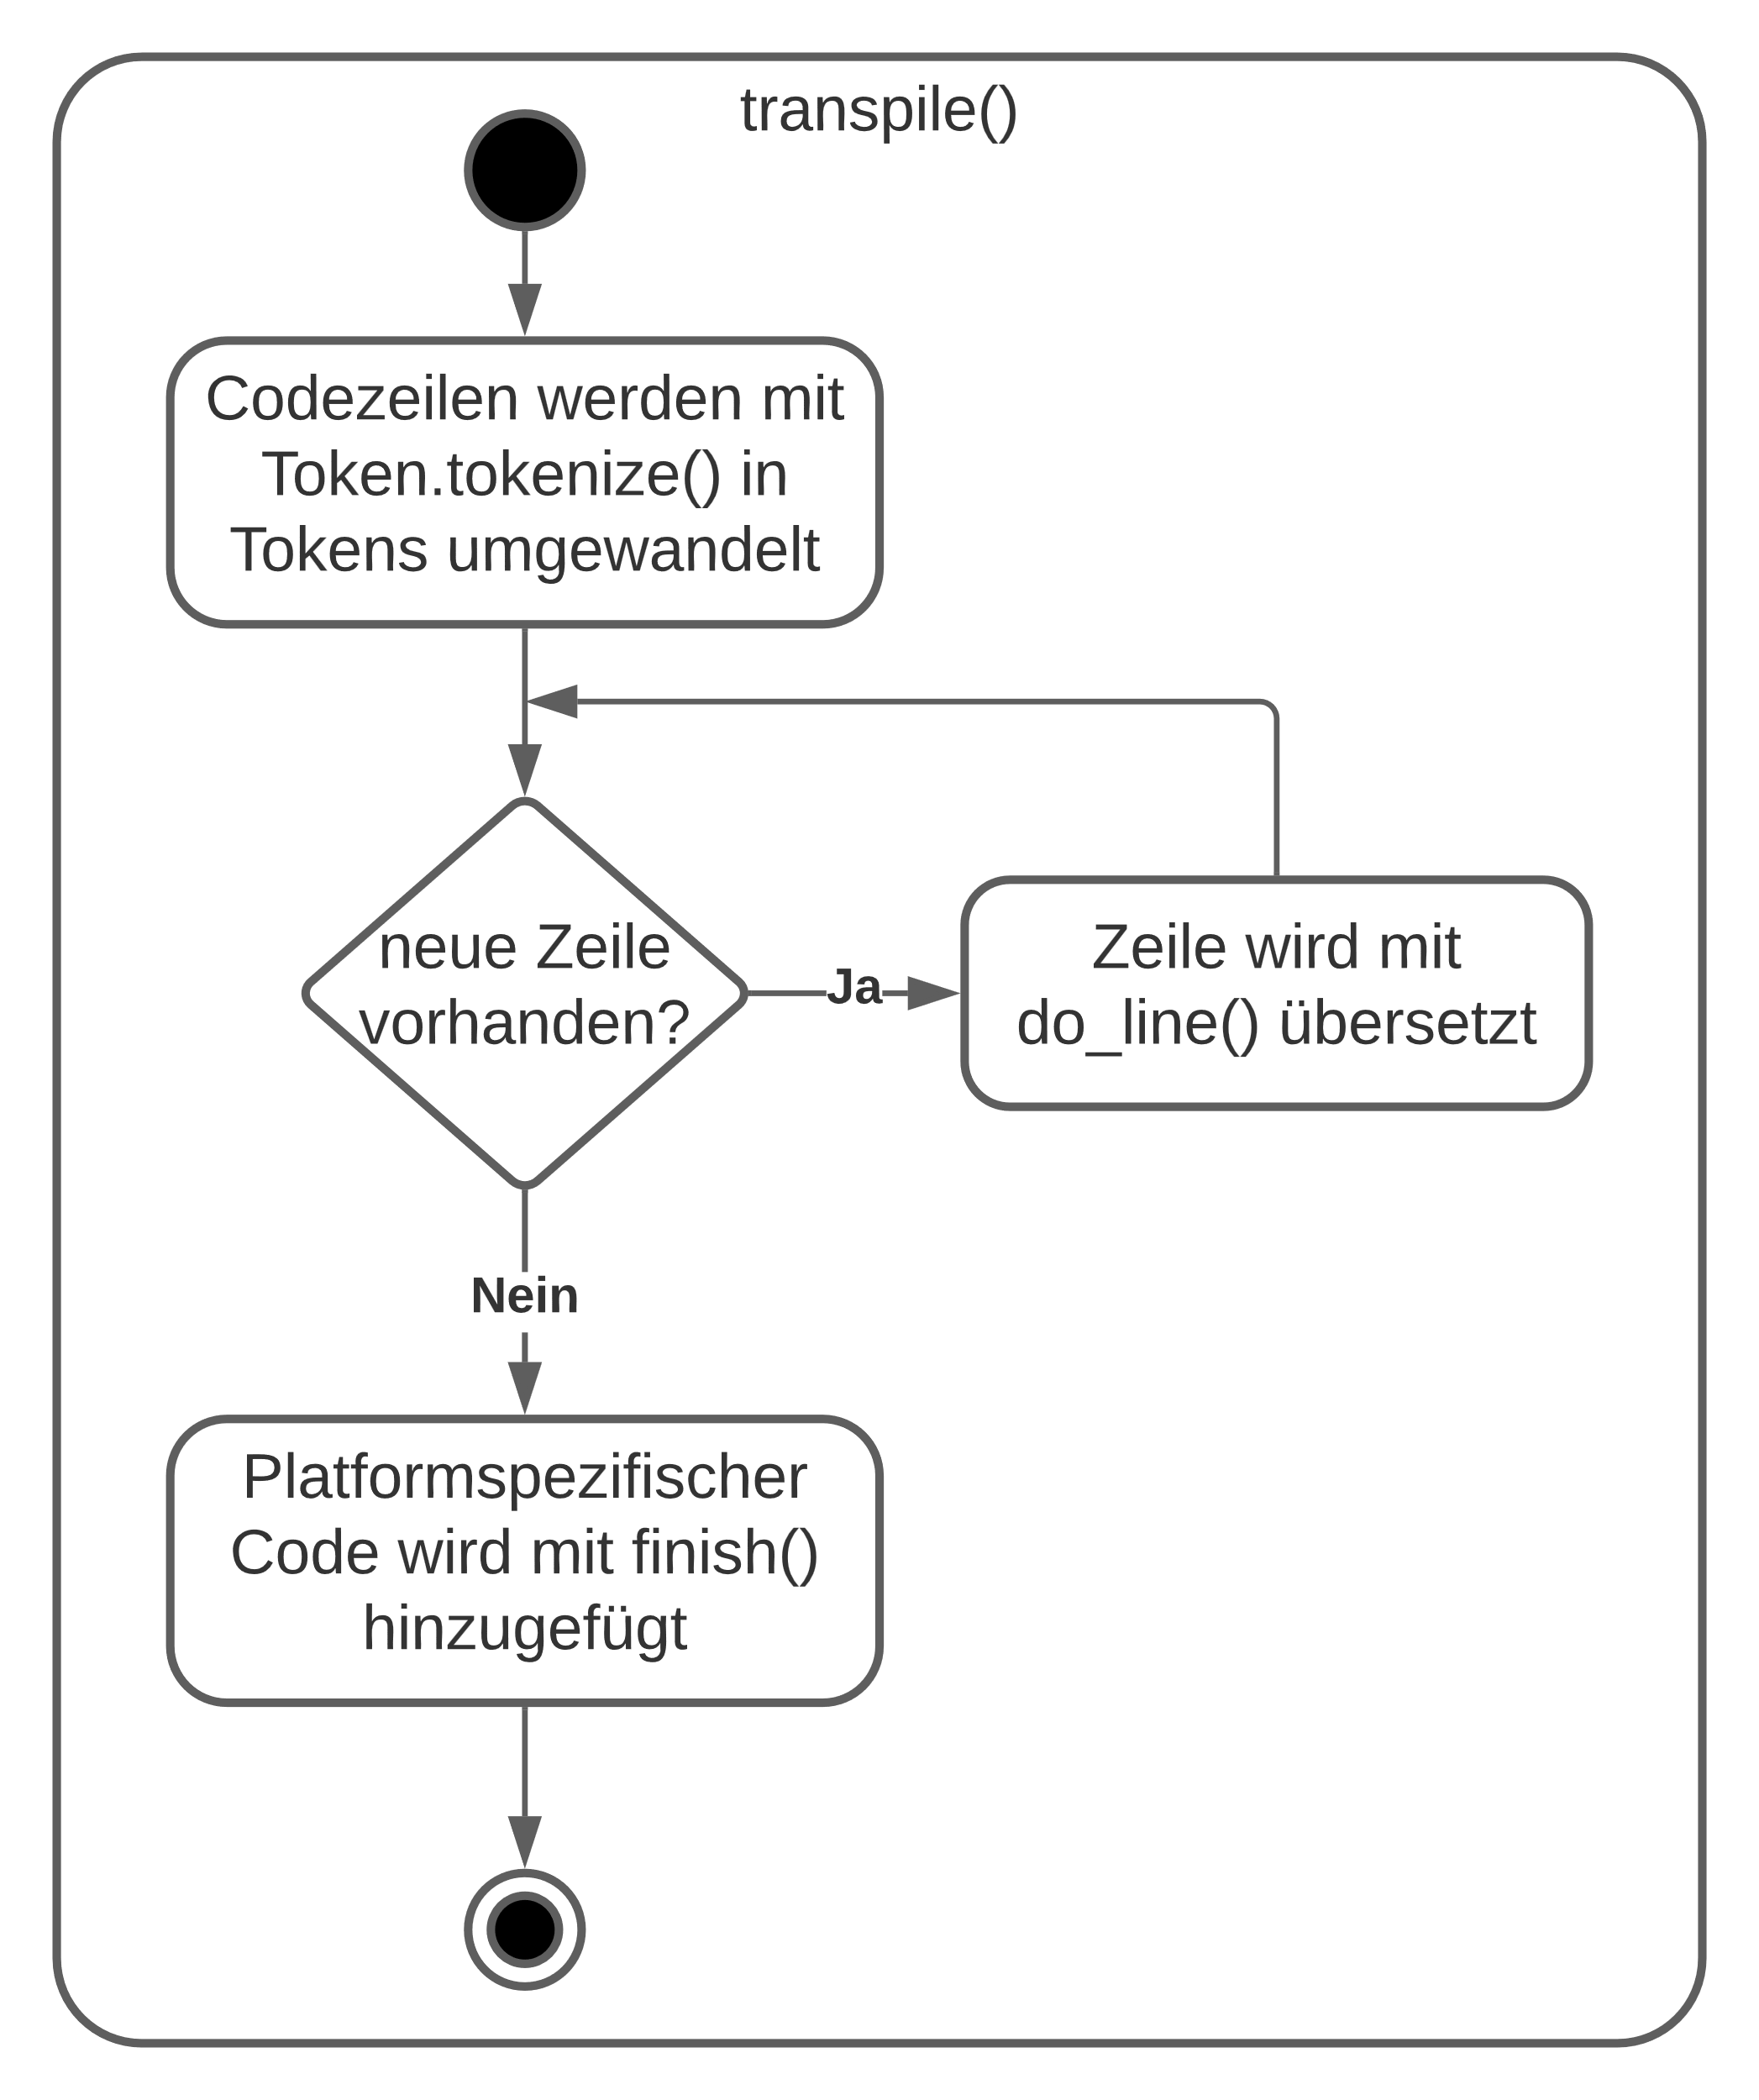
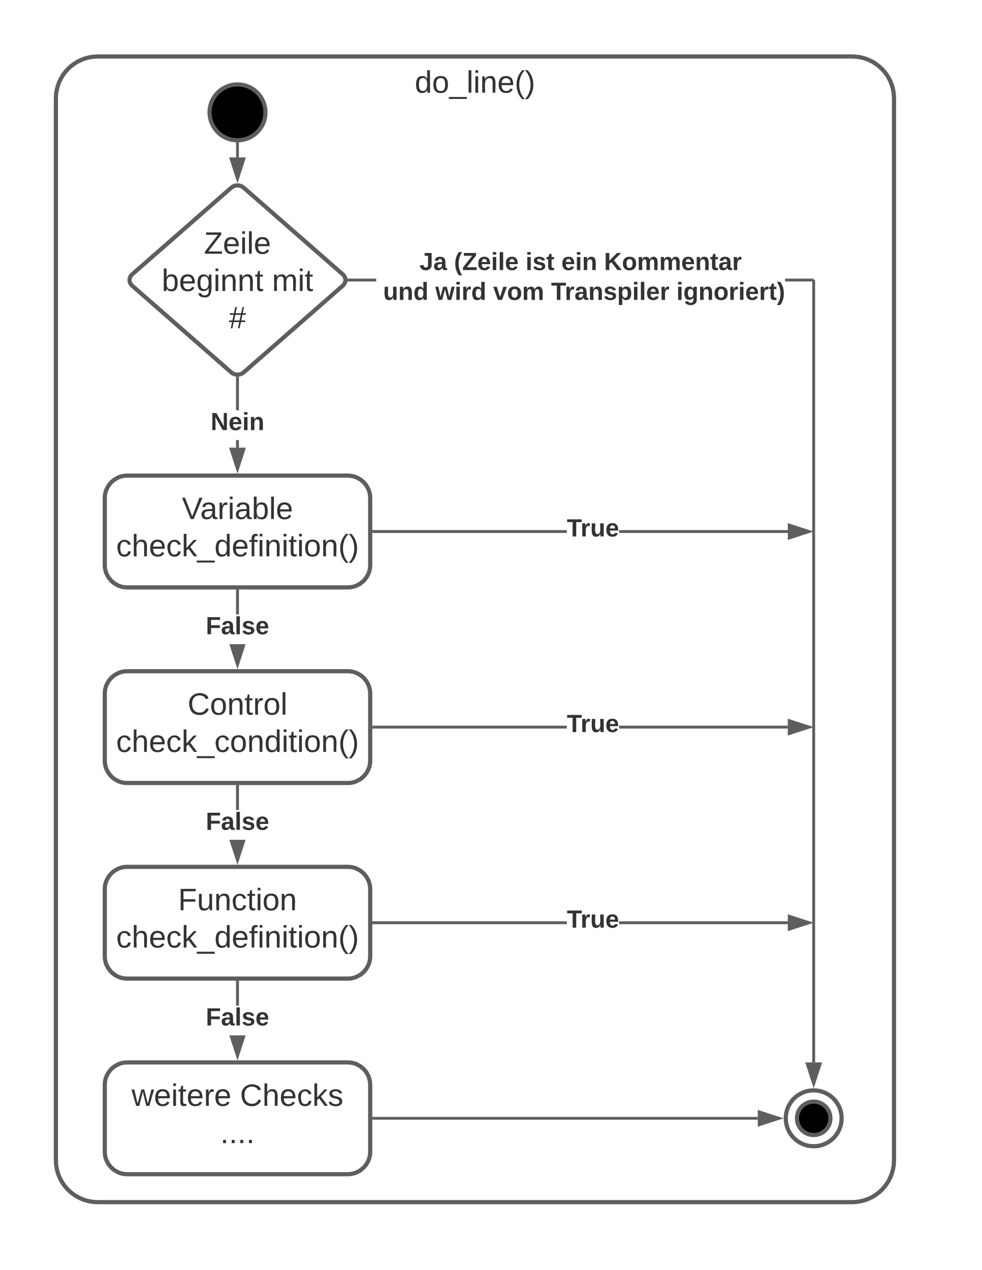
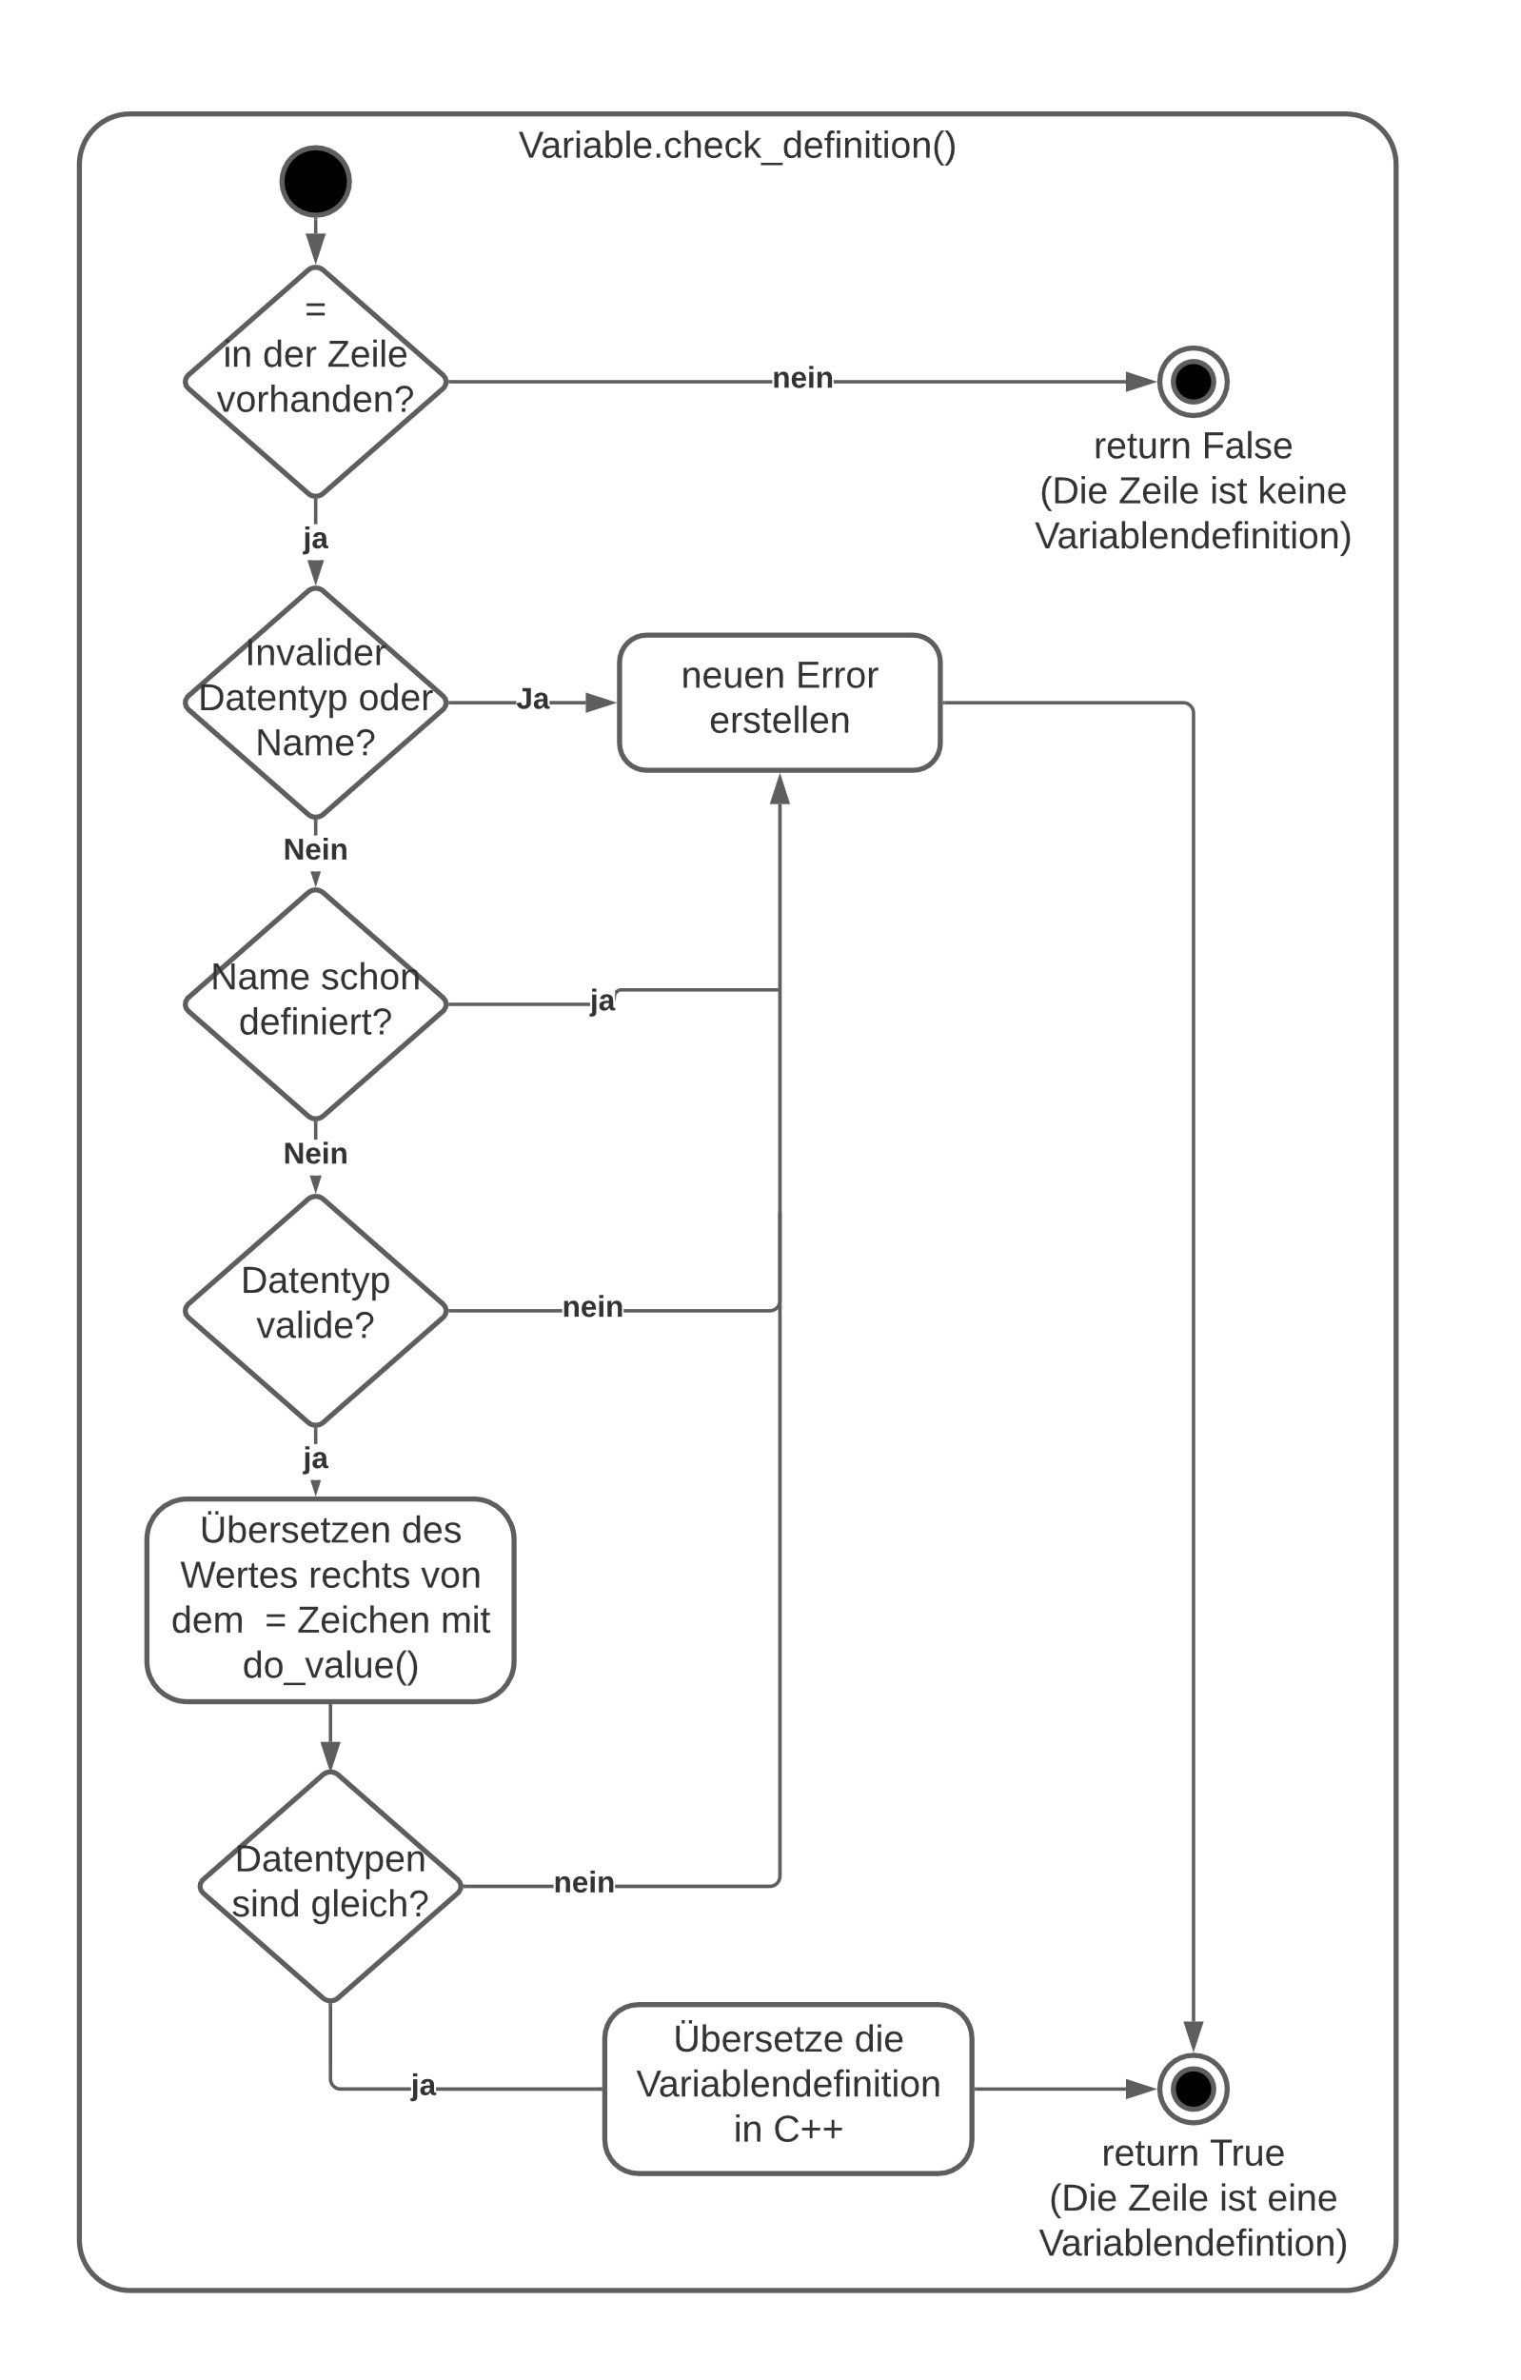
Ablauf
In der transpile() Funktion wird der Pyduino-Code zeilenweise in C++ übersetzt
Eine einzelne Zeile wird mit der do_line() Funktion übersetzt. Die Zeile wird dabei auf verschiedene Anweisungsarten überprüft.
Die do_line() Funktion verwendet verschiedene check Funktionen, um die Zeile auf verschiedene Anweisungsarten zu überprüfen. Diese Funktionen geben True zurück, wenn die entsprechende Anweisung gefunden wurde, egal ob diese korrekt übersetzt werden konnte oder nicht. Ansonsten wird False zurückgegeben. Ein Beispiel dafür ist die Variable.check_definition() Funktion.
Notes:
Rechte seite

