Slide 1

Transfer Orbit Design Proposal:
EARTH TO EARTH-MOON L4
BERIT SYLTEBO

Slide 2
GOALS
SIMPLIFICATIONS
Further investigate the mechanics of the Circular Restricted 3-Body Problem (CR3BP)
Analyze the stability of L4 to determine stable and simple orbits about the libration point
All CR3BP models will be linearized
The Method of Patched Conics was used to develop the transfer itself
In-Plane orbits and maneuvers with Earth-Moon system

Slide 3
METHOD
Determine desired initial and final states:
Where on/near Earth?
What happens at L4?
Design transfer based on conditions:
Design criteria?
What model to use?
Optimization?

Slide 4
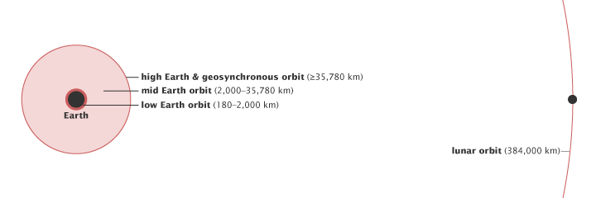
INITIAL STATE
Low Earth Orbit (LEO):
Impractical for the mission
Simplifies project - more time to focus on other aspects
https://earthobservatory.nasa.gov/ContentFeature/OrbitsCatalog/images/orbits_schematic.png

Slide 5
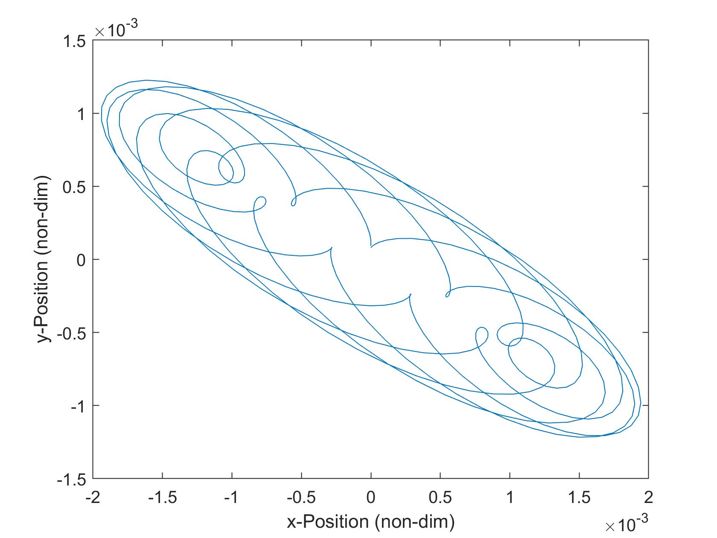
FINAL STATE
More Complicated…
Consider Homework 6:
Perturb spacecraft from L4 to determine stability
Complicated oscillatory motion but stable
Initial conditions:
L4
x₀ = [0 0.00008 0 0 0 0]^{T}

Slide 6
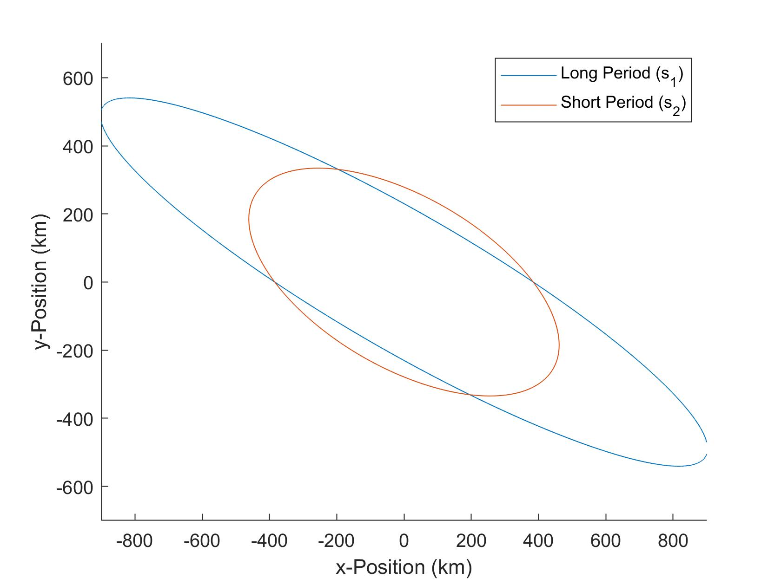
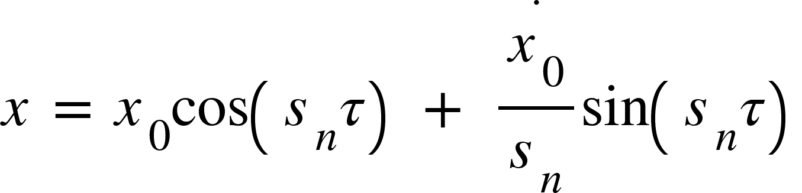
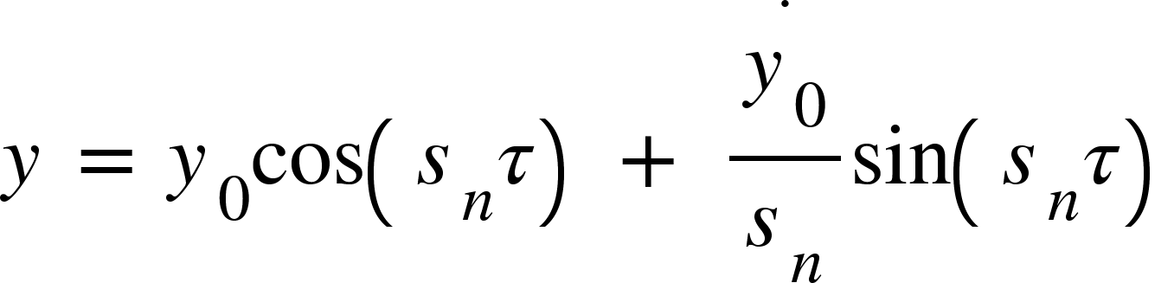
FINAL STATE
In-Plane non-dimensional frequencies:
𝛌_{1,2}= 0.29820789544347032i = s₁i
𝛌_{3,4}= 0.95450094347526815i = s₂i
L4

Slide 7
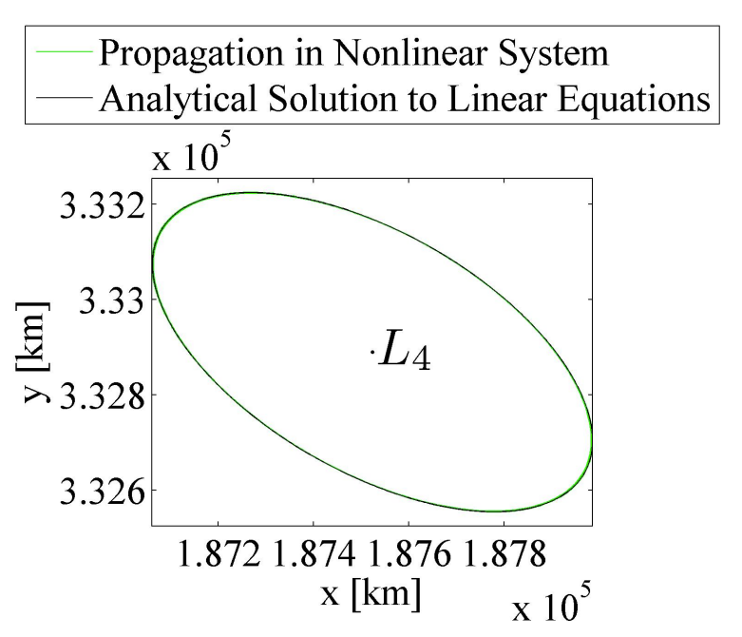
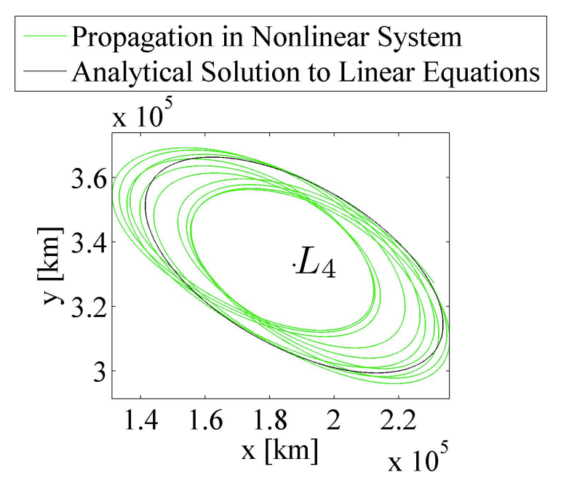
FINAL STATE: Accuracy
x₀ = 384.388174 km
x₀ = 38, 438.8174 km

Slide 8
FINAL STATE: Decision
Short Period
Long Period
x₀ | 384.388174 km
y₀ | 0
z₀ | 0
ẋ₀ | −6.4930122430871529 × 10⁻⁴ km/s
ẏ₀ | −8.5093620067750277 × 10⁻⁴ km/s
ż₀ | 0
x₀ | 384.388174 km
y₀ | 0
z₀ | 0
ẋ₀ | −6.4930122430871529 × 10⁻⁴ km/s
ẏ₀ | −4.2976712600309528 × 10−4 km/s
ż₀ | 0

Slide 9
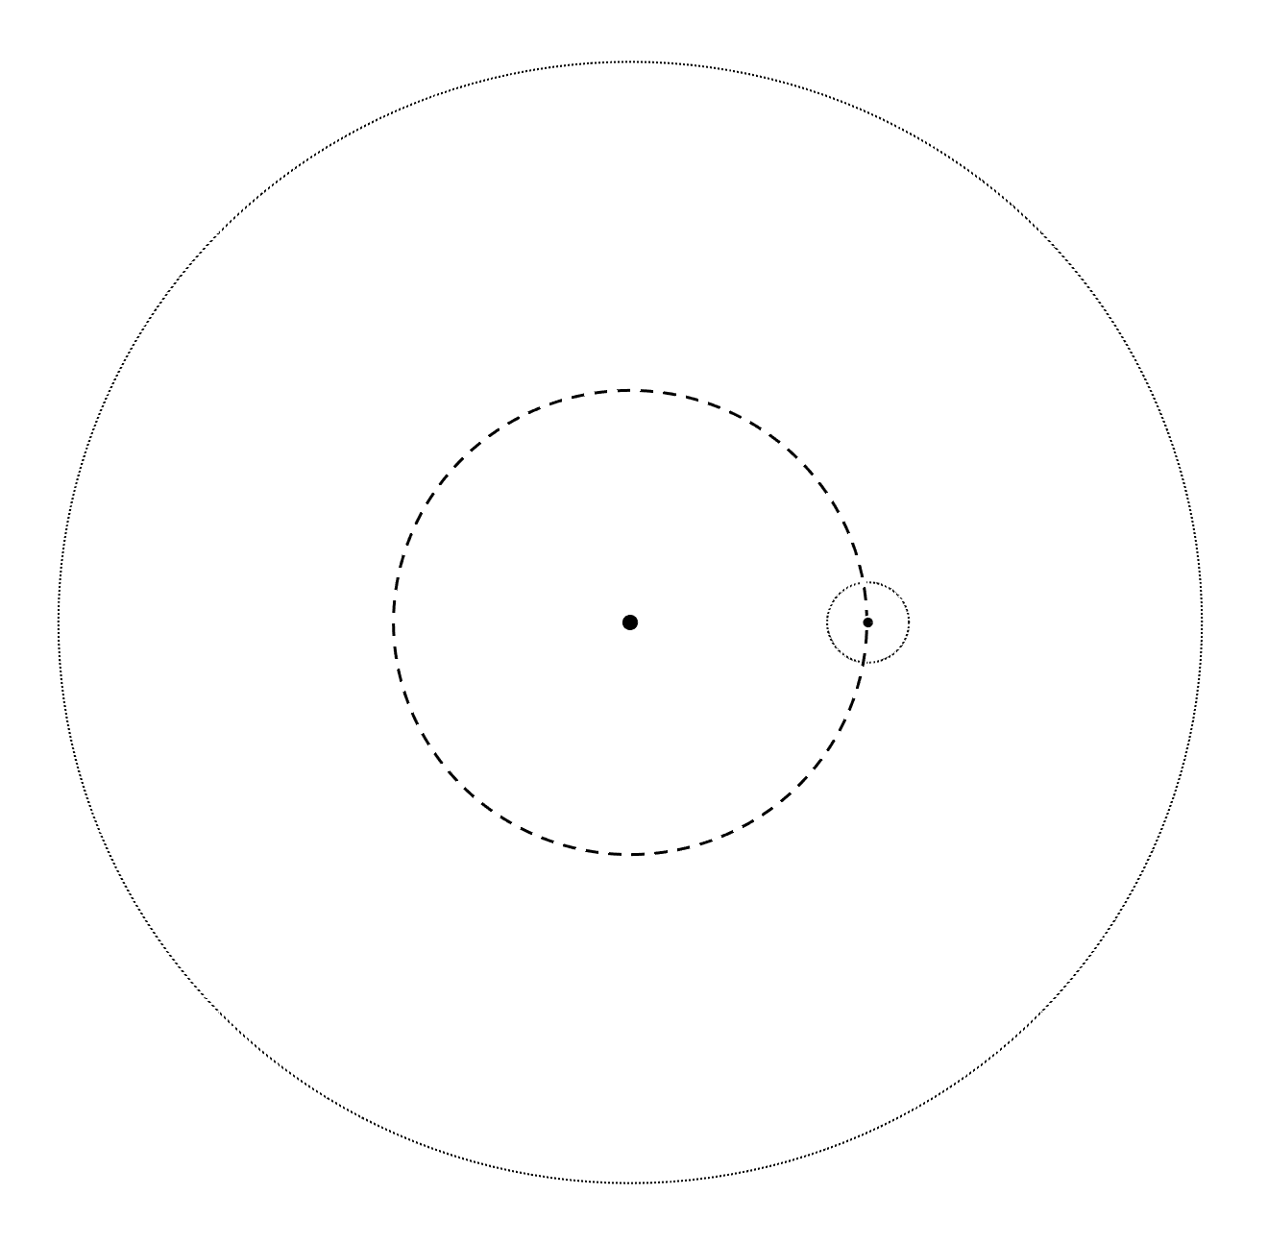
TRANSFER
SOI♁
CR3BP
Trajectory optimization via multiple shooting method - fancy guess and check
2-Body Approximation
Method of Patched Conics - choosing dominant gravitational body at a given time based on Sphere of Influence (SOI)
Earth
Moon
SOI☾
Lunar Orbit

Slide 10
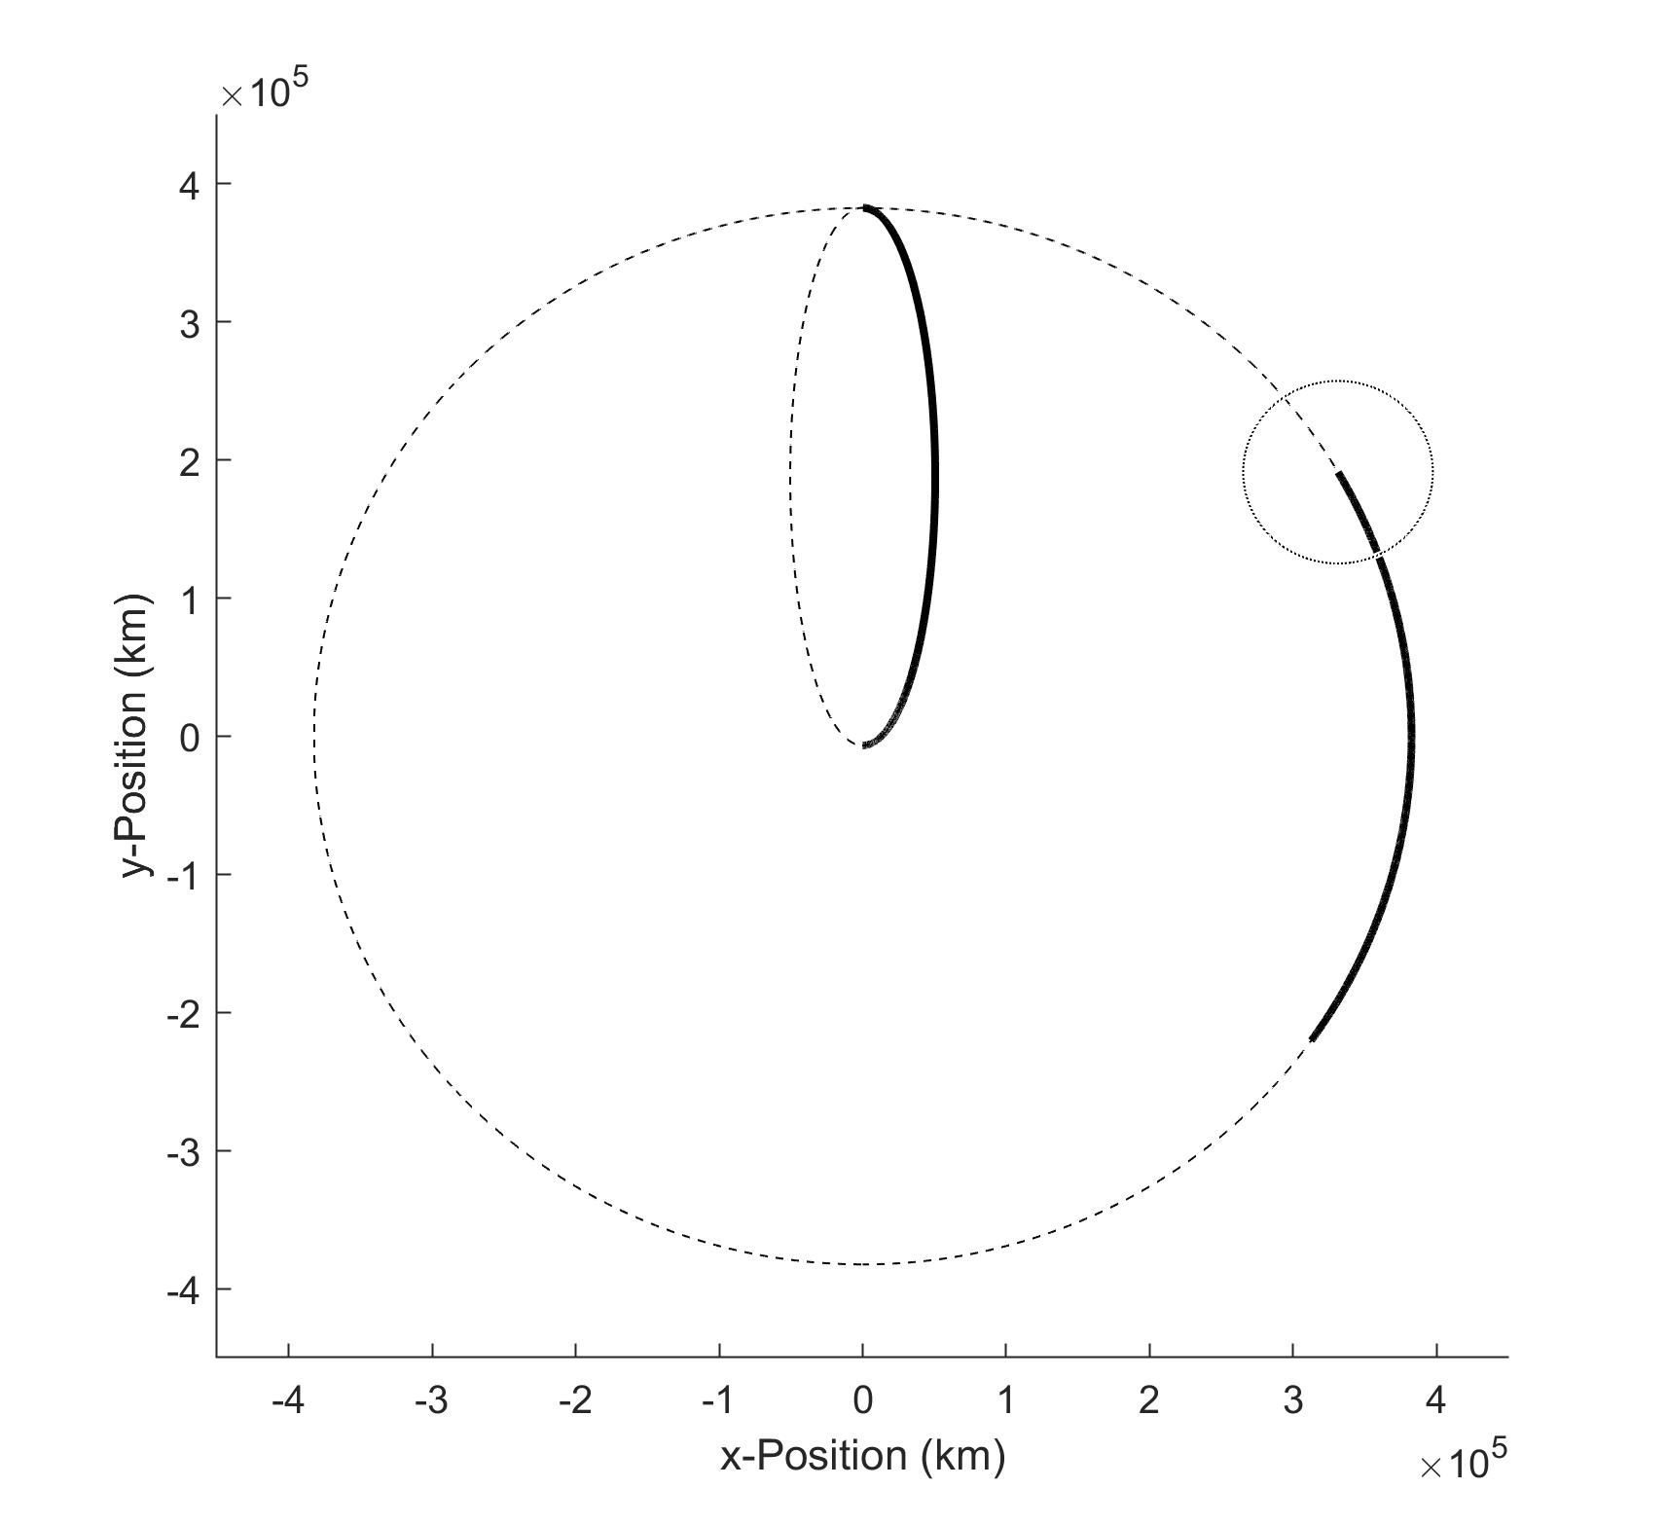
TRANSFER DESIGN
Final L4 position
Hohmann Transfer
Same orbit direction as Moon to reduce Δv at interception
Stays out of range of Moon Sphere of Influence
e = 0.9657
a = 194685 km
P_{transfer} = 4.947 days
SOI☾
Transfer
Moon trajectory during transfer

Slide 11
VELOCITY CORRECTIONS
Δv₁
LEO velocity: 7.726 km/s
Perigee velocity: 10.832 km/s
Δv₁ = 3.106 km/s
Δv₂
Apogee velocity: 0.189 km/s
Moon velocity: 1.021 km/s
Rotating L4:
x-direction: -0.6493 m/s
y-direction: -0.8509 m/s
Δv₂ = 0.832km/s
(For negligible L4 orbit motion)

Slide 12
NEXT STEPS
Apply nonlinear model to L4 orbit to expand applications
Optimize transfer orbit per specific time and fuel constraints
Rework transfer using CR3BP and multiple shooting method
(If I had more time)

Slide 13
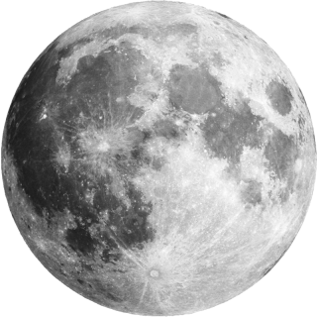
Thank you!

Slide 14
REFERENCES
Investigation of Transfer Trajectories to and from the Equilateral Libration Points L4 and L5 in the Earth-Moon System - Lucia R. Irrgang
Low-Thrust Transfer to the Earth-Moon Triangular Libration Point Via Horseshoe Orbit - Xingji He et al

