Slide 1

Grey Wolf Optimizer on IEEE 34 Bus system
Berkant Can Erkanat
150717057

Slide 2
GREY WOLF OPTIMIZER AND HOW IT IS USED
The Grey Wolf Optimizer (GWO) mimics the leadership hierarchy and hunting mechanism of grey wolves in nature. Four types of grey wolves such as alpha, beta, delta, and omega are employed for simulating the leadership hierarchy. In addition, three main steps of hunting, searching for prey, encircling prey, and attacking prey, are implemented to perform optimization [1].
In main.m file , we specify how many iterations there are, search agent number and which function we want to optimize.
In Get_functions_details.m file, we define our function and we set lower bound, upper bound and dimensions for our input parameters (e.g. x) .
In GWO.m file, GWO algorithm takes place and it gives us optimal tap values considering our specifications.

Slide 3
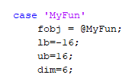

fobj is the function handle. It will be called while applying GWO algorithm.
lb is lower bound. In our case since min tap value is -16. This should at least -16
ub is upper bound. In our case, since max tap value is 16. This should be at most 16.
IEEE 34 Bus system consists of 6 regulators. Then we set dim to 6.
This is the function definition. I call run34() inside it to test the new tap values provided by GWO algorithm
run34() is where our power flow is solved on OpenDSS

Slide 4
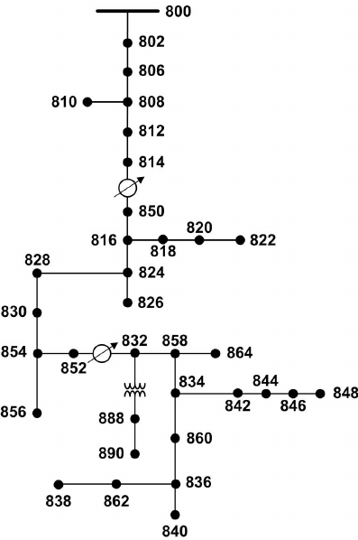
IEEE 34 BUS SYSTEM TOPOLOGY
Fig 3.1 IEEE 34 Bus System Topology [2]

Slide 5
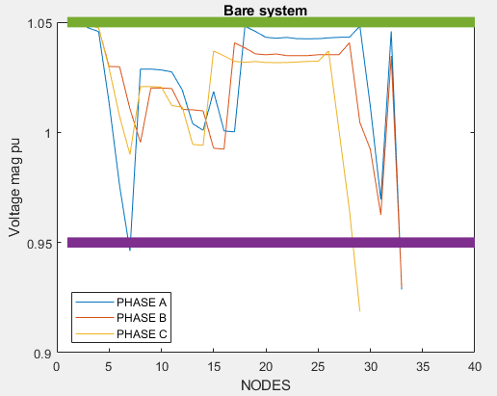
OPENDSS FIGURES
Nothing changed. IEEE 34 Bus system directly solved

Slide 6
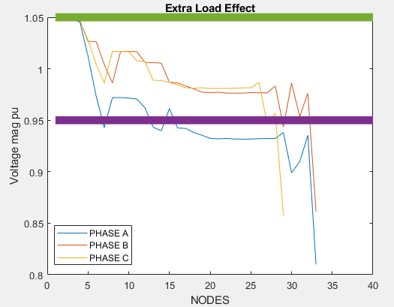
OPENDSS FIGURES
Loads are increased a bit. Difference is seen. Voltage magnitudes dropped.

Slide 7
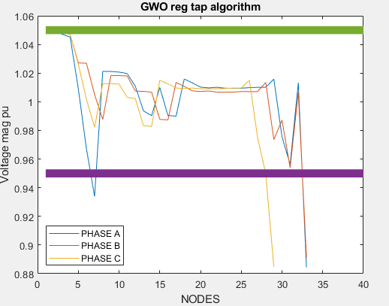
OPENDSS FIGURES
Optimal regulator tap positions found by GWO make the voltage magnitudes to go up a bit.
But we still have problems for the last nodes

Slide 8
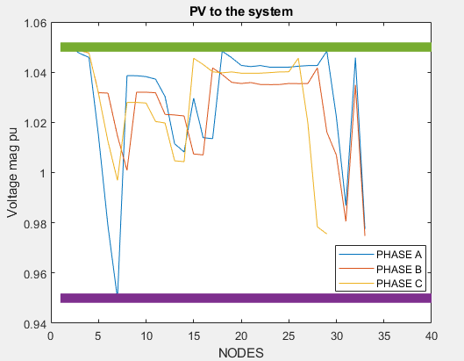
OPENDSS FIGURES
PV is added to the system to provide extra energy to the system
Everything complies with the ANSI standard

Slide 9
REGULATOR TAP POSITIONS FOUND BY GWO AND BEST SOLUTION OBTAINED

Slide 10
REFERENCES
[1] MIRJALILI, S. E. Y. E. D. A. L. I. (n.d.). Grey Wolf Optimizer. SEYEDALI MIRJALILI. Retrieved January 18, 2022, from https://seyedalimirjalili.com/gwo
[2] ResarchGate. (n.d.). IEEE 34 Bus Topology [Photograph]. ResearchGate. https://www.researchgate.net/figure/Schematic-diagram-of-the-IEEE-34-bus-test-distribution-system_fig2_260145909

Slide 11
THANK YOU!
If requested, I can further explain how I managed to integrate OpenDSS with GWO algorithm.

