Slide 1



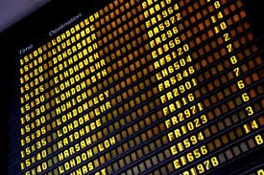
AIRPORT FLIGHT CONTROL
DOKUZ EYLUL UNIVERSITY
COMPUTER ENGINEERING DEPARTMENT
2011510037 BETÜL RÜMEYSA KARADEMİR
2011510105 BERKAY TÜRKGELDİ
2010510031 ALİ GÖKŞEN

Slide 2
OUTLINE
THE AIM OF THE PROJECT
SPECIFICATION OF AIRPORT FLIGHTS
WEEKLY PROGRAM
TASKS SHARING
PROBLEMS OF ENCOUNTERED
CONCLUSION:SCREEN SHOTS
REFERENCES
QUESTIONS

Slide 3
THE AIM OF THE PROJECT
Developing an airport simulation of arrival and departure flights and listing passengers according to the flights.
When developing the software that using our lectures knowledge.
Completing the project by using time efficiently and doing group work.

Slide 4
SPECIFICATION OF AIRPORT FLIGHTS
The simulated airport has only one runway.
Arrivals have two times higher priority over departures.
There are 2 companies at the airport: DEHY has 3 airplanes,DJET has 5 airplanes.
There 2 types of airplanes: Airbus and Boeing.
Airbus have 8 seats,Boeing have 6 seats.
The time is expressed in minutes.
Flights and passenger information was read from text files.

Slide 5
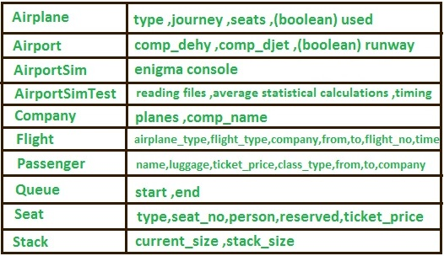
WEEKLY PROGRAM
First week:
Designing object oriented model of the project.
Creating necessary classes and attributes.

Slide 6
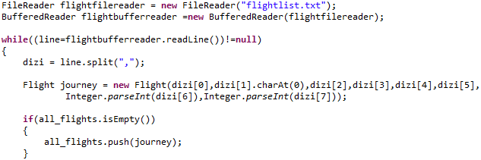
WEEKLY PROGRAM
Second week:
Reading the flights info from a text file and sorting flights.

Slide 7
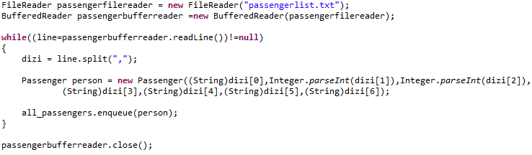
WEEKLY PROGRAM
Third week:
Reading passengers info from a text file and creating the passenger list.

Slide 8
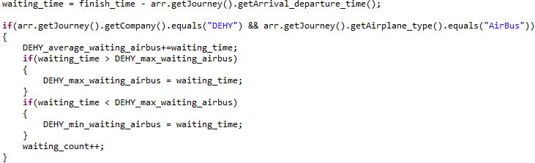
WEEKLY PROGRAM
Fourth week:
Adding statistical calculations and testing.

Slide 9
TASKS SHARING
CREATING CLASSES
READING INPUT FILES FROM TEXT FILE
BETÜL R. KARADEMİR
DESIGNING THE SCREEN
TAKE OFF AND LAND MANAGEMENT
BERKAY TÜRKGELDİ
ALİ GÖKŞEN
CREATING STACKS DATA STRUCTURES
SORTING ALGORITHM FOR TEXT FILE
ALL TOGETHER
CALCULATİNG STATISTICAL DATA
TIMING CONTROL

Slide 10
PROBLEMS OF ENCOUNTERED
Problem 1:
When showing information for waiting arrival and departure, deleting process was problem because of queue data structure
Solution
Using static queue structures for waiting arrival and departure planes

Slide 11
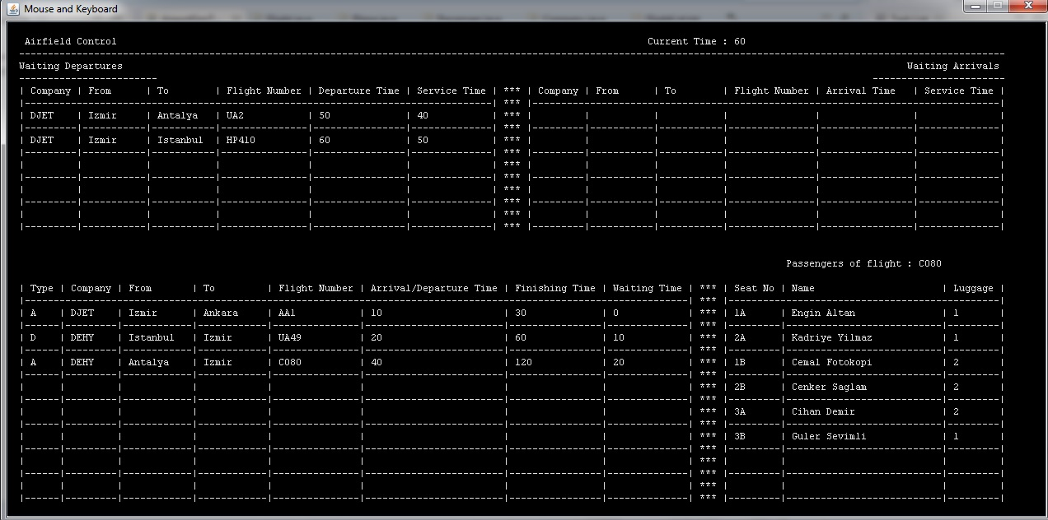

Slide 12
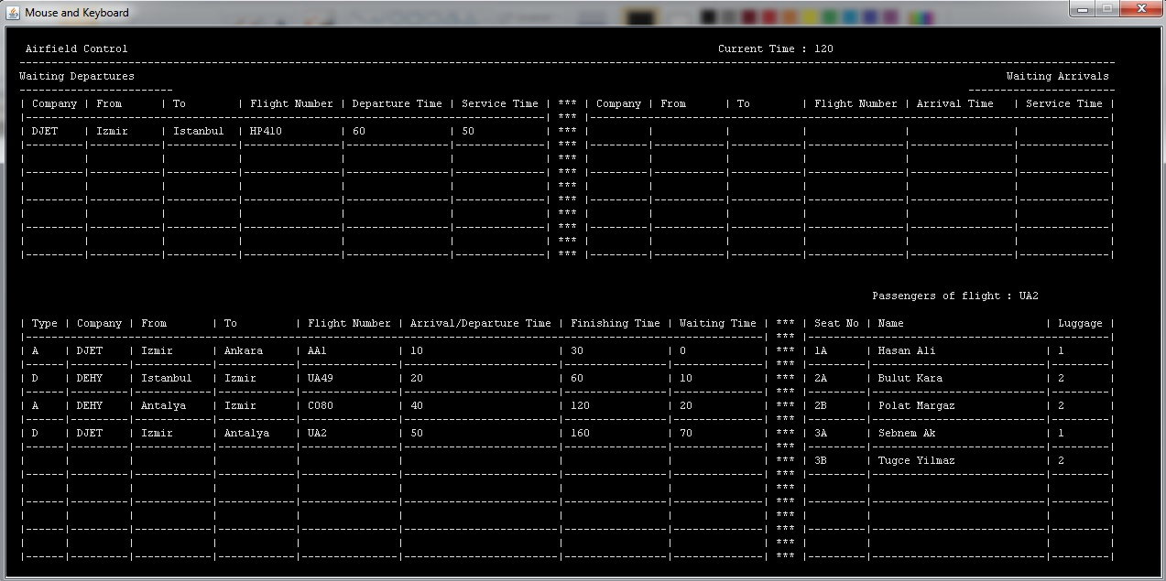

Slide 13
PROBLEMS OF ENCOUNTERED
Problem 2:
When processing flight types in any part of the code, tryed to use airplane type ‘Airbus’ rather than ‘AirBus’
Solution
Realized that Java is case sensitive and changing name with its correct version

Slide 14
PROBLEMS OF ENCOUNTERED
Problem 3:
When plane stack is empty, the program could be ended immediately and planes which wait for take off remain
Solution
Adding end condition correctly (plane stack and waiting queues must be empty)

Slide 15
PROBLEMS OF ENCOUNTERED
Problem 4:
When running the sumilation, an error
could be appeared that stack is empty
Solution
When a plane has taken off, we control if the next plane enter for any waiting queue, but stack can be empty. We added if statement that if stack is empty, do not query for any waiting plane

Slide 16
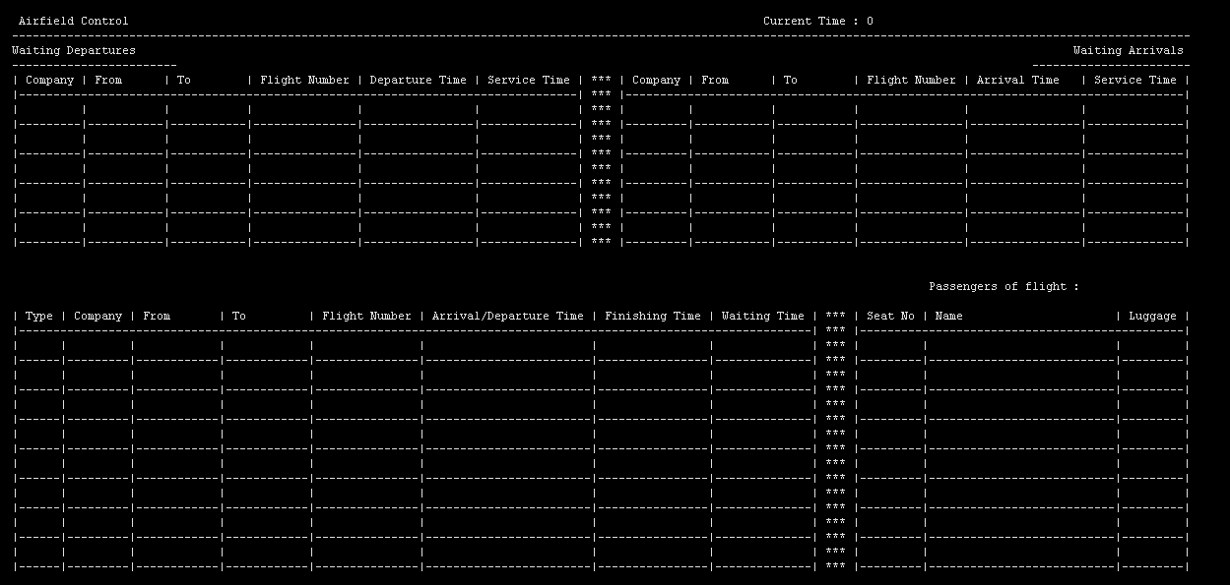
CONCLUSION:SCREEN SHOTS
First image of screen.

Slide 17
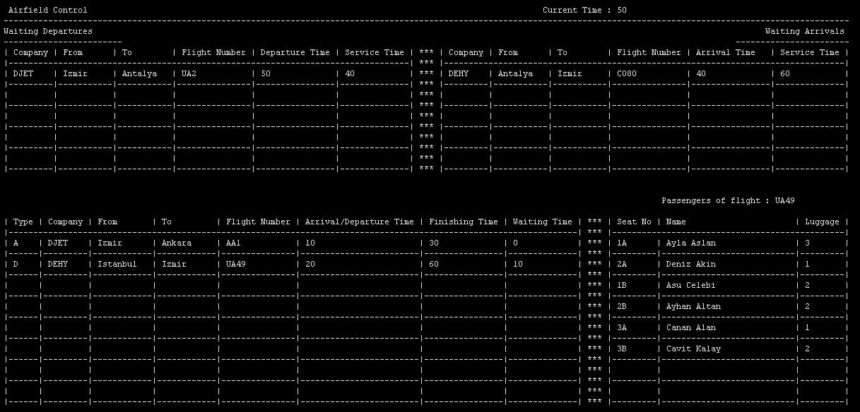
CONCLUSION:SCREEN SHOTS
Showing information in screen.

Slide 18
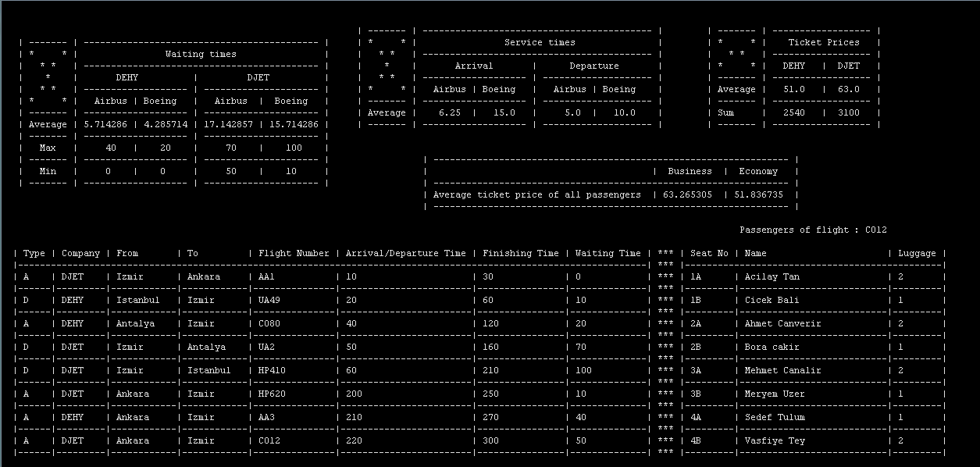
CONCLUSION:SCREEN SHOTS
Running the simulation.

Slide 19
REFERENCES
Lectures.deu.edu.tr

Slide 20

ANY QUESTIONS?

Slide 21


